Slide 1

REPLICATION REPORT ON IMPROVING POWERLINE FAULT DETECTION
APPRENTICESHIP & INTERNSHIP PROGRAM
AUGUST, 2023

Slide 2


Our team
Problem statement
Table Of Content
Objective
Purpose solution
Resultats and discussions
Conclusion

Slide 3
Our Team

Slide 4


THYNK UNLIMITED
Problem statement
Presentations are communication tools that can be used as demonstrations, lectures, speeches, reports, and more. It is mostly presented before an audience.

Slide 5

THYNK UNLIMITED
Objectif
The project aims at predicting partial discharge in an electrical signal using a Random Forest machine learning ensemble model and improving the model performance using the intel extension

Slide 6

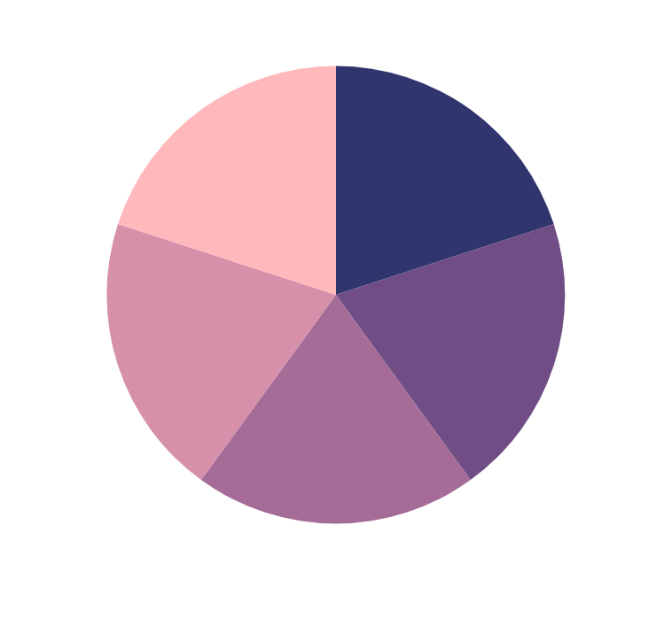
THYNK UNLIMITED
Solution
Presentations are communication tools that can be used as demonstrations, lectures, speeches, reports, and more. It is mostly presented before an audience.

Slide 7




THYNK UNLIMITED
Results and discussions
Presentations are communication tools that can be used as demonstrations, lectures, speeches, reports, and more.

Slide 8
THANK YOU

