Slide 1

SPEECH EMOTION RECOGNITION
TEAM – THUNDERS
Padmasai Paladugu - 16355403
Samsritha Raavi - 16351883
Madhuri Katakamsettty - 16355560
Chandu Bodepudi - 16354652

Slide 2
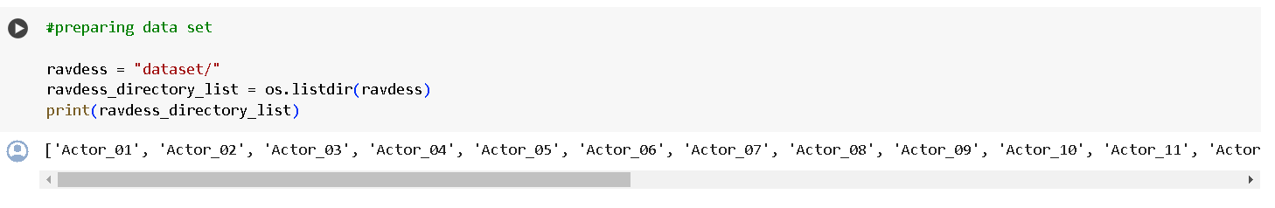
Dataset
script sets a directory path ('dataset/') to the variable ravdess,
uses os.listdir to retrieve the list of directories in 'dataset',.
prints this list, which includes directories named 'Actor_01' through 'Actor_24'.

Slide 3
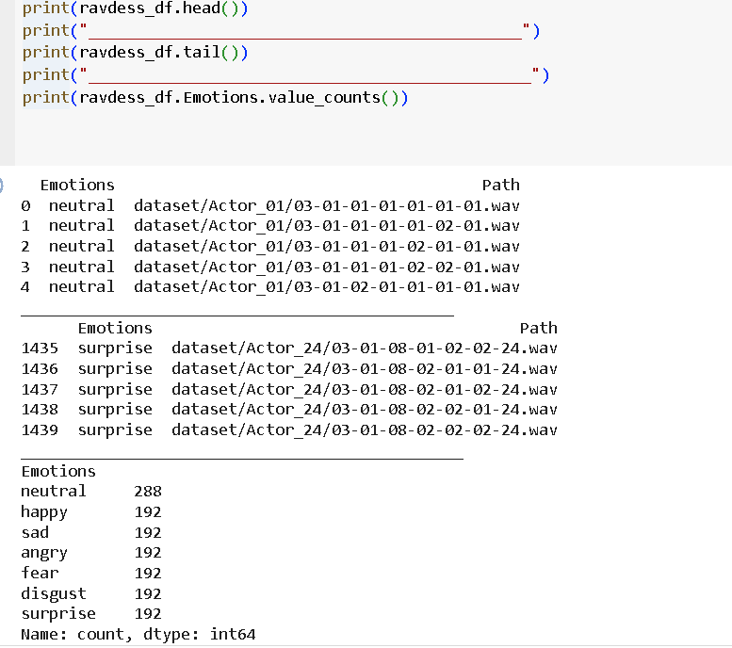
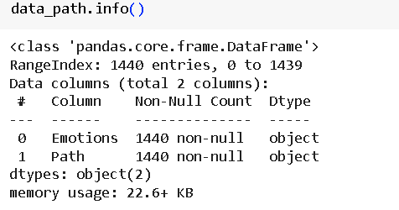
Data Preprocessing
Resampling the audio data to a consistent sampling rate.
Applying filtering techniques to remove noise and unwanted frequencies from the audio signal.
Converting the raw audio data into a format suitable for the speech recognition model, such as log-mel spectrograms or MFCC features.

Slide 4
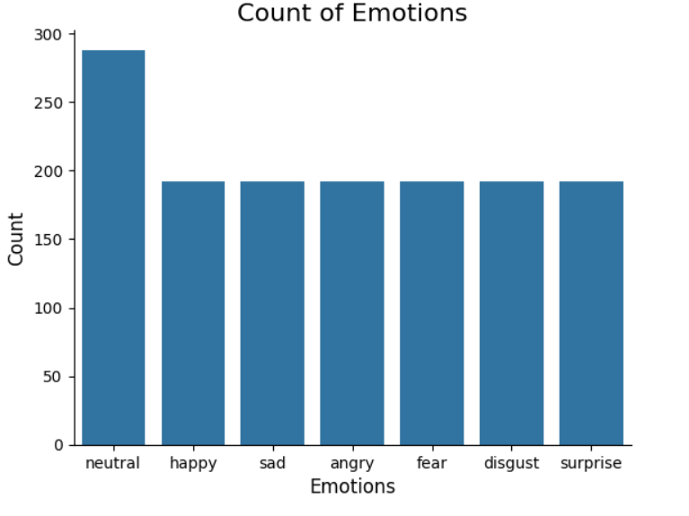
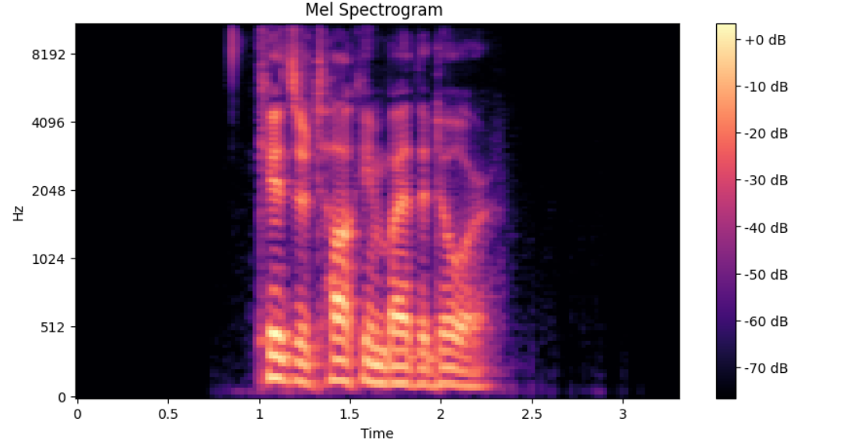
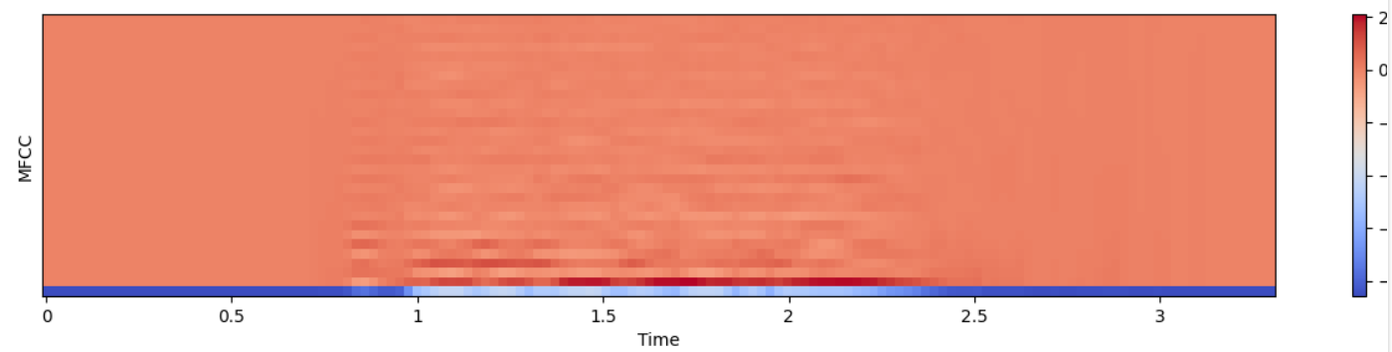
Data Visualization and Exploration
Use line charts to visualize the performance of speech recognition models over time, such as accuracy, word error rate, or other relevant metrics.
Employ bar charts to compare the performance of different speech recognition models or algorithms, highlighting their strengths and weaknesses
Leverage scatter plots to visualize the relationship between input features (e.g., audio signal characteristics) and speech recognition accuracy, aiding in model optimization

Slide 5
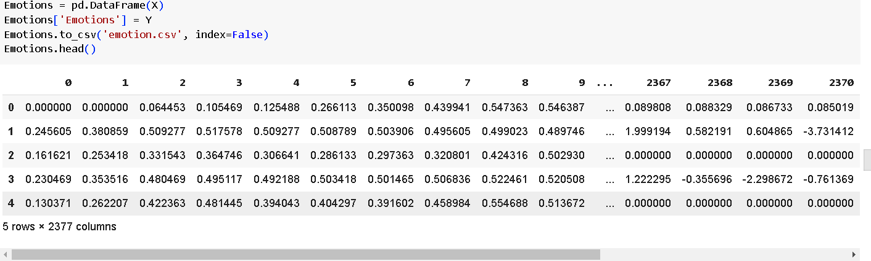
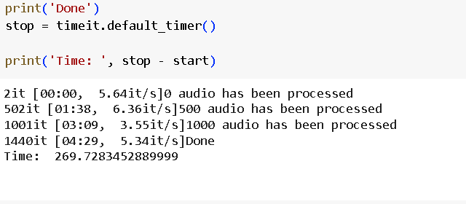
Feature Extraction
The ‘extract_features’ function computes zcr, rmse, mfcc, which combine into a single feature vector.
The final feature matrix returned by the ‘get_features’ function contains the original audio features as well as the features computed from the transformed audio samples

Slide 6
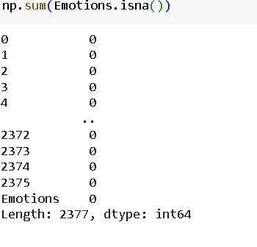
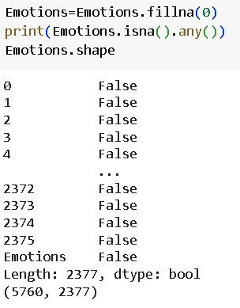
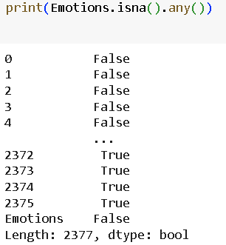
Feature Extraction
np.sum() count the total number of missing values in the ‘Emotions’ data frame.
Isna() returns true when there are missed values, and false when there are no missed values

Slide 7
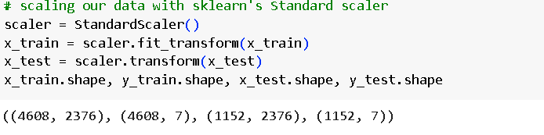
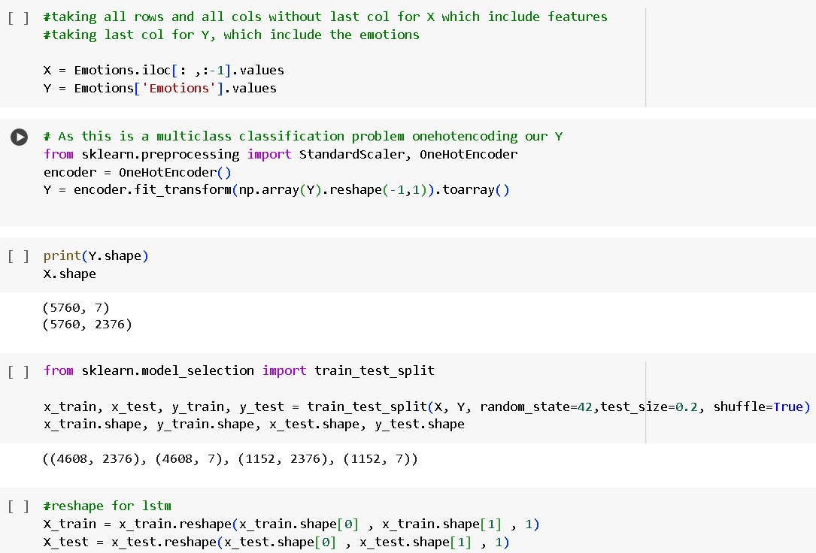
Data Preparation
We used short audio clips which are in format.

Slide 8
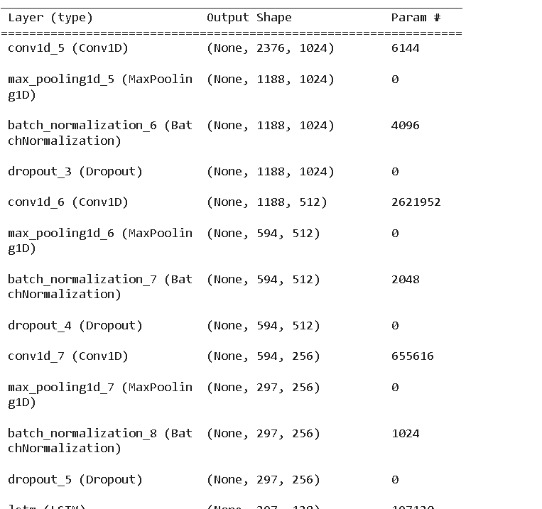
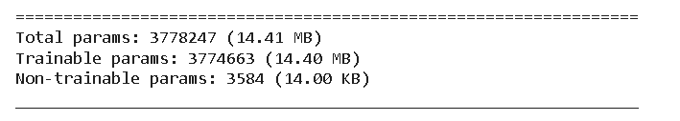
CNN-LSTM MODEL
1D CNN and LSTM are powerful deep-learning architectures for speech recognition that can effectively capture temporal and spectral features in speech signals

Slide 9
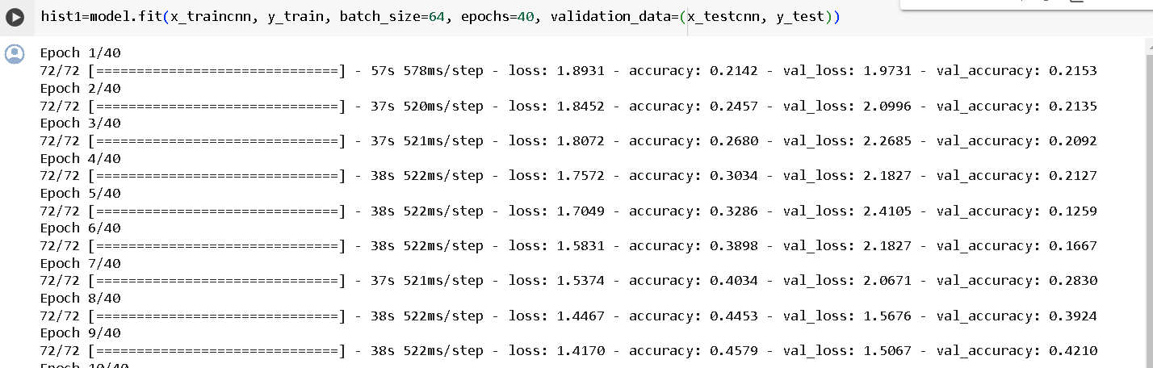
CNN-LSTM MODEL

Slide 10
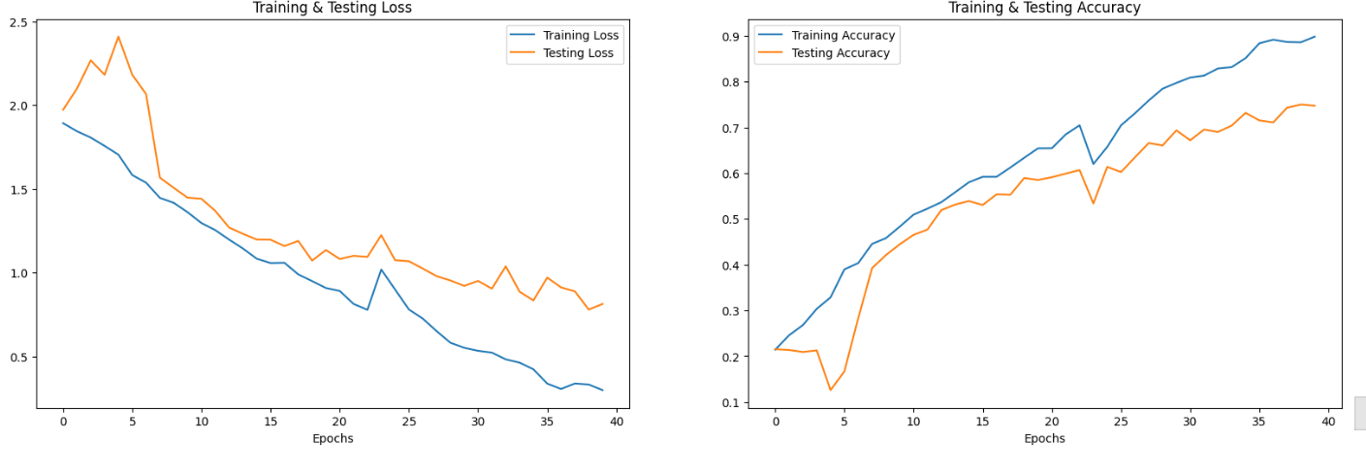
Training and Testing

Slide 11
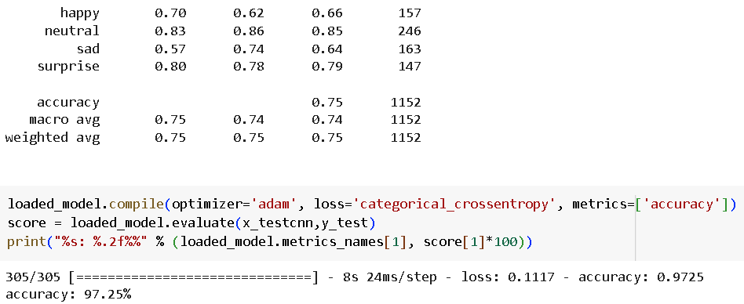
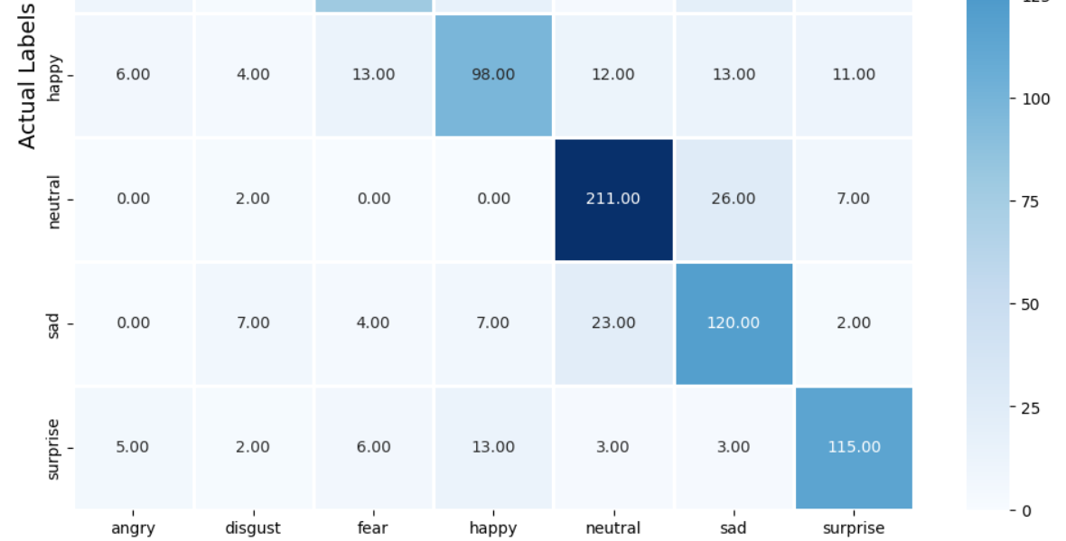
Evaluation
Initial research in speech recognition
focused on traditional models like HMMs and GMMs.
Advancements in deep learning techniques like CNNs,
RNNs and Transformers have changed significantly.
improved speech recognition accuracy.
Recent models like Whisper, Vall-E,
and Hubert have pushed the state-of-the-art in
speech transcription.
Key challenges remain in noise robustness, speaker
and domain-specific vocabulary.

Slide 12
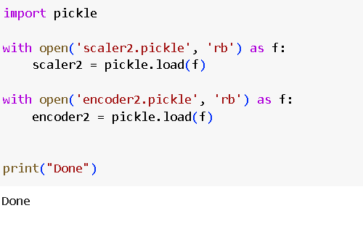
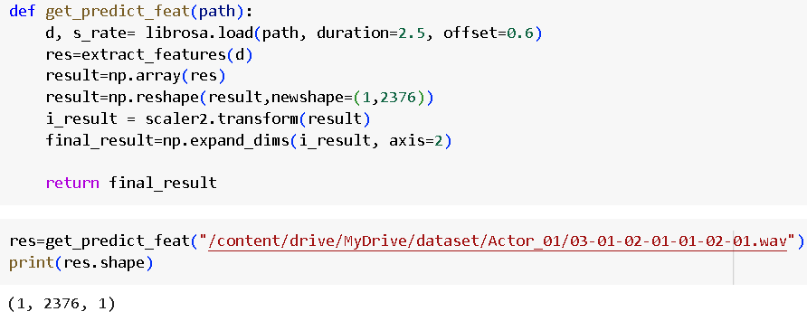
Inference
This appears to be a function
call to extract features from an audio file for a speech emotion recognition task.
The extracted features can be used as input to a machine-learning model for speech emotion recognition.

Slide 13
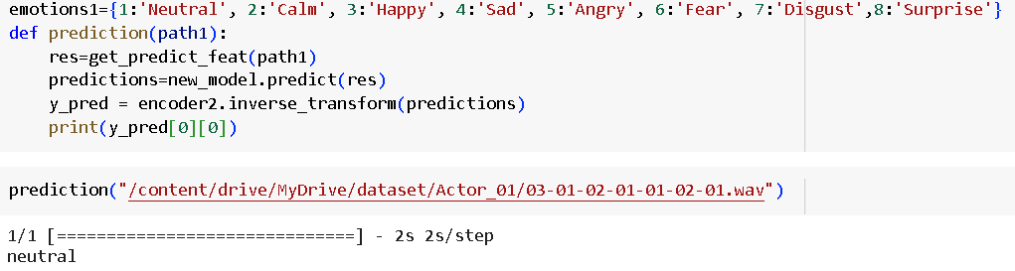
Inference
Here it shows the output as neutral based on the audio signal.

Slide 14
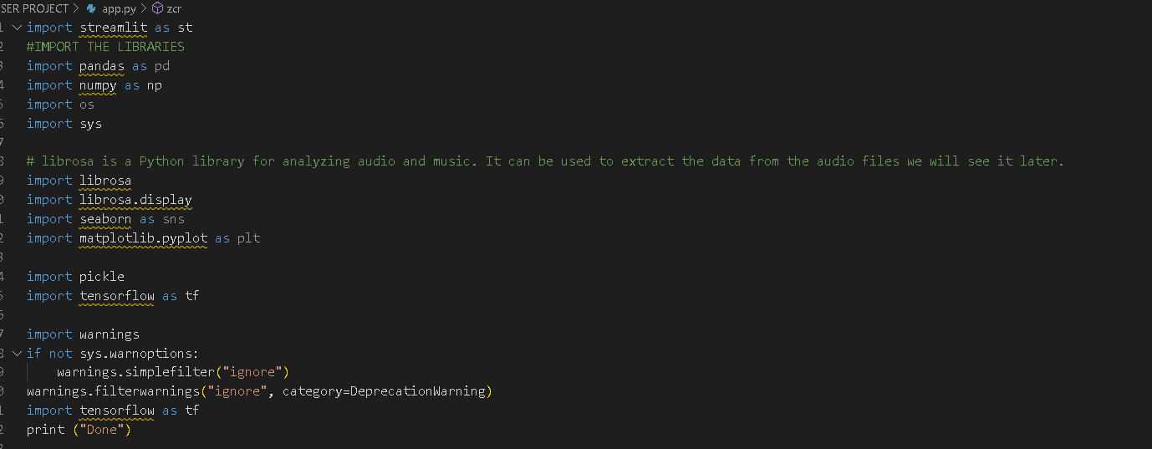
Web Application – Using Streamlit

Slide 15
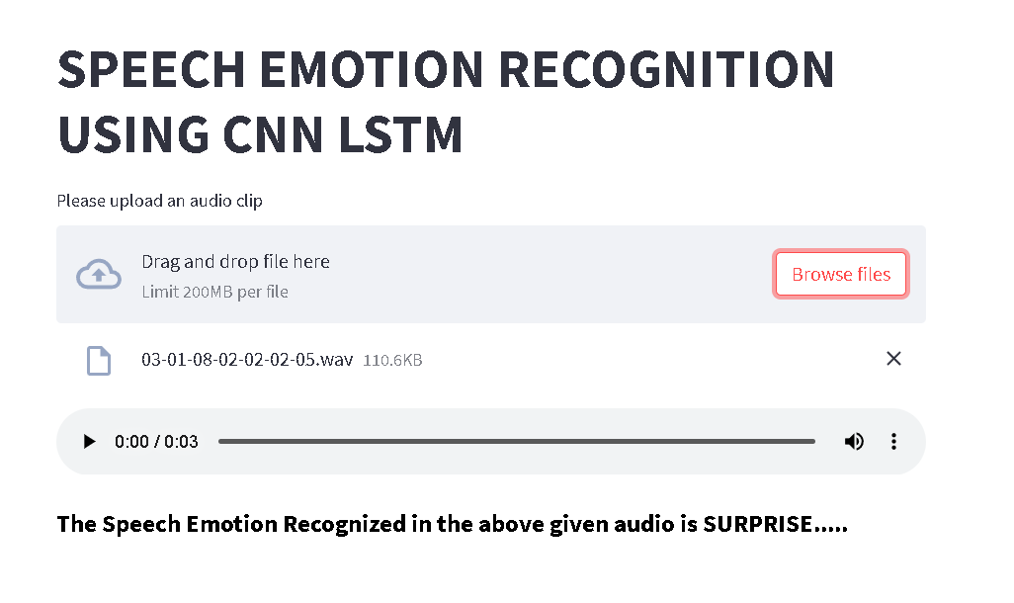
Web Application- Using Streamlit

Slide 16


Thank You

