Slide 1
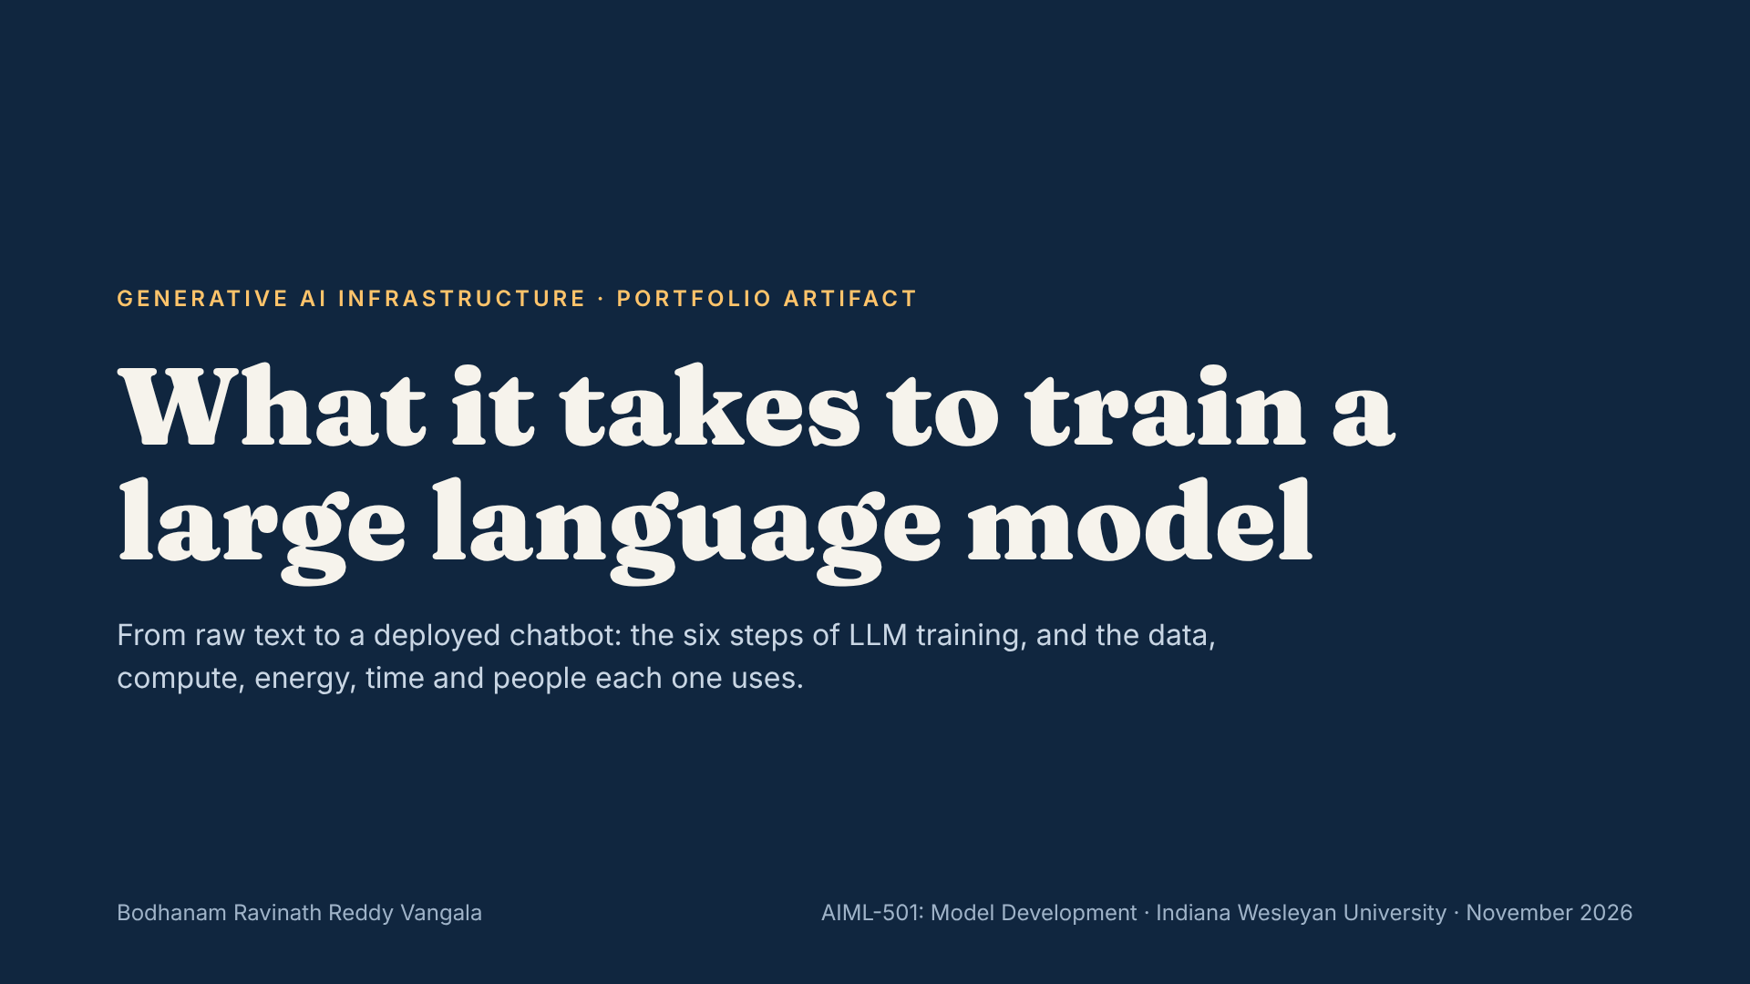
Notes:
Today I’ll walk through how large language models like GPT-4, Claude, Gemini and LLaMA are trained, and what that training costs in data, compute, energy, time and people. The goal is to make AI infrastructure costs understandable for anyone, not only engineers.

Slide 2
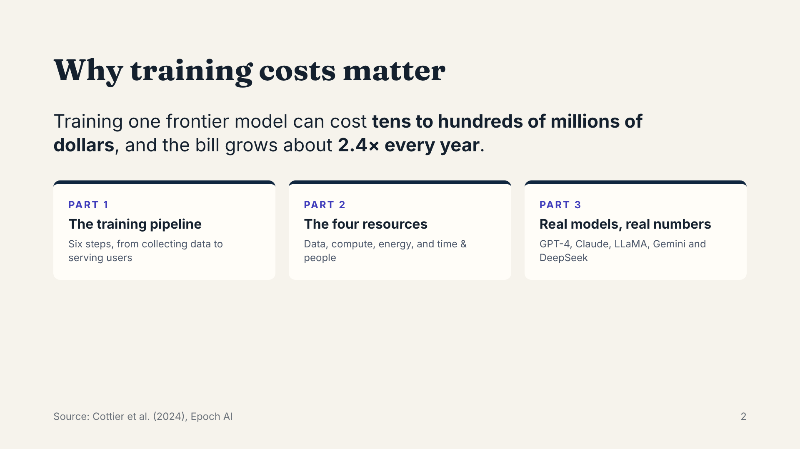
Notes:
Anyone making decisions about AI, whether building products, investing or setting policy, needs to understand what these models cost to make. Epoch AI found that frontier training costs have grown about 2.4 times per year since 2016. The talk has three parts: the training pipeline, the four resources it consumes, and real examples from specific models.

Slide 3
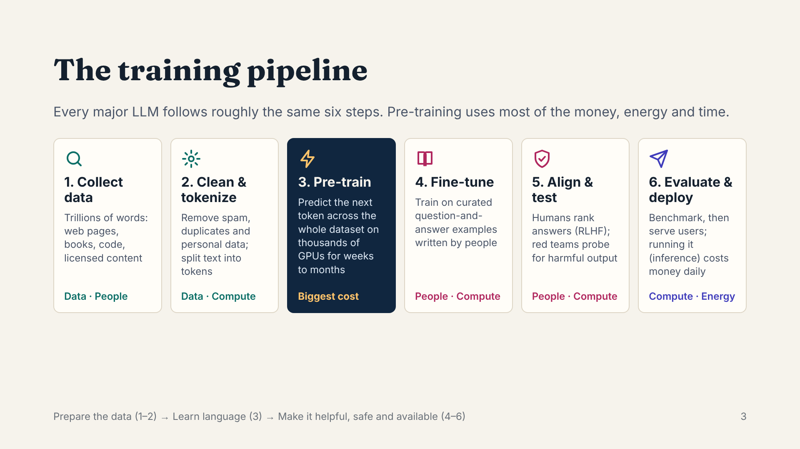
Notes:
Step 1 gathers trillions of words from the web, books, code and licensed sources. Step 2 cleans that data and turns it into tokens, the word pieces a model reads. Step 3, pre-training, is the expensive one: the model predicts the next token over and over across the entire dataset, running on thousands of GPUs for weeks or months. Steps 4 and 5 make the model useful and safe: people write example answers, rank the model’s answers, and red teams try to make it fail. Step 6 is deployment, where inference costs continue every day the model is in use.

Slide 4
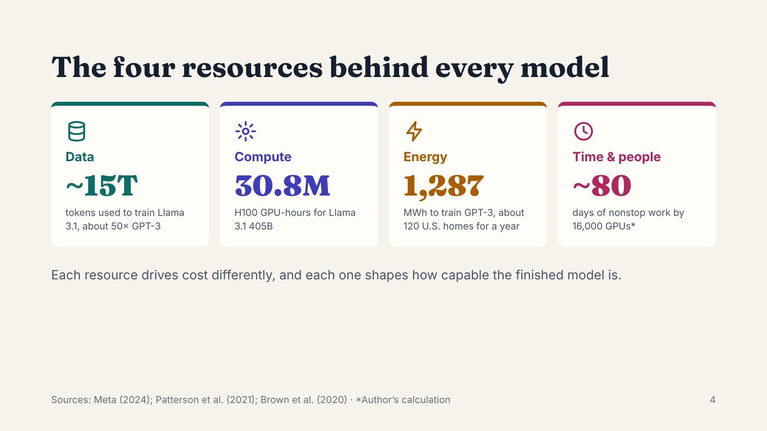
Notes:
Here are the four resources in one view, each with a headline number. Data: about 15 trillion tokens for Llama 3.1. Compute: 30.8 million GPU-hours. Energy: 1,287 megawatt-hours just for GPT-3. Time: about 80 days of nonstop GPU work for one frontier run. The next four slides look at each one and how it affects cost and performance.

Slide 5
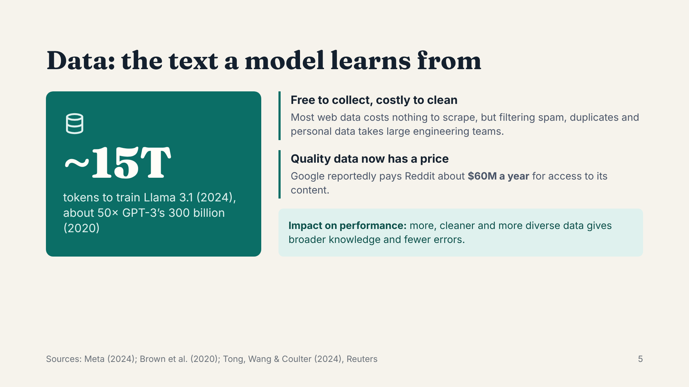
Notes:
Training data is measured in tokens, which are word pieces. Datasets have grown fiftyfold in four years, from 300 billion tokens for GPT-3 to about 15 trillion for Llama 3.1. Collecting web text is cheap, but cleaning it is not, and high-quality data is becoming a paid resource. Google’s reported deal with Reddit, about 60 million dollars a year, shows that. Better data directly improves what the model knows and how often it makes mistakes.

Slide 6
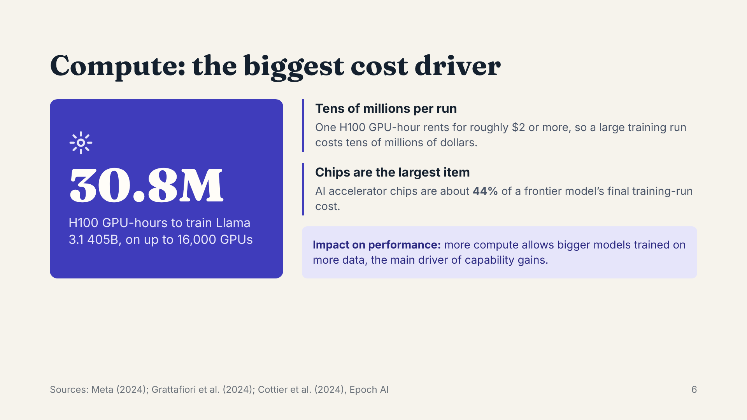
Notes:
Compute means the GPUs, servers and networks that do the training. Meta used 30.8 million GPU-hours to train its largest Llama 3.1 model, spread across up to 16,000 H100 GPUs. At about two dollars per GPU-hour, that is tens of millions of dollars for one run. Epoch AI estimates that the chips alone are 44 percent of the final run’s cost. Compute is also what makes models better: more of it lets labs train bigger models on more data.

Slide 7
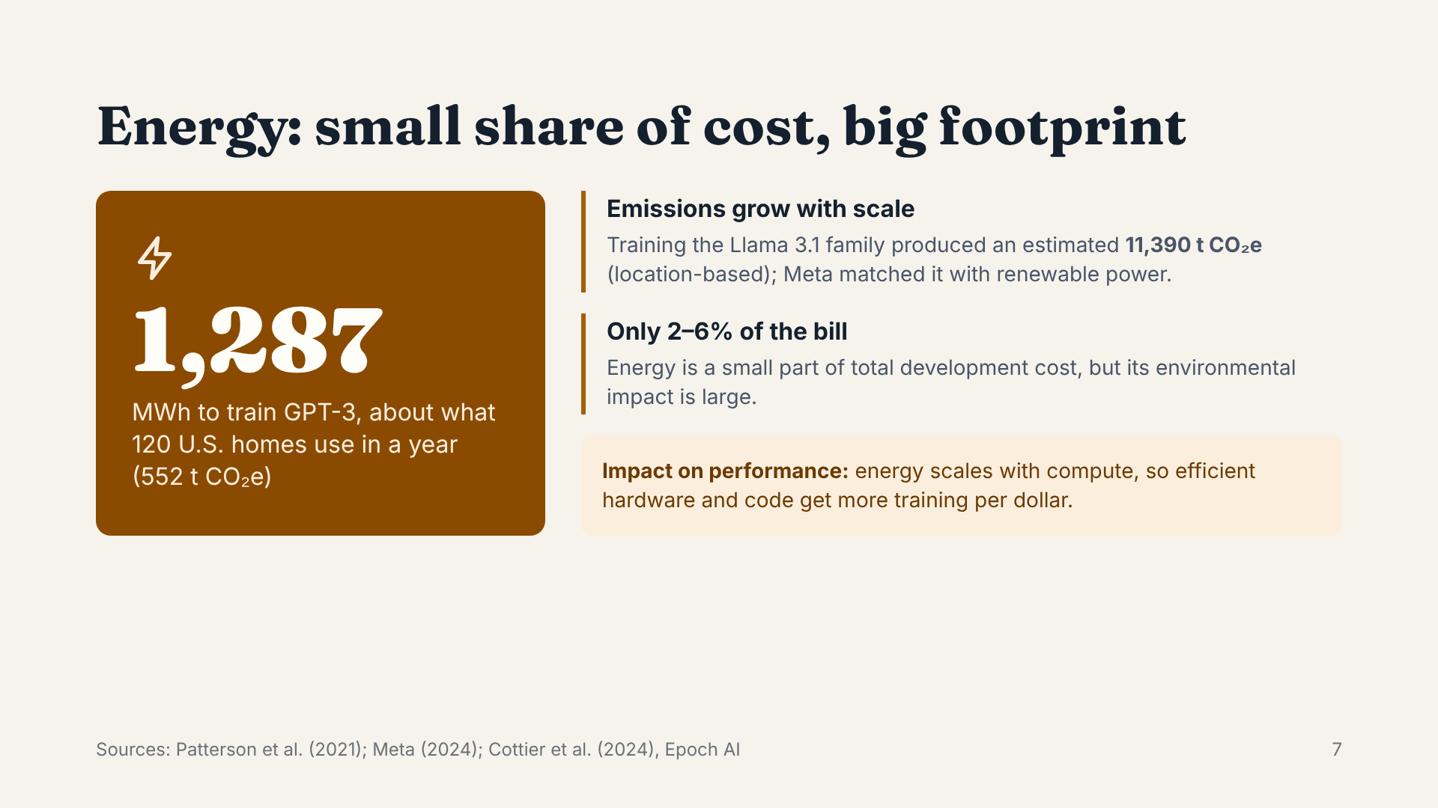
Notes:
Training GPT-3 used about 1,287 megawatt-hours of electricity, roughly a year of power for 120 American homes, and produced about 552 tonnes of CO2. Newer models are much bigger: the Llama 3.1 family produced over 11,000 tonnes before Meta’s renewable energy matching. Interestingly, energy is only 2 to 6 percent of the total cost, so it matters more for sustainability and policy than for the budget.

Slide 8
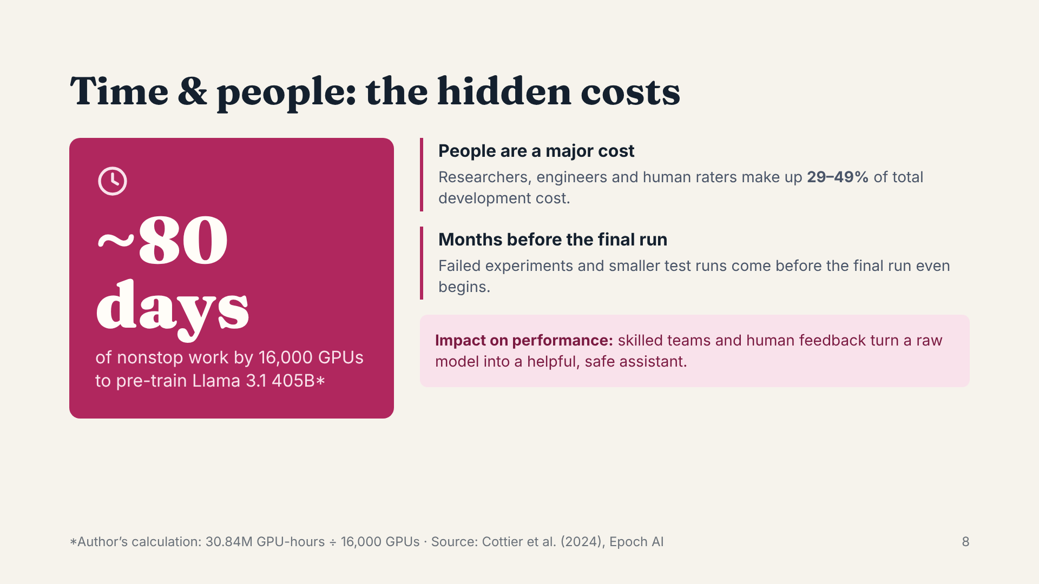
Notes:
Dividing Meta’s published 30.84 million GPU-hours by its 16,000-GPU cluster gives about 80 days of continuous training, and that is just the final run. People are the other hidden cost: Epoch AI estimates that staff make up 29 to 49 percent of total development cost. The human raters who rank answers in RLHF are a big reason ChatGPT and Claude feel helpful rather than raw.

Slide 9
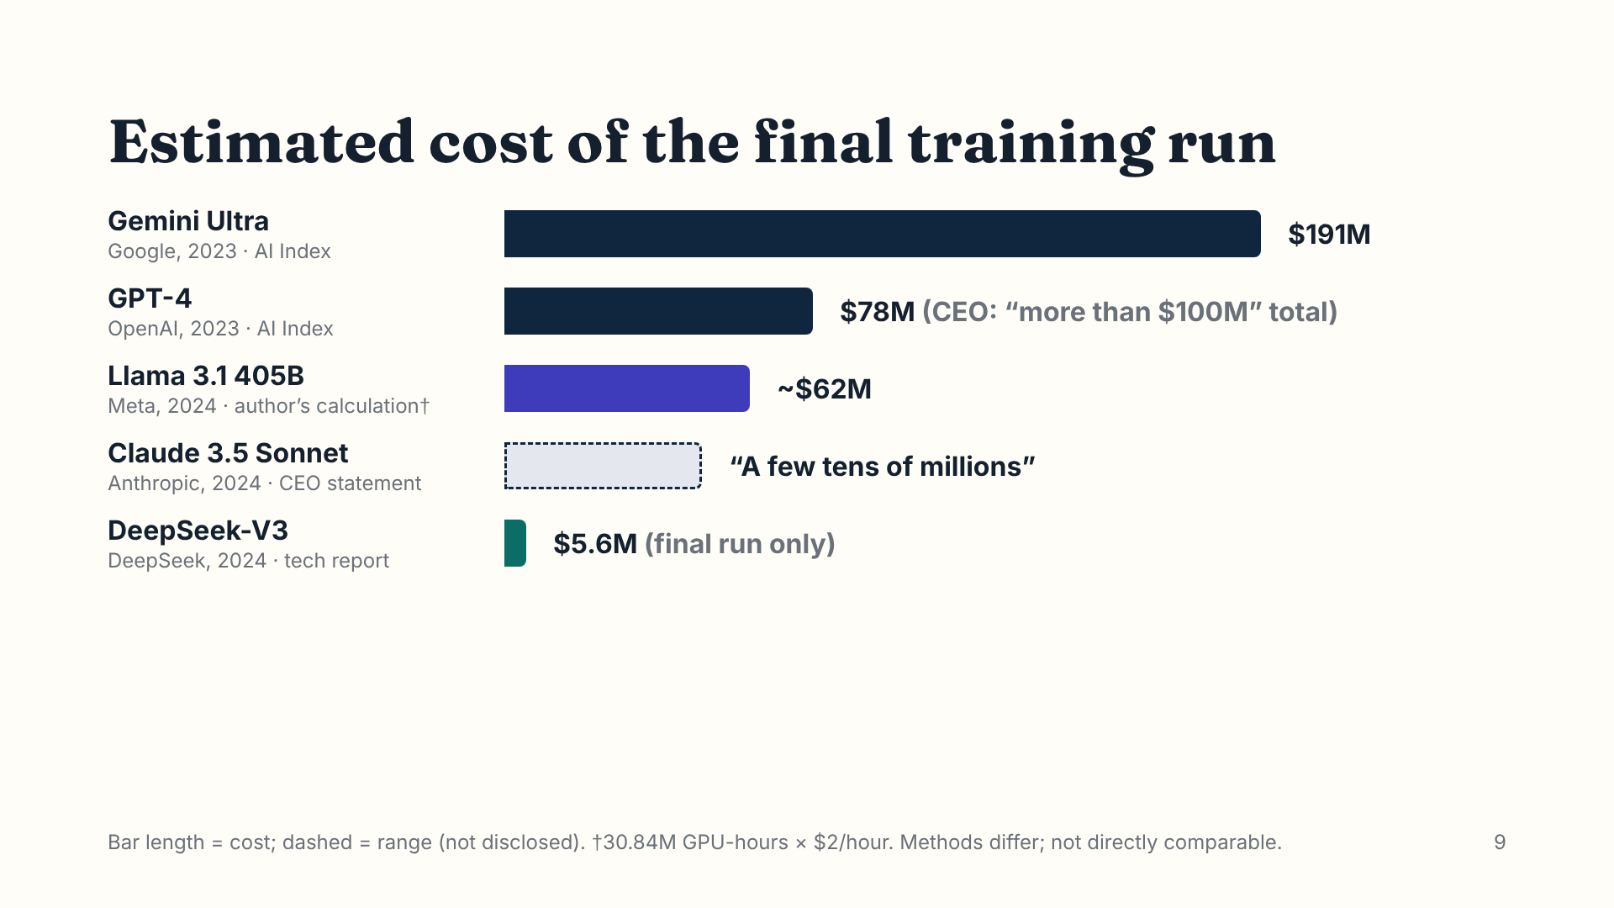
Notes:
These are the best available estimates for five well-known models. The Stanford AI Index puts Gemini Ultra at about 191 million dollars and GPT-4 at 78 million, and OpenAI’s CEO has said GPT-4 cost over 100 million in total. Meta didn’t publish a cost, so I multiplied its published GPU-hours by two dollars an hour, the same rate DeepSeek used, which gives about 62 million. Anthropic’s CEO said Claude 3.5 Sonnet cost a few tens of millions. DeepSeek-V3 reported just 5.6 million, but only for the final run, not its research. Each estimate uses a different method, so treat the ranking as approximate.

Slide 10
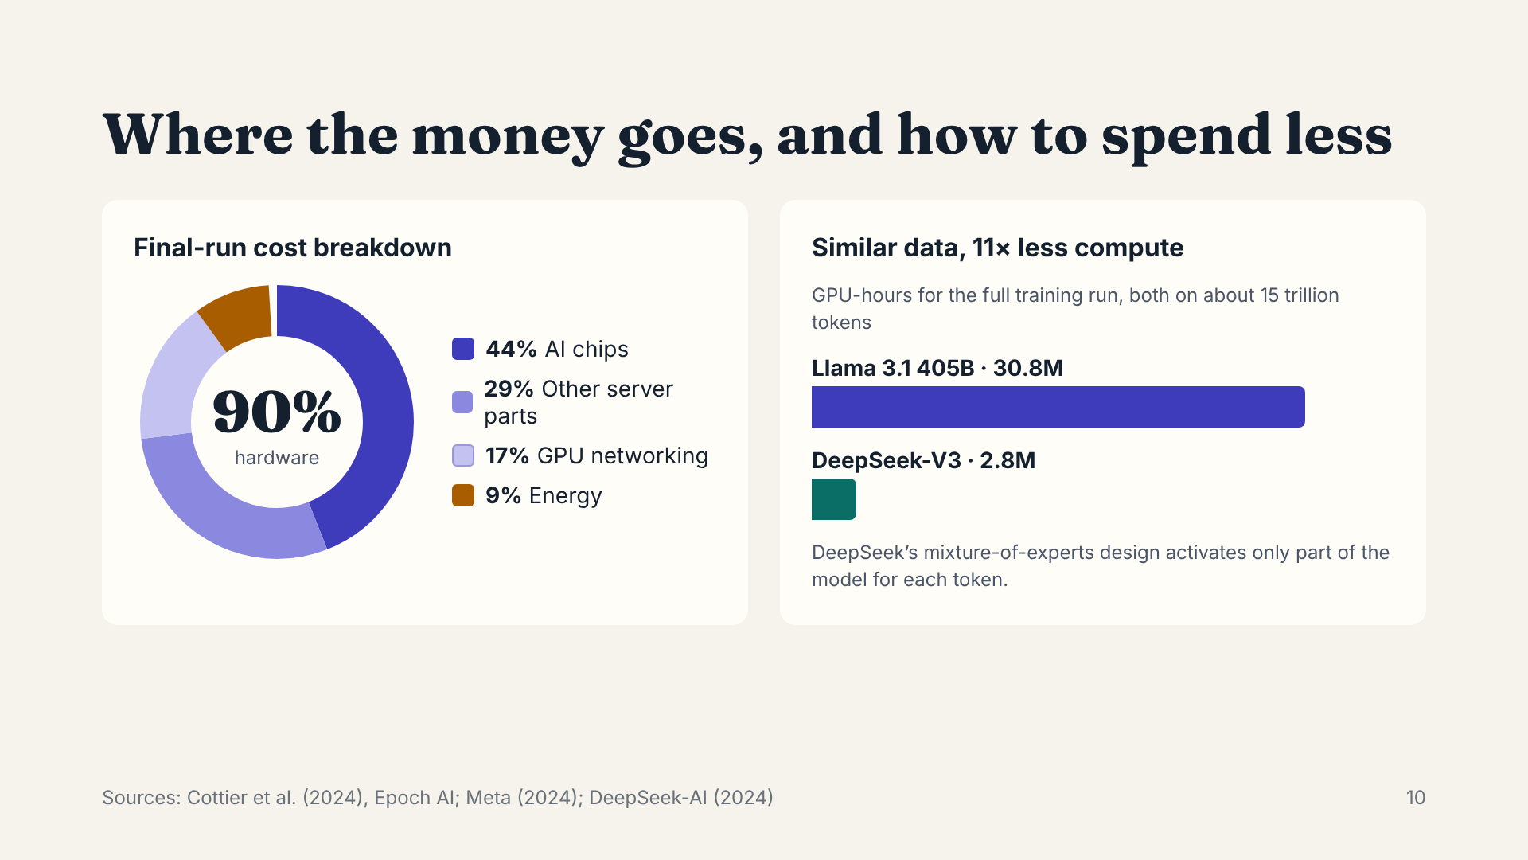
Notes:
On the left, Epoch AI’s breakdown of a frontier final training run: about 90 percent is hardware, and chips alone are 44 percent. Energy is only 9 percent of this figure. On the right is why efficiency matters: DeepSeek-V3 and Llama 3.1 trained on similar amounts of data, but DeepSeek used about 11 times fewer GPU-hours, because its mixture-of-experts design only uses part of the model for each token.

Slide 11
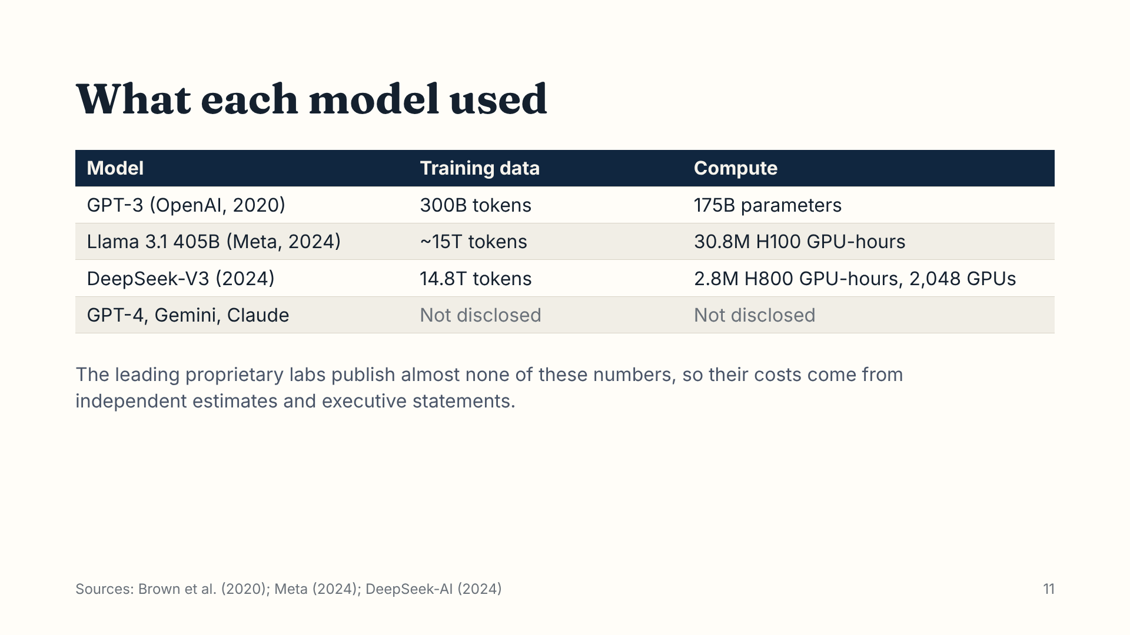
Notes:
This table shows the technical details that have been published. Open models like Llama and DeepSeek report their data and compute; OpenAI, Google and Anthropic don’t for their newest models. That transparency gap is one of the key considerations when reading any cost figure.

Slide 12
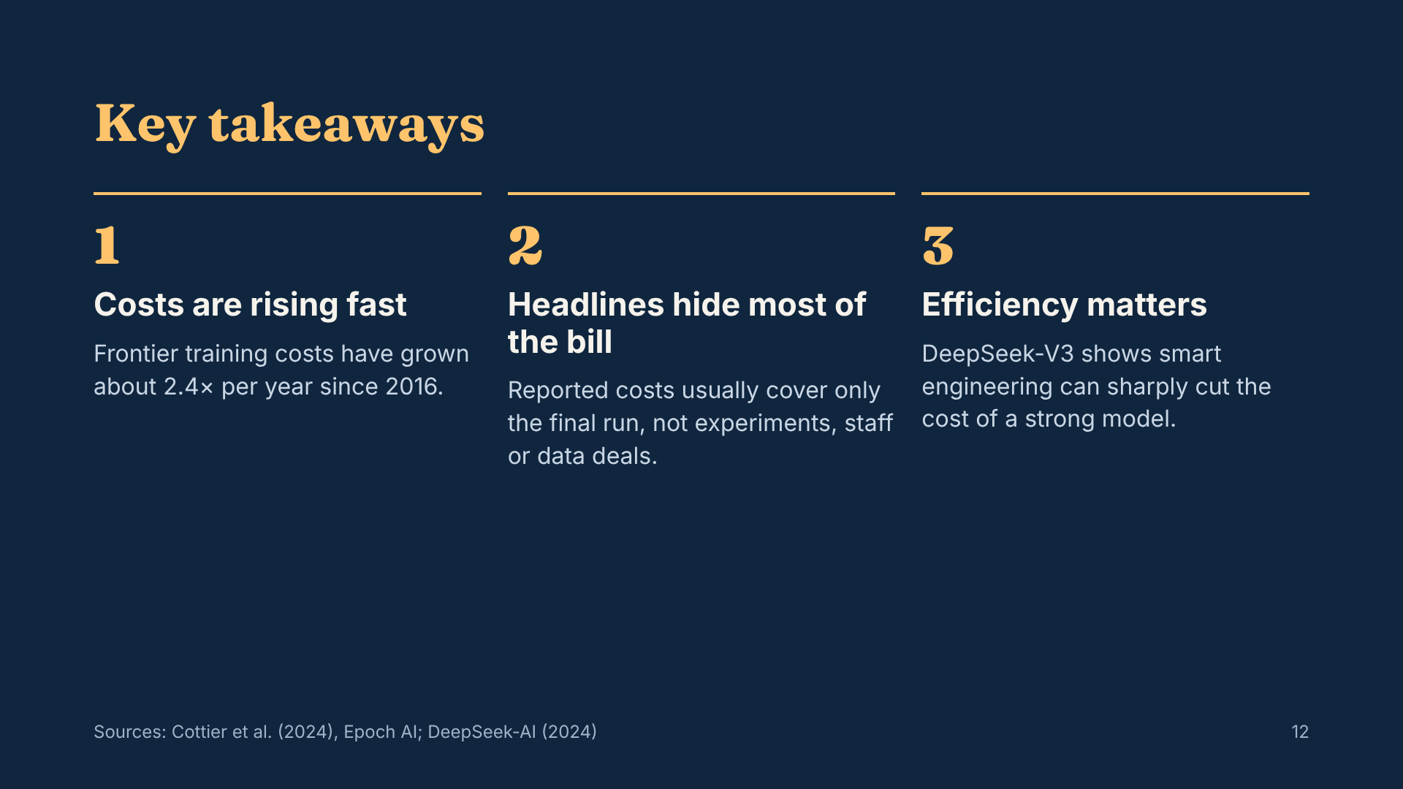
Notes:
Three things to remember. First, costs are climbing about 2.4 times a year. Second, the numbers in the news are usually just the final training run; experiments, salaries and data licensing can multiply the real total. Third, efficiency matters: DeepSeek showed that good engineering can produce a strong model for a fraction of the compute.

Slide 13
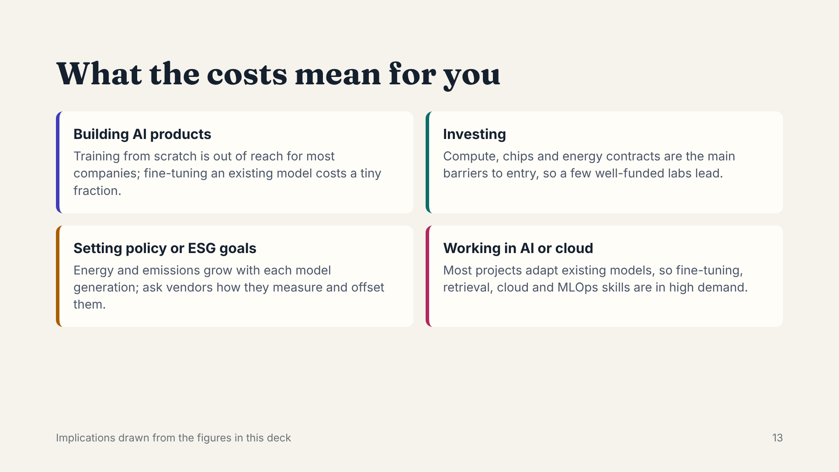
Notes:
What does this mean in practice? For most companies, training from scratch is not realistic; adapting existing models is. For investors, compute and chips are the moat. For policymakers, energy use is the growing concern. And for people like me working in cloud and AI, the demand is in fine-tuning, retrieval and the infrastructure that runs these models.

Slide 14
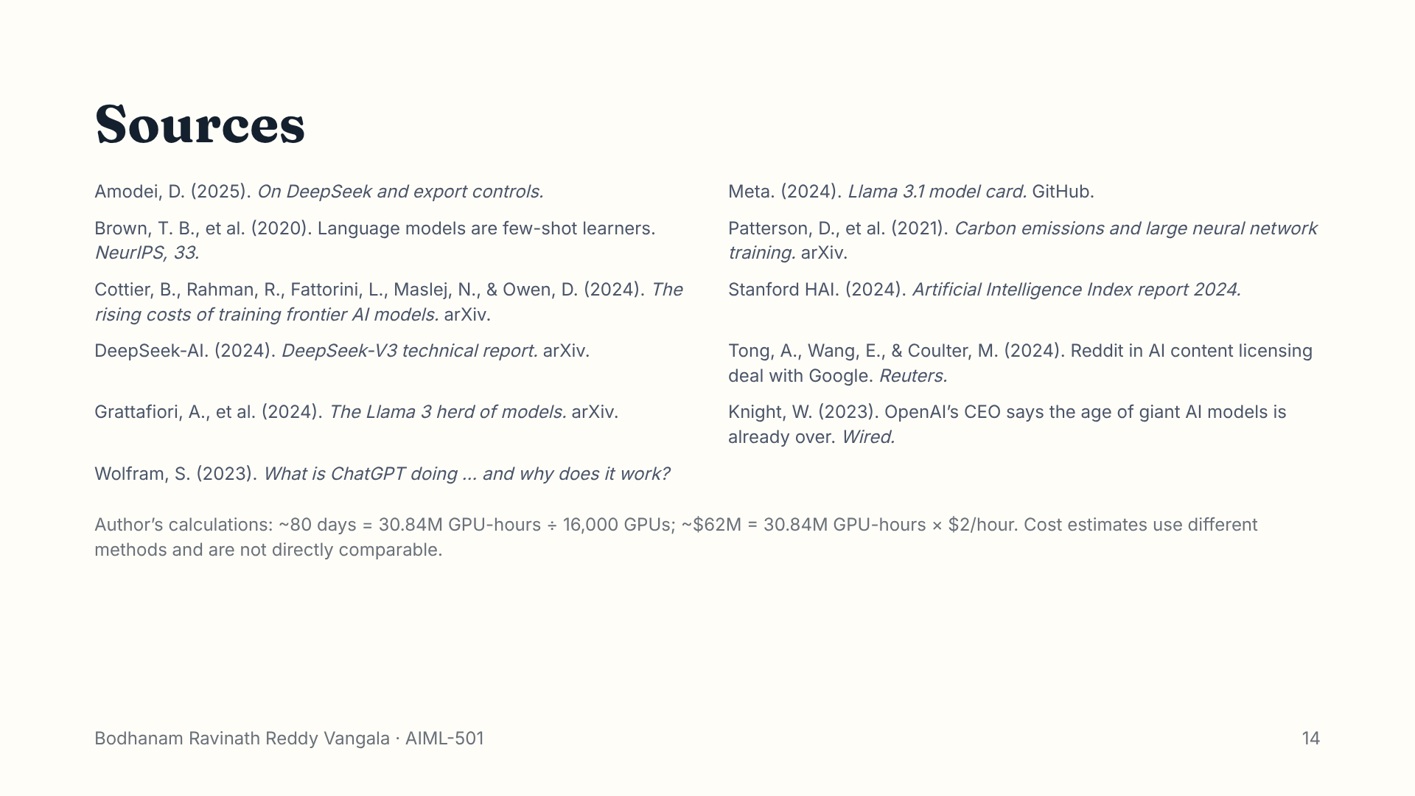
Notes:
Full references are in the explanatory document. The two figures I calculated myself are explained at the bottom of this slide.

