Slide 1
What is PostgreSQL?
PostgreSQL, often referred to as Postgres, is a free and open-source database system known for its reliability and advanced features. It supports SQL (Structured Query Language) and offers features such as transactions, foreign keys, and views. PostgreSQL is highly extensible, allowing users to define their own data types, operators, and functions.

Slide 2


Slide 3
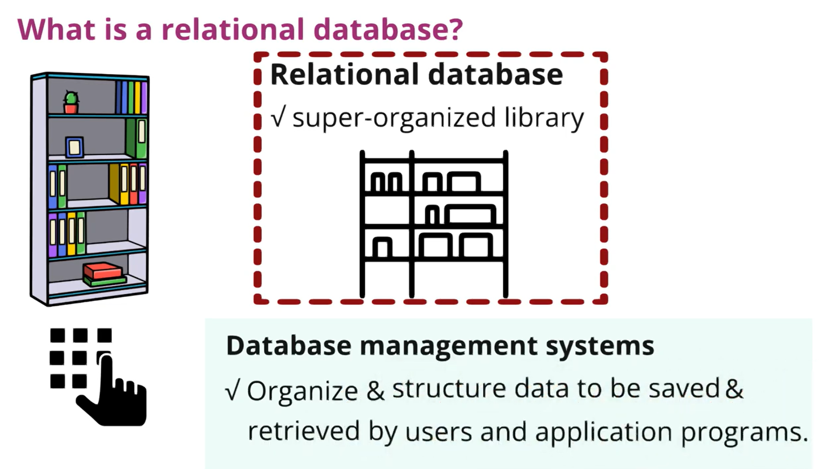

Slide 4
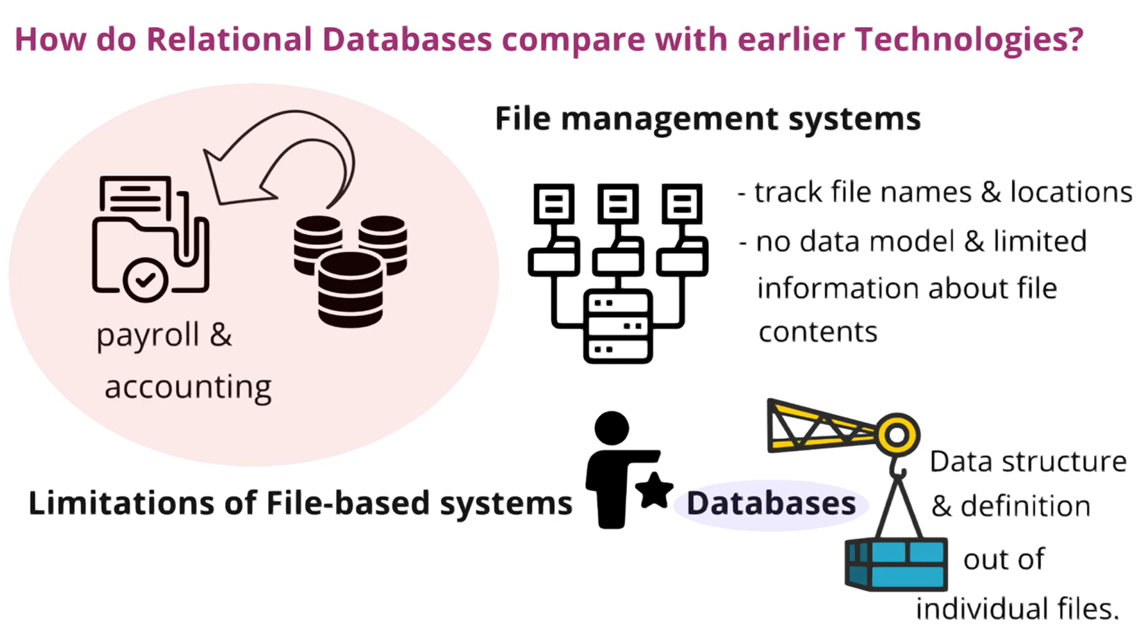

Slide 5
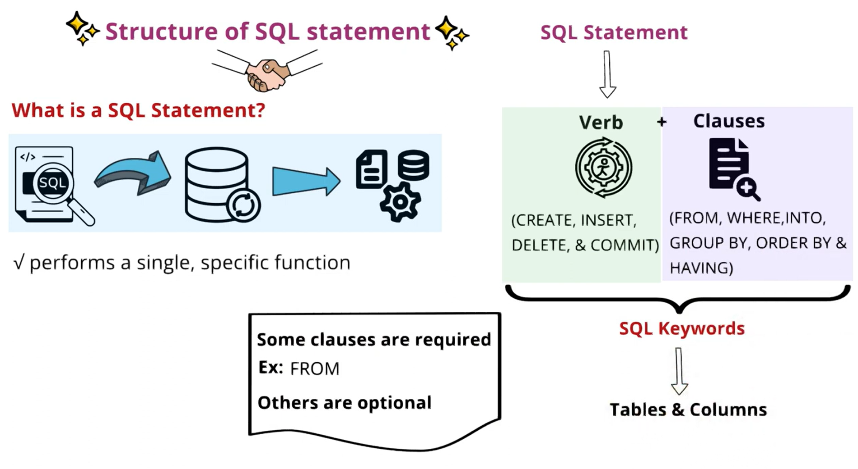

Slide 6
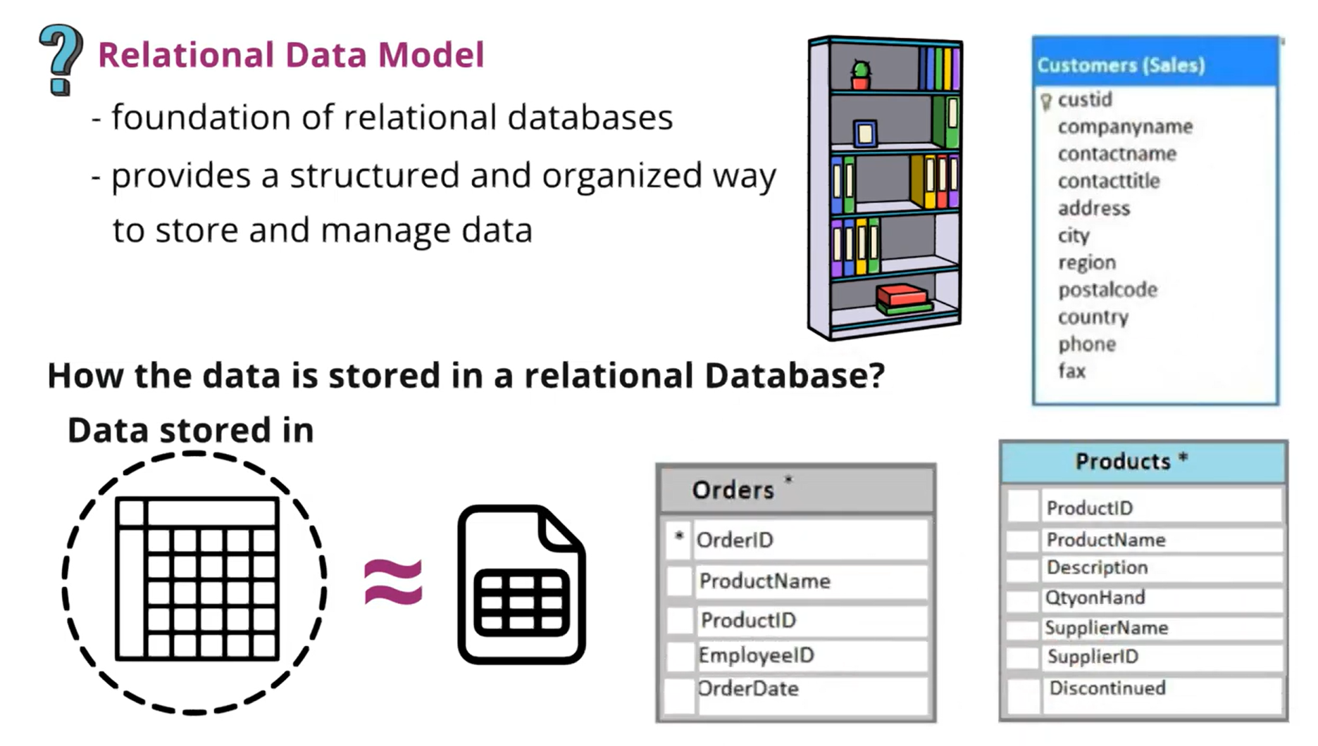

Slide 7


Slide 8
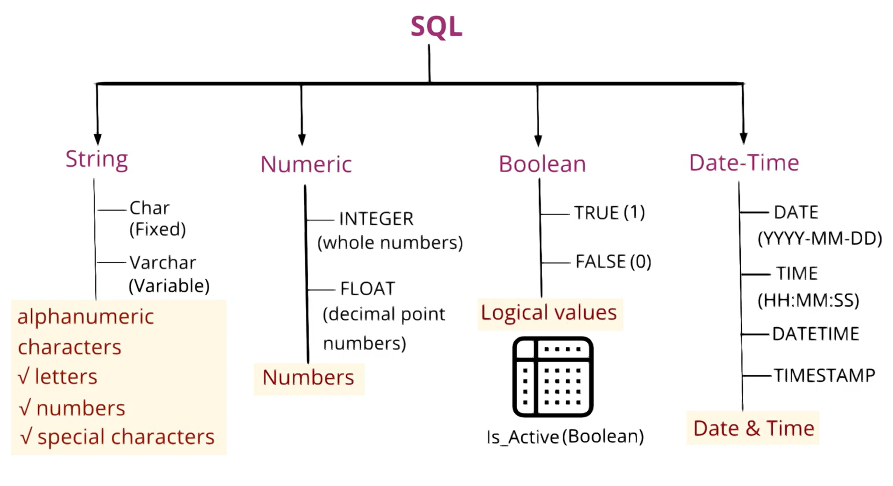

Slide 9
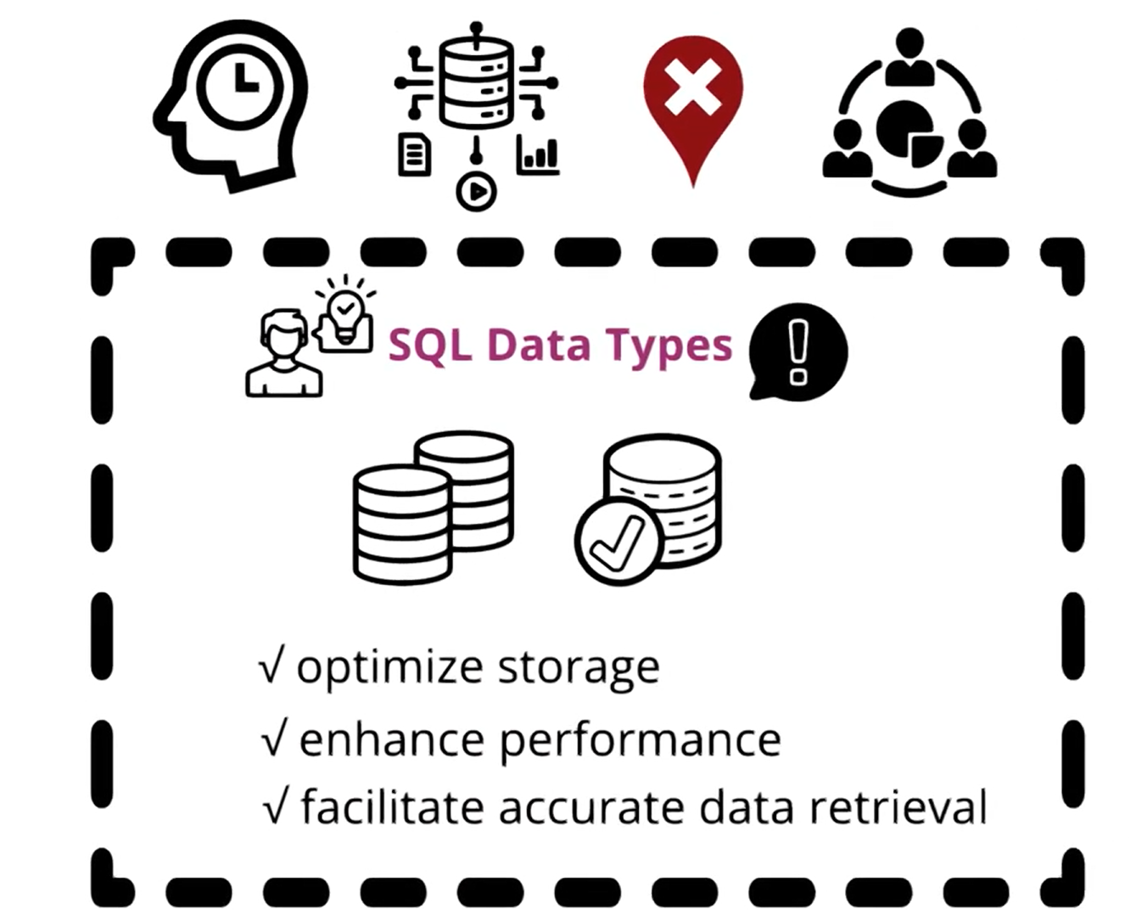

Slide 10


Slide 11
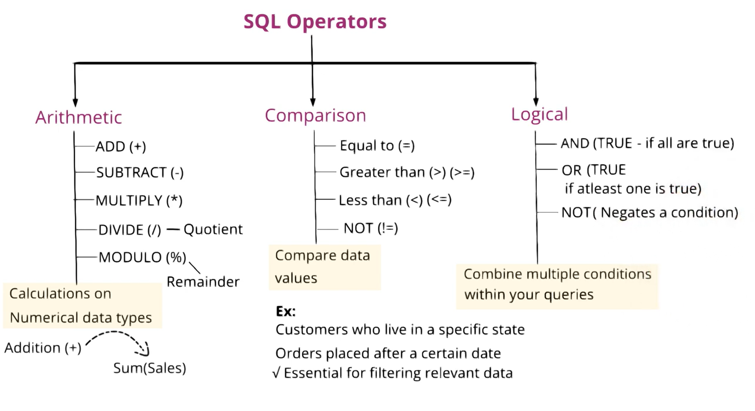

Slide 12
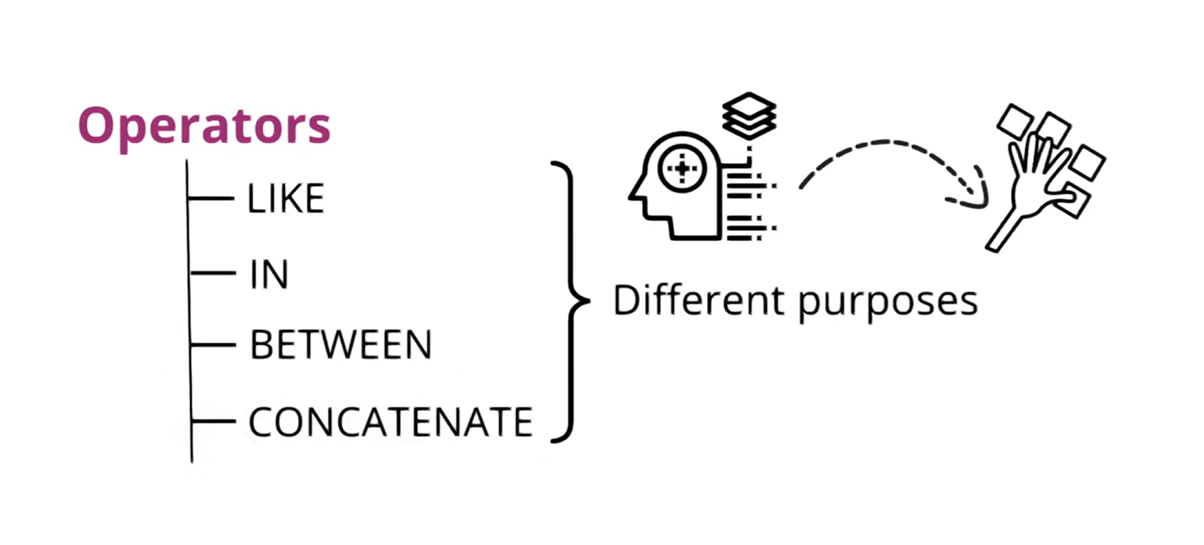

Slide 13
OFFSET AND FETCH
OFFSET n ROWS → skip the first n rows
FETCH NEXT m ROWS ONLY → get the next m rows
SELECT column_list
FROM table_name
ORDER BY some_column
OFFSET n ROWS
FETCH NEXT m ROWS ONLY;
OFFSET n ROWS → skip the first n rows
FETCH NEXT m ROWS ONLY → get the next m rows

Slide 14
SELECT employee_id, first_name, last_name
FROM employee
ORDER BY employee_id
LIMIT 10 OFFSET 5;

Slide 15
Common Aggregate Functions
Function | What it does | Example
COUNT() | Counts rows or non-NULL values | COUNT(*) counts all rows
SUM() | Adds up numeric values | SUM(salary)
AVG() | Calculates average | AVG(age)
MIN() | Finds minimum value | MIN(salary)
MAX() | Finds maximum value | MAX(age)

Slide 16


Slide 17
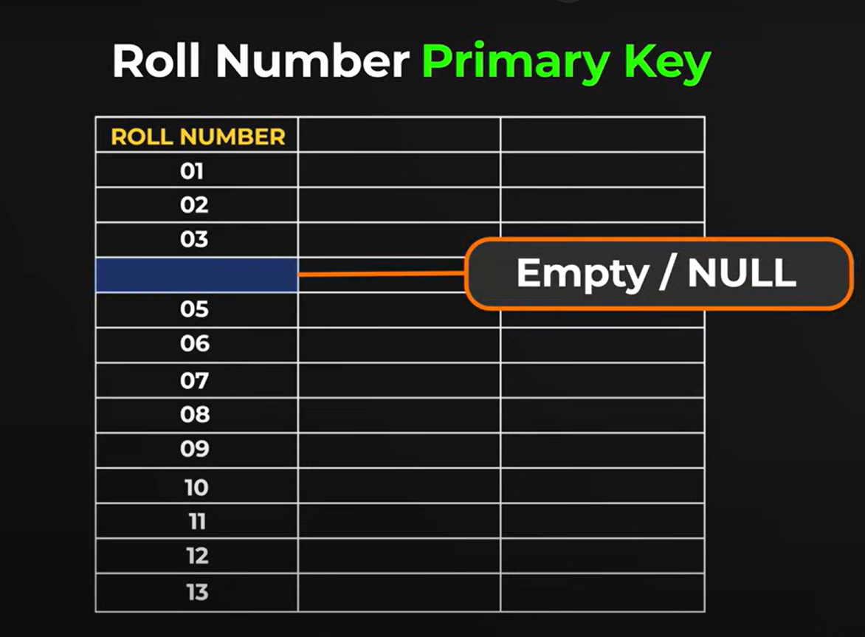
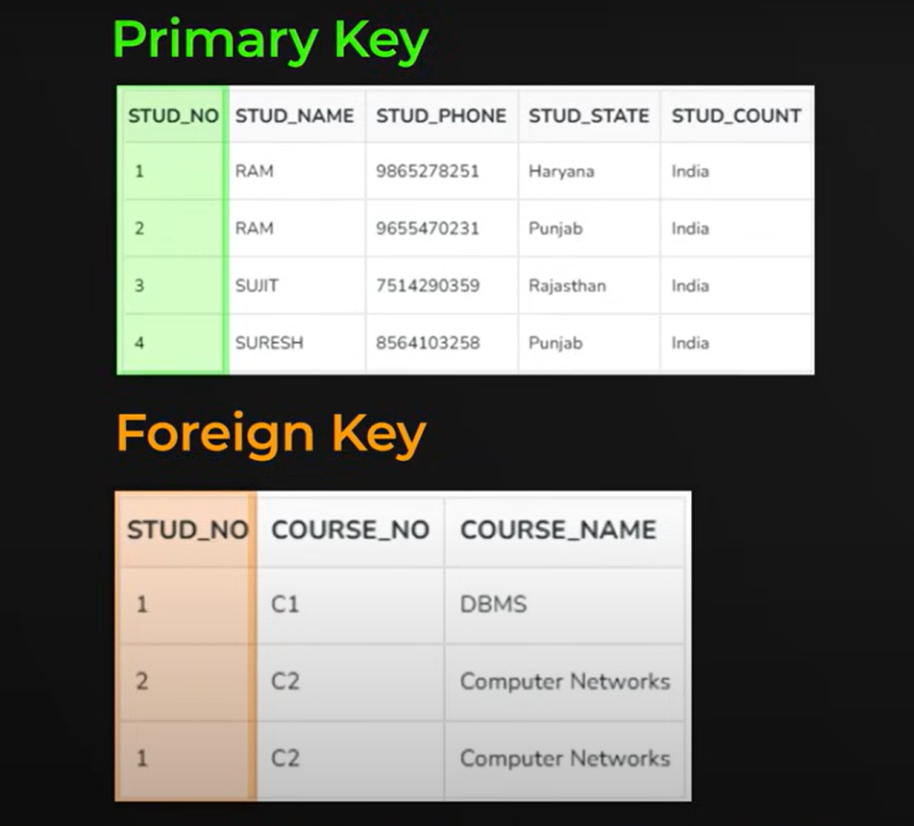


Slide 18
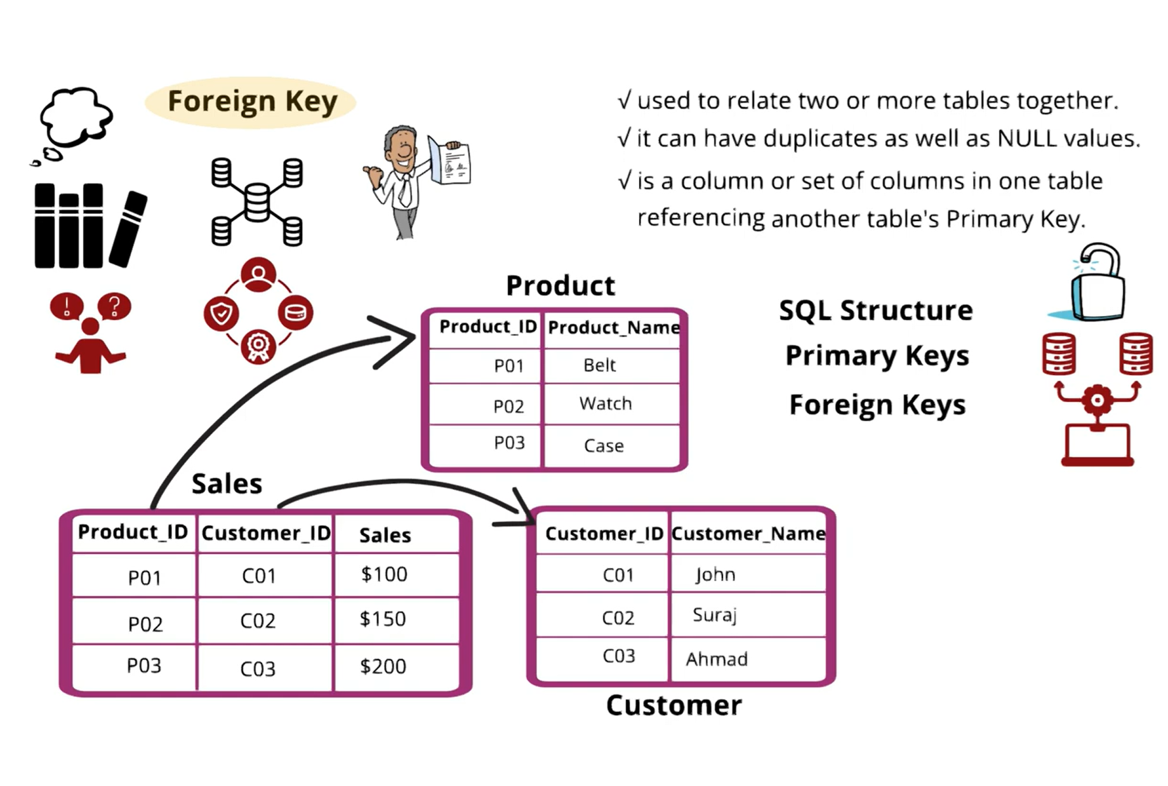

Slide 19
CREATE TABLE employee_batch06 (
employee_id INT GENERATED ALWAYS AS IDENTITY PRIMARY KEY,
first_name VARCHAR(100),
last_name VARCHAR(100),
department_id INT,
CONSTRAINT employee_department_fk
FOREIGN KEY (department_id)
REFERENCES department_batch06 (department_id)
);
CREATE TABLE employee_batch (
employee_id INT GENERATED ALWAYS AS IDENTITY PRIMARY KEY,
first_name VARCHAR(100),
last_name VARCHAR(100),
department_id INT
)
alter table employee_batch
add constraint TEST_FK FOREIGN KEY (department_id)
REFERENCES department_batch06 (department_id)
select * from employee_batch

Slide 20
DATES
SELECT CURRENT_DATE; -- only date
SELECT CURRENT_TIME; -- only time
SELECT CURRENT_TIMESTAMP; -- date + time
SELECT NOW(); -- equivalent to CURRENT_TIMESTAMP
SELECT EXTRACT(YEAR FROM hire_date) AS hire_year,
EXTRACT(MONTH FROM hire_date) AS hire_month,
EXTRACT(DAY FROM hire_date) AS hire_day
FROM employee;
-- Alternative in PostgreSQL
SELECT DATE_PART('year', hire_date) AS hire_year
FROM employee;

Slide 21
Filtering by Date
-- Employees hired this year
SELECT *
FROM employee
WHERE EXTRACT(YEAR FROM hire_date) = EXTRACT(YEAR FROM CURRENT_DATE);

Slide 22
Using Intervals for Queries
-- Employees hired in last 30 days
SELECT *
FROM employee
WHERE hire_date >= CURRENT_DATE - INTERVAL '30 days';

Slide 23


Slide 24
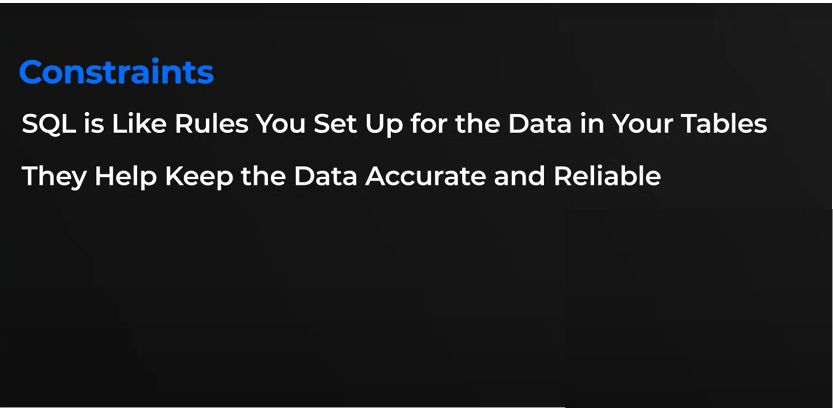

Slide 25
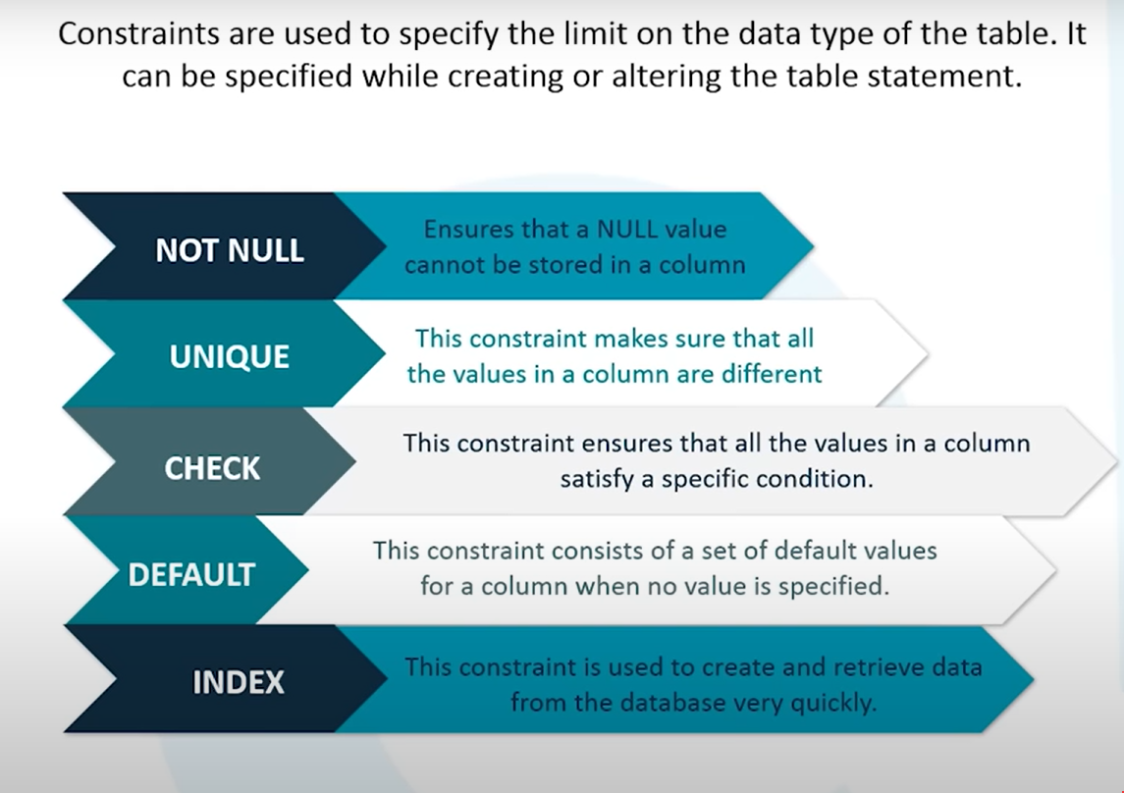

Slide 26
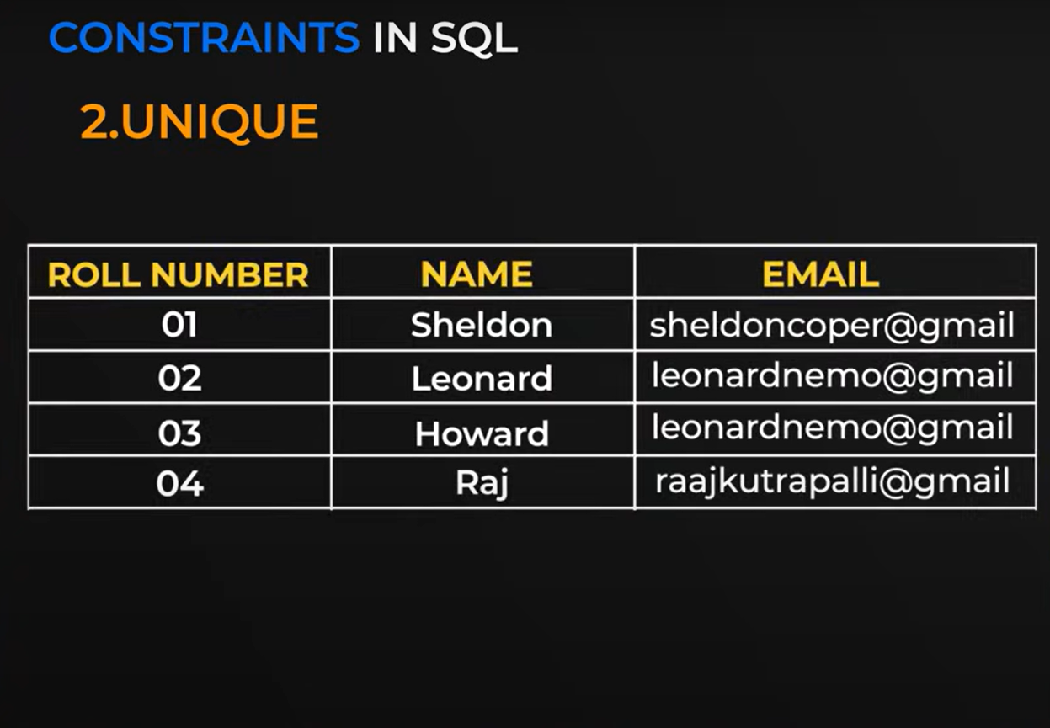

Slide 27
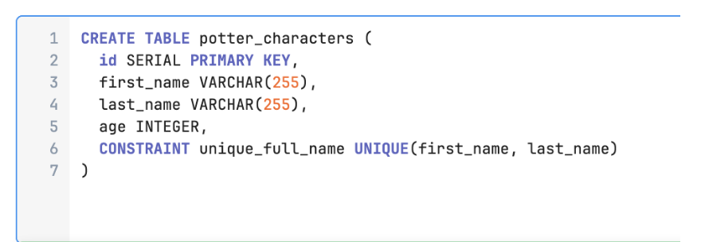
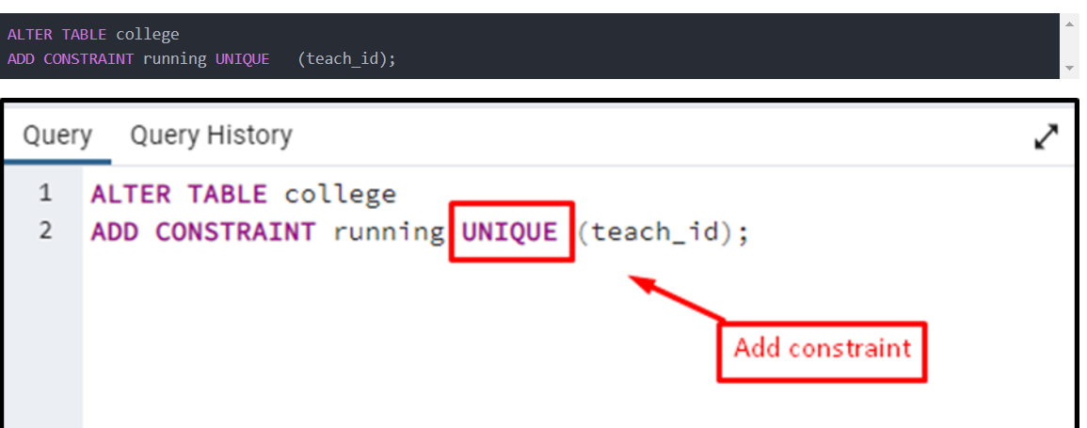

Slide 28


Slide 29
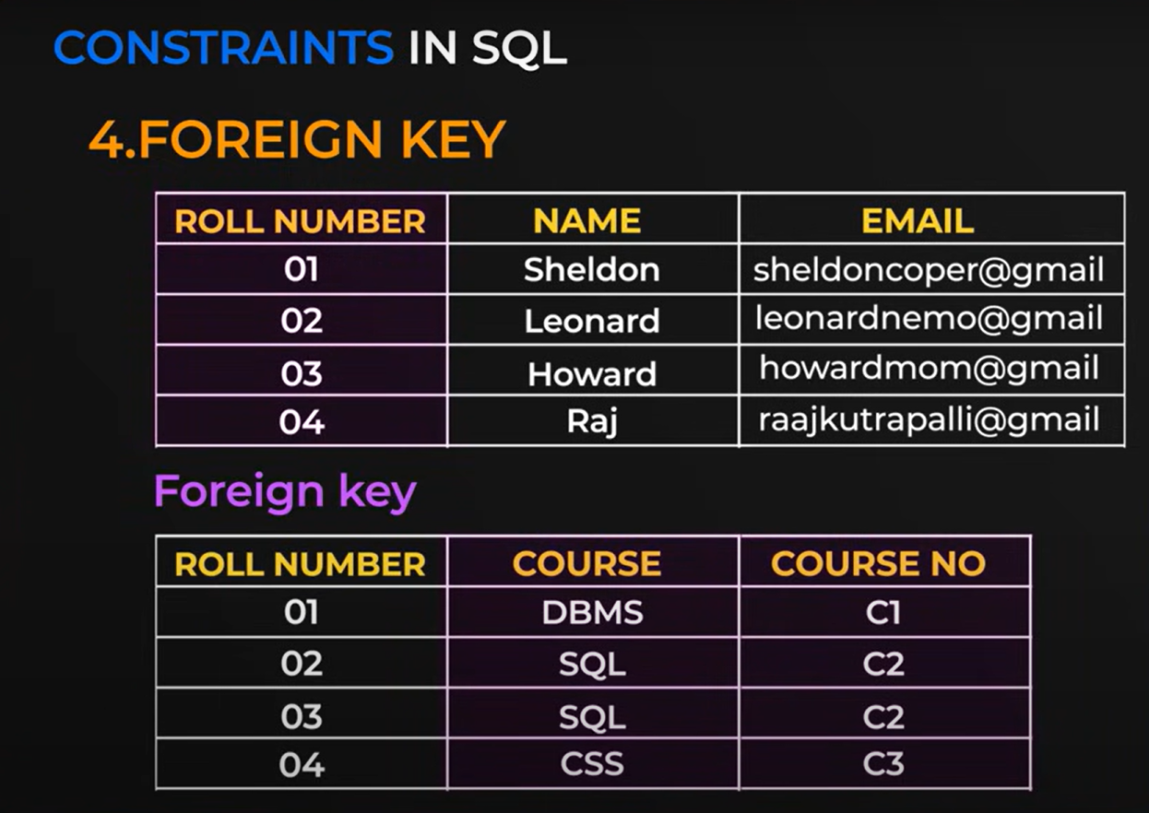

Slide 30
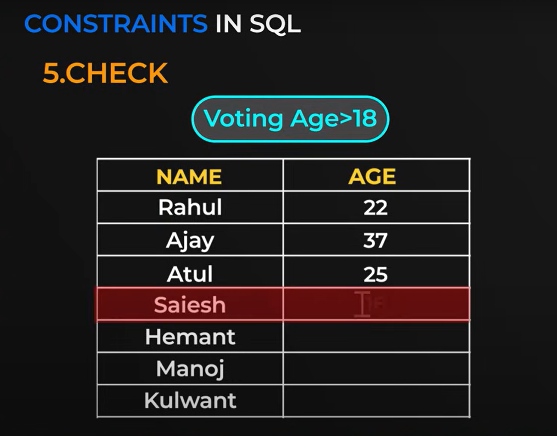

Slide 31
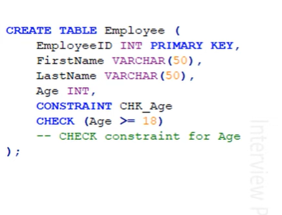

Slide 32
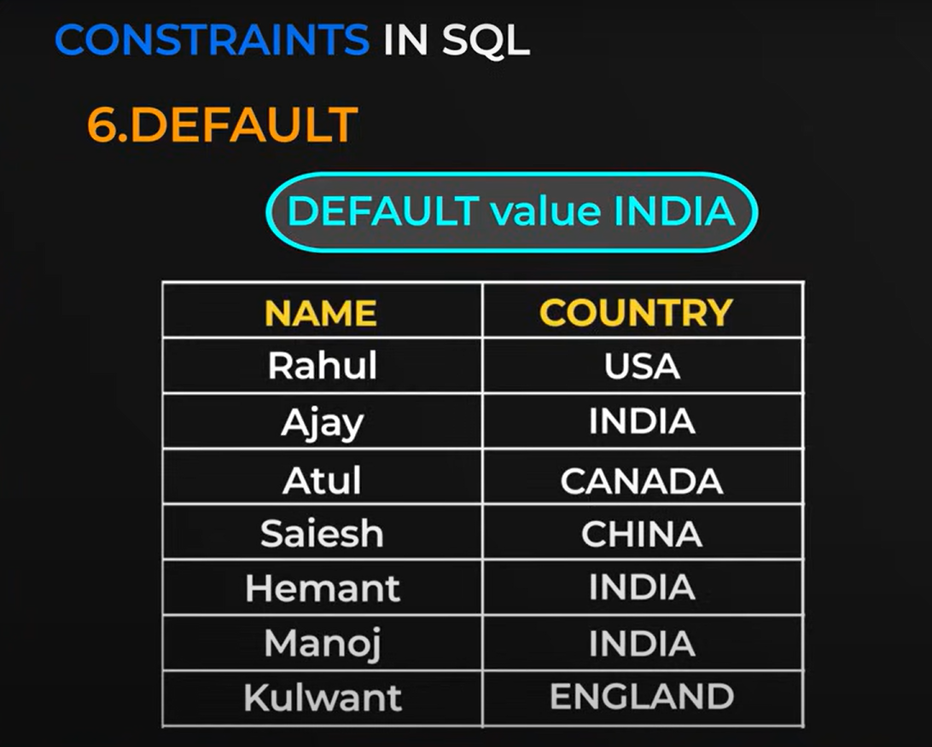

Slide 33


Slide 34
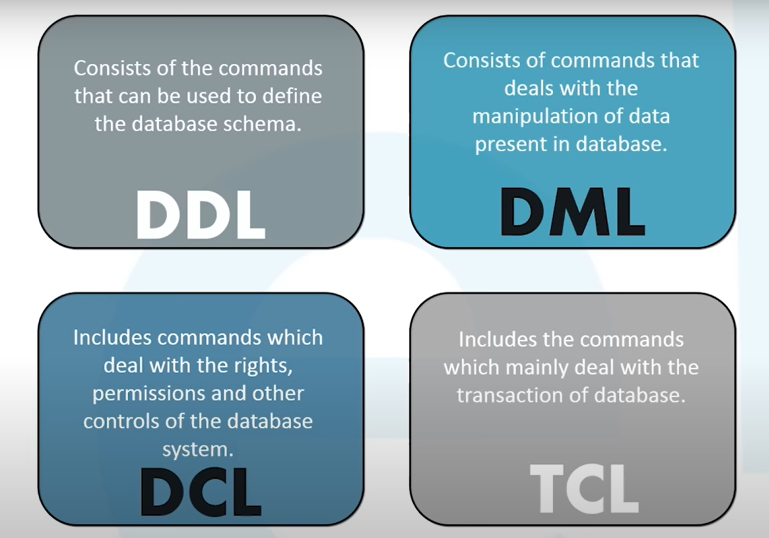

Slide 35
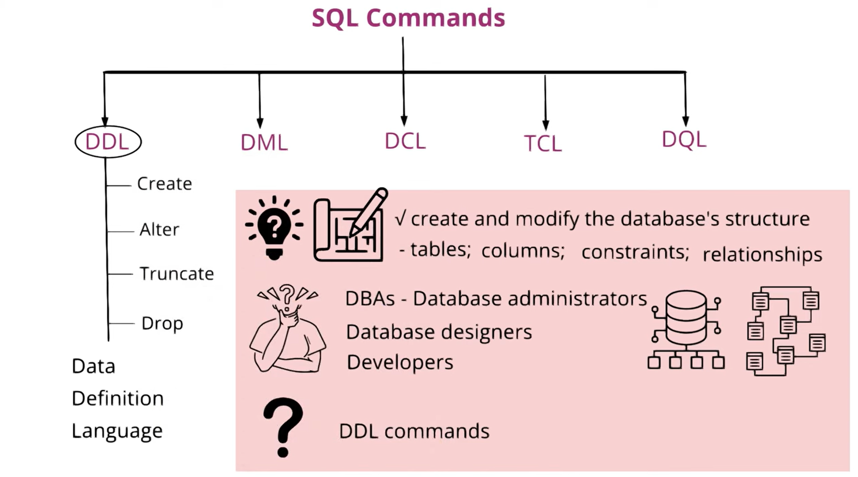

Slide 36
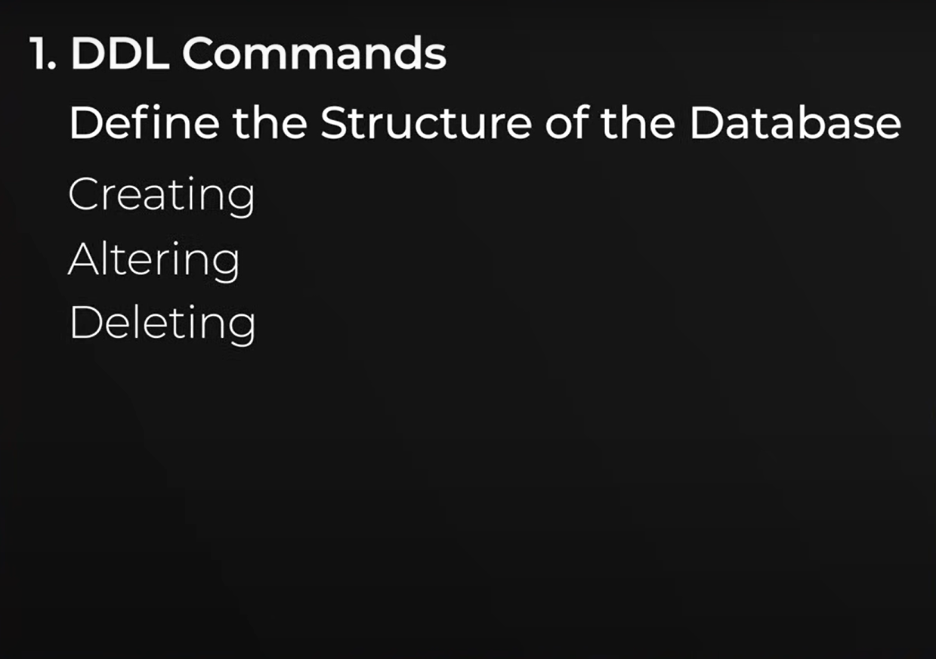

Slide 37
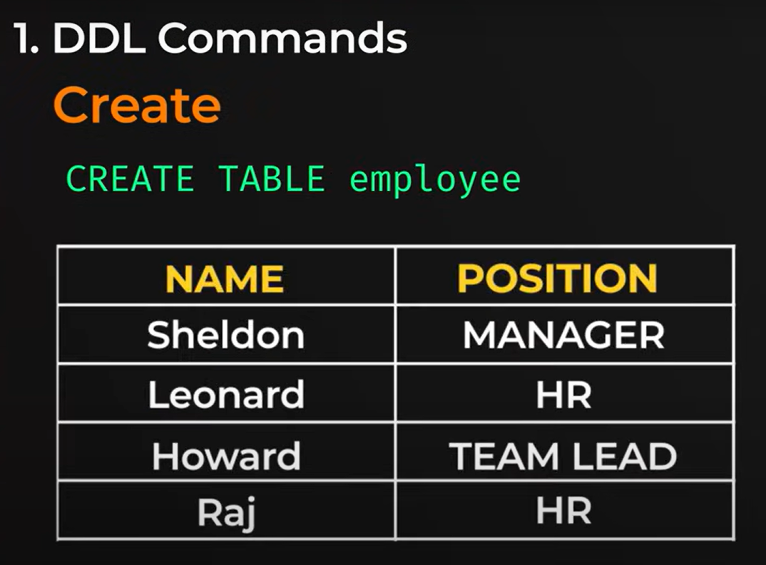

Slide 38
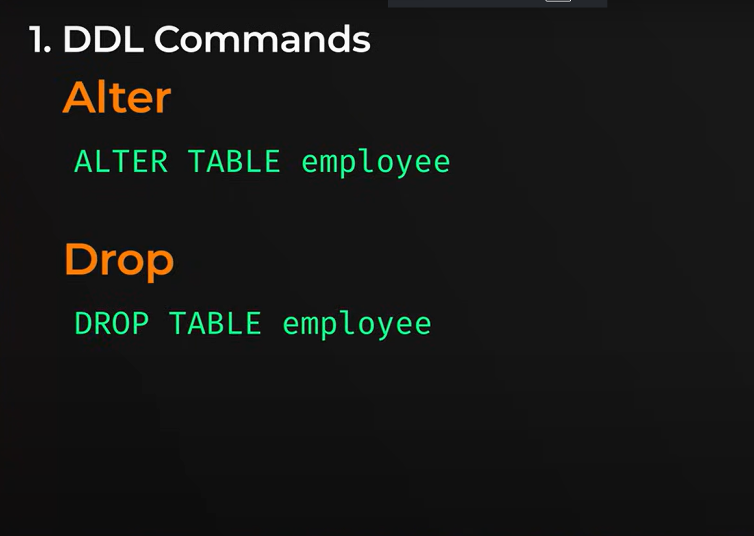

Slide 39
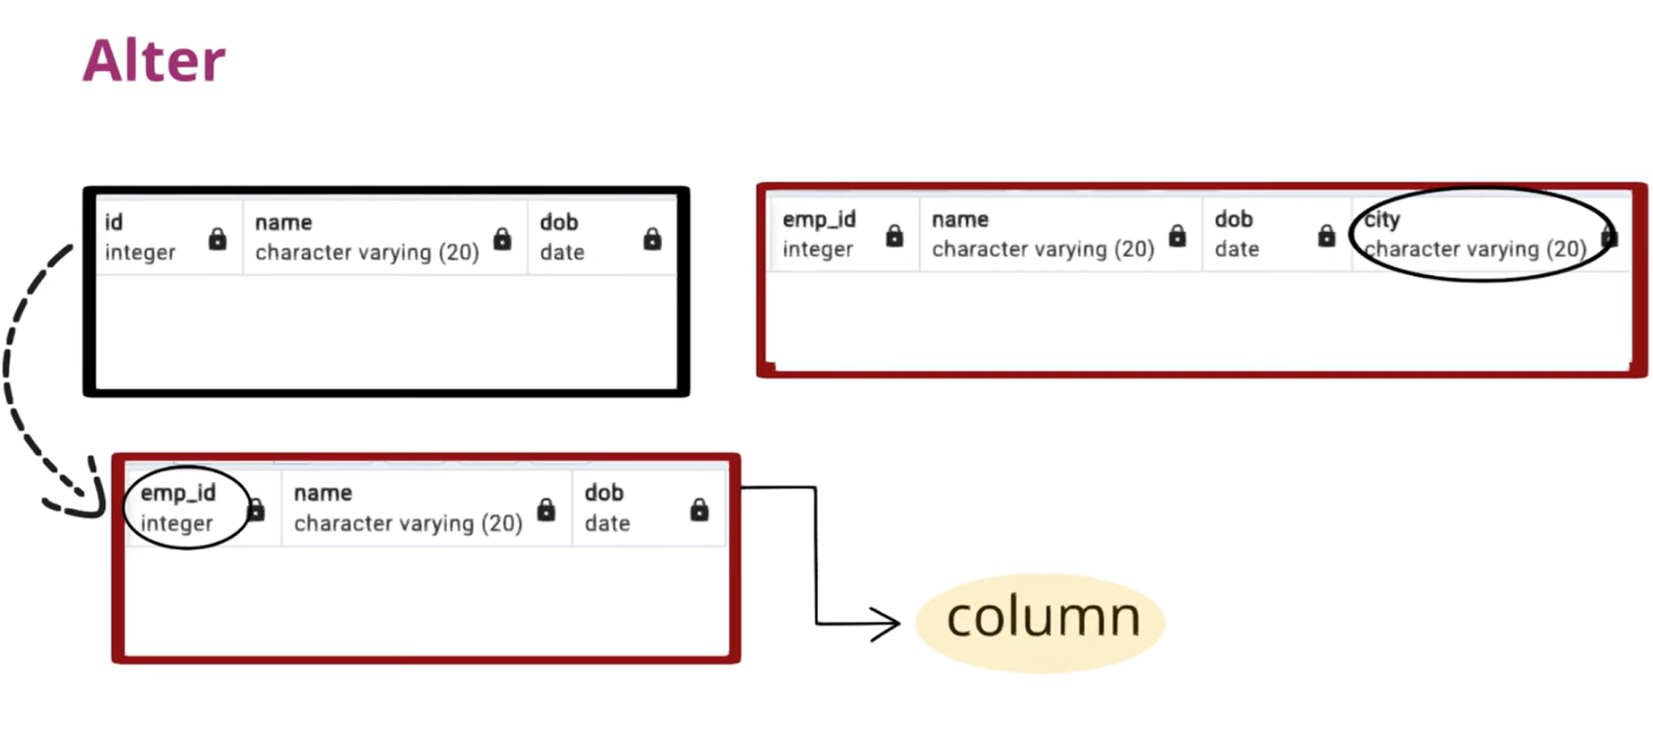

Slide 40
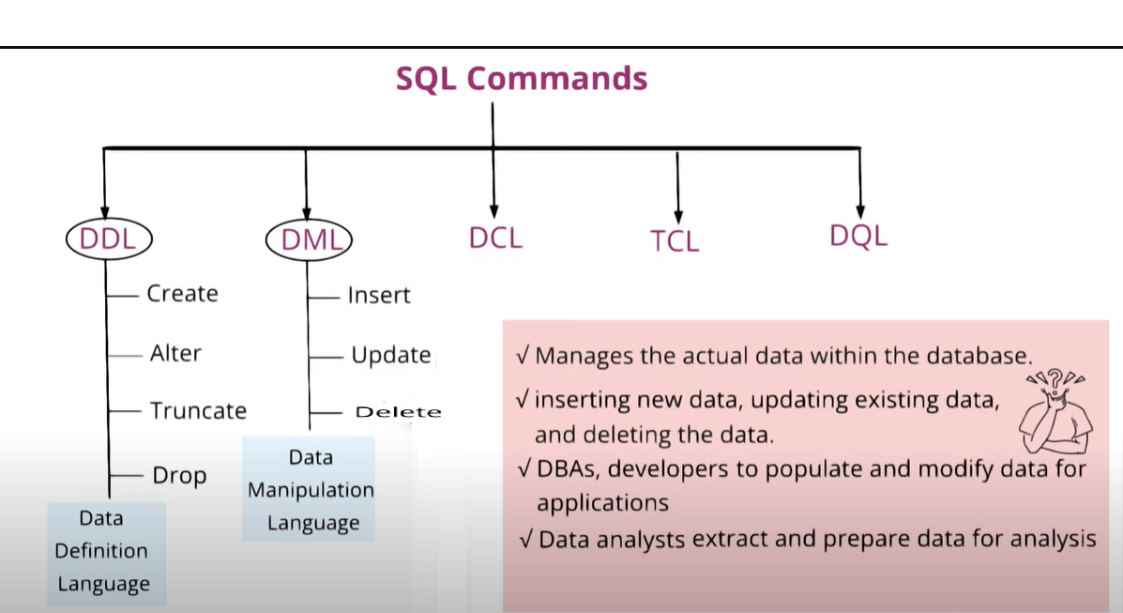

Slide 41
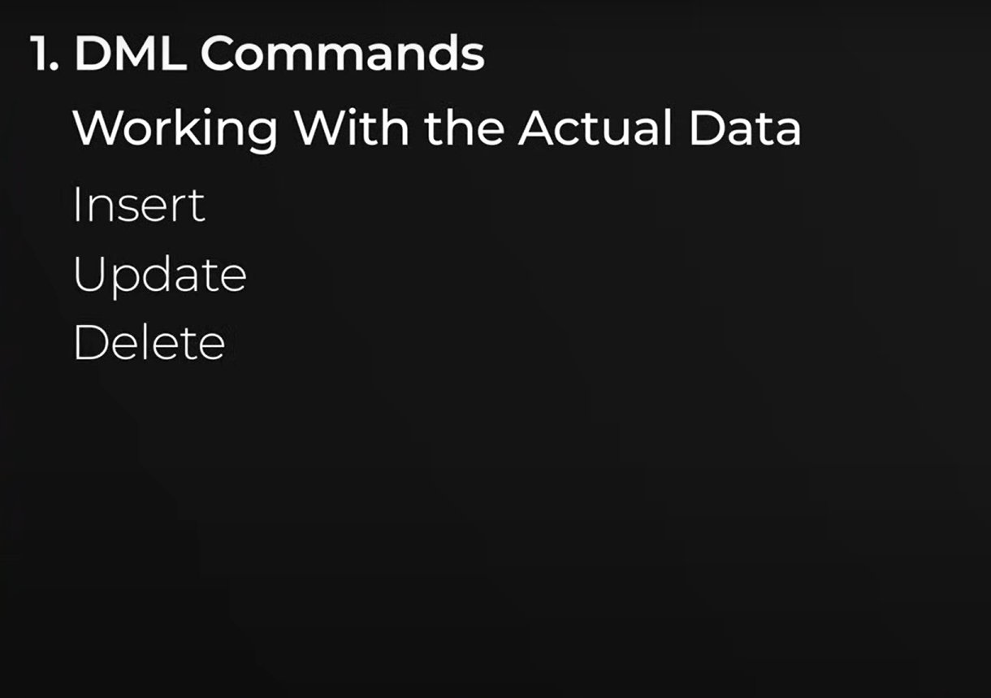

Slide 42
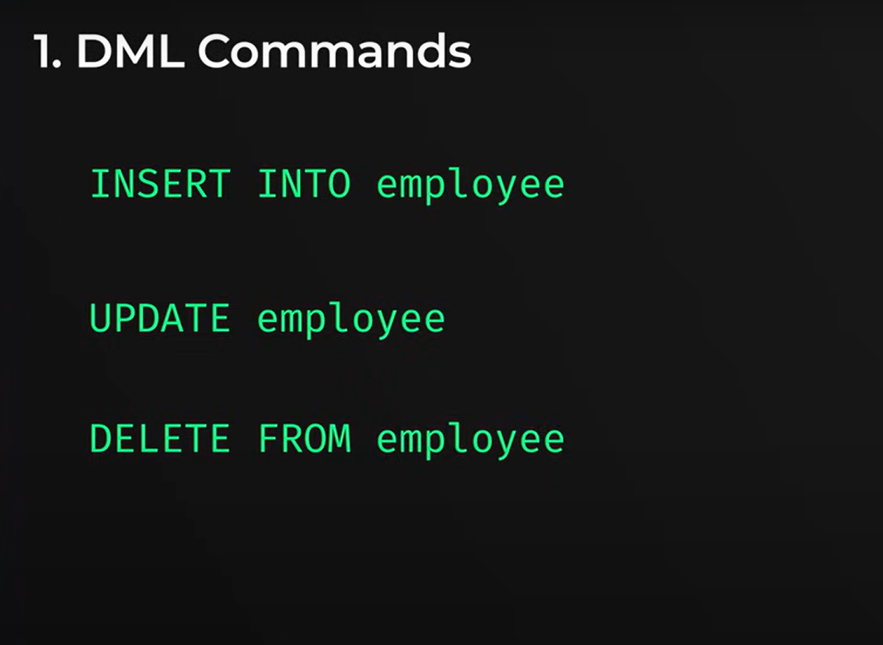

Slide 43
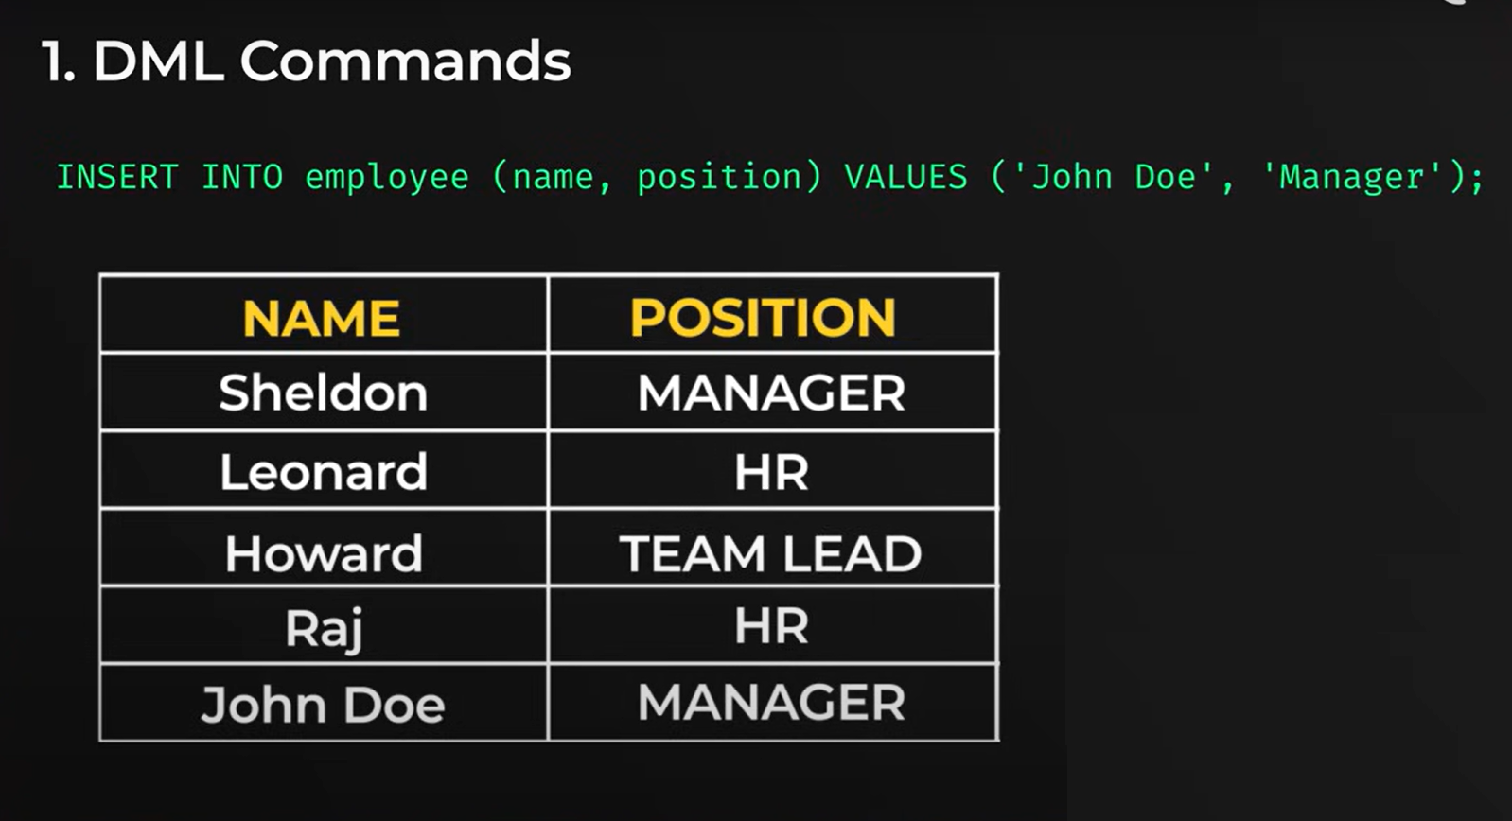

Slide 44


Slide 45


Slide 46


Slide 47


Slide 48
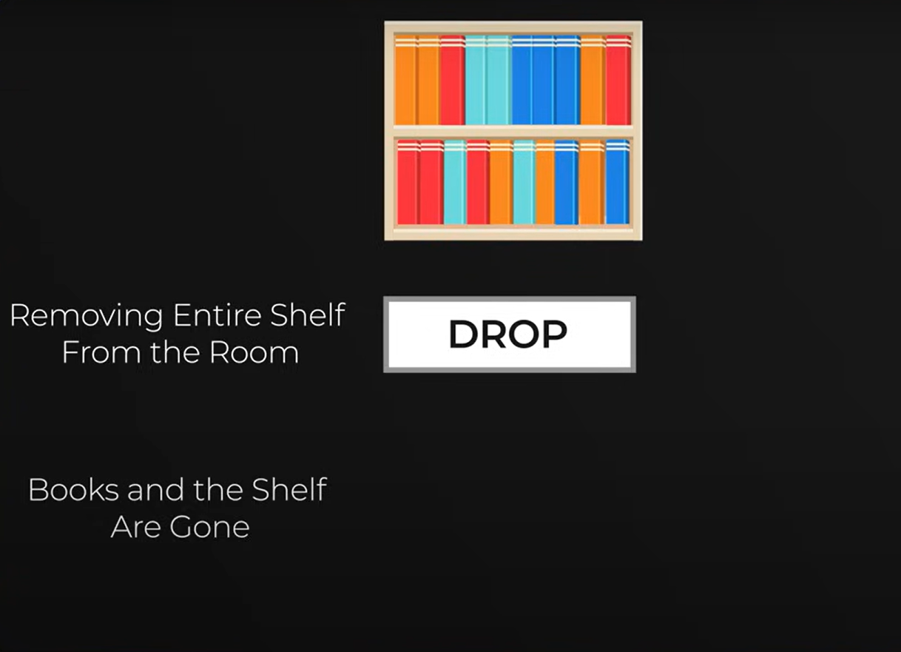

Slide 49
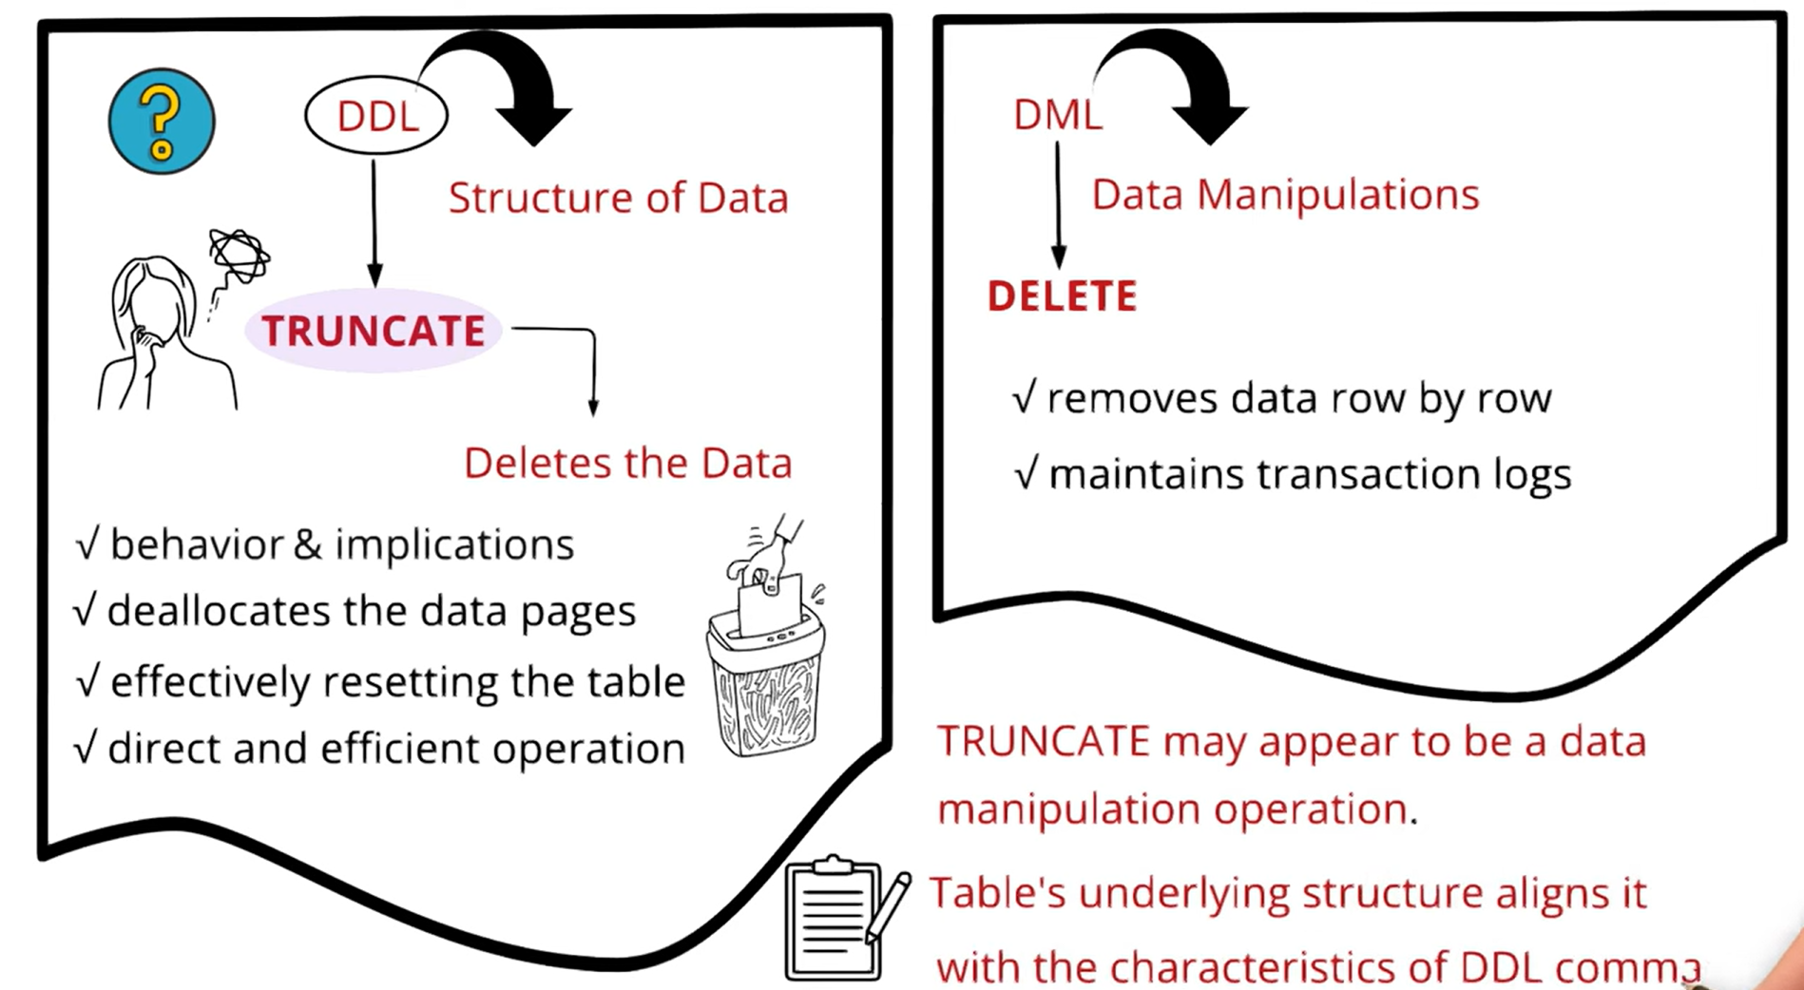

Slide 50
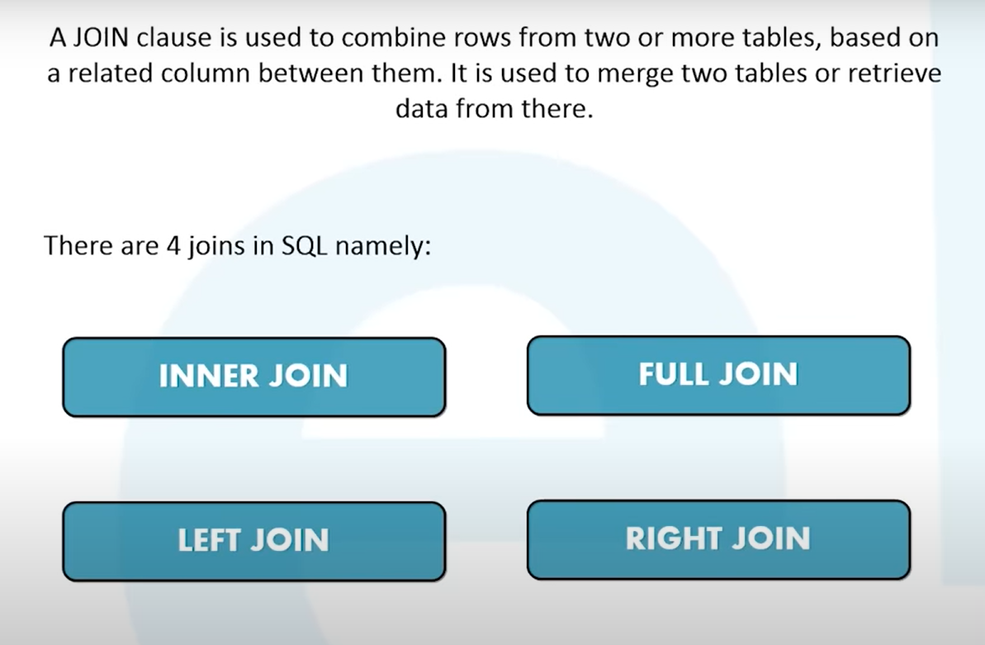

Slide 51
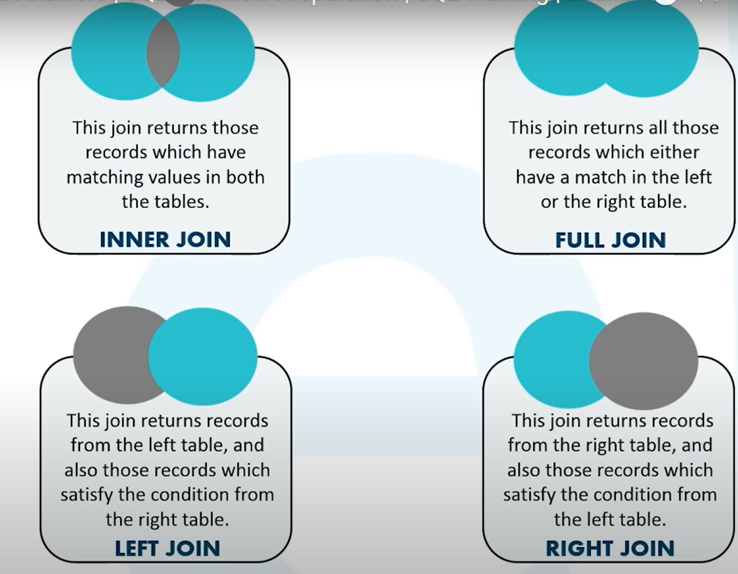

Slide 52
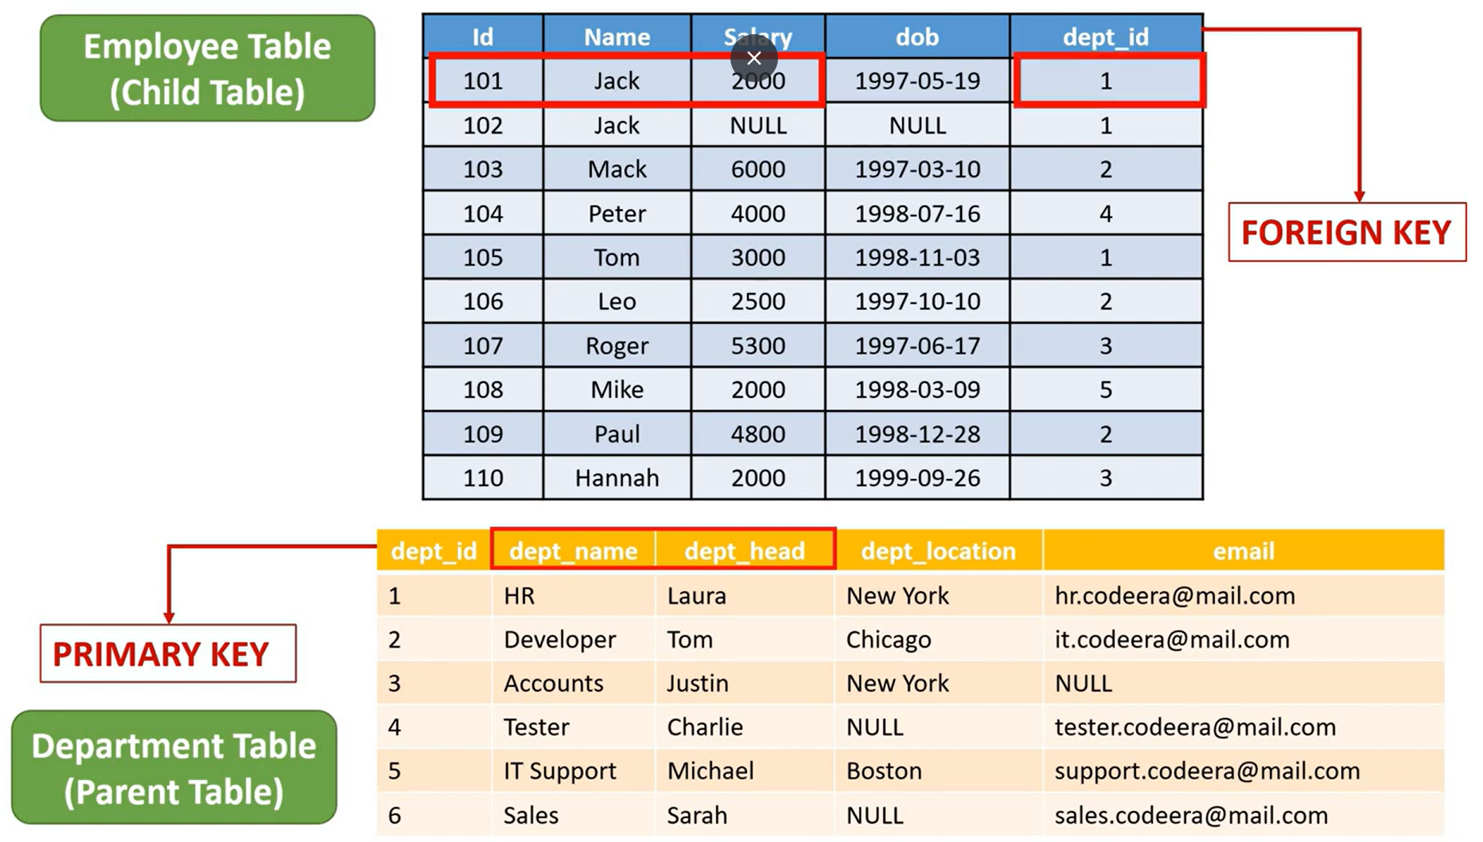

Slide 53
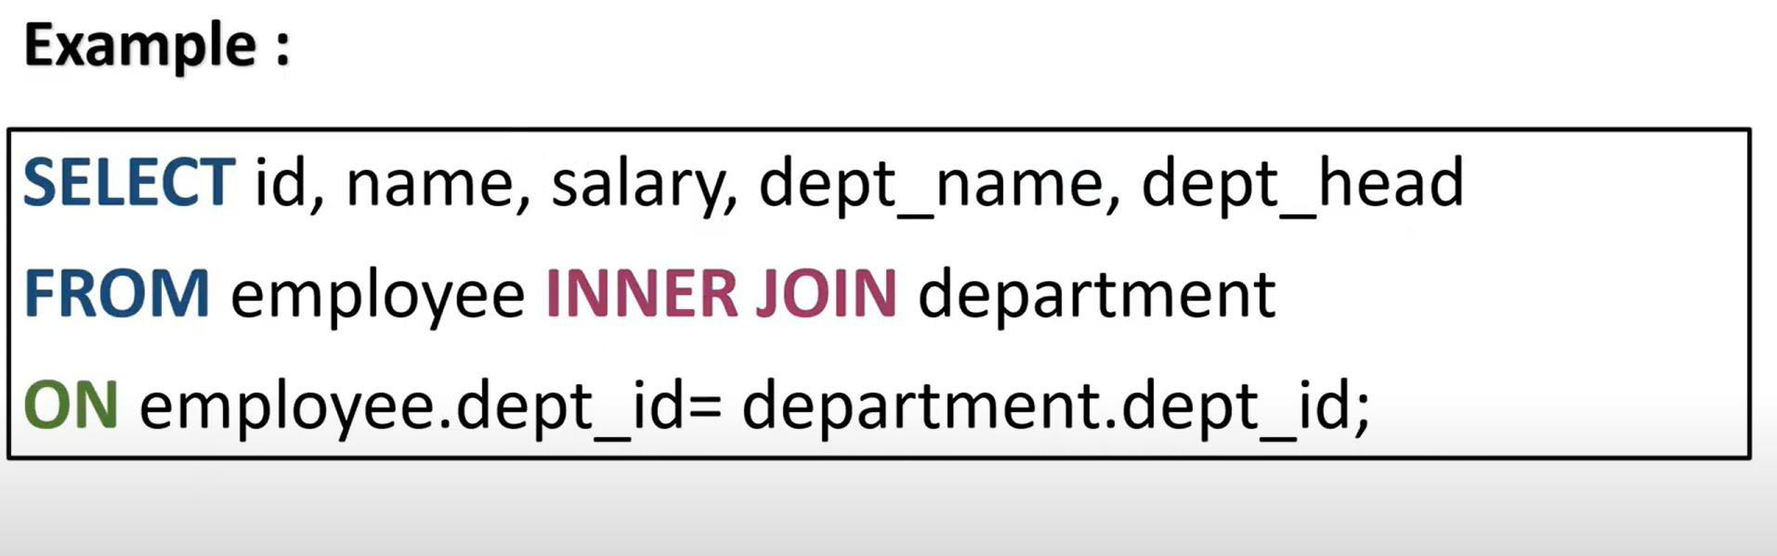

Slide 54
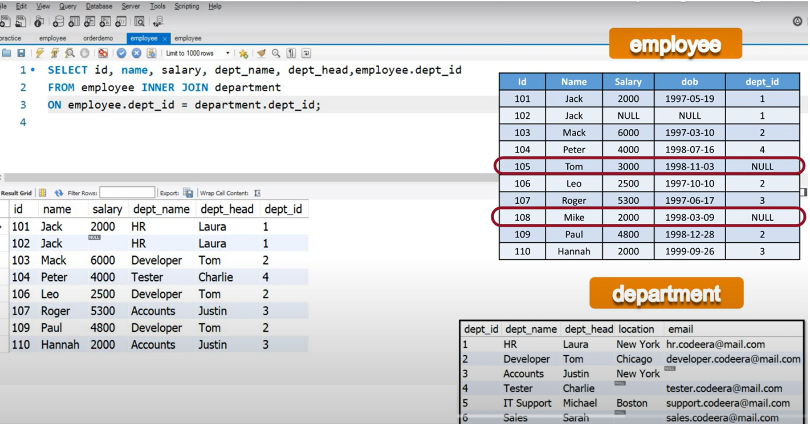

Slide 55
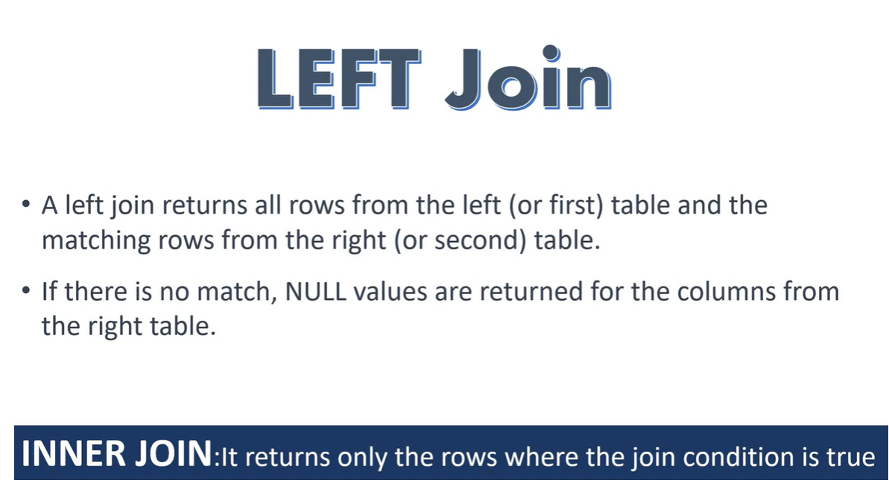

Slide 56
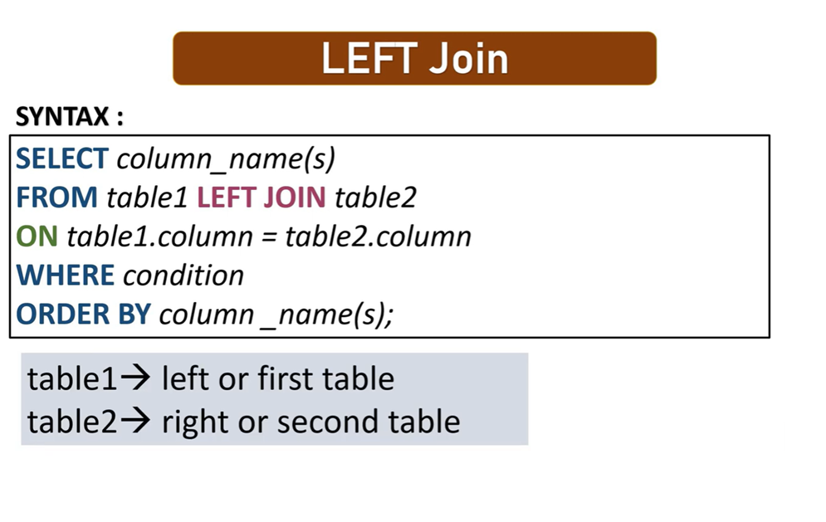
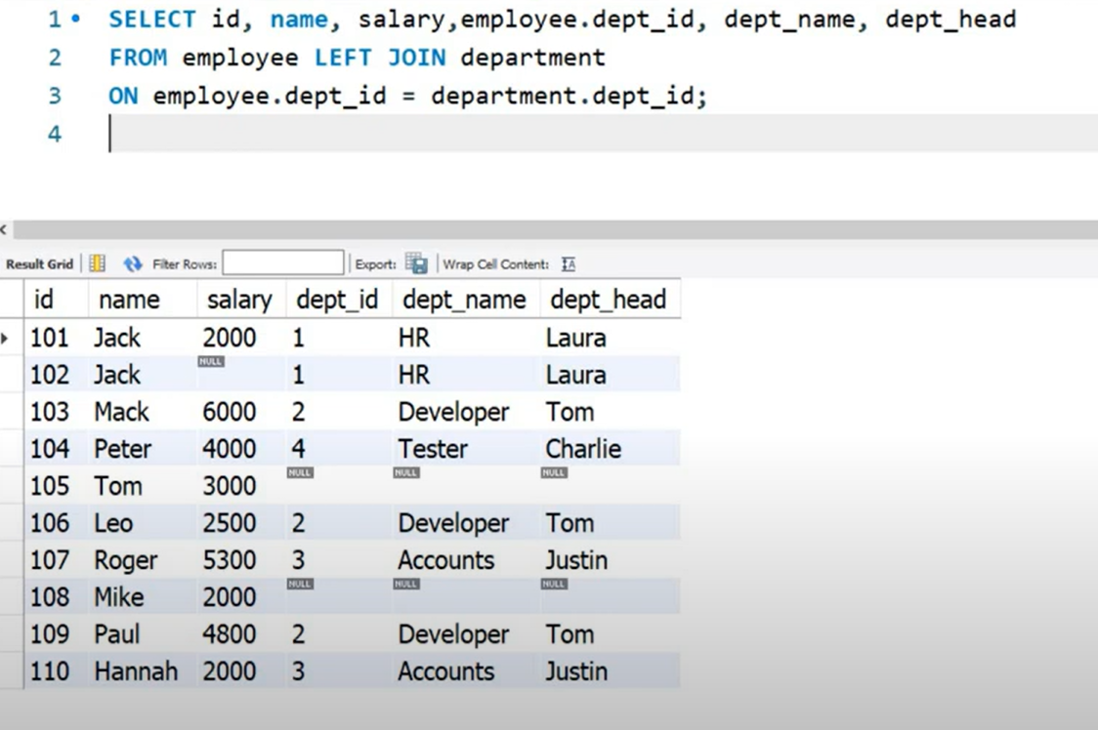

Slide 57
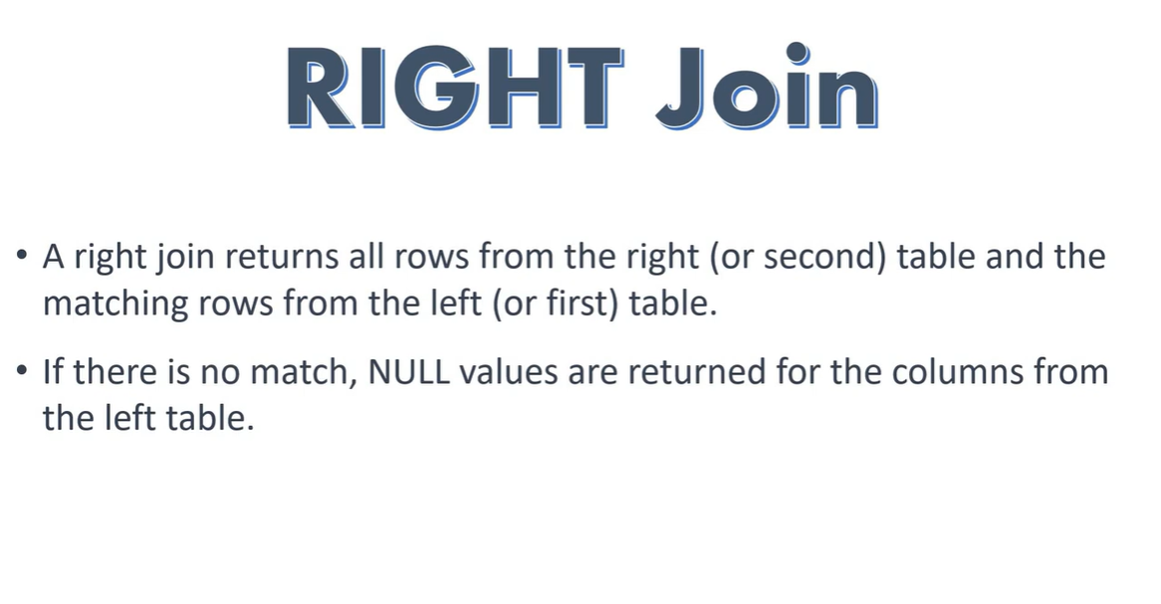

Slide 58
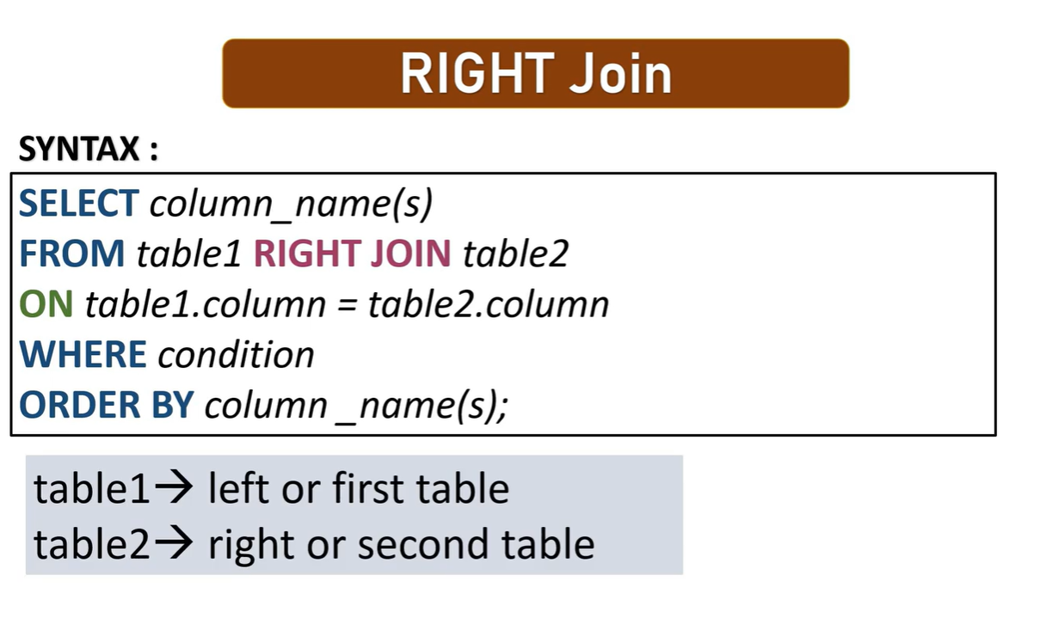
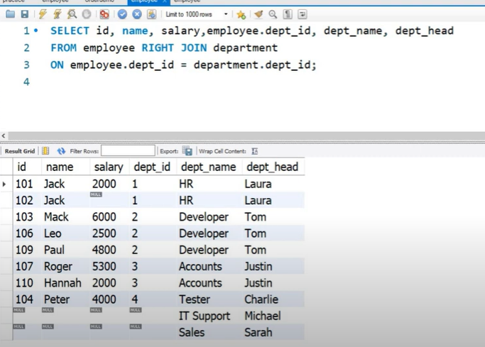

Slide 59


Slide 60
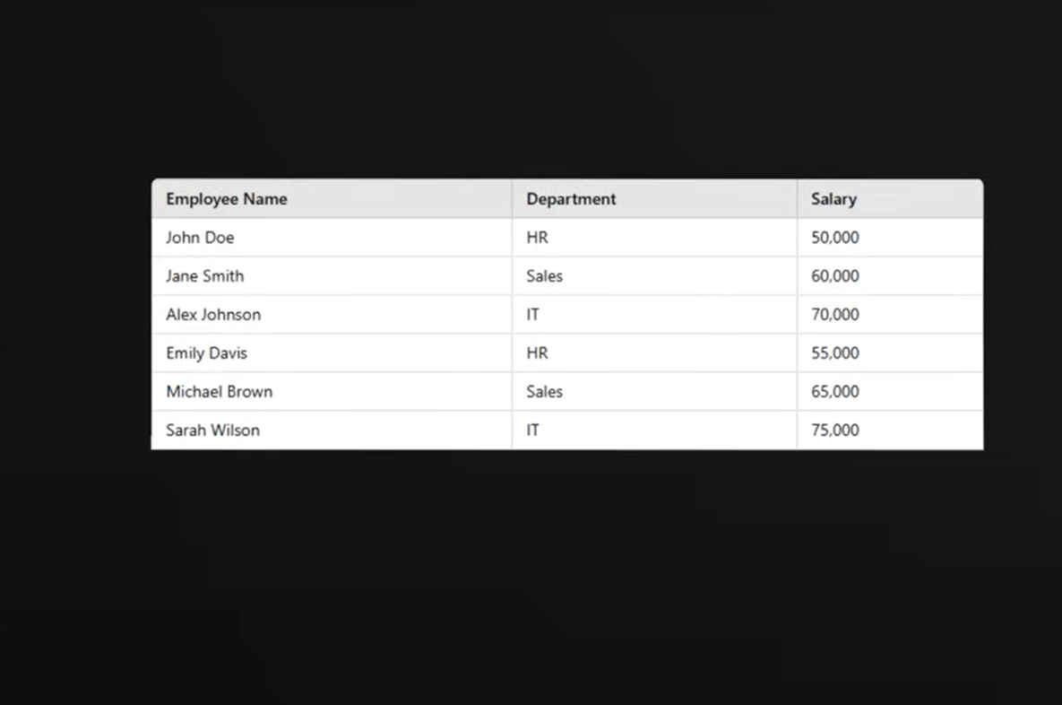

Slide 61
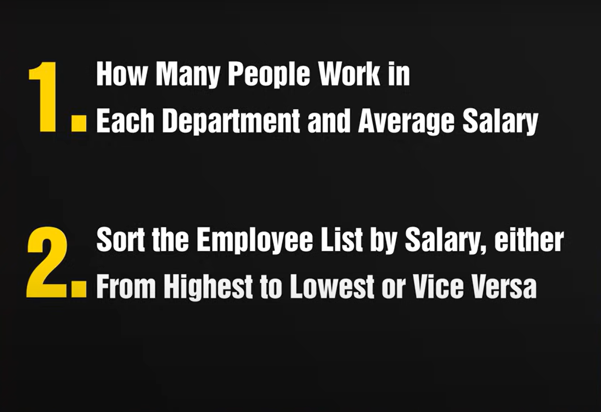

Slide 62
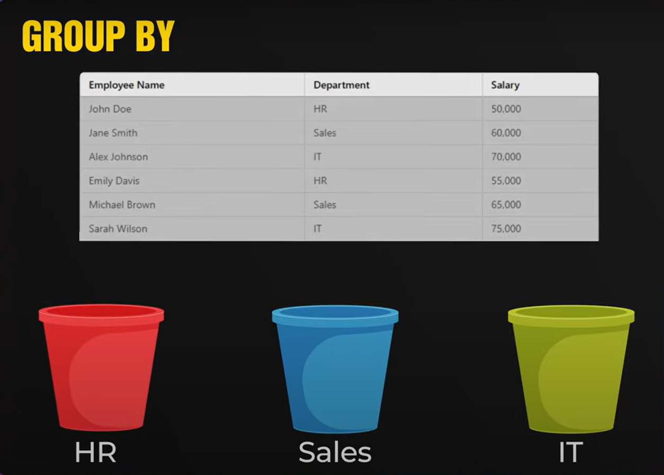

Slide 63
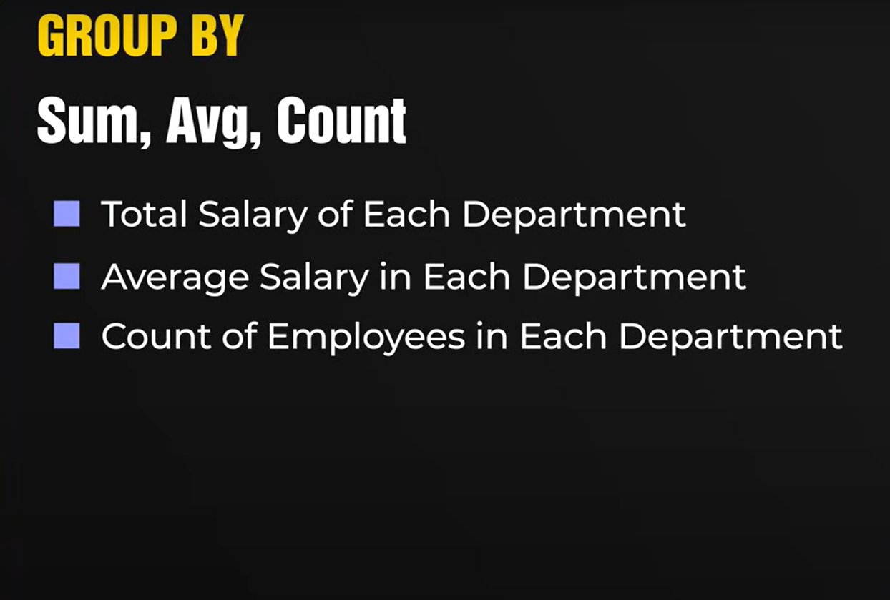

Slide 64
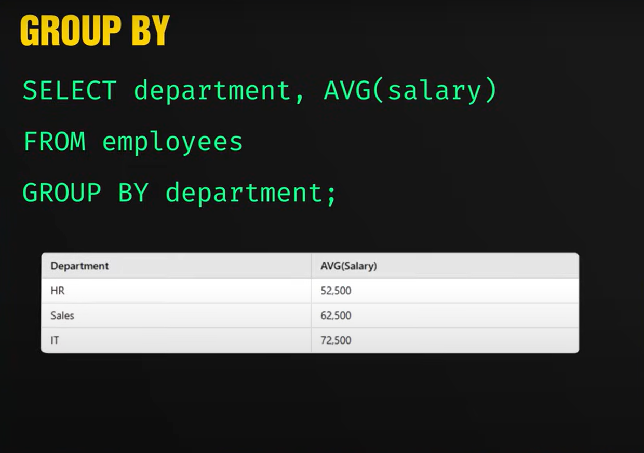

Slide 65
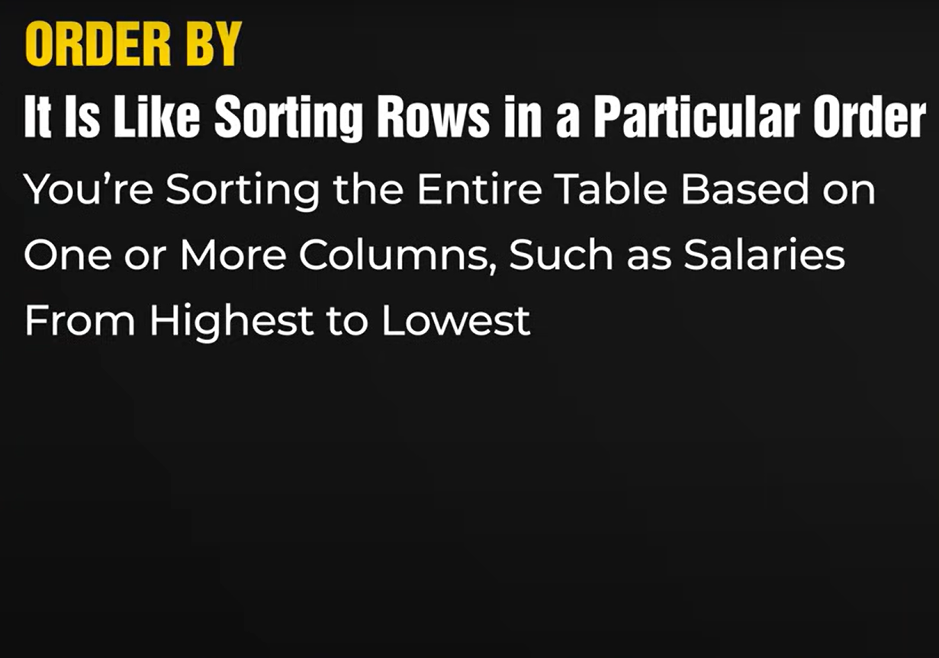

Slide 66
Group By Rules
Every column in SELECT must be:
1) inside an aggregate function (COUNT, SUM, AVG, etc.), or
2) listed in the GROUP BY
WHERE filters before grouping
HAVING filters after grouping
FROM
WHERE ← filters ROWS
GROUP BY ← makes GROUPS
HAVING ← filters GROUPS
SELECT
ORDER BY

Slide 67


Slide 68


Slide 69
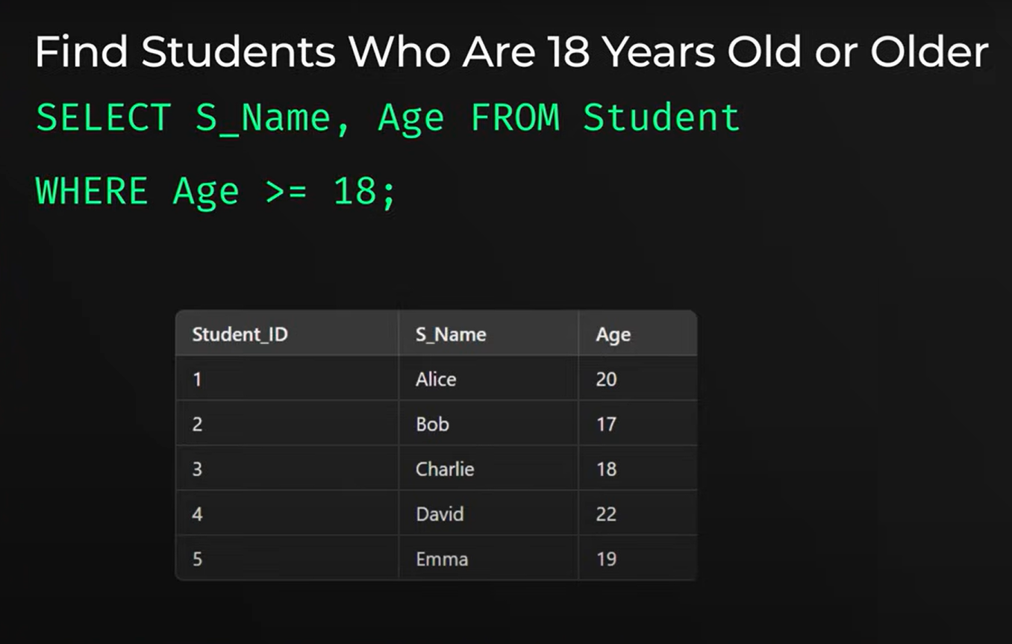

Slide 70


Slide 71


Slide 72


Slide 73


Slide 74


Slide 75


Slide 76


Slide 77


Slide 78


Slide 79


Slide 80


Slide 81


Slide 82


Slide 83


Slide 84


Slide 85


Slide 86


Slide 87


Slide 88


Slide 89



Slide 90


Slide 91



Slide 92


Slide 93


Slide 94


Slide 95


Slide 96


Slide 97


Slide 98


Slide 99



Slide 100


Slide 101


Slide 102


Slide 103


Slide 104


Slide 105



Slide 106


Slide 107


Slide 108


Slide 109


Slide 110


Slide 111


Slide 112


Slide 113


Slide 114


Slide 115


Slide 116


Slide 117


Slide 118


Slide 119


Slide 120


Slide 121


Slide 122


Slide 123


Slide 124


Slide 125


Slide 126


Slide 127


Slide 128


Slide 129


Slide 130


Slide 131


Slide 132


Slide 133


Slide 134


Slide 135


Slide 136


Slide 137
PRACTICE QUESTIONS

Slide 138




Slide 139


Slide 140


Slide 141



Second Day Confirmation

Slide 142



Slide 143


Slide 144



Slide 145


Slide 146


Answer:

Slide 147



Slide 148


Slide 149




Slide 150


Server Utilization Time
Amazon Web Services (AWS) is powered by fleets of servers. Senior management has
requested data-driven solutions to optimize server usage.
Write a query that calculates the total time that the fleet of servers was running.
The output should be in units of full days.
Assumptions:
Each server might start and stop several times.
The total time in which the server fleet is running can be calculated as the sum of each server's uptime.
server_utilization Table:

Slide 151


Slide 152
Second Highest Salary
Imagine you're an HR analyst at a tech company tasked with analyzing employee salaries. Your manager is keen on understanding the pay distribution and asks you to determine the second highest salary among all employees.
It's possible that multiple employees may share the same second highest salary. In case of duplicate, display the salary only once.

Slide 153
Second Highest Salary

Slide 154
Assume you're given a table containing data on Amazon customers and their spending on products in different category, write a query to identify the top two highest-grossing products within each category in the year 2022. The output should include the category, product, and total spend.

Slide 155


