Slide 1
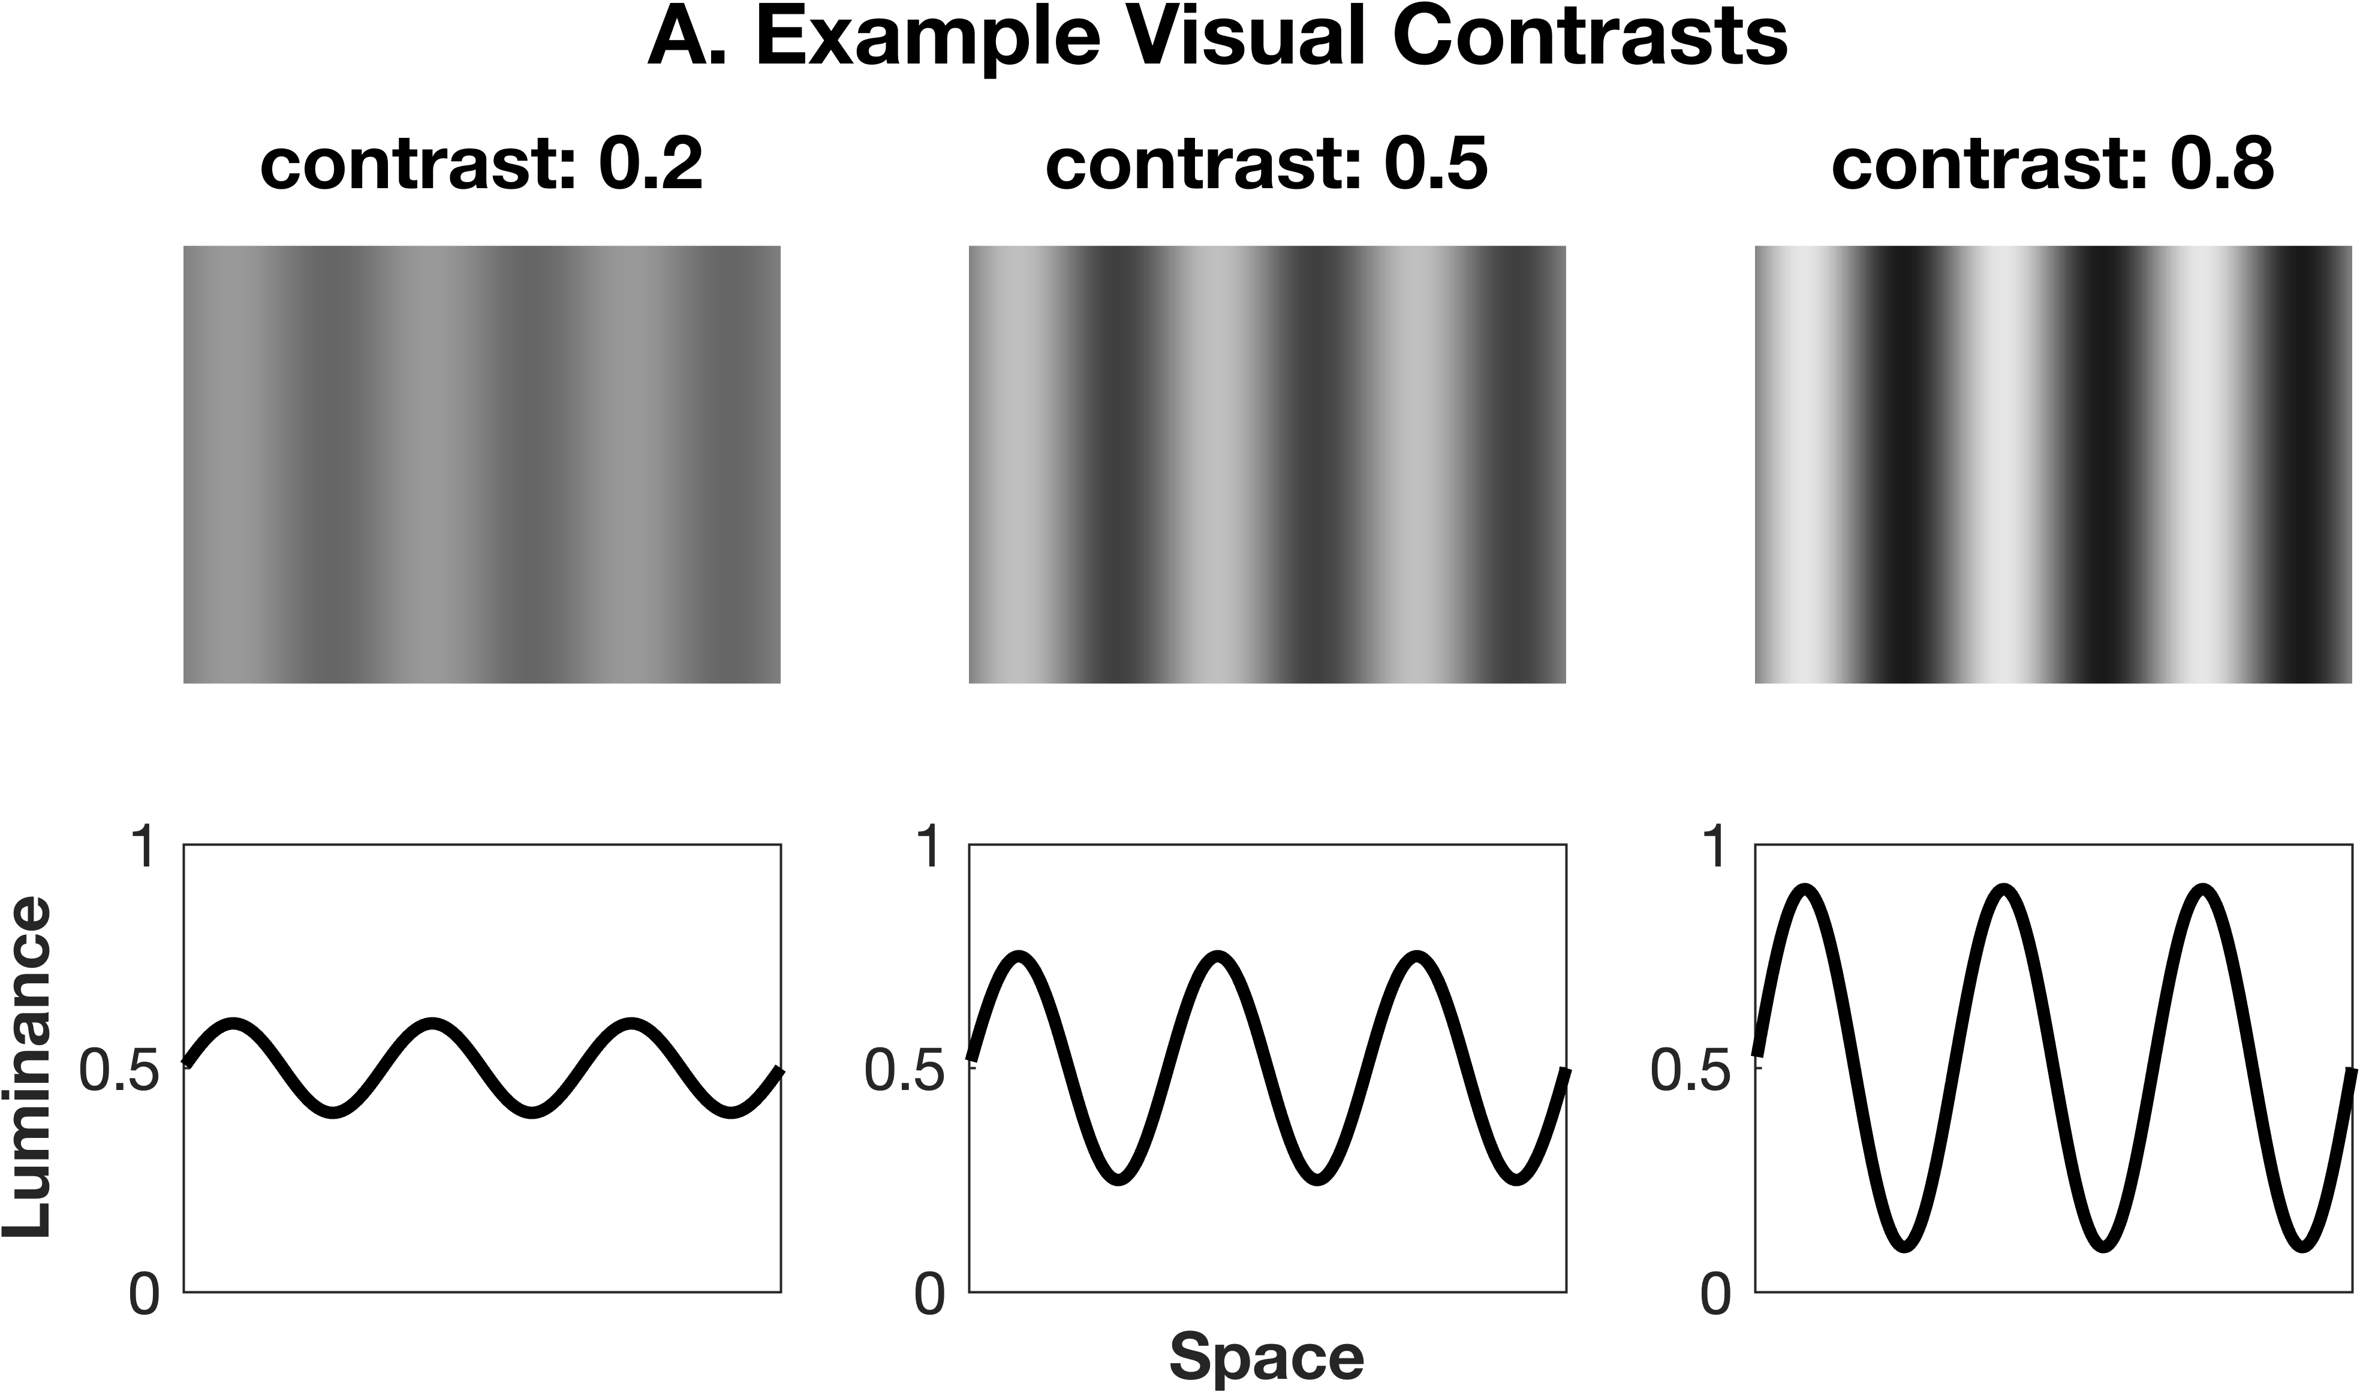
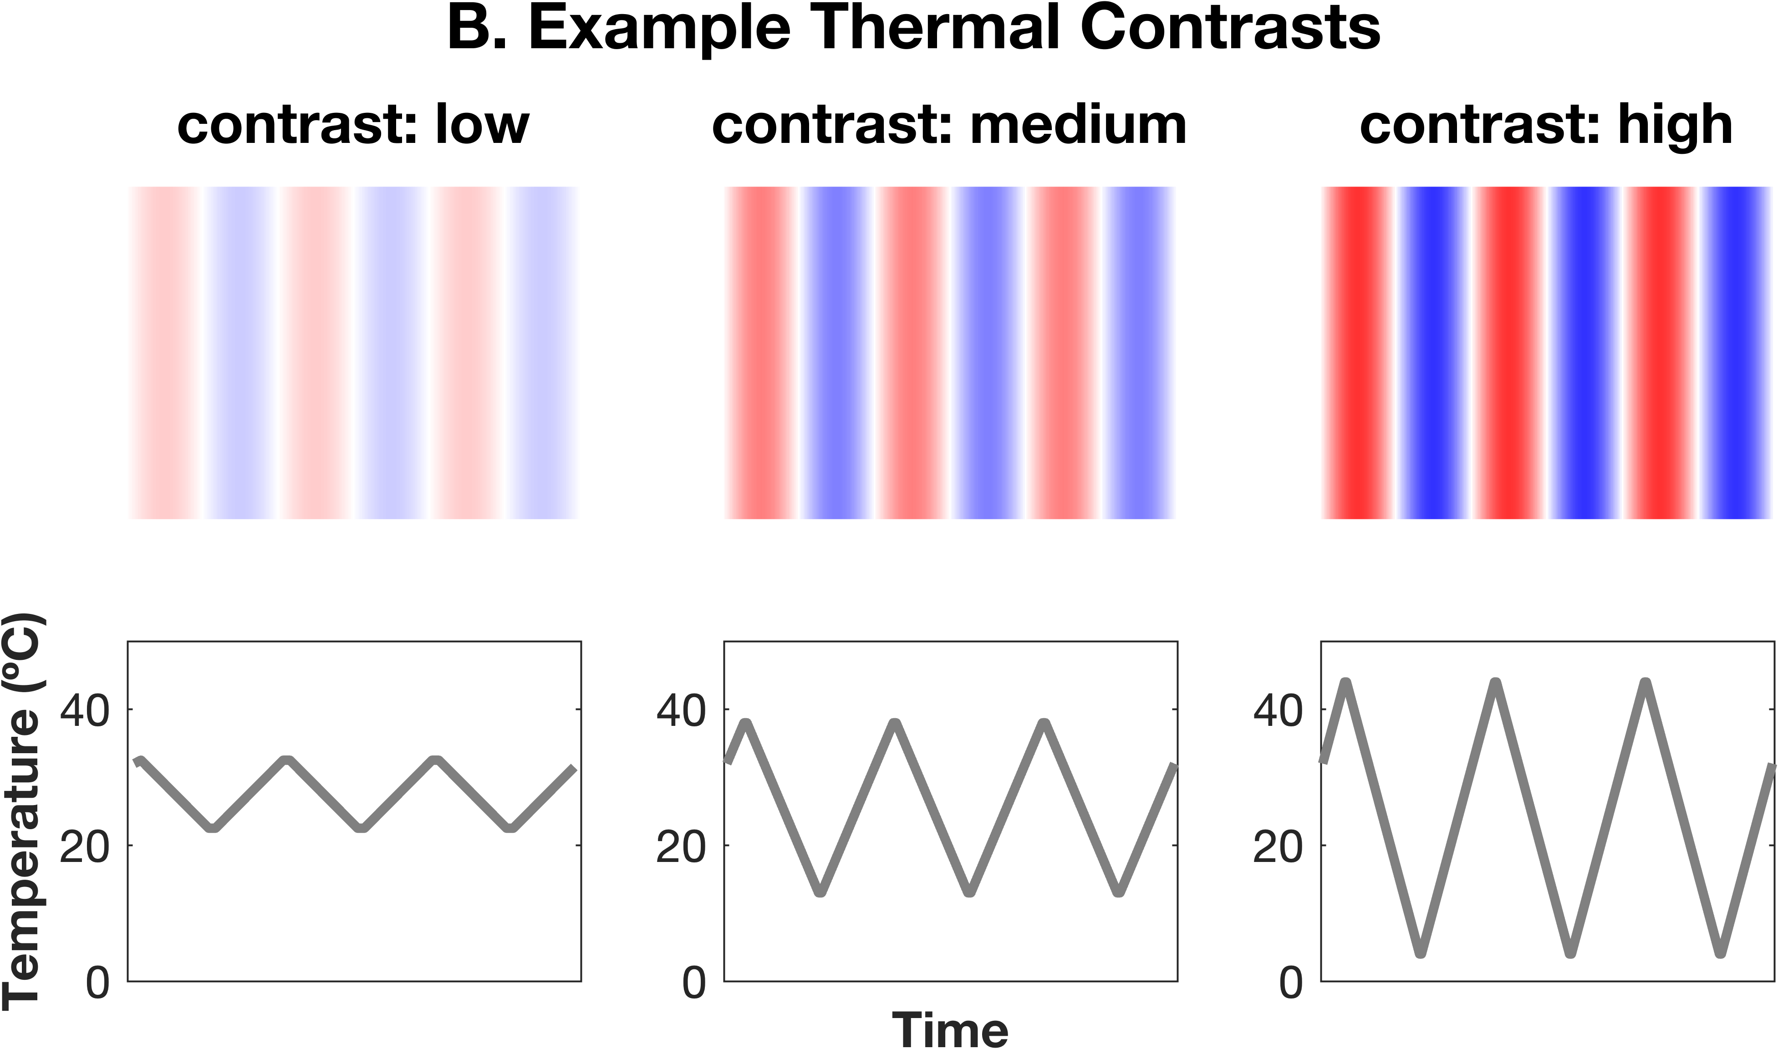
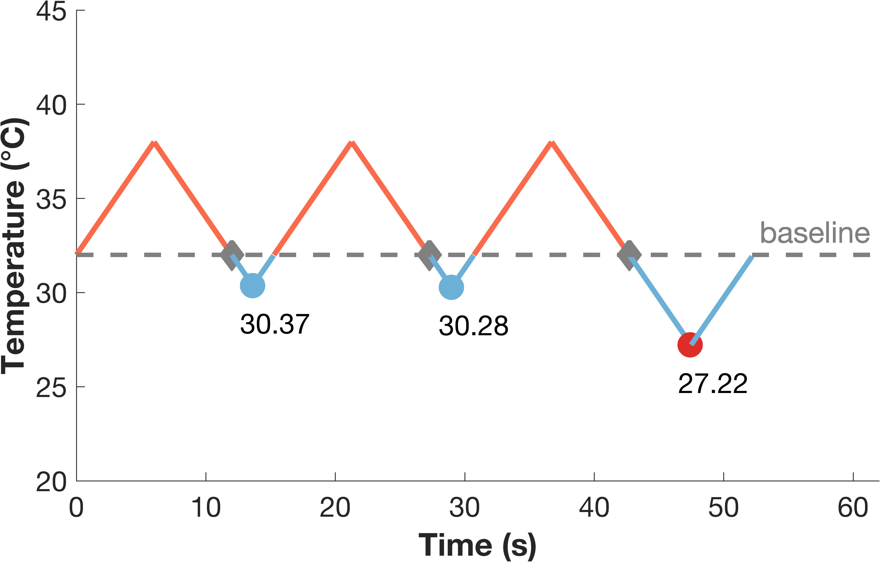

C. Adapted Thermal Sensory Limen Task
button press without PHS
button press with PHS
tone permitting response
$$TCF= \frac{T_{warm} − T_{cold}}{T_{\max{warm }}− T_{\min{cold}}}$$
Notes:
Change size of TSL – longer to fit into height of panel A
Increase font size
Tidy up fonts and organisation etc

