Slide 1
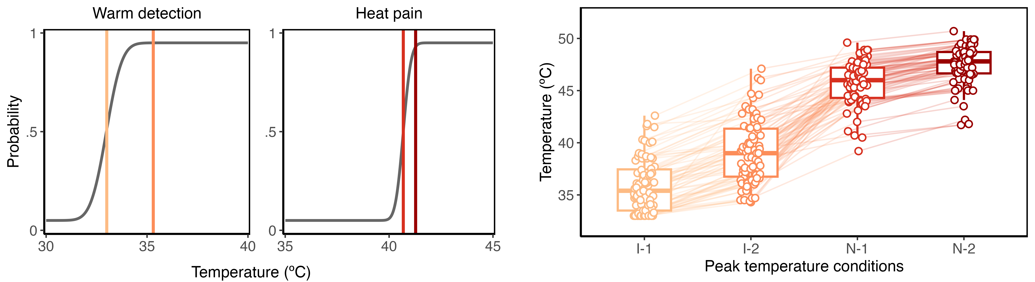
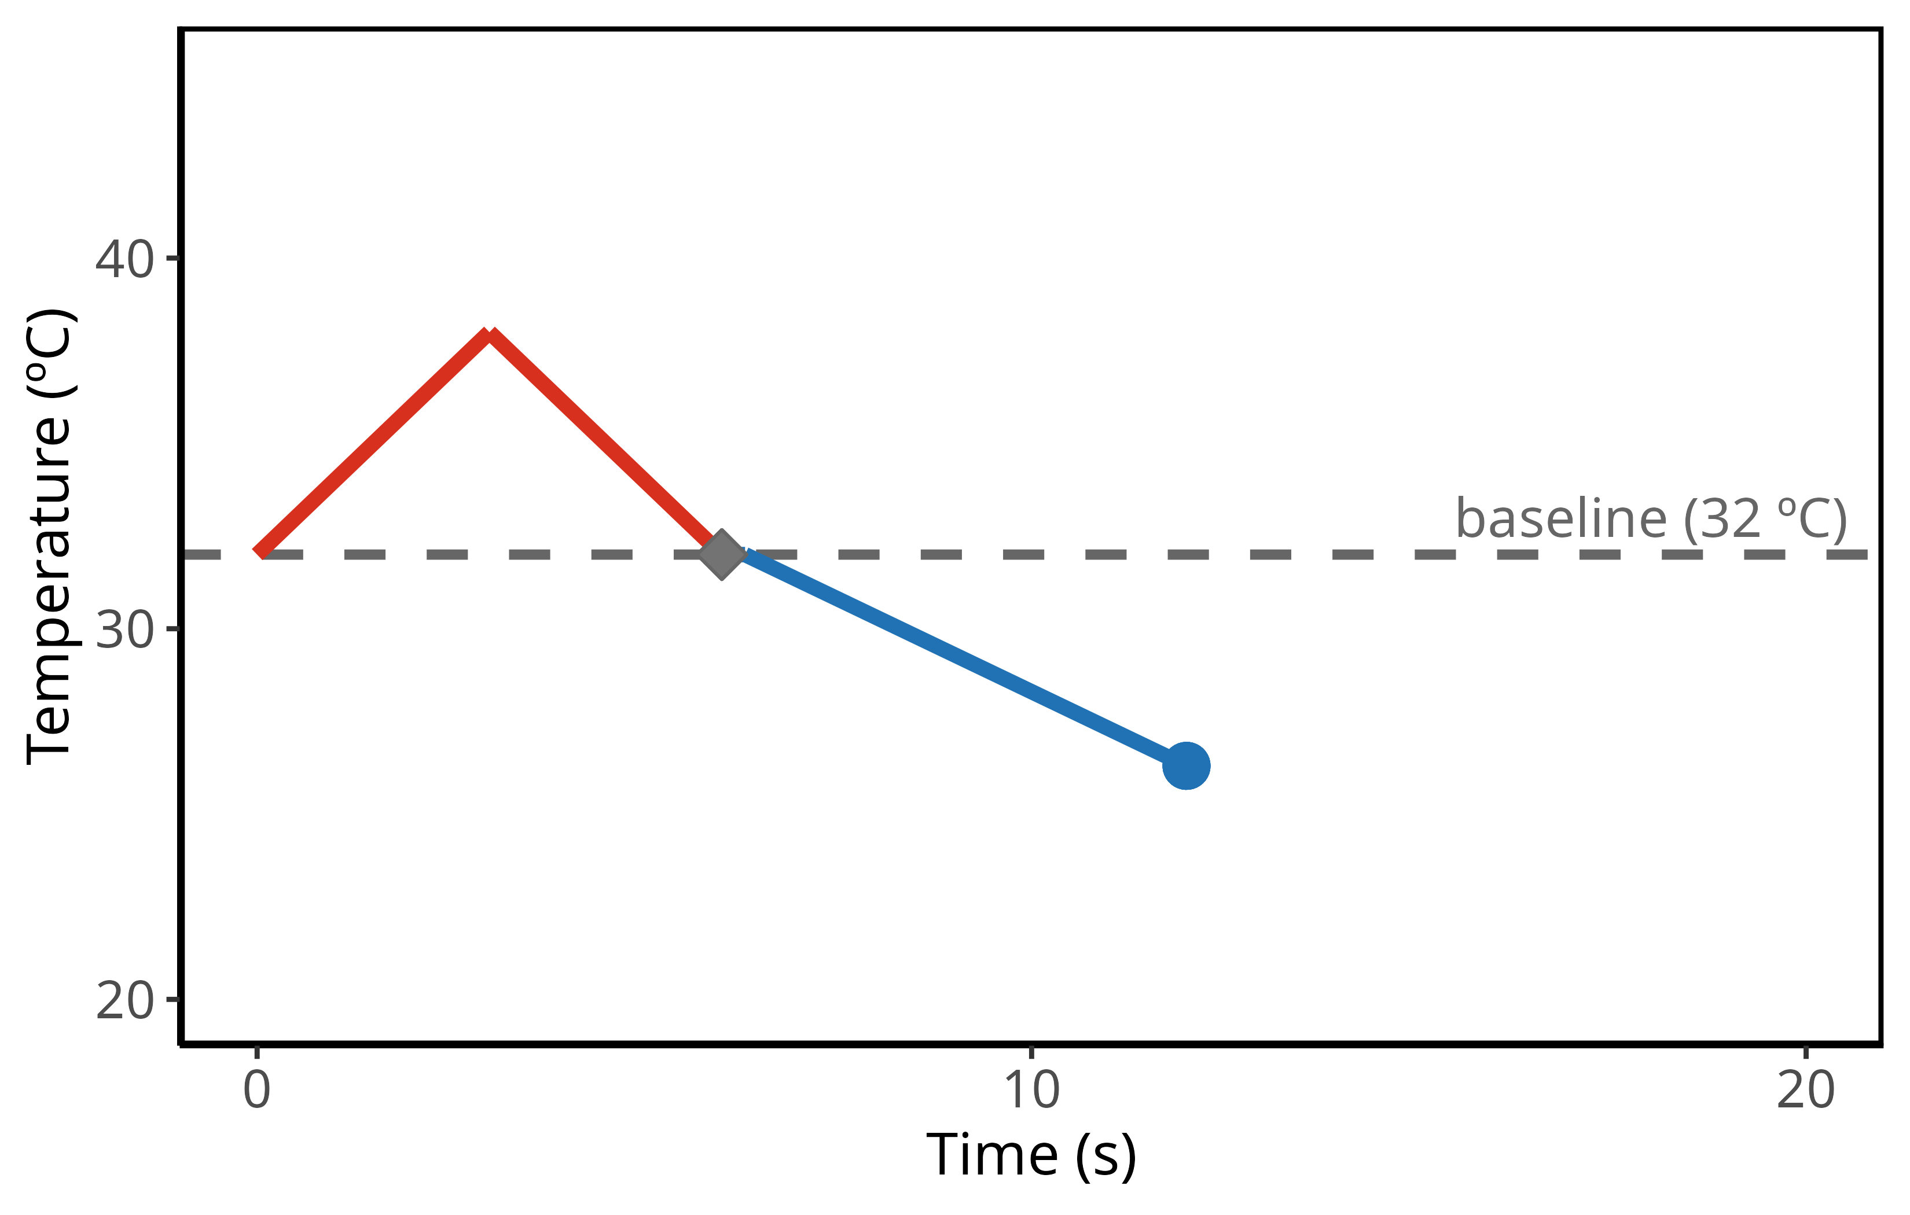
A.
Peak temperature selection
B.
All peak temperatures
I-1
N-1
I-2
N-2
C.
Example stimulation for a single trial
D.
Example trial sequence
tone
Warm stimulus
button press
+
Cool stimulus
Response
<10s
Press ‘up’ when you perceive a change in sensation
Which temperature did you feel?
Confidence
<10s
TC
Time
cold
warm
How confident are you in your reported sensation?
Guess
Certain

