Slide 1
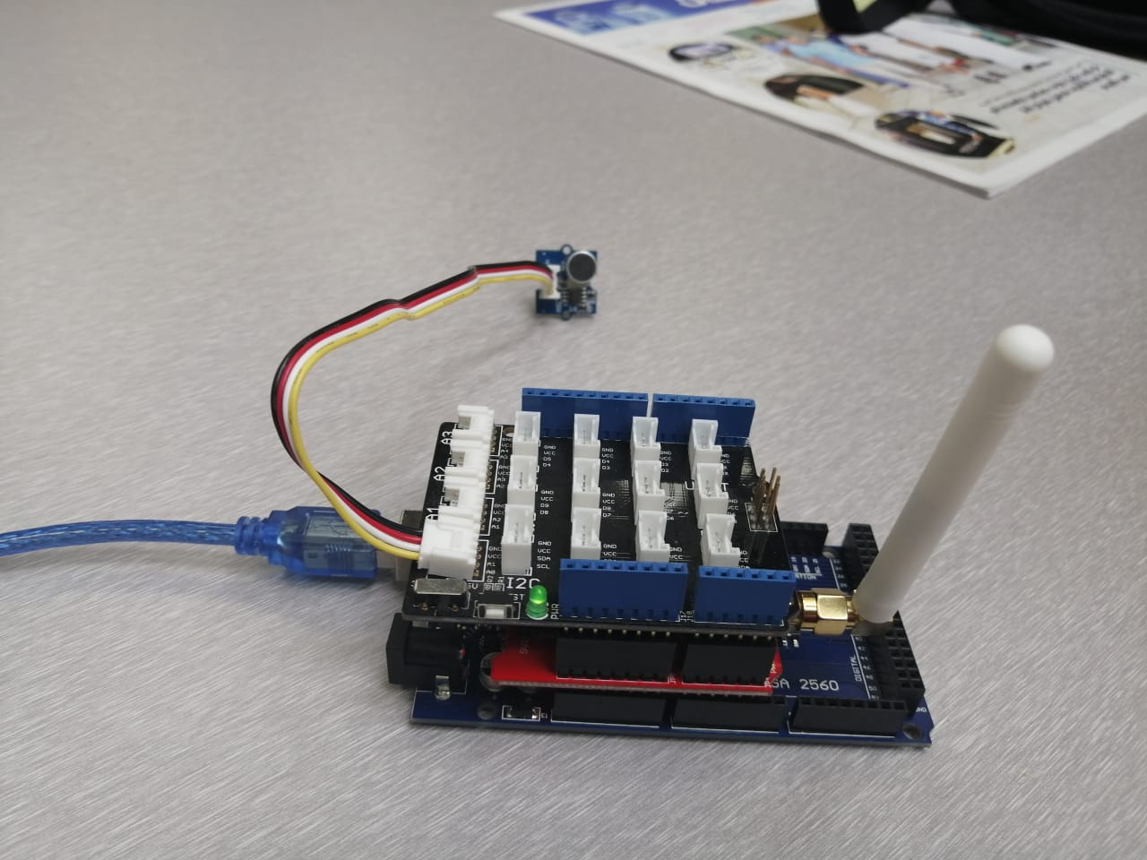
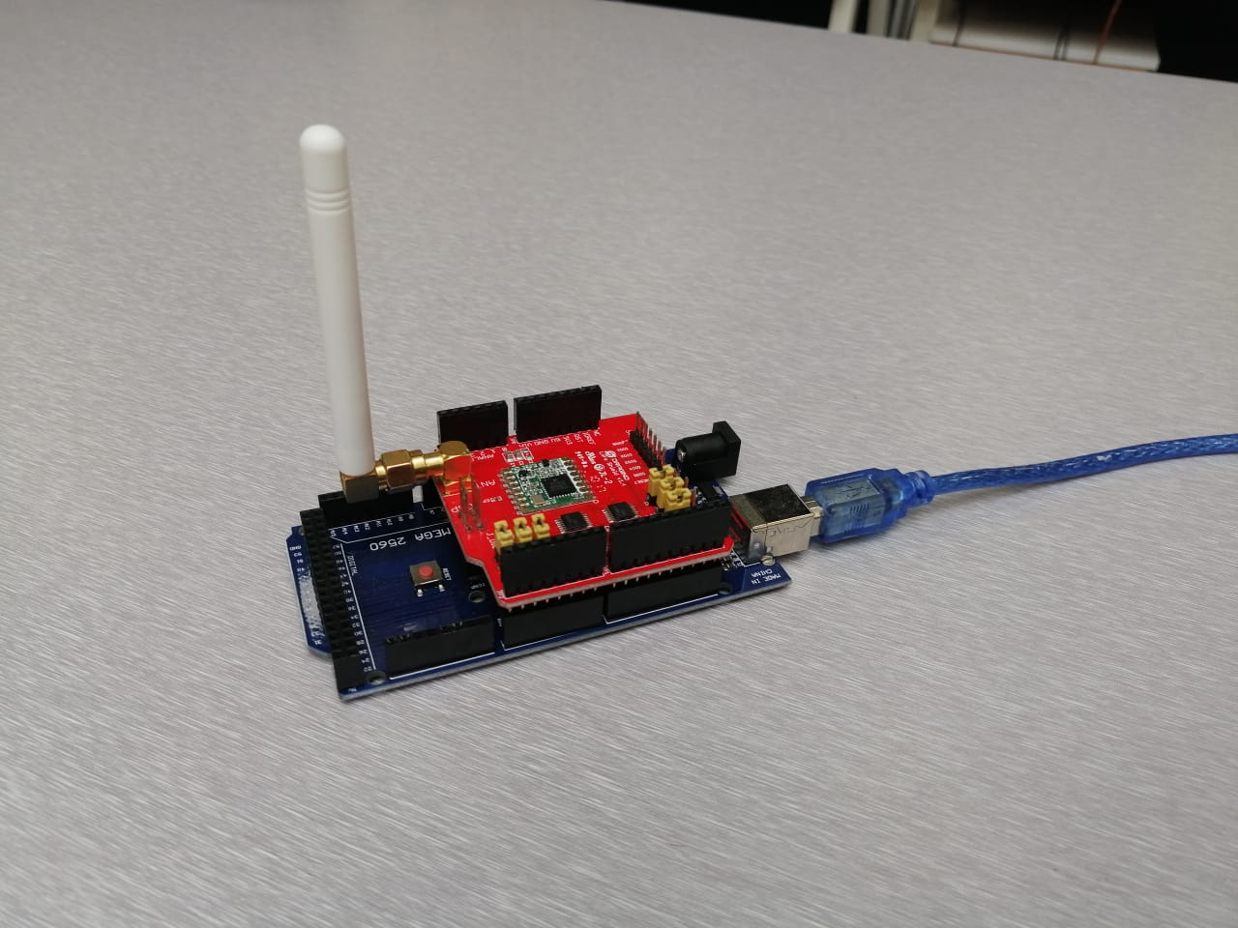
Sound Sensor Application Overview
Abdulrahman Elsharqawi
Abdulrahman Alfayez

Slide 2
Hardware Overview
• 2x Arduino Mega
• 2x USB Cable
• Sound Sensor
• 2x LoRa Shield
• Base Shield

Slide 3
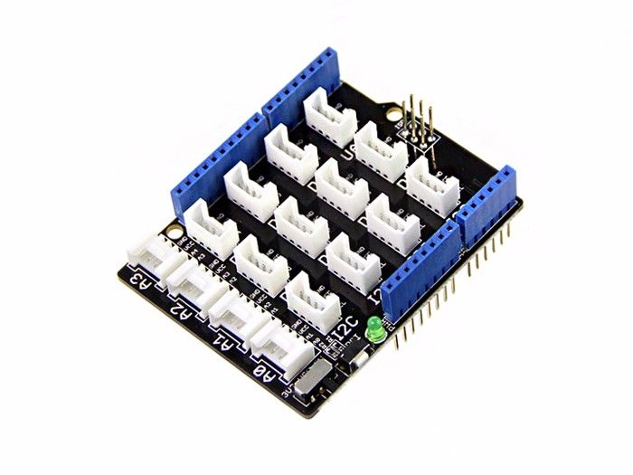
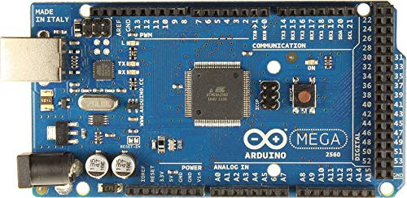
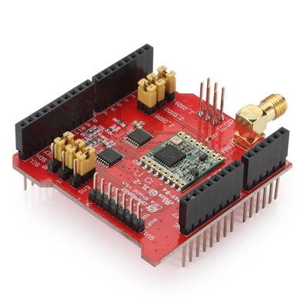
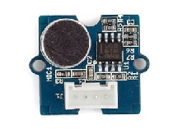
Hardware Overview
Arduino Mega
Base Shield
LoRa Shield
Sound Sensor

Slide 4
Technologies Used
LoRa Protocol: which is implemented using the LoRa Shield. This allows you to send packets to very far distance (sometimes up to 10 KM).
Client-Server model: To transfer data from Arduino board to another.
Sound sensing: Via sound sensor, so we can collect sound values and deal with it.
JSON manipulation: by generating JSON objects and send them to the server

Slide 5
LoRa Sender Overview
• LoRa
◦ A library created to be fully utilise all the features of LoRa hardware.
• ArduinoJson
◦ It’s used to generate JSON objects in a simple way such that serialization is streamlined.
• Time
◦ A library for tracking and utilising a wide array of time functions.

Slide 6
LoRa Reciver Overview
Both sender and receiver are taken from this LINK, but receiver is ready to use and does not need any changes.

Slide 7
Handler Code Overview
Written in Python.
The code uses the following libraries:
Serial: to handle the serial port and correctly read data from Arduino.
Csv: to generate csv files and fill it with data.
Datetime: to show date and time info.
Matplotlib: to show figures in a separated window.
Numpy: to deal with scientific calculations.
Json: to create and parse JSON objects
Os, sys: to handle exceptions

