Slide 1





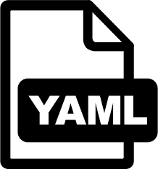

code versioning
data versioning data pipelines
flexible structure
and templates
pre-commit
linting
config management
flexible reporting

Slide 2

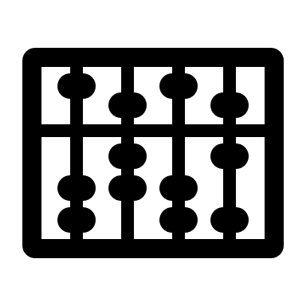
Data Storage
GIT
local
file
checksum
.dvc file
Notes:
DVC is a version control system for data-driven projects
It makes projects reproducible by tracking changes in input data (e.g. samplesheets, cgetd config files, cget output...) or parameters (e.g. qc cutoffs, p-value thresholds, ..)
Integrated into dso
DVC identifies when stage dependencies or parameters change -> will reproduce that stage
ensures all output is up-to-date
DVC works seamlessly with Git, allowing for effective collaboration and version control of data and scripts

Slide 3


Data Storage
GIT
output file
checksum
.dvc file
recipe
dvc.yaml
input file
checksum
.dvc file
parameters
Notes:
DVC is a version control system for data-driven projects
It makes projects reproducible by tracking changes in input data (e.g. samplesheets, cgetd config files, cget output...) or parameters (e.g. qc cutoffs, p-value thresholds, ..)
Integrated into dso
DVC identifies when stage dependencies or parameters change -> will reproduce that stage
ensures all output is up-to-date
DVC works seamlessly with Git, allowing for effective collaboration and version control of data and scripts

Slide 4

!path relative path
→ live demo
config management
“single point of truth or change”
project
folder
stage
params.in.yaml
params.in.yaml
params.in.yaml
params.yaml
params.yaml
params.yaml
Notes:
Why: limiting the number of changes needed within your code/scripts/configuration files
single point of truth – reducing redundancies
some information is only locally needed, some globally
Parameters and Dependencies are defined in params.in.yaml
Will be written into params.yaml using dso compile-config
Params.yaml files contain dependencies and parameters from parent params.in.yaml files
Overwriting of parameters possible

