Slide 1
Java 8 Optionals with XTend
Max Bureck, ??. Month 2015

Slide 2
Java 8 Optionals with XTend
What are Optionals?
Can syntax be improved for usage in Xtend?
What is missing in Java Optionals and can we complement?
How can we further improve using Optionals, and where can we use them?
Where are the limits of what is possible with plain Xtend?

Slide 3
Java 8 Optionals with XTend
What is Optional<T>
Represent a value that may or may not be present
How is this different from reference that may be null ?
Null oftentimes leads to NullPointerExceptions, so can be considered unsafe
Null is not available for primitive values
Boxed primitives have same NullPointerException problems
Downside: One more object per reference (memory), more „pointer chasing“ (locality, speed). At least until Java introduces value types
Notes:
Basically Box hodlding 0 or 1 value of T
Usage: Often return value of method if result not available / existing

Slide 4
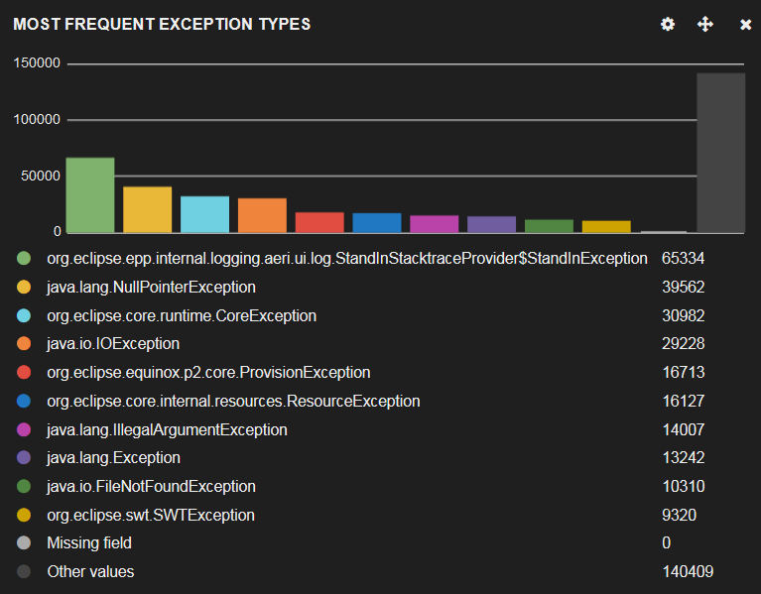
Java 8 Optionals with XTend
Motivation: NPE is Extremely Common
Statistics from Eclipse Mars Error Reporting (2015-06-25 until 2015-08-10) *⁾
*⁾ https://dev.eclipse.org/recommenders/committers/dashboard/#/dashboard/file/reports.json

Slide 5
Java 8 Optionals with XTend
Optional<T> API (extract)
Creation public static <T> Optional<T> ofNullable(T value) public static<T> Optional<T> empty()
Query public boolean isPresent()
Value access public T get() throws NoSuchElementException public T orElse(T other) public void ifPresent(Consumer<? super T> consumer)
Transformation public<U> Optional<U> map(Function<? super T, ? extends U> mapper) public Optional<T> filter(Predicate<? super T> predicate)
There are versions for primitives int, long and double

Slide 6
Java 8 Optionals with XTend
Xtendify!
General Questions:
Can we improve Optional with Xtend?
Can we use Optional better with Xtend?
All functionality shown in the following is part of the „Optionals for Xtend“ library, that will be open sourced soon.
Some functionality is still work-in-progress

Slide 7
Java 8 Optionals with XTend
Rule: Keep most used functions as concise as possible
What are most used functions for Optionals?
No data available, CodeRecommenders provides no ranking
Guessed from personal usage:
Factory methods
Call Optional#ifPresent to do something with value
Optional#orElse / Optional#orElseGet to get value or default value
If-then-else with Optional#isPresent and Optional#get
Notes:
maybe, some, none, noXXX
orElse
Use with, Use with pair

Slide 8
Java 8 Optionals with XTend
Can We Make These Functions More Consise with Xtend?
What features does Xtend provide that can help?
Operator overloading with extension functions
Static factory functions with more speaking names
Notes:
Problems: empty can be ambigous
Function of is not very speaking

Slide 9
Java 8 Optionals with XTend
More concise syntax
DEMO

Slide 10
Java 8 Optionals with XTend
Consise Syntax for Factory Methods
Factory functions are long to write ( especially Optional.ofNullable(val) )
Statically imported methods named “empty” clash
Statically imported methods named ”of“ are not very meaningful
What are terms in other languages?
Scala: case class Option, subclasses Some and None
Haskell: algebraic type data Maybe a = Just a | Nothing
Identifiers “some” and “none” are concise → used as alias for “of” and “empty”
Identifier “none” would still clash, so primitive noInt, noLong, noDouble
Introduced “maybe” as alias for “ofNullable”

Slide 11
Java 8 Optionals with XTend
Consise Syntax for Factory Methods: Examples
val str = some("foo") // => Optional.of("foo") val ns = none // => Optional.empty()
val ms = maybe(getString()) // => Optional.ofNullable(getString())
val i = some(42) // => OptionalInt.of(42)
val j = noInt // => OptionalInt.empty()

Slide 12
Java 8 Optionals with XTend
Filtering an value on post-condition
Function returning a value only if a condition holds
def Optional<String> normalize(String s) {
s.trim.toLowerCase.onlyIf [length > 3]
}

Slide 13
Java 8 Optionals with XTend
Concise Optional#ifPresent
Introduced >> operator to extract value from Optional
Also used to extract values from Pair of Optionals or Optional of Pair
some("foo") >> [
println(length)
]
(some("foo") -> some("bar")) >> [a, b |
println(a + b)
]
some("foo").zip(some("bar")) >> [a, b |
println(a + b)
]

Slide 14
Java 8 Optionals with XTend
Internal DSL for If Present – then – else
Uses lambdas with Java default methods to look like language construct
getOptional() => ifPresent [
println(it)
].elseDo [
println("awww")
]

Slide 15
Java 8 Optionals with XTend
Concise Optional#orElse
Introduced ?: operator as alias for Optional#orElse / Optional#orElseGet
val len = some("wee").map[length] ?: 0
val display = maybe(fetchName()) ?: [fetchUserNick()]

Slide 16
Java 8 Optionals with XTend
Summary: Concise Syntax
Creation by
maybe / some / none / no<Primitive> / onlyIf
ifPresent shortcut: „extract operator“ >> for
Single and
Pair of Optionals
ifPresent – elseDo syntax
orElse / orElseGet shortcut by „elvis operator“ ?:

Slide 17
Java 8 Optionals with XTend
What is Missing in Java 8 Optionals?
Primitive optionals do not have map and filter functions
No map to primitive optional (only map to boxed version)
Can we Add Missing Functions in Xtend?
What features does Xtend provide that can help?
Extension methods

Slide 18
Java 8 Optionals with XTend
Provided Extensions
Added mapping/filter functions
All optionals now have map / mapInt / mapLong / mapDouble methods
All optionals now have filter method
Filter by type for Optional
some("foo").mapInt[length]
some(42).filter[it>0]

Slide 19
Java 8 Optionals with XTend
Additional Stuff
Looping over Optional<? extends IntegerRange>
some(5..10).forEachInt [num, index|
println(index + ": "+ num)
]

Slide 20
Java 8 Optionals with XTend
Additional Stuff
Collecting element with java.util.stream.Collector val list = some("hui") >>> Collectors.toList
“or operator” || between Optionals (take the first non-empty optional, or empty) none || some("foo") || some("bar") // => some("foo") none || none // => none
Fun fact: With extensions optional is now an additive monad and idempotent monoid*
*⁾ according to Wikipedia: https://en.wikipedia.org/wiki/Option_type

Slide 21
Java 8 Optionals with XTend
Optionals Use Case
Exceptions to Optionals val boo = [|somethingDangerous()].doCatch
val foo = [|somethingDangerous()].doCatch [
printStackTrace
]

Slide 22
Java 8 Optionals with XTend
Optionals Use Case
Exceptions to Optionals val baz = trySupply [
somethingDangerous()
].doRecover(NumberFormatException) [
"bar"
].doCatch(UnsupportedOperationException) [
printStackTrace
].doCatch [
System.err.println("Something is seriously wrong")
printStackTrace
].eval

Slide 23

Java 8 Optionals with XTend
More?

Slide 24
Java 8 Optionals with XTend
Function Composition
val toUpper = [String it|toUpperCase].noNull
toUpper.apply(map.get("hui")) >> [
println(it)
]
val sqrt = [double d| d > 0.0d].preFor [Math.sqrt(it)]
sqrt.apply(42.0) >> [
println(it)
]
val sqrt2 = [Math.sqrt(it)].filter [!isNaN && !infinite]
sqrt2.apply(42.0) >> [
println(it)
]

Slide 25
Java 8 Optionals with XTend
Null-Safety for Standard Java Collections
Some collection methods return null, if value not available
Added extension methods on Map, List, Queue, Deque:
if<operation> and <operation>Opt methods
val map = newHashMap("hui" -> "buh")
map.ifGet("hui") [
println(it)
]
map.getOpt("hui") >> [
println(it)
]
Notes:
Even some extension standard Xtend extension methods on collections return null for „not available“.

Slide 26
Java 8 Optionals with XTend
Iterable of Optional Reductions
// same as filter empty -> extract value -> fold
#[some("foo"), none, some("bar")].foldPresent("") [r, t| r + t] => [
println(it)
]
// same as filter empty -> extract value -> reduce
#[some("foo"), none, some("bar")].reducePresent [a, b| a + b] >> [
println(it)
]

Slide 27
Java 8 Optionals with XTend
What would be nice to have?
Xtend allows nullsafe navigation for objects
new Person("Bob ")?.name?.trim?.length
How does this look for optionals?
val person = some(new Person("Bob "))
person.map[name].map[trim].mapInt[length] ?: 0
Can we make this more concise? Without mixing concepts like this: person.mapInt[name?.trim?.length]

Slide 28


Java 8 Optionals with XTend
What can we do?
How about a new operator (e.g. „->“) for mapping functions?
Same operator for map, mapInt, etc. not practical
Xtend (and Java) compiler cannot distinguish between lambdas for ToIntFunction<T> and Function<T,U>
Operator „.“ seems to have precedence over others, problems may occur
person->[name]->[trim].mapInt[length] ?: 0
has to be written like this:
(person->[name]->[trim]).mapInt[length] ?: 0
☹
First World Problems Cat

Slide 29

Java 8 Optionals with XTend
More Null-Safety in Xtend?
Xtend does not seem to support Eclipse‘s @NonNull, @Nullable annotations on variables, parameters and generic types
@NonNullByDefault causes Problems with Xtend generated methods
Maybe solved by own Active Annotations or language extension
Y U NO Annotations?

Slide 30
Java 8 Optionals with XTend
Summary
Working with Optionals in Xtend can be simplified
Missing functions on Optionals can be complemented
Many more things can be done with Optionals
Null-safe member access cannot be simplified further (in a sane manner)
Also nice to have, but not possible: declaring type in form String? instead of Optional<String>
Further null-safety is desired

Slide 31
The End
Thank you!
Any questions?

