Slide 1
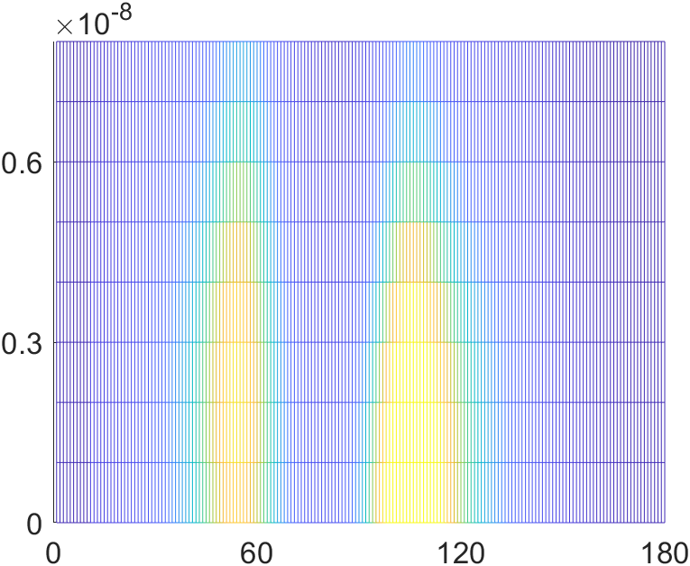
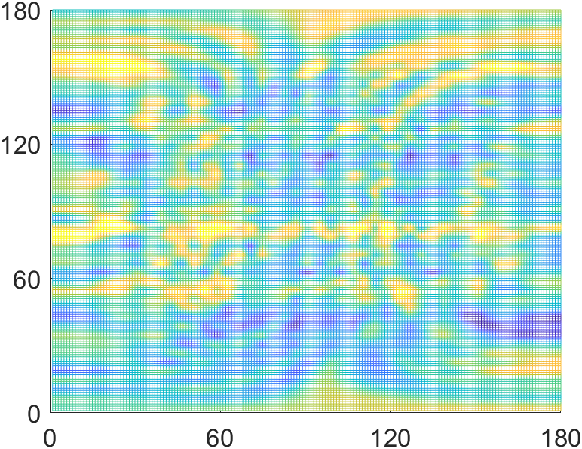
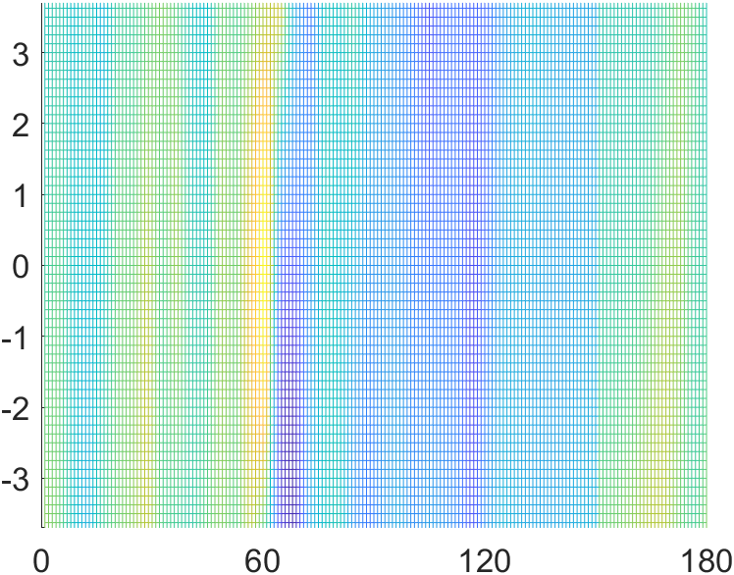

User1
User2
User 1
User 2
Elevation (°)
Velocity (m/s)
ToF (s)
User 1
User 2
Azimuth (°)
AoD (°)
Azimuth (°)

