Slide 1
dATA acquisition
Blake Rohde, Joel Tanzi, Michael Albert

Slide 2
Project WiMDAS
Wireless Modular Data Acquisition System

Slide 3
Project Features
Project WiMDAS
Modular, abstracted design
USB or Ethernet-connected devices/microcontrollers interface to external protocols
E.g. CAN, SPI, I2C, Serial, GPIO, etc.
SD Card-based storage
Real-time web interface for live-race analysis
Utilities for exporting data into existing, mature data analysis products for post-race analysis
E.g. GDA's GEMS, MoTeC's i2, etc.

Slide 4
Objectives Breakdown
Project WiMDAS
Vehicle Host (V-Host)
Intercept/capture all communications
PCM-required (“primary”) sensors via CAN buses
PCM output to sub-systems, debug messages
“Secondary” sensors, e.g. GPS
Relay all input wirelessly to R-Host
Develop efficient storage, communication protocols
Microcontroller-to-VHost data transmission
Vhost-to-RHost wireless data transmission
Data storage protocol
Remote Host (R-Host)
Retrieve and capture/store all V-Host transmissions
Host LAN/WiFi-accessable real-time web interface
Preset and user-configurable panels
Continuous, pause-able, zoom-able graphs for time-sensitive metrics
Message panel for threshold alerts, debug messages

Slide 5
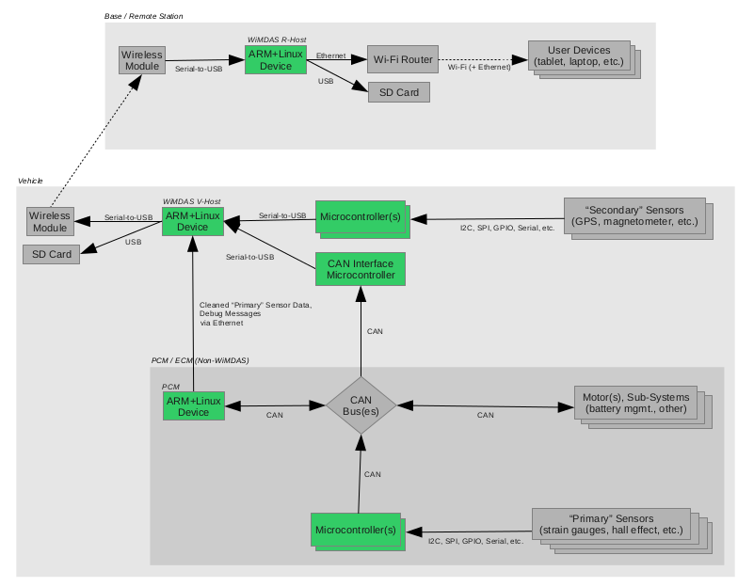
System Block Diagram
Project WiMDAS

Slide 7
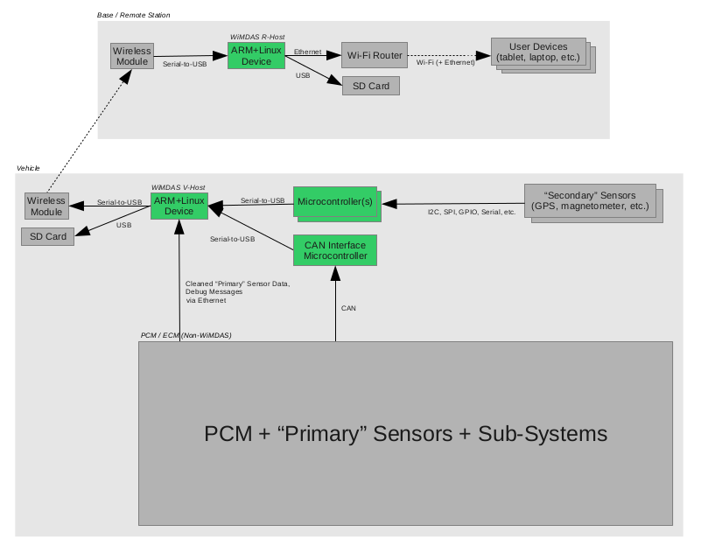

Slide 8
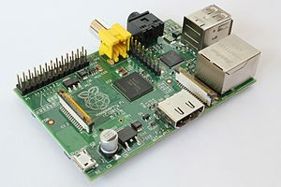
Hardware Breakdown
Project WiMDAS
“ARM+Linux Device”
Raspberry Pi
700 MHz ARM11, 256 MB RAM
10/100 Ethernet, USB
Composite RCA & HDMI Video
USB SD Card R/W’er
“CAN Interface Microcontroller”
Arduino Mega2560
SparkFun CAN-BUS Shield
“Microcontroller”
Arduino Mega2560
“Wireless Module”
Ubiquiti Networks airMAX Bullet M
10/100 Ethernet interface, 100+ Mbps (12.5 MB/s), 50+ km (31+ mi)
Source: Wikimedia (jwrodgers)

Slide 9
Schedule
Project WiMDAS
December 1, 2012
Vehicle Host (V-Host) completed
Capture all sensory data
Inc. Microcontroller interfaces to sensors
Data converter utility
Febuary 1, 2013
Remote Host (R-Host) completed
Wireless
Real-time web interface
Free-time Bonuses
Vehicle steering wheel display
Video stream
???
PROFIT!!!

