Slide 1
dATA acquisition
Blake Rohde, Joel Tanzi, Michael Albert
Wireless Connectivity: Michael Tran
CAN-Bus Interfacing: Trey Zhong

Slide 2
Project WiMDAS
Wireless Modular Data Acquisition System

Slide 3
Project Features
Project WiMDAS
Modular, abstracted design
USB or Ethernet-connected devices/microcontrollers interface to external protocols
E.g. CAN, SPI, I2C, Serial, GPIO, etc.
SD Card-based storage
Real-time web interface for live-race analysis
Utilities for exporting data into existing, mature data analysis products for post-race analysis
E.g. GDA's GEMS, MoTeC's i2, etc.

Slide 4
Objectives Breakdown
Project WiMDAS
Vehicle Host (V-Host)
Intercept/capture all communications
PCM-required (“primary”) sensors via CAN buses
PCM output to sub-systems, debug messages
“Secondary” sensors, e.g. GPS
Relay all input wirelessly to R-Host
Develop efficient storage, communication protocols
Microcontroller-to-VHost data transmission
Vhost-to-RHost wireless data transmission
Data storage protocol
Remote Host (R-Host)
Retrieve and capture/store all V-Host transmissions
Host LAN/WiFi-accessable real-time web interface
Preset and user-configurable panels
Continuous, pause-able, zoom-able graphs for time-sensitive metrics
Message panel for threshold alerts, debug messages

Slide 5
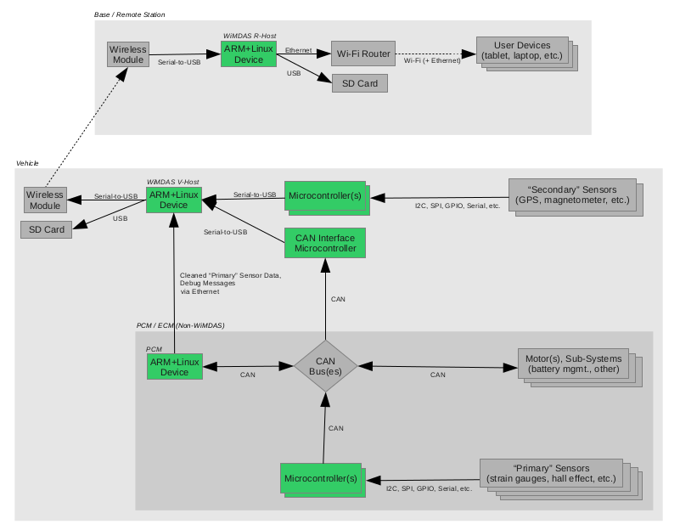
System Block Diagram
Project WiMDAS

Slide 7
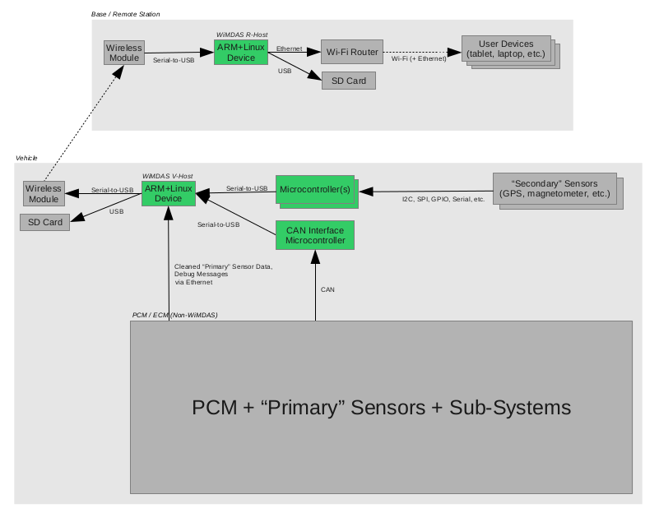

Slide 8
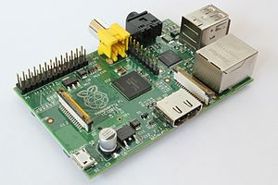
Hardware Breakdown
Project WiMDAS
“ARM+Linux Device”
Raspberry Pi
700 MHz ARM11, 256 MB RAM
10/100 Ethernet, USB
Composite RCA & HDMI Video
USB SD Card R/W’er
“CAN Interface Microcontroller”
Arduino Mega2560
SparkFun CAN-BUS Shield
“Microcontroller”
Arduino Mega2560
“Wireless Module”
Ubiquiti Networks airMAX Rocket M
10/100 Ethernet interface, 100+ Mbps (12.5 MB/s)
Source: Wikimedia (jwrodgers)

Slide 9
Wireless Connectivity
Project WiMDAS
Relay sensor data to ground station
Requirements
At least 50 Mbit/s at >1 km range
Manageable space and power footprint
Recommended modules
Ubiquiti Networks airMAX Rocket M5
10/100 Ethernet interface, up to 300 Mbit/s (37.5 MB/s)
2.5 W typical power draw, 8 W max
$80
Ubquiti Networks Omni 5G-10 antenna
Omnidirectional, 2x2 MIMO, 10 dBi gain
0.68 kg, 10lb wind loading at 100 mph
$110

Slide 10
Wireless Transfer Speeds
Project WiMDAS
Available Tx power and required Rx power are dependent on desired transfer speeds
Faster transfer rates decrease available Tx power and require higher Rx power
MCS Index | Data Rate (Mbit/s) | Tx Power (dBm) | Rx Power (dBm)
MCS10 | 90 | 27 | -90
MCS11 | 120 | 27 | -87
MCS12 | 180 | 26 | -84
MCS13 | 240 | 24 | -79
MCS14 | 270 | 22 | -78
MCS15 | 300 | 21 | -75

Slide 11
Wireless Link Budget
Project WiMDAS
Maximum 300 Mbit/sec probably not achievable
Very little (3 dB) fade margin
90 or 120 Mbit/sec is achievable
20-30 dB is a comfortable fade margin
Tx power | 21 dBm
Tx antenna gain | 10 dBi
Tx mismatch | - 0.177 dB
Free space path loss (1 km) | - 106.4 dB
Atmospheric attenuation | Negligible at 1 km
Object fade | <3 dB with LOS
Polarization loss | <3 dB proper orientation
Rx antenna gain | 10 dBi
Rx mismatch | - 0.177 dB
Rx power | - 70 dBm

Slide 12
Wireless Considerations
Project WiMDAS
5 GHz vs. 2.4 GHz vs. 900 MHz
Lower frequencies have increased range (effective ~6 dB for 2.4)
Lower frequency antennas are larger, sometimes more expensive
2.4 GHz has a higher noise floor (Wifi, cordless phones, microwaves)
Omnidirectional vs. Directional Antennas
Tradeoff increased gain (range/speed) for directionality
High quality directional antennas are more expensive, but the increased gain may allow the use of cheaper quality antennas and still maintain required range/power
Mounting Issues
Proposed antenna exerts ~8lb drag force at 100 mph
Can be reduced with non-metal, radio-transparent aerodynamic fairing or shell
Antenna must be properly oriented (vertically) to avoid polarization loss

Slide 13
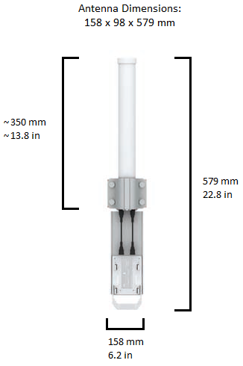
Antenna Dimensions
Project WiMDAS
Antenna
Antenna + Module

Slide 14
Schedule – December 1, 2012
Project WiMDAS
Vehicle Host (VHost) completed
Auto-connect to USB-connected microcontrollers (DONE)
Save data from USB-connected microcontrollers (DONE)
Microcontroller-to-VHost protocol (DONE)
VHost storage protocol (DONE)
Extend to allow interface for Ethernet-connected devices
Program “CAN-Interfacing Microcontroller”
Program secondary-sensor microcontroller(s)
Program steering wheel screen GUI application
Will run on VHost, read parsed data from VHost core application via Unix Socket

Slide 15
Schedule – Remaining
Project WiMDAS
January 1, 2012
Wireless module & antenna testing completed
Hardware testing
Isolation testing
Range testing
Data converter utility
Or MATLAB script(s) if commercial data analysis tools cannot be sourced
February 1, 2012
Remote Host (RHost) completed
Read data sent by VHost
Save/replicate data
Design and program real-time web interface
Wireless integration
Free-time Bonuses
Video stream

