Slide 1
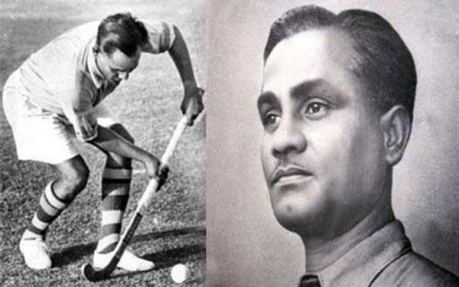
Country : India, Sport: Hockey
Nick name:” Wizard”
Dhyan Chand
He helped India win three Olympic gold medals in 1928, 1932 and 1936. Nicknamed the ‘Wizard’ for his extraordinary goal-scoring skills, Dhyan Chand is still considered to be the finest sportsman to have ever played the game.

Slide 2
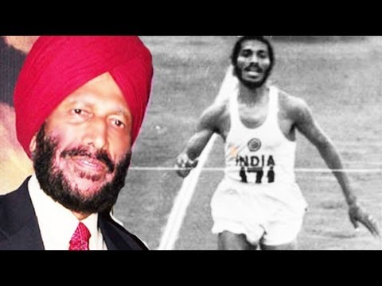
Country : India, Sport: athlete , Sprint
Nick name: “The Flying Sikh”
Milkha Singh
Is the most famous Indian sprinter and one of the first sporting icons of the country. Singh was the first Indian athlete to win a gold medal in the Commonwealth Games. He won the top prize in the 400-metre competition in 1958

Slide 3
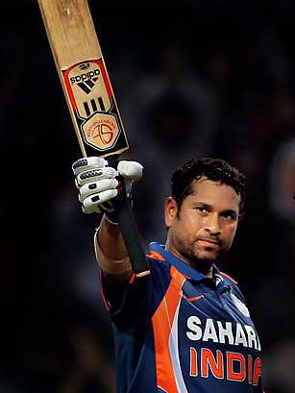
Country : India, Sport: Cricket
Nick name: “Little Master’”, “Master Blaster”
Sachin Tendulkar
One of the greatest batsmen of all time.
He is the highest run scorer of all time in International cricket.
the first batsman to score a double century in a ODI
most number of runs in both Test and ODI
complete more than 30,000 runs in international cricket

Slide 4
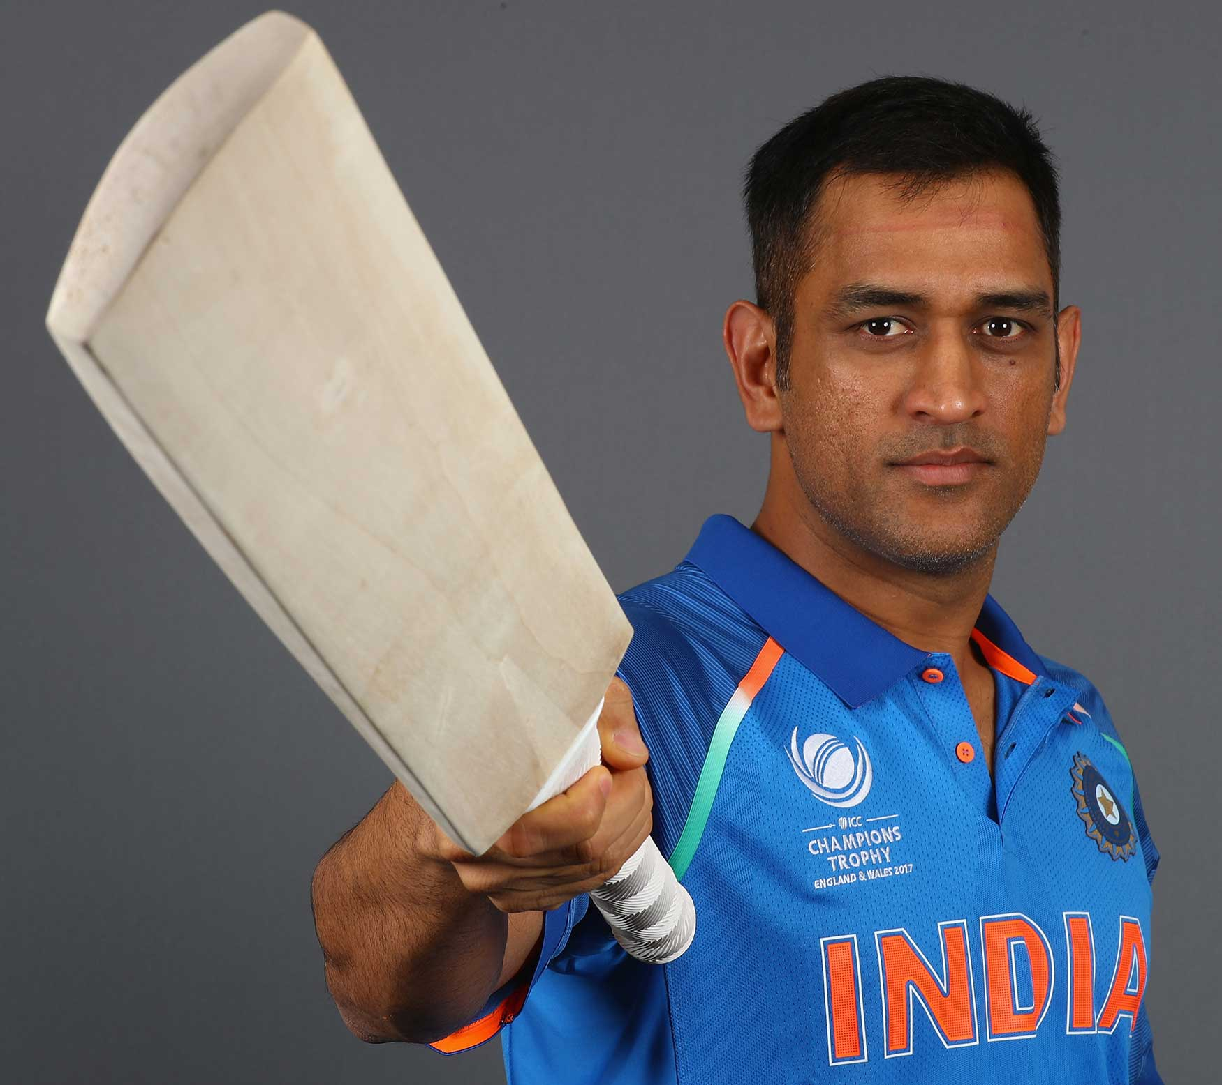
Mahendra Singh Dhoni
Country : India, Sport: Cricket
Nick name: Mahi, MSD, Captain Cool, Thala
He is widely regarded as one of the greatest finishers in limited-overs cricket. He is also regarded as one of the best wicket-keepers in world cricket

Slide 5
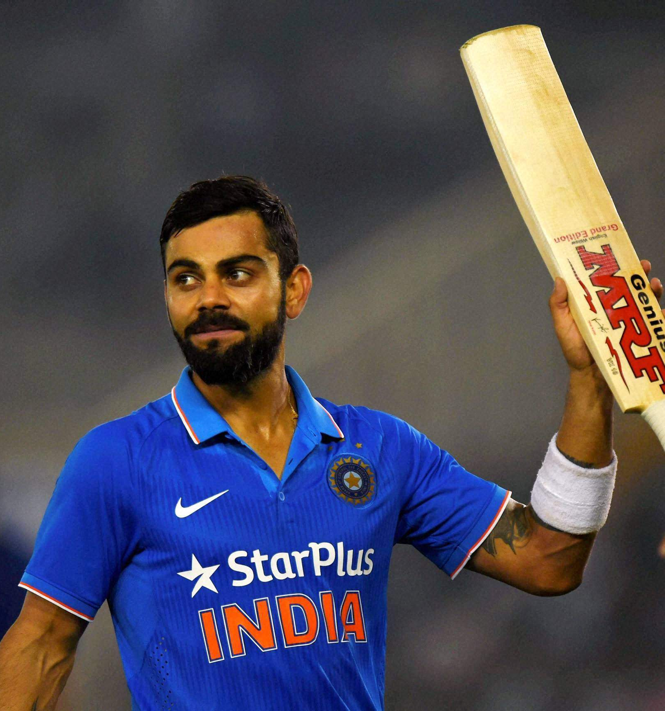
Virat Kohli
Country : India, Sport: Cricket
Nick name:
Virat Kohli is an Indian international cricketer who currently captains the India national team. An elegant right-handed batsman, Kohli is regarded as one of the best batsmen in the world.

Slide 6
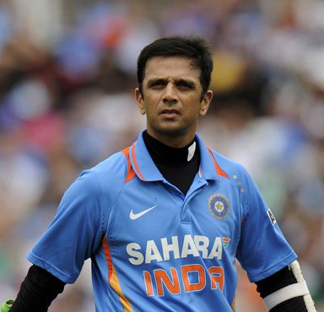
Rahul Dravid
Country : India, Sport: Cricket
Nick name: The Wall
is a former Indian cricketer and captain, widely regarded as one of the greatest batsmen in the history of cricket.He is the current Overseas Batting Consultant for the Indian team, and also the head coach for the Under-19 and 'A' teams

Slide 7
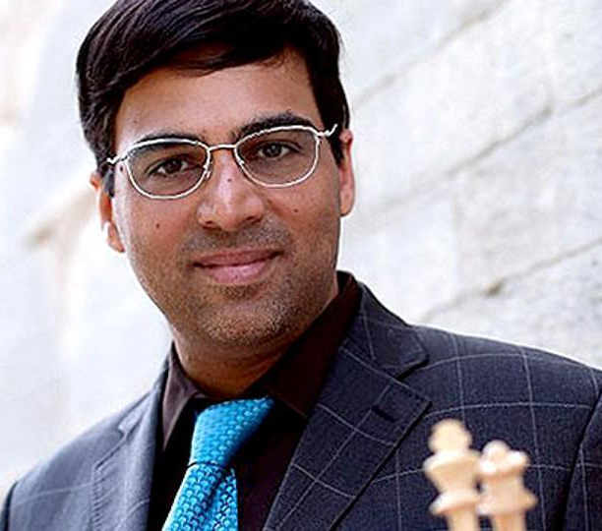
Viswanathan Anand
Country : India, Sport: Chess
Nick name:
Is an Indian chess grandmaster, a former World Chess Champion, and the current World Rapid Chess Champion.
Anand became India's first grandmaster in 1988
Anand was also the first recipient of the Rajiv Gandhi Khel Ratna Award in 1991–92, India's highest sporting honour. In 2007
He was awarded India's second highest civilian award, the Padma Vibhushan, making him the first sportsperson to receive the award.

Slide 8
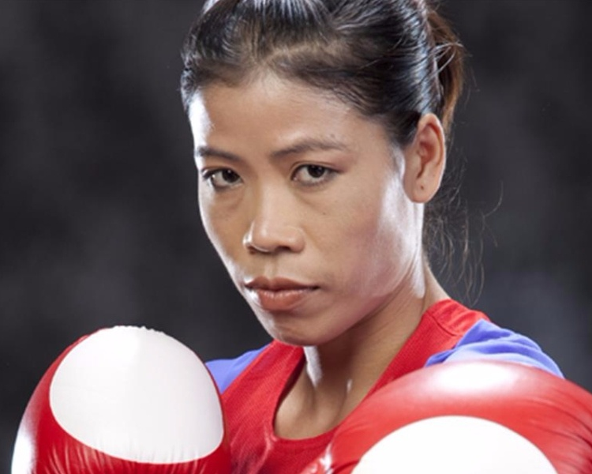
Mary Kom
Country : India, Sport: Boxer
Nick name:
Is an Indian Olympic boxer hailing from Manipur. She is a five-time World Amateur Boxing champion, and the only woman boxer to have won a medal in each one of the six world championships.
first Indian woman boxer to get a Gold Medal in the Asian Games in 2014
woman boxer to have won a medal in each one of the six world championships
bronze medal in 2012 Summer Olympics

Slide 9
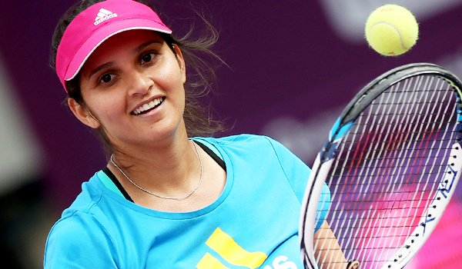
Country : India, Sport: Tennis Player
Nick name:
Sania Mirza
She is an Indian professional tennis player. A former world No. 1 in the doubles discipline, she has won six Grand Slam titles in her caree

Slide 10
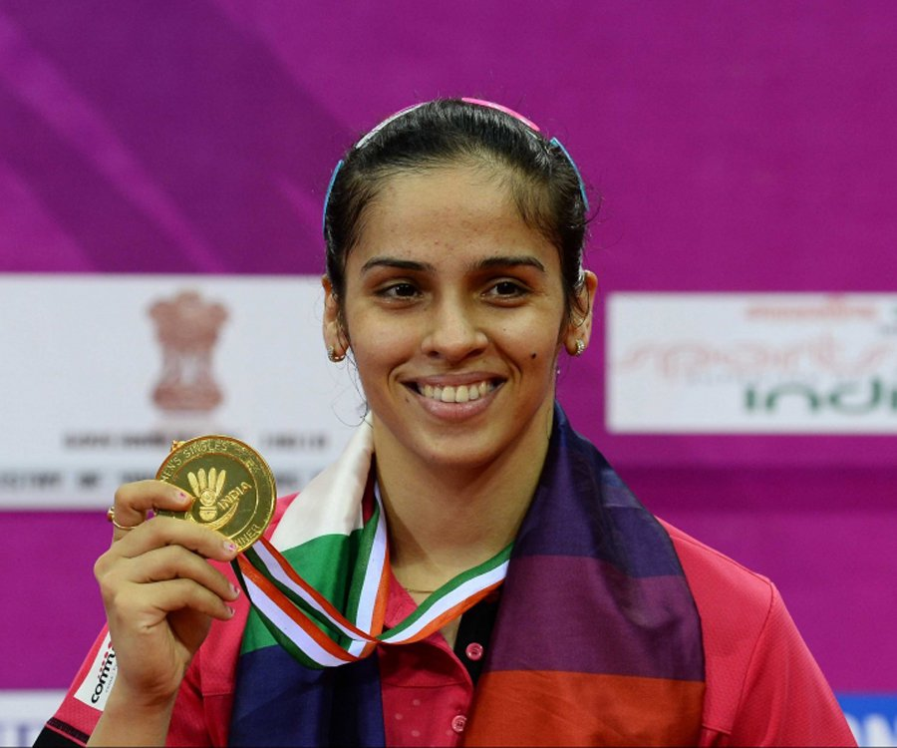
Saina Nehwal
Country : India, Sport: Badminton
is an Indian professional badminton singles player. She won gold at 2018 Commonwealth Games in women's singles,
In 2015, Saina Nehwal became the only Indian female badminton player to have attained the world number one ranking. In fact, she is only the second Indian to have achieved this feat. Prakash Padukone was ranked number one back in 1980. She has won over 21 international titles and a bronze medal in the Olympics.

Slide 11
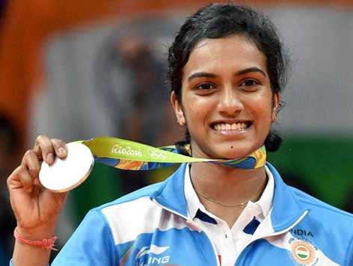
P. V. Sindhu
Country : India, Sport: Badminton
Pusarla Venkata Sindhu is an Indian professional badminton player. She became the first Indian woman to win an Olympic silver medal.
Won silver in Women's singles at Commonwealth Games 2018
She grab the silver medal win in the women's singles event of the 2016 Summer Olympics

Slide 12
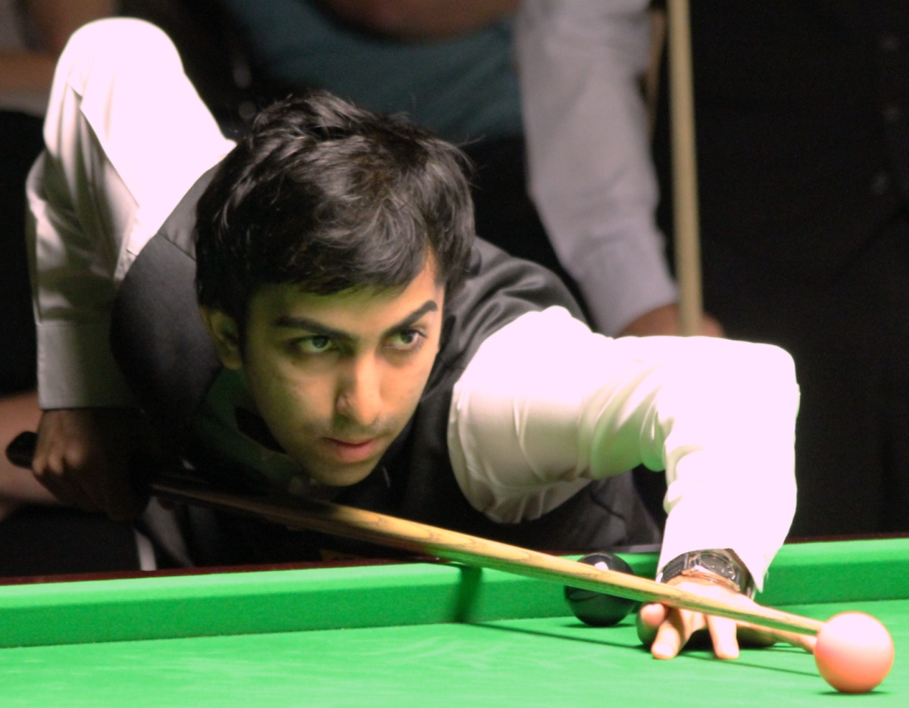
Country : India, Sport: Billiards and Snooker
Pankaj Advani
Pankaj Advani is an 18-time World Billiards and Snooker Champion. He won his first World Title at the young age of 18. He is the only person in the history of the game to have won both the billiards and snooker IBSF World Titles as well as the World Professional Billiards Championship. While mastering just one format of the game is hard enough, Advani has specialized in both billiards and snooker and has done it with aplomb.

Slide 13
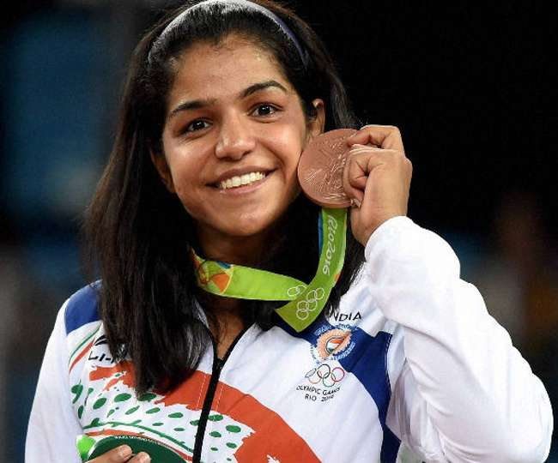
Country : India, Sport: Wrestling
Sakshi Malik
Sakshi Malik made history in the 2016 Rio Olympics by becoming the first ever Indian female wrestler to win an Olympic medal, the bronze medal in the 58 kg category. Professional wrestlers, like Malik and sisters Geeta and Babita Phogat, deserve credit for not just having the courage to enter an entirely male-dominated sport (at least in India) but doing the country proud by winning medals in sporting events like the Olympics and the Commonwealth Games.

Slide 14
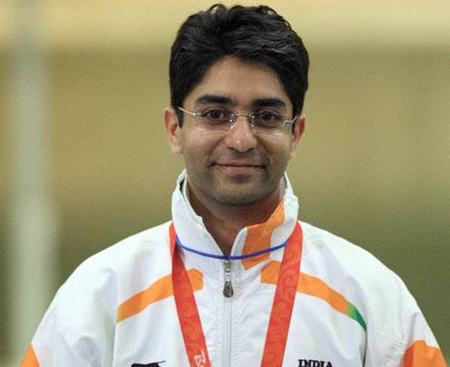
Abhinav Bindra
Country : India, Sport: athlete, Shooting
Abhinav Bindra is the first Indian individual athlete to win a gold medal in the Olympic games. He won the 10 metre Air Rifle event at the 2008 Beijing Olympic Games. Bindra is also a former World Shooting Champion and a gold medalist in the 2014 Commonwealth Games. His shooting career began early with Bindra becoming the youngest participant in the 1998 Commonwealth Games at just 15 years old.
first Indian individual athlete to win a gold medal in the Olympic games 2008

Slide 15
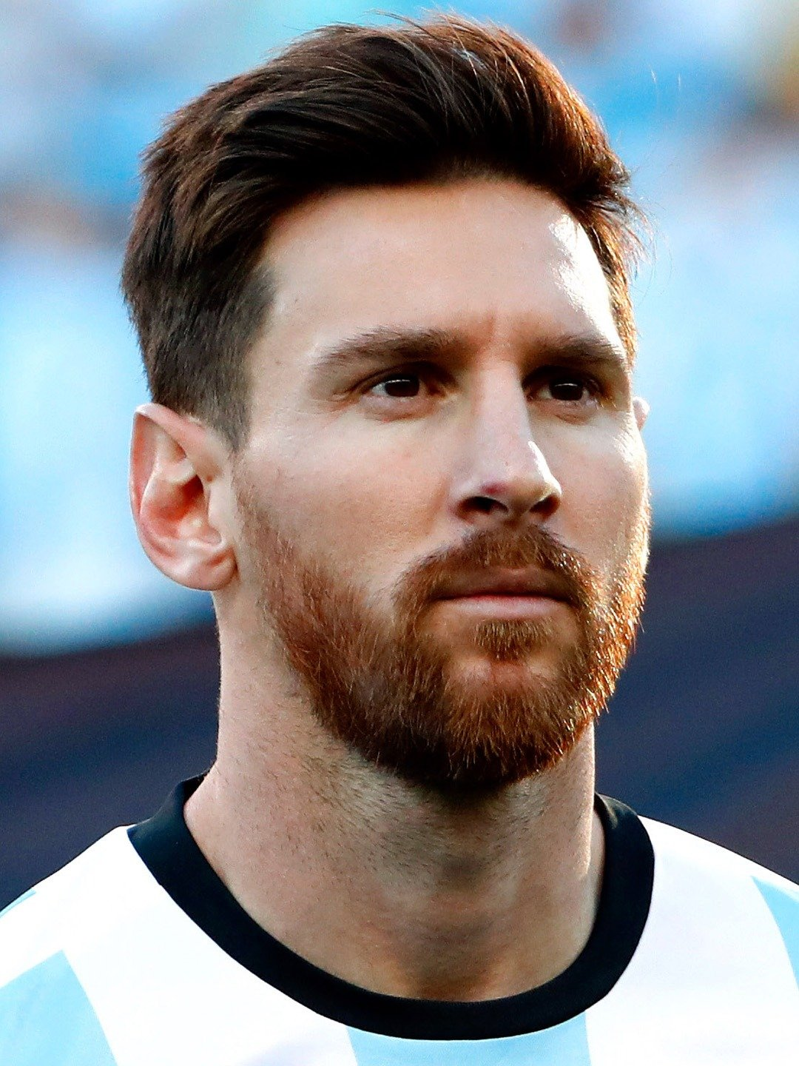
Country: Argentina Football Player
Lionel Messi

Slide 16
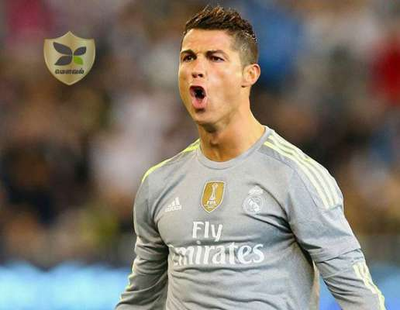
Cristiano Ronaldo
Country : Portuguese , Sport: football

Slide 17
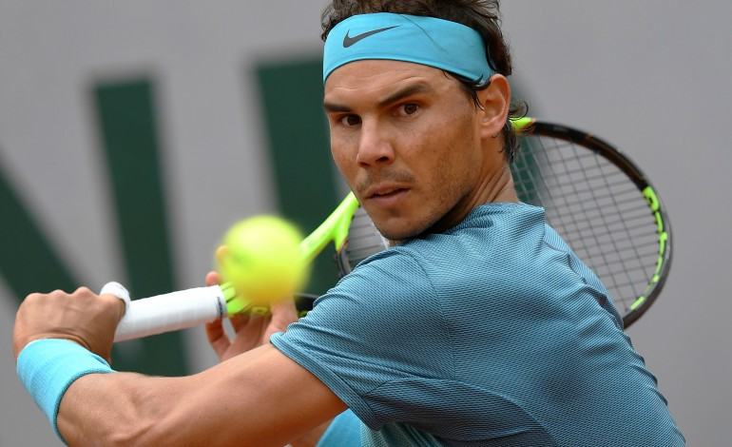
Rafael Nadal
Country : Spain, Sport: tennis
world No. 1 in men's singles tennis
Nadal has won 17 Grand Slam singles titles,
the 2008 Olympic gold medal in singles

Slide 18
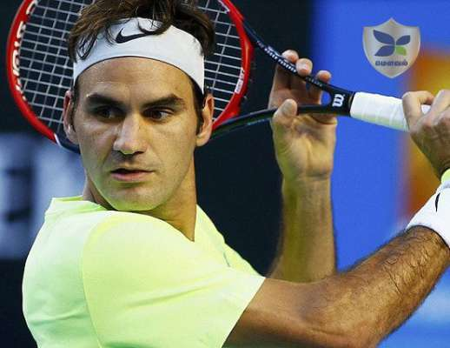
Roger Federer
Country : Switzerland, Sport: tennis
ranked world No. 2 in men's singles tennis
won 20 Grand Slamsingles titles—the most in history for a male player
won a record eight Wimbledon titles

Slide 19
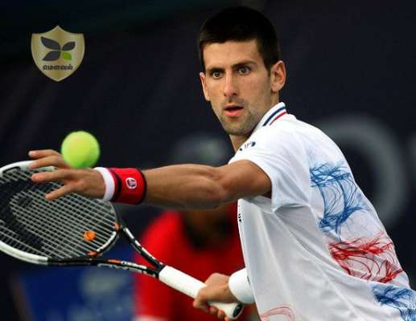
Novak Djokovic
Country : Serbia, Sport: tennis
Djokovic has won 13 Grand Slam singles titles,
four Wimbledon titles. Currently ranked world No. 10 in men's singles tennis

Slide 20
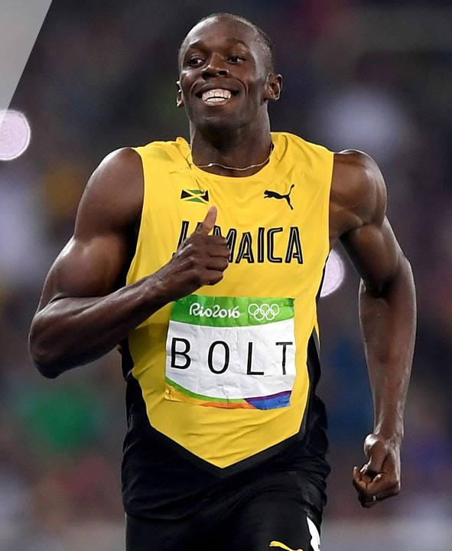
Usain Bolt

Slide 21
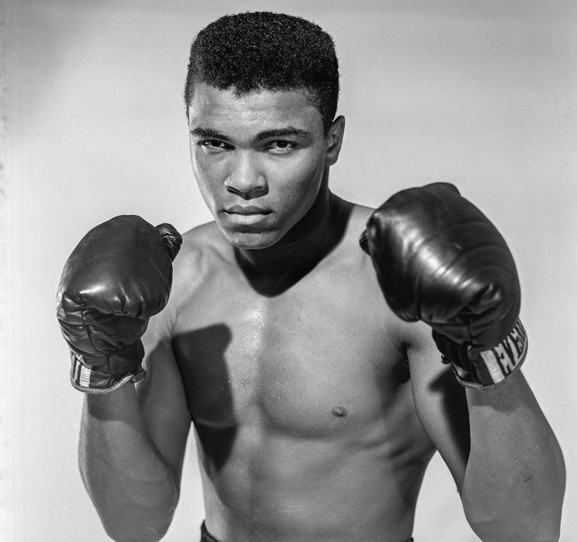
Muhammad Ali

Slide 22
Number of Players in Various Sports
S.NO | SPORTS NAME | NUMBER OF PLAYERS | Duration
1 | Badminton | 2 or 4 players
2 | Baseball | 9 players | Around 3 hrs
3 | Basketball | 5 players | 48 min
4 | Bridge | 2 players | 180 min
5 | Carrom | 2 or 4 players
6 | Cricket | 11 players | 1 day 6 hrs or 5 days 8 hrs each
7 | Chess | 2 player
8 | Football | 11 players | 90 min
9 | Rugby Football | 15 players | 80 min
10 | Kabaddi | 7 players | 40 min
11 | Hockey | 11 players | 60 min
12 | Polo | 4 players
13 | Tennis | 2 or 4 players
14 | Volleyball | 6 players | 60 to 90 min
15 | Water polo | 7 players

Slide 23
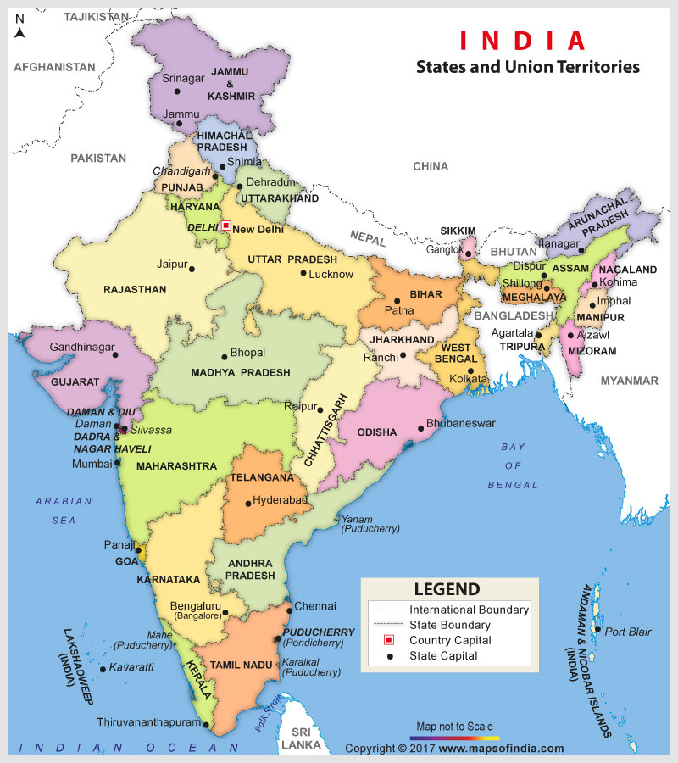

Slide 24
S.no | State | Capital
1 | Andhra Pradesh | Hyderabad (De jure - 2 June 2024) Amaravati (proposed)
2 | Arunachal Pradesh | Itanagar
3 | Assam | Dispur
4 | Bihar | Patna
5 | Chhattisgarh | Raipur
6 | Goa | Panaji
7 | Gujarat | Gandhinagar
8 | Haryana | Chandigarh (shared with Punjab)
9 | Himachal Pradesh | Shimla
10 | Jammu and Kashmir | Srinagar (summer), Jammu (winter)
11 | Jharkhand | Ranchi
12 | Karnataka | Bengaluru (formerly Bangalore)
13 | Kerala | Thiruvananthapuram
14 | Madhya Pradesh | Bhopal
15 | Maharashtra | Mumbai
16 | Manipur | Imphal
17 | Meghalaya | Shillong
18 | Mizoram | Aizawl
19 | Nagaland | Kohima
20 | Odisha | Bhubaneswar
21 | Punjab | Chandigarh
22 | Rajasthan | Jaipur
23 | Sikkim | Gangtok
24 | Tamil Nadu | Chennai
25 | Telangana | Hyderabad (from June 2, 2014 – shared with Andhra Pradesh)
26 | Tripura | Agartala
27 | Uttar Pradesh | Lucknow
28 | Uttarakhand | Dehradun
29 | West Bengal | Kolkata

Slide 25
State | Chief Ministers Name^{[3]} |  | State | Chief Ministers Name^{[3]}
Delhi | Arvind Kejriwal |  | Maharashtra | Devendra Fadnavis
Uttar Pradesh | Yogi Adityanath |  | Sikkim | Pawan Kumar Chamling
Gujarat | Vijay Rupani |  | Goa | Manohar Parrikar
Tripura | Biplab Kumar Deb |  | West Bengal | Mamata Banerjee
Telangana | K. Chandrashekhar Rao |  | Uttarakhand | Trivendra Singh Rawat
Tamil Nadu | Edappadi K. Palaniswami |  | Puducherry | V. Narayanasamy
Odisha | Naveen Patnaik |  | Rajasthan | Vasundhara Raje
Nagaland | Neiphiu Rio |  | Punjab | Amarinder Singh
Mizoram | Lal Thanhawla |  | Manipur | N. Biren Singh
Meghalaya | Conrad Sangma |  | Maharashtra | Devendra Fadnavis
Karnataka | H. D. Kumaraswamy |  | Madhya Pradesh | Shivraj Singh Chouhan
Jharkhand | Raghubar Das |  | Kerala | Pinarayi Vijayan
Jammu and Kashmir | Vacant[ (Governor's rule) |  | Himachal Pradesh | Jai Ram Thakur
Haryana | Manohar Lal Khattar |  | Andhra Pradesh | N. Chandrababu Naidu
Assam | Sarbananda Sonowal |  | Chhattisgarh | Raman Singh
Arunachal Pradesh | Pema Khandu |  | Bihar | Nitish Kumar

Slide 26
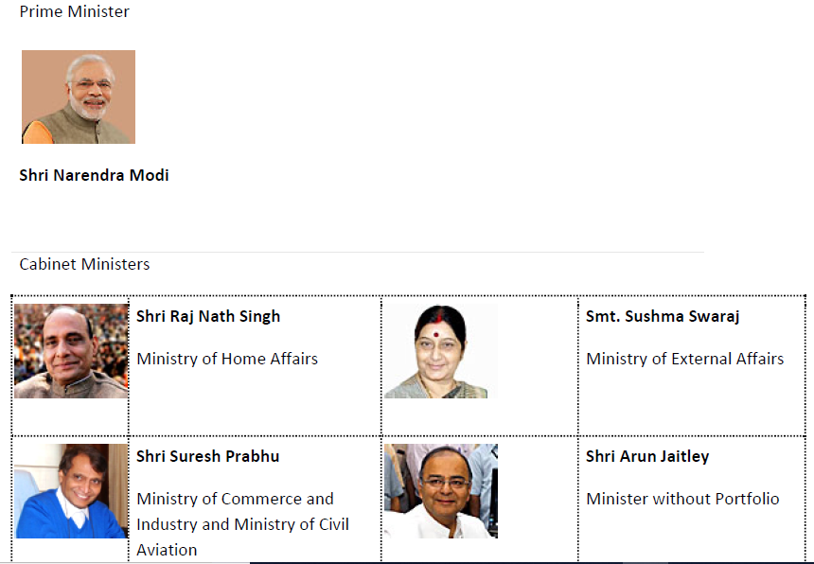
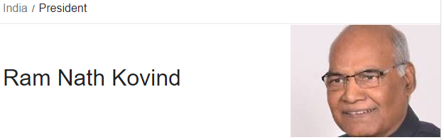
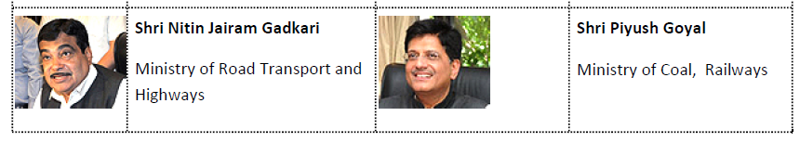

Slide 27
Name of the Award | Given for | First given in the year | Monetary Grant
Rajiv Gandhi Khel Ratna Award | For the spectacular and most outstanding performance in the field of sports by a sportsperson over a period of four years immediately preceding the year during which award is to be given. | 1991-92 | Rs. 7.5 lakhs
Dronacharya Award | To sports coaches who have successfully trained sportspersons or teams and enabled them to achieve outstanding results in international competitions. | 1985 | Rs. 5 lakhs
Dhyanchand Award | To those sportspersons who have contributed to sports by their performance and continue to contribute to the promotion of sports even after their retirement from active sporting career. | 2002 | Rs. 5 lakhs
Tenzing Norgay National Adventure Award | To recognise the achievement of persons associated in the field of adventure. 3 categories for adventure on land, sea and air and 1 award for lifetime achievement. | 1993 | Rs. 5 lakhs
Arjuna Award | Ordinarily not more than 15 in a year in each discipline with at least one award for sports for physically challenged. For good performance over the previous four years at the International level and also should have shown qualities of leadership, sportsmanship and a sense of discipline. | 1961 | Rs. 5 lakhs
Rashtriya Khel Protsahan Puraskar | 4 categories (a) Identification and nurturing of budding/young talent (b) Encouragement to sports through Corporate Social Responsibility (c) Employment of sports persons and sports welfare measures (d) Sports for Development | 2009 | No cash award
Maulana Abul Kalam Azad Trophy | Overall top performing university in the Inter-University tournaments. (The top 3 universities are given cash awards) | 1956-57 | 1. Rs. 10 lakhs 2. Rs. 5 lakhs & 3. 3 lakhs

Slide 28
Achievement | Sportsperson
The first Indian to win an individual medal at the Olympic Games | KD Jadhav
The first Indian to win a gold medal at the Olympic Games | Abhinav Bindra
The first Indian woman to win an individual medal at the Olympic Games | Karnam Malleswari
The first Indian to win a Grand Slam title (French Open mixed doubles title in 1997) | Mahesh Bhupathi
India's first Grandmaster and also the first Indian to win the FIDE World Chess Championship | Vishwanathan Anand
The first Indian woman to win a Grand Slam title | Sania Mirza
The first Indian to win the World Junior Badminton Championships and also to win a Super Series tournament, (by clinching the Indonesia Open). First Indian woman to be ranked World No. 1 | Saina Nehwal
1st recipient of Rajiv Gandhi Khel Ratna Award | Viswanathan Anand
1st woman recipient of Rajiv Gandhi Khel Ratna Award | Karnam Malleswari
1st Indian to win Olympic medals at two consecutive Olympic Games | Sushil Kumar
1st Indian recipient of International Cricket Council's Sir Garfield Sobers Trophy (also the first in the world) | Rahul Dravid
1st Indian recipient of Wisden Leading Cricketer in the World | Virender Sehwag

Slide 29
Games | First held (Year & Host) | Last held (Year & Host) | Next at (Year & Host)
Olympic Games | 1896 Athens Greece | 2016 Rio de Janeiro Brazil | 2020 Tokyo Japan
Cricket World Cup | 1975 England | 2015 Australia, New Zealand | 2019 England
Football World Cup (Men's) | 1930 Uruguay | 2014 Brazil | 2018 Russia
Hockey World Cup | 1971 Barcelona, Spain | 2014 The Hague, The Netherlands | 2018 Bhubaneshwar, India

