Slide 1
Seven Wonders of the Modern World
Wonder | Location | Significance
Channel Tunnel | Strait of Dover, between the United Kingdom and France | The longest undersea portion of any tunnel in the world.
CN Tower | Toronto, Ontario, Canada | Tallest freestanding structure in the world 1976–2007.
Empire State Building | New York City, New York, U.S. | Tallest structure in the world 1931–1954, Tallest freestanding structure in the world 1931–1967, Tallest Building in the world 1931–1970. First building with 100+ stories.
Golden Gate Bridge | Golden Gate Strait, north of San Francisco, California, U.S. | The longest suspension bridge main span in the world from 1937 to 1964.
Itaipu Dam | Paraná River, between Brazil and Paraguay | The largest operating hydroelectric facility in the world in terms of annual energy generation.
Delta and Zuiderzee Works | Zeeland, South Holland, North Holland, Friesland and Flevoland, Netherlands | The largest hydraulic engineering project undertaken by the Netherlands during the twentieth century.
Panama Canal | Isthmus of Panama | One of the largest and most difficult engineering projects ever

Slide 2
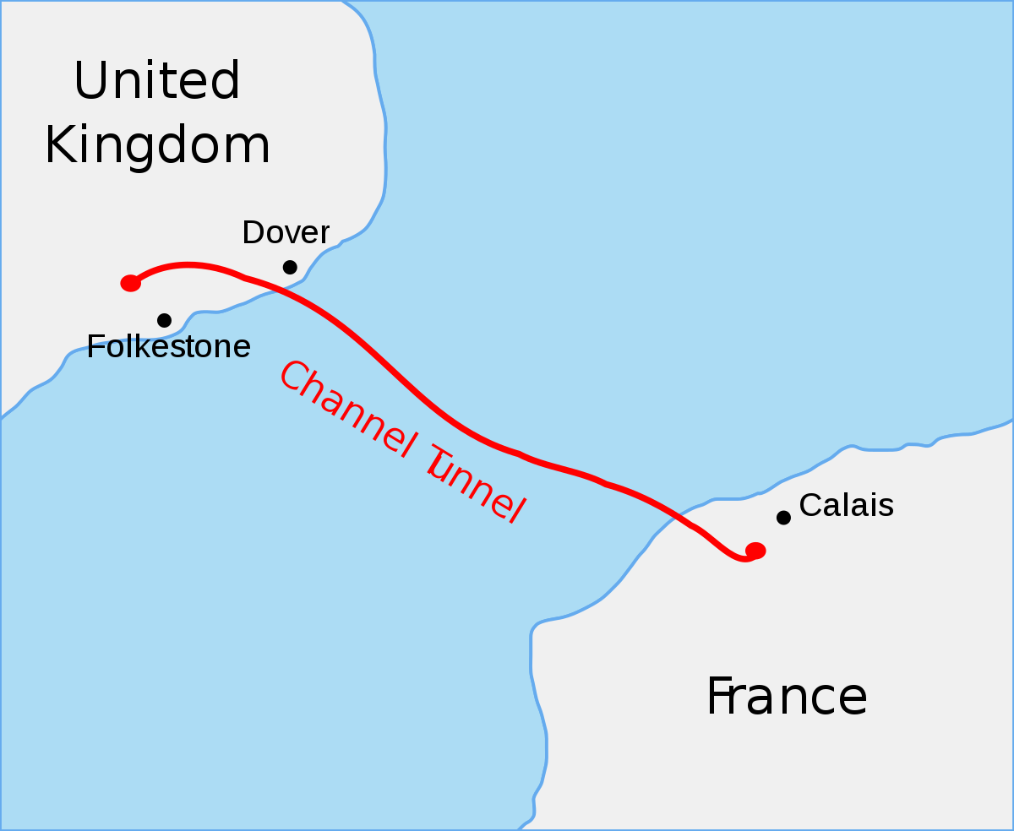
Channel Tunnel Strait of Dover, between the United Kingdom and France The longest undersea portion of any rail tunnel in the world. 50.45-kilometre At its lowest point, it is 75 m (250 ft) deep below the sea bed and 115 m (380 ft) below sea level

Slide 3
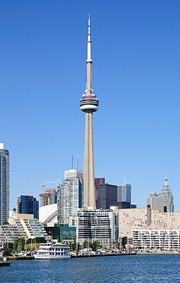
CN Tower
CN Tower is a Tallest freestanding structure in the world 1976–2007.It is 553.3 m-high (1,815.3 ft) located in DowntownToronto, Ontario, Canada

