Slide 1



HOUSE PRICE PREDICTION
Team members:
Yang Yu Hao
Sun Gan Yu
Xu Hao Yang
Xu Wei Bin
Zhao Qi Heng

Slide 2


Content
1
Introduction:
Outlines the problem background, dataset, and study objectives.
2
Model Comparison:
Compares Random Forest, XGBoost, and Linear Regression in terms of method and performance.
3
Summary:
Highlights the best-performing model and suggests future improvements.

Slide 3

introduction
Problem Background
• House price prediction is important for buyers, sellers, and investors
• Traditional methods rely on experience and are less accurate
Our Approach
• Use machine learning models to predict house prices
• Analyse historical housing data to improve accuracy

Slide 4
Objective
• To build and compare three machine learning models (Random Forest, XGBoost, and Linear Regression) for house price prediction, in order to identify the most accurate and suitable model.
• To evaluate model performance using multiple metrics such as R², MAE, RMSE, and MAPE, and analyse the strengths and limitations of each approach.
• To provide meaningful insights into how different features influence house prices, and support better decision-making in real-world scenarios.

Slide 5


Introduction to the Random Forest
Random Forest is an ensemble learning algorithm based on decision trees.
Why we use Random Forest
1.can handle complex and nonlinear relationships.
2.robust to noise and overfitting.
3.works well with feature engineering and mixed data types.

Slide 6
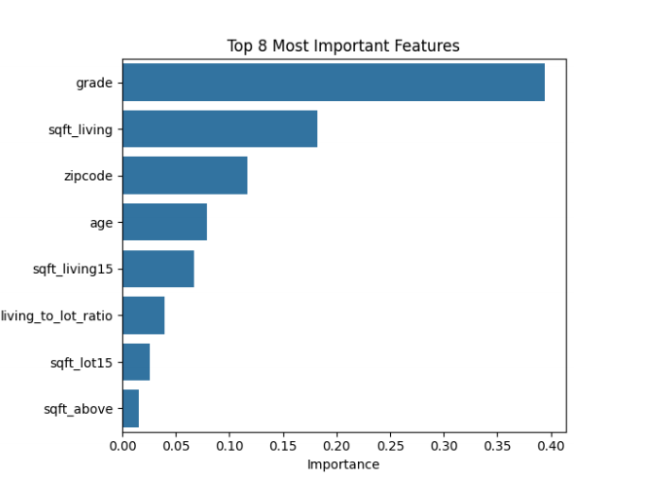
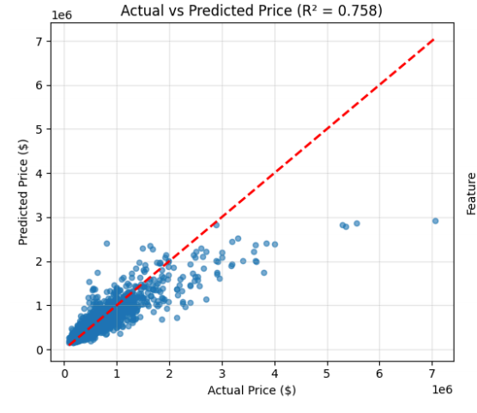
Random Forest Prediction Results
R² = 0.758 MAE = $100,504.84 RMSE = $201,602.08 MAPE = 17.89%
The model shows that quality, size, and location are the three most important factors affecting house prices.

Slide 7
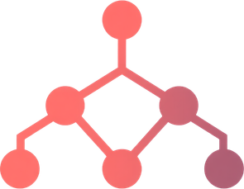

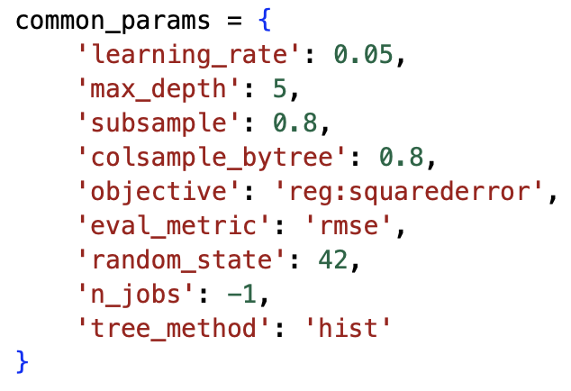
Introduction to the XGBoost
Handles structured features effectively
Captures non-linear relationships
Learns feature interactions automatically
Early Stopping Support

Slide 8
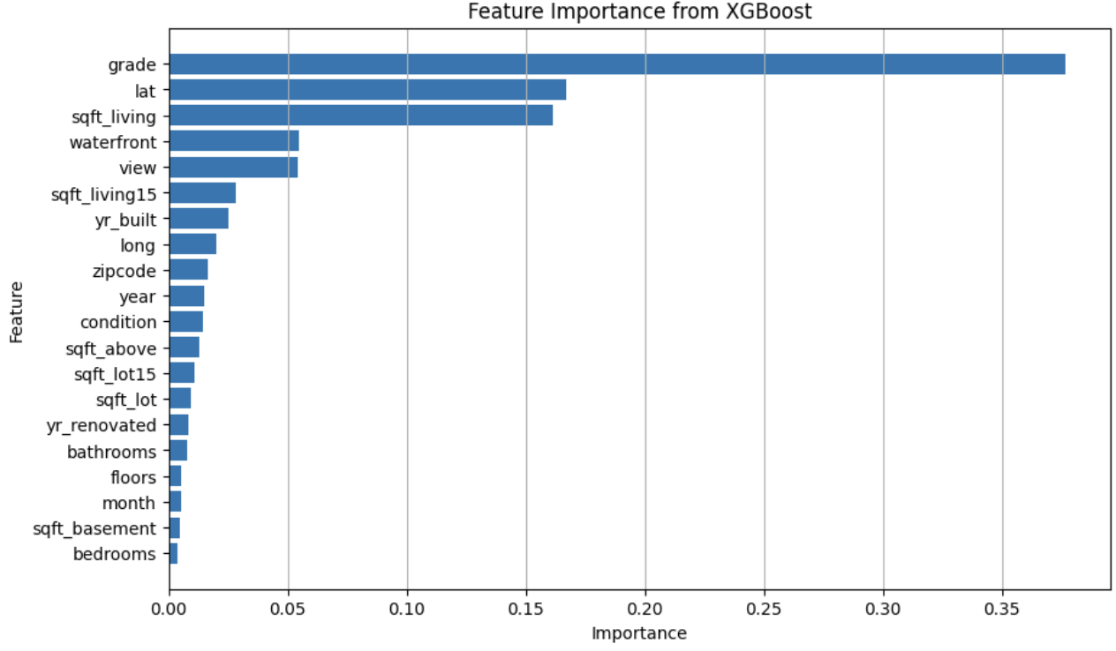
XGBoost prediction results
Model | Val RMSE | Test RMSE | Val R^2 | Test R^2
No early stopping | 119245.220828 | 120046.513293 | 0.891377 | 0.914230
With early stopping | 118521.778184 | 118958.002996 | 0.892691 | 0.915778
The function of Early Stopping:
Prevent model deterioration
Improve result stability
Automatically select the optimal number of training rounds

Slide 9
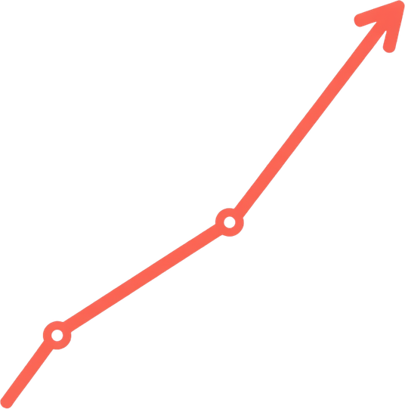


Introduction to the linear Regression
Linear Regression is a supervised learning algorithm that models the relationship between input features and the target variable by fitting a linear equation.
Simple and efficient, suitable as a baseline model
High interpretability, facilitating the analysis of feature impacts
Suitable for processing data with approximate linear relationships

Slide 10
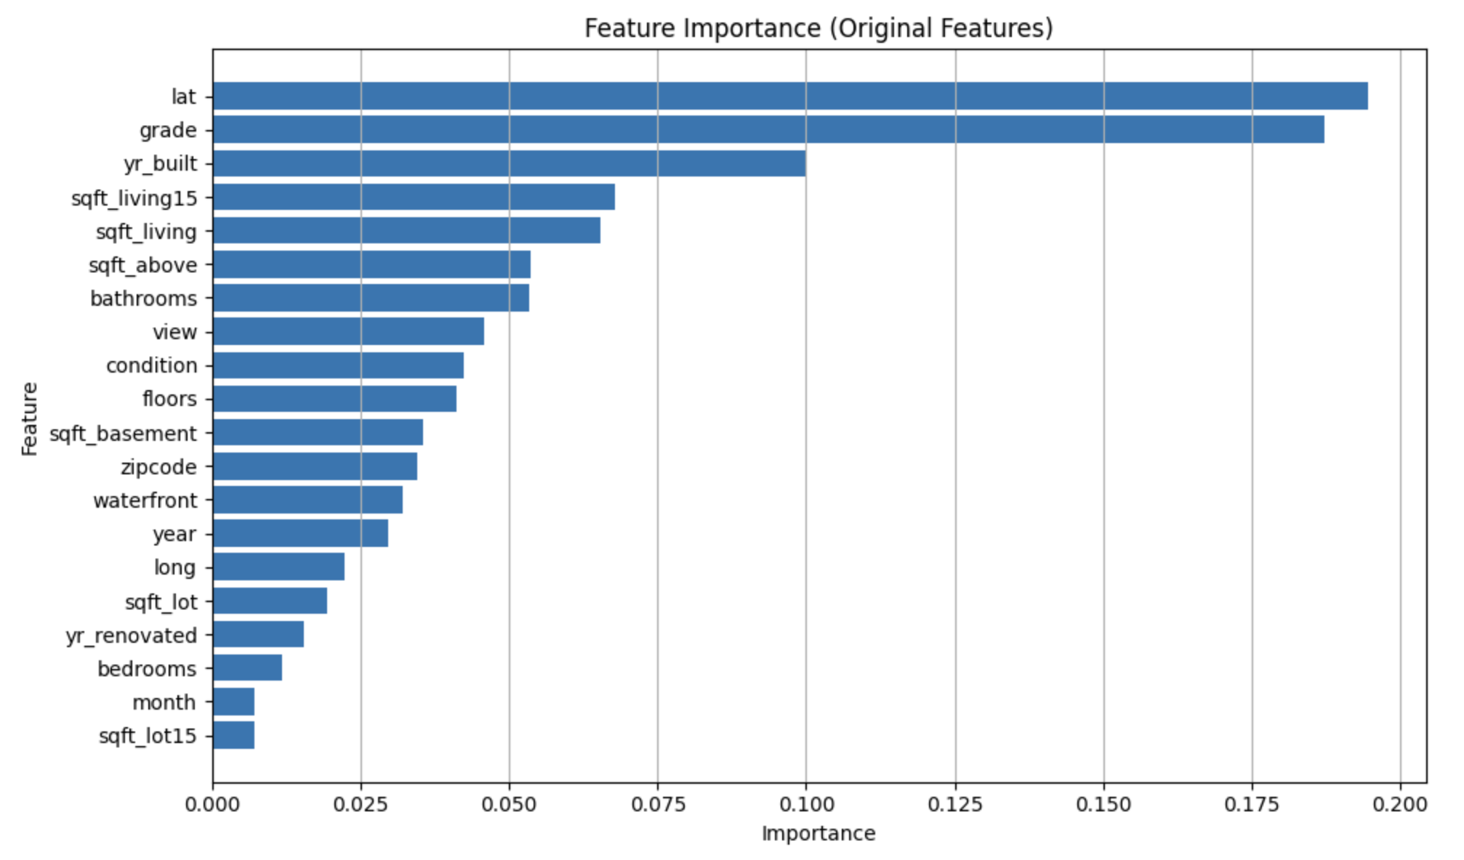
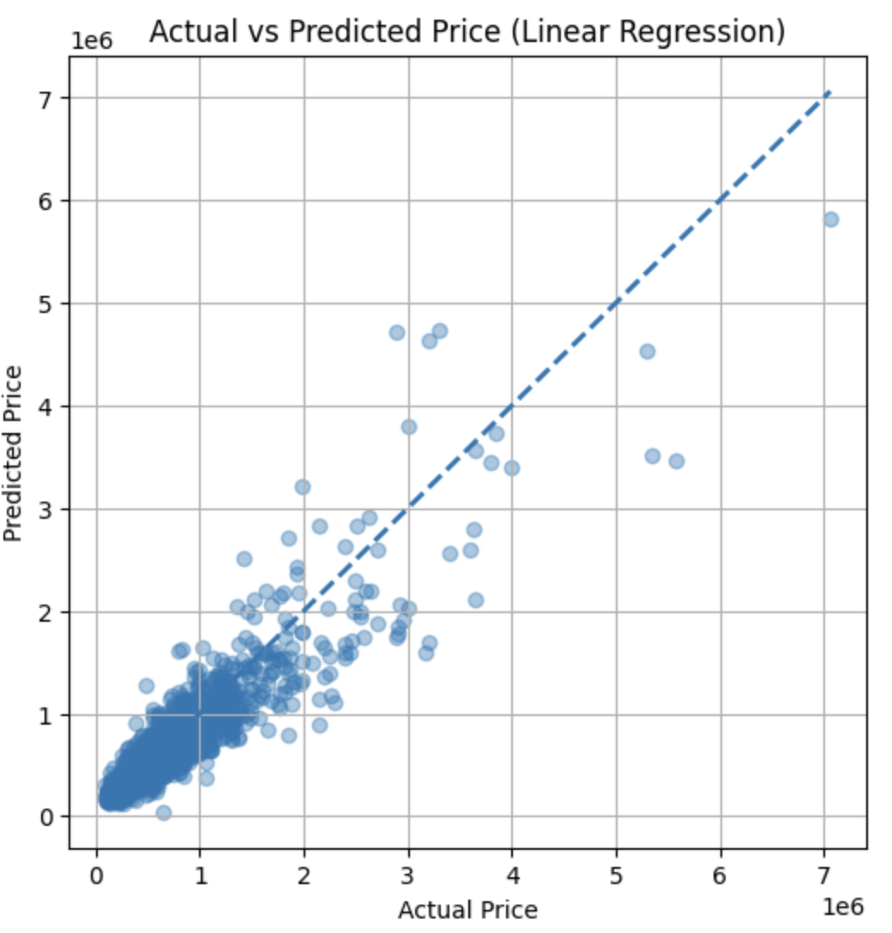
linear Regression prediction results
R² = 0.833 MAE = $94758.56 RMSE = $167344.79 MAPE = 17.236
The model has a good fitting effect and strong interpretability.
lat,grade,yr_bulit,sqft_living are key factors affecting housing prices in reality.
Large prediction error for high-priced housing

Slide 11
Comparison of Three Models
1
Accuracy Comparison
3
Interpretability
XGBoost > Random Forest > Linear Regression. XGBoost usually achieves the highest accuracy through gradient boosting. Random Forest also performs well through ensemble learning, while Linear Regression is weaker with nonlinear data.
Linear Regression > Random Forest > XGBoost. Linear Regression coefficients are intuitive. Random Forest can rank feature importance. XGBoost is more complex and usually needs tools such as SHAP for explanation.
2
Training Time
4
Application Scenarios
Linear Regression < Random Forest < XGBoost.
Linear Regression is simple and trains the fastest. Random Forest builds many decision trees. XGBoost is more time-consuming because of iterative optimization, but GPU acceleration can help.
Linear Regression: clear linear relationships and fast modeling. Random Forest: medium-sized data and stable results. XGBoost: highest accuracy, large datasets, and sufficient computing resources.

Slide 12

Summary Analysis:
Best Model Recommendation
Based on the overall analysis, XGBoost is the best-performing model for the house price prediction task. It outperforms Random Forest and Linear Regression on key metrics such as R², RMSE, and MAE. XGBoost can effectively capture nonlinear relationships in house price data, while also showing good generalization ability and relatively efficient training performance. Therefore, XGBoost is recommended as the preferred model for practical house price prediction applications.

Slide 13


Thank for watching
Q & A

