Slide 1



Mini Bank Management System
Course Title: Object Oriented Programming
Course Code: CSE 202 Section: 251_D1
Presented by:
Jonayet Bogdady
ID: 251002011
Presented to:
Kazi Hasnayeen Emad
Lecturer, Department of SWE
Green University of Bangladesh

Slide 2

Introduction
The Mini Bank Management System is a lightweight desktop banking application built in Java that automates core branch operations. It replaces manual ledger work with digital account management, secure transactions, and a simple GUI for staff and customers.
This project demonstrates how OOP design improves code structure, maintainability, and real-world banking workflows.
Mini Bank Management System
Page No. 01

Slide 3





Motivation
Slow Service
Manual processes cause long queues and delays.
Paperwork Overload
Physical ledgers are error-prone and hard to search.
Security Risks
Inconsistent record keeping increases fraud exposure.
Human Errors
Manual entries lead to mistakes in balances and records.
Mini Bank Management System
Page No. 02

Slide 4





Problem Statement
Bank branches need a secure, user-friendly system to manage customer accounts and transactions. The solution must:
Support account creation and secure login
Handle deposits, withdrawals, and balance checks reliably
Maintain transaction history and customer records
Be maintainable using OOP principles in Java
Manual Queues
Digitize Accounts
Automated Ops
Secure Records
This workflow shows how automation reduces errors and improves speed.
Mini Bank Management System
Page No. 03

Slide 5
Objectives
Create Accounts
Secure Login
Deposit & Withdraw
Collect customer details and initialize savings/current accounts.
Implement credential checks and simple session control.
Safe balance updates with input validation and receipts.
Transaction History
OOP Design
Persist and display transaction logs for auditing.
Use classes, encapsulation, inheritance, polymorphism, and abstraction for modular code.
Mini Bank Management System
Page No. 04

Slide 6

Technologies Used
Java SE — core programming language
Swing / JFrame — desktop GUI components
NetBeans or VS Code IDEA — development environment
File handling & ArrayList — simple persistence and in-memory storage
OOP principles — for clean, testable design
Mini Bank Management System
Page No. 05

Slide 7





OOP Concepts Applied
Class & Object
Concrete classes model accounts, customers, and transactions.
Account
SavingsAccount
Base class for all accounts
Derived class with interest
Encapsulation
Private fields with getters/setters protect balance and credentials.
CurrentAccount
Customer
Inheritance
Derived class for checking
Owner of account objects
Base Account class extended by SavingsAccount and CurrentAccount.
The diagram maps class relationships: inheritance for account types, composition for transactions stored within account objects, and a separate AuthService for login.
Polymorphism & Abstraction
Use abstract methods for account-specific behavior and interchangeable interfaces.
Mini Bank Management System
Page No. 06

Slide 8




System Features
Create Account
Secure Login
Deposit / Withdraw
Transaction History
Basic authentication flow with input validation.
Register customers with unique account IDs and secure passwords.
Balance updates with transaction records and simple receipts.
View chronological logs for auditing and dispute resolution.
Mini Bank Management System
Page No. 07

Slide 9
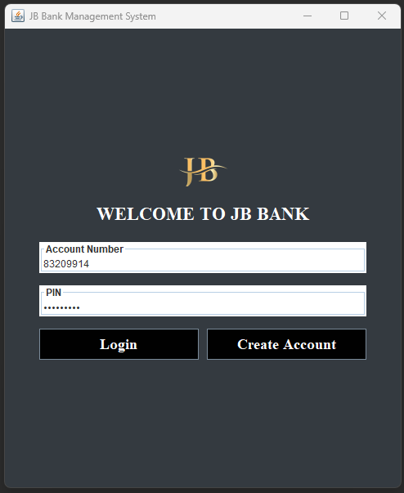
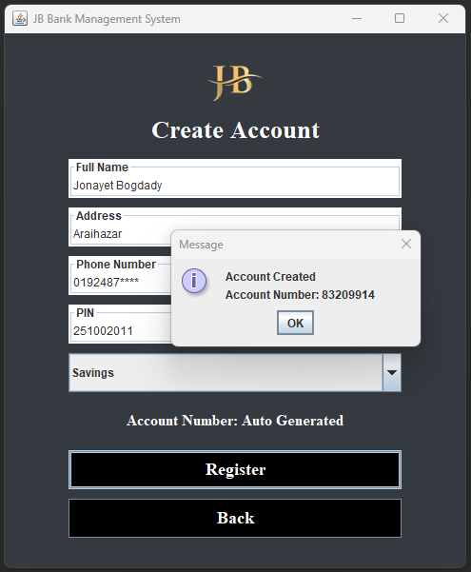
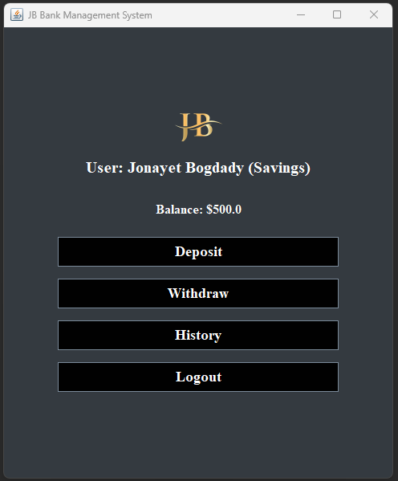
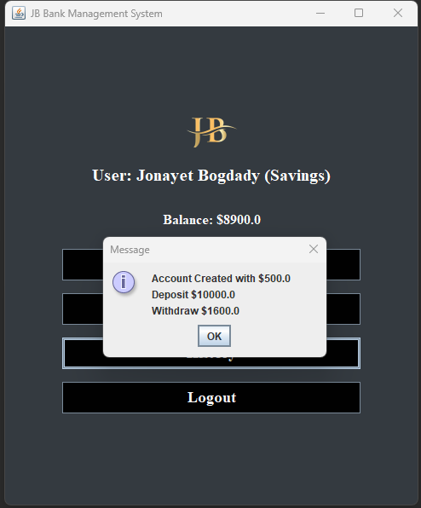
GUI Screenshots
Login Page
Create Account Page
User Dashboard Page
User Transactions History
Mini Bank Management System
Page No. 08

Slide 10


Future Improvements
1
2
Database Integration
ATM & Card Support
Migrate file-based storage to MySQL/PostgreSQL for reliability and concurrency.
Add card management, PIN validation, and offline transaction queuing.
3
4
Mobile App
Enhanced Security
Provide Android/iOS front-end with REST API backend.
OTP, password hashing, role-based access, and audit trails.
Planned improvements scale the prototype into a production-ready system suitable for campus or small-branch use.
Mini Bank Management System
Page No. 09

Slide 11
Conclusion
The Mini Bank Management System is a useful Java-based project that demonstrates practical use of Object-Oriented Programming concepts. It helps automate banking activities, improves efficiency, reduces manual errors, and provides a secure environment for account management. This project also builds strong programming knowledge and real-world software development experience.
Mini Bank Management System
Page No. 10

Slide 12
Thank You Everyone!

