Slide 1
Concurrency
Issues in Databases
Mândru Cătălin, Oprișiu Bogdan-Ioan, Pampu Ioan-Cristian, Tudor Luca

Slide 2
What is concurrency control?
Concurrency in databases refers to the ability of a database management system (DBMS) to handle multiple operations, usually from different users or applications, simultaneously
The goal of managing concurrency is to ensure that the database remains consistent and reliable even when many operations are occurring at the same time.

Slide 3

Transactions

Slide 4
Transactions - short overview
Transactions are sets of actions that are treated as a single unit. They ensure that all actions are either completed successfully or none of them are.
Example: a transaction which transfers money from one account to another
Check account balance: The system checks the balance of the source account to ensure that there are sufficient funds for the transfer.
Take money from source account: If the balance check is successful, the system debits the source account by the transfer amount.
Credit Destination Account: After debiting the source account, the system adds to the destination account the same amount.
Obs: If one step fails, the entire transaction is cancelled and changes are rolled back

Slide 5
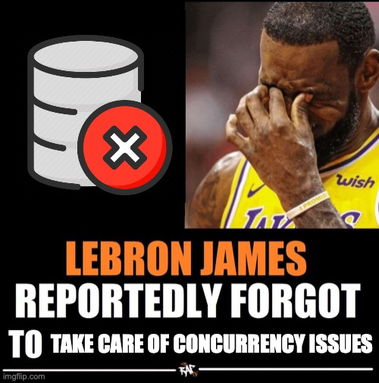
Concurrency issues

Slide 6
What are concurrency issues?
Concurrency issues arise when multiple transactions or operations attempt to access and manipulate the same data concurrently in a database
These issues can lead to inconsistencies, data corruption, and unexpected outcomes if not properly managed
Concurrency issues are especially prominent in multi-user database environments where the integrity and accuracy of data are paramount

Slide 7
Examples of concurrency issues
Online Ticket Booking: In an online ticket booking system, multiple users may try to book the last available seat for a popular event simultaneously. Without proper concurrency control, it's possible for two or more users to reserve the same seat, resulting in overbooking and customer dissatisfaction.
Inventory Management: In a retail environment, concurrent updates to inventory levels can lead to inconsistencies. For example, if two employees simultaneously update the inventory count for the same product, the system may not accurately reflect the actual stock levels, leading to issues like stock outs or excess inventory.
Social Media Interactions: On social media platforms, multiple users may attempt to like or comment on the same post simultaneously. Without proper concurrency control, race conditions can occur, leading to inconsistent display of likes or comments, or even loss of data.

Slide 8
Types of concurrency issues
Dirty Write
Lost Update
Unrepeatable Reads
Phantom Reads
Dirty Reads

Slide 9
Dirty write
A dirty write, also known as a write-write conflict, occurs when two transactions concurrently attempt to update the same data item, and one transaction overwrites the changes made by the other before either transaction commits
This can lead to data corruption because the overwritten data might never have been intended to be discarded
Dirty writes are a particular type of concurrency issue that databases must handle to maintain data integrity

Slide 10
Scenario: Illustrating Dirty Write
Transaction A begins and updates a record, setting a value of a column to 10.
Before Transaction A commits or rolls back, Transaction B also starts and updates the same record, changing the value of the same column to 20.
Transaction B commits its change.
Transaction A then commits its change, overwriting the update made by Transaction B with the old value that Transaction A had initially set.

Slide 11
II. Lost update
A "lost update" occurs when two or more transactions simultaneously access the same data and then make updates based on the initial read, which can result in one of the transactions' updates being overwritten by another.
This type of concurrency issue is particularly problematic because it can lead to inaccurate data being saved in the database, which might go unnoticed for some time.

Slide 12
Scenario Illustrating a Lost Update
Transaction A retrieves a row from the database to update a record, for example, the quantity of an item in inventory.
Simultaneously, Transaction B retrieves the same row for the same item to update it based on a new shipment that just arrived.
Transaction A updates the row based on its business logic (e.g., decreases the quantity due to a sale) and commits the change to the database.
Shortly afterward, Transaction B updates the row based on a different set of logic (e.g., increases the quantity because of the new shipment) and commits. However, Transaction B’s update was based on the original data, not including the recent update from Transaction A.

Slide 13
III. Unrepeatable reads
Unrepeatable reads occur in a database when a transaction reads the same row of data more than once and gets different values each time.
This phenomenon happens because another transaction modifies the data between the initial and subsequent reads by the first transaction.
Unrepeatable reads can lead to inconsistencies and unpredictable results in applications that rely on stable data for the duration of the transaction.

Slide 14
Scenario Illustrating Unrepeatable Reads
Transaction A starts and reads a row from the Customers table to display a customer's profile information.
While Transaction A is still in progress, Transaction B starts, updates the same customer's profile (e.g., change of address), and commits the change.
Transaction A, needing to verify some information, reads the customer's profile again. This time, it retrieves the updated address that Transaction B committed, which differs from what was originally read at the beginning of Transaction A.
In this scenario, Transaction A experiences unrepeatable reads because the data it read at two different points in time within the same transaction was not the same, potentially leading to incorrect or confusing results.

Slide 15

IV. Phantom reads
Phantom reads occur in database systems when a transaction reads a set of rows that satisfy a certain condition, and then finds that the set of rows satisfying the condition has changed in a subsequent read within the same transaction.
This phenomenon can occur because other transactions have inserted, updated, or deleted rows in the database between the two reads.

Slide 16
Scenario Illustrating a Phantom Read
Transaction A begins and executes a query to find all orders placed in the last week. It finds, for example, 10 orders.
While Transaction A is still in progress, Transaction B starts and inserts a new order that also fits the criteria of orders placed in the last week.
Transaction A, still active, repeats its initial query to find all orders from the last week and this time finds 11 orders, including the new order added by Transaction B.
In this scenario, Transaction A experiences phantom reads—the set of rows matching its query criteria changes during its execution due to the concurrent activity of Transaction B.

Slide 17
V. Dirty Read
A dirty read is a phenomenon in database systems where a transaction reads data that has been modified by another transaction but not yet committed.
This situation can lead to significant issues because the data being read might never actually be saved in the database if the modifying transaction is rolled back

Slide 18
Scenario Illustrating a Dirty Read
Transaction A starts and updates the balance of a bank account, increasing it from $1,000 to $1,500.
Before Transaction A commits or rolls back its changes, Transaction B reads the updated balance of the same bank account.
If Transaction A subsequently fails for some reason and rolls back its transaction, the balance reverts to the original $1,000.
However, Transaction B, which has already read the temporary balance of $1,500, may make decisions based on incorrect data, thinking the account has more money than it actually does.

Slide 19
Causes and Impact of Dirty Reads
Dirty reads are primarily caused by a low level of transaction isolation, allowing one transaction to see the uncommitted changes made by another.
The impact of a dirty read can be serious in systems where accuracy and data integrity are crucial.
For example, in financial systems, dirty reads can lead to incorrect fund transfer amounts, incorrect billing, or faulty business decisions based on premature data.

Slide 20
Solution to concurrency issues
- Lock-Based concurrency control -

Slide 21
Basics of Locking
Locks are used to control access to shared resources such as database records or tables.
Transactions acquire locks before accessing a resource and release them after completing their operation.
Two primary types of locks:
Read Lock (Shared Lock): Allows concurrent read access but prevents write access by other transactions.
Write Lock (Exclusive Lock): Grants exclusive access, preventing both read and write access by other transactions.

Slide 22

Deadlock
A deadlock occurs when two or more transactions are waiting indefinitely for each other to release locks on resources that they need to proceed further. Deadlocks are a result of poor transaction scheduling or inadequate management of concurrent transactions
In a deadlock:
Transactions are effectively stuck and cannot make progress.
The system may remain in this state indefinitely unless external intervention occurs.
Deadlocks can significantly impact system performance and throughput, as resources are tied up and cannot be used by other transactions.

Slide 23


Slide 24
Deadlock example
Transaction A locks Resource 1 and then tries to access Resource 2.
At the same time, Transaction B locks Resource 2 and then tries to access Resource 1.
Now, both transactions are holding a resource that the other needs. They cannot proceed because each is waiting for the other to release the resource it needs to continue. This situation results in a deadlock.

Slide 25
Managing Deadlocks
DBMS employs various techniques to manage deadlocks, including deadlock detection, prevention, and resolution.
Deadlock detection involves periodically checking for deadlock situations and taking corrective action.
Deadlock prevention techniques aim to avoid deadlocks by enforcing strict lock ordering or using timestamp-based protocols.
Deadlock resolution involves aborting one or more transactions involved in the deadlock and rolling back their changes to break the deadlock.

Slide 26
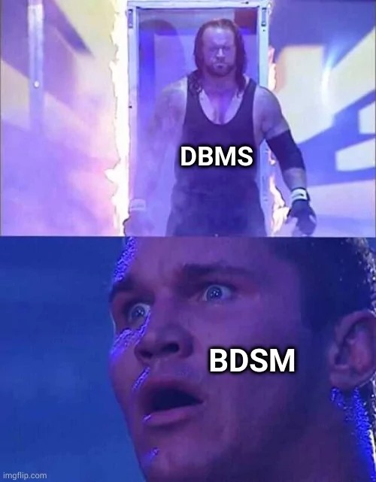
Thank you for your patience

