Slide 1



AdventureWorks_Report_COMPLETE
View in Power BI
Last data refresh:
26/02/2023 10:48:51 UTC
Downloaded at:
26/02/2023 10:58:56 UTC

Slide 2
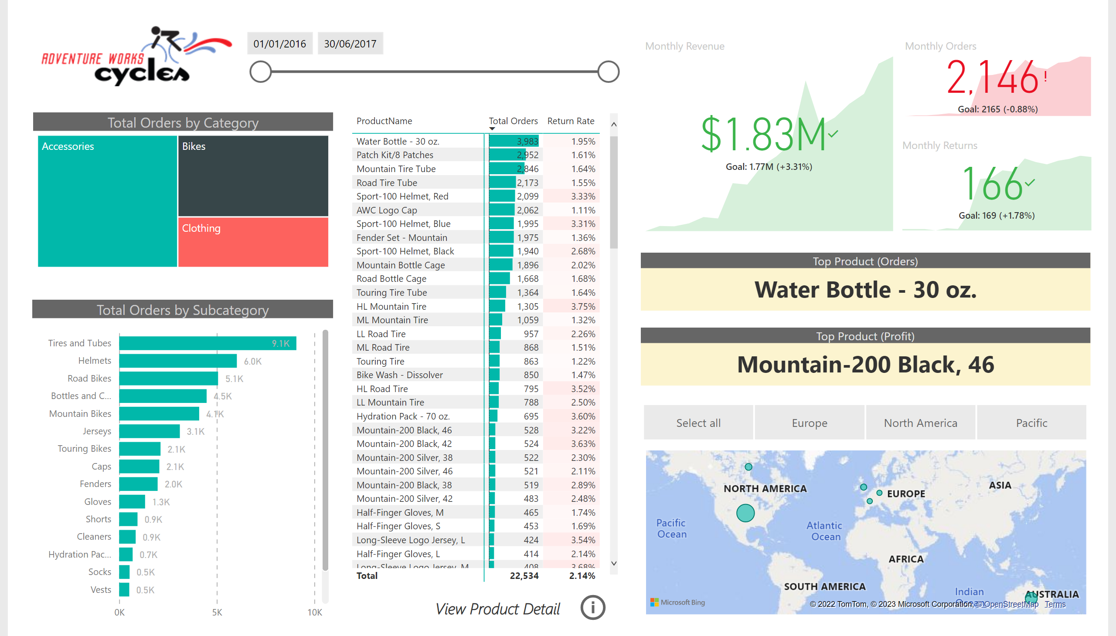
Exec Summary
Notes:
image
No alt text provided
Total Orders by Subcategory
No alt text provided
Total Orders by Category
No alt text provided
pivotTable
No alt text provided
slicer
No alt text provided
Monthly Revenue
No alt text provided
Monthly Orders
No alt text provided
Monthly Returns
No alt text provided
Top Product (Orders)
No alt text provided
Top Product (Profit)
No alt text provided
map
No alt text provided
slicer
No alt text provided
textbox
No alt text provided
actionButton
No alt text provided

Slide 3
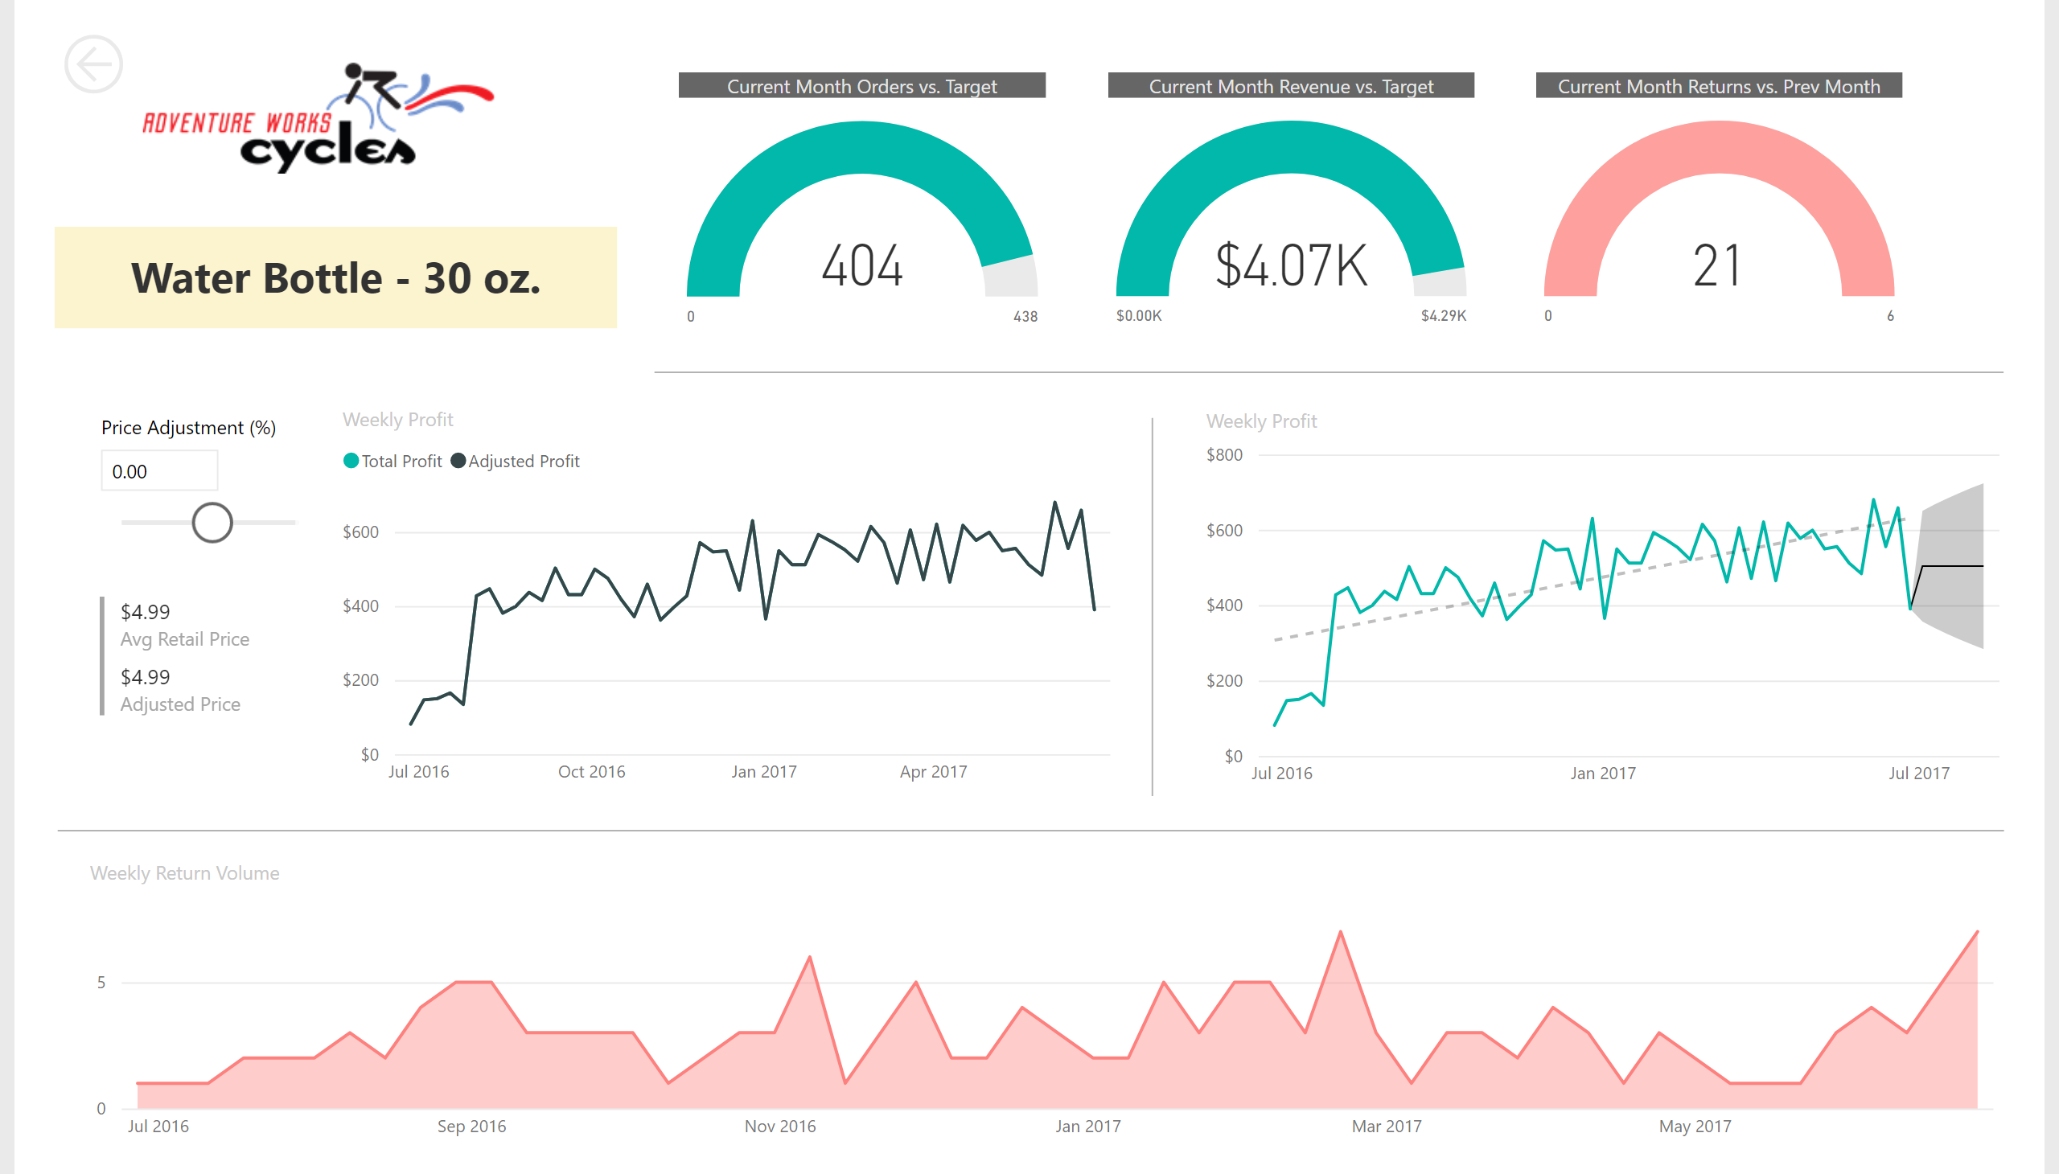
Product Detail
Notes:
image
No alt text provided
Weekly Profit
No alt text provided
Weekly Return Volume
No alt text provided
Current Month Orders vs. Target
No alt text provided
Current Month Revenue vs. Target
No alt text provided
Current Month Returns vs. Prev Month
No alt text provided
card
No alt text provided
basicShape
No alt text provided
slicer
No alt text provided
multiRowCard
No alt text provided
Weekly Profit
No alt text provided
basicShape
No alt text provided
basicShape
No alt text provided
basicShape
No alt text provided

Slide 4
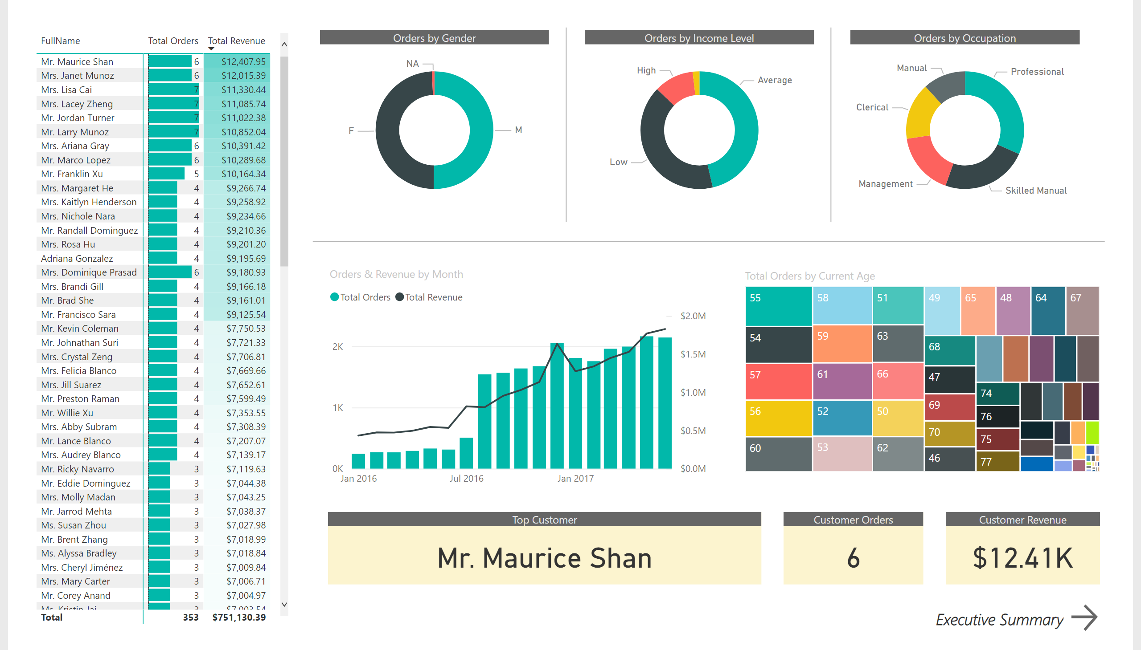
Customer Detail
Notes:
pivotTable
No alt text provided
Orders by Gender
No alt text provided
Orders by Income Level
No alt text provided
Orders by Occupation
No alt text provided
Orders & Revenue by Month
No alt text provided
treemap
No alt text provided
Top Customer
No alt text provided
Customer Orders
No alt text provided
Customer Revenue
No alt text provided
textbox
No alt text provided
actionButton
No alt text provided
basicShape
No alt text provided
basicShape
No alt text provided
basicShape
No alt text provided

