Slide 1
Creating simple Ci/CD chain for Flask app
Bohdan Fedorov
Student of EPAM DevOps Winter Program 2020-2021

Slide 2
Main aim
Automatization of delivery new artifacts of Flask app to Docker Hub repository for following deploying to target server

Slide 3



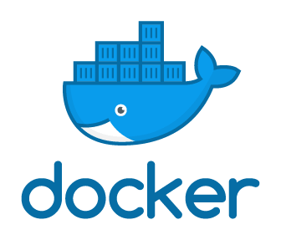

Used tools

Slide 4

CI/CD chain
manually

Slide 5
sequencing of Configuration
Creating two VMs on AWS: Jenkins VM and VM with installed Docker
Installation Jenkins, creating and configuration Job
Installation Docker and creating Docker Hub Account
Configuration of GitHub
Testing CI/CD chain

Slide 6
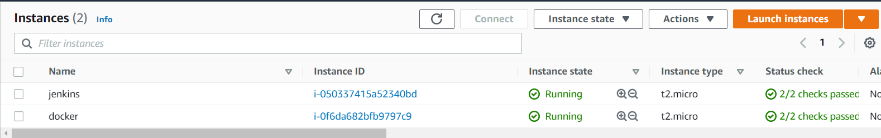
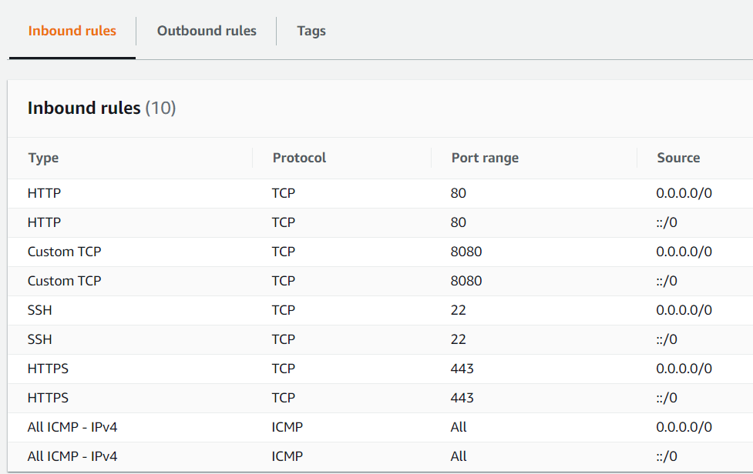
AWS configuration
Attention!

Slide 7
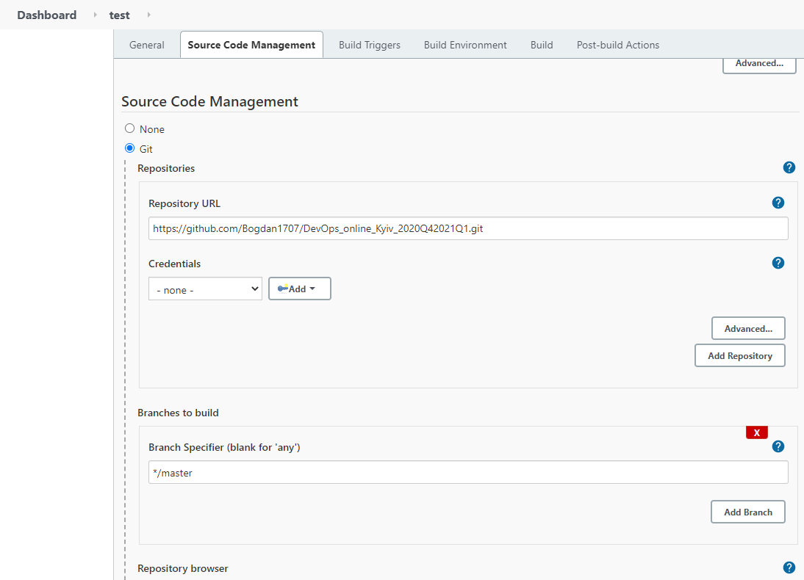

Jenkins Configuration

Slide 8
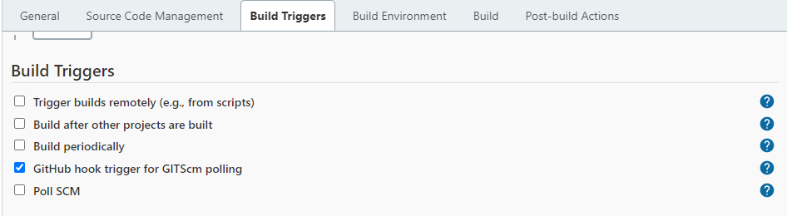

Jenkins Configuration

Slide 9
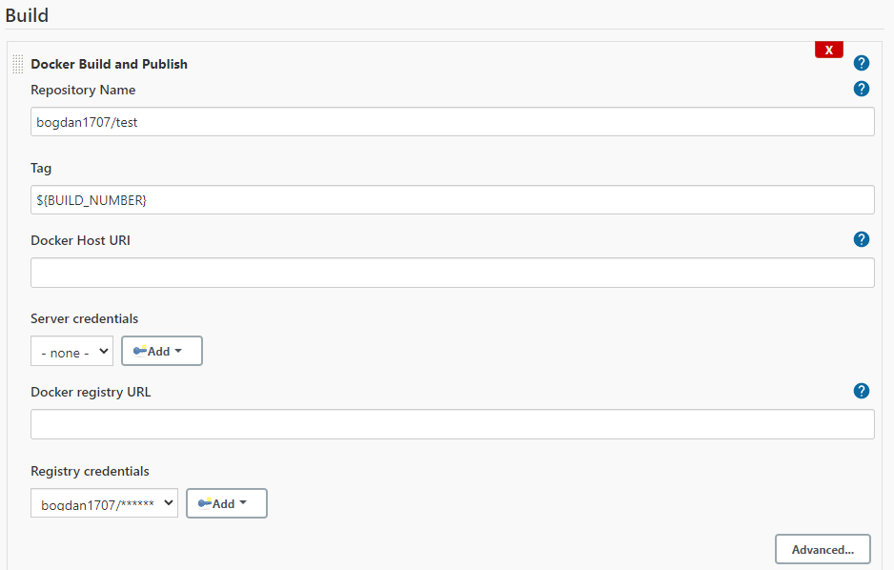

Jenkins Configuration

Slide 10
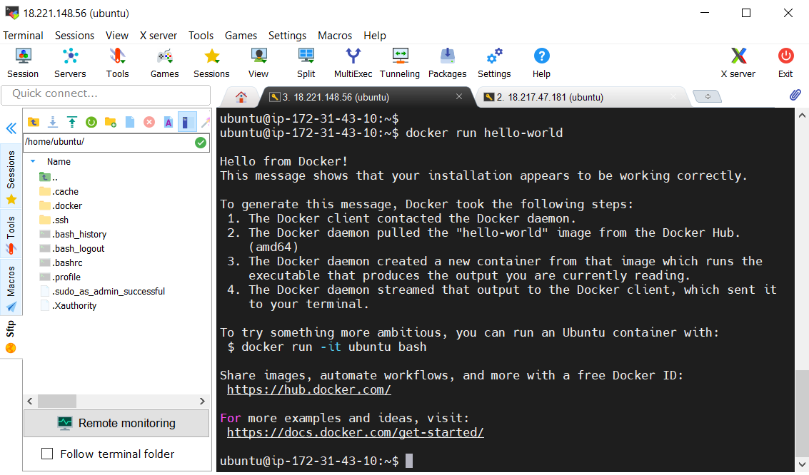
Docker Configuration

Slide 11
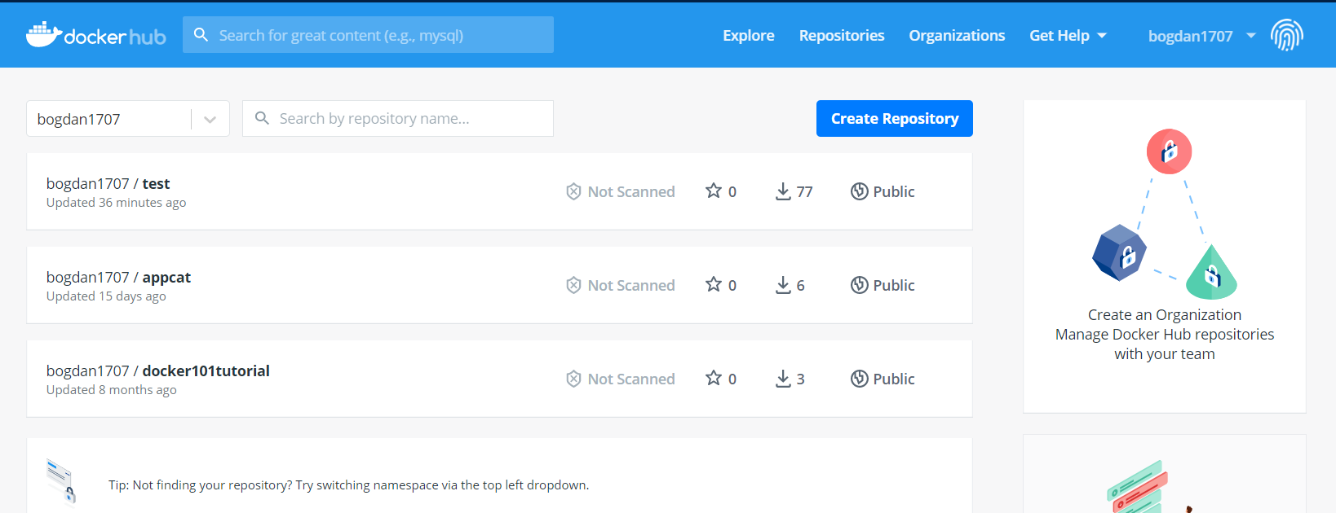
Docker Configuration

Slide 12
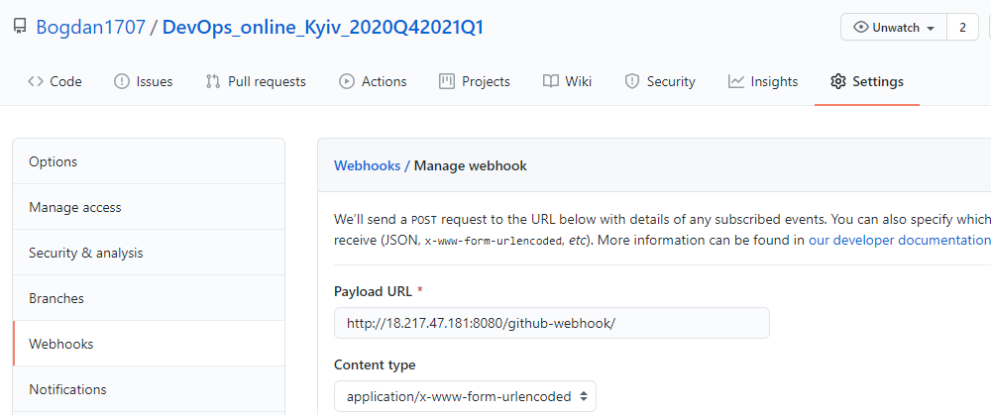
GitHub configuration

Slide 13
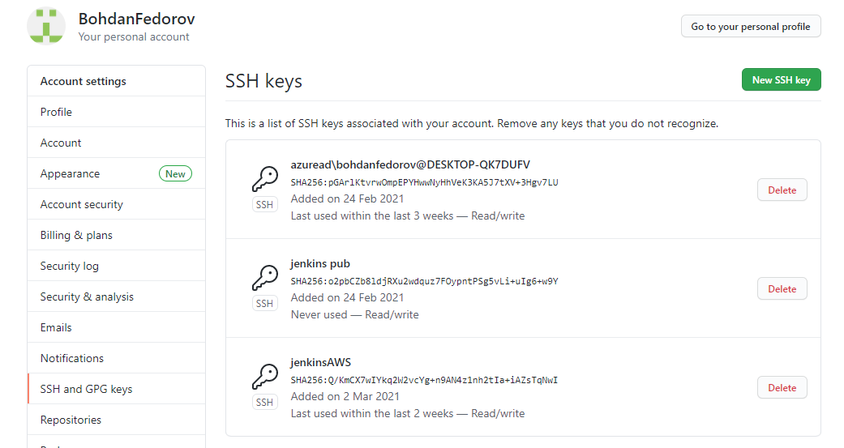
GitHub configuration

Slide 14
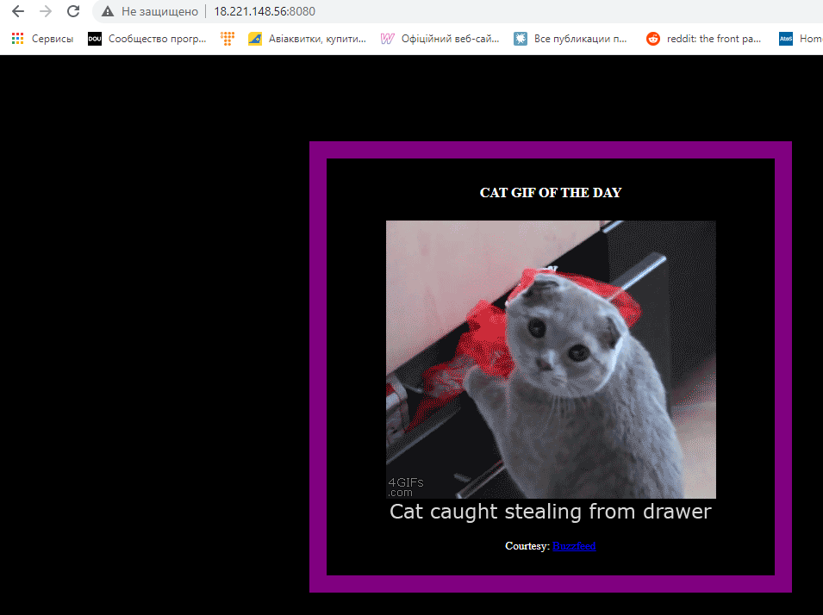
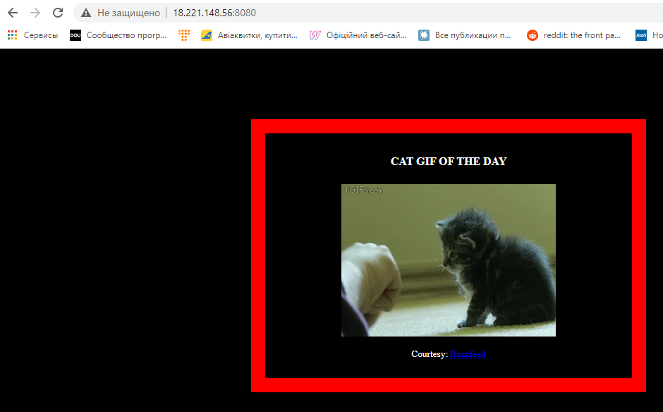
Final Test
Before
After
Project URL: Cat App

Slide 15
How to improve this project?
Deployment process automatization;
Instance configuration (Elastic IP, SecGroups etc.)
Jenkins configuration (adding Slaves)

Slide 16
Thank you for Attention! Q&A

