Slide 1


Accessibility with SPA's
CanberraJS

Slide 2

The web landscape
We're using more complex Javascript frontend frameworks to generate web content. Accessibility isn't made more difficult, the same rules still apply.

Slide 3
Why accessibility?
Because it’s the right thing to do
Because its not hard or expensive
Because of Government, Government digital services have to be accessible to WCAG 2.0 AA

Slide 4
A recap on WCAG 2/2.1
International best practice standard to make websites accessible
AAA
most comprehensive and requires more work to
bring a website up to speed
AA
Is the compromise between effort and accessibility
A
basic level of accessibility it'll help some people and it doesn’t take much overhead

Slide 5
Websites
Generally straightforward to make a website accessible. They're static with little functionality.

Slide 6
Web applications
More challenging to make accessible. Handling complex functionality means we need to put greater emphasis into adding the accessibility.

Slide 7
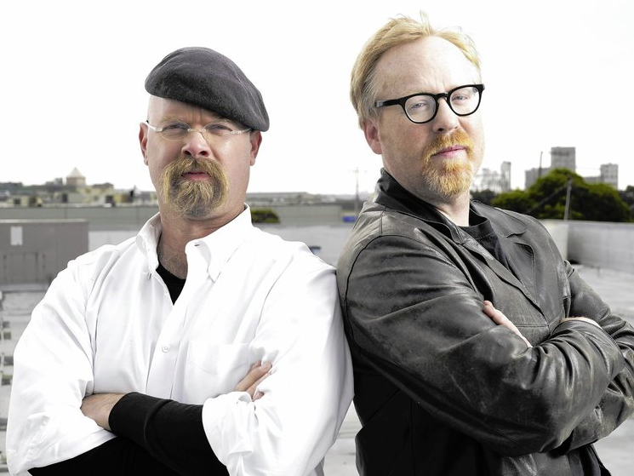
Mythbusting
Javascript frameworks don't make a web application any more or any less accessible

Slide 8
Accessibility in React
"React fully supports building accessible websites, often by using standard HTML techniques"
https://reactjs.org/docs/accessibility.html

Slide 9
Accessibility in Angular 7
"Create accessible applications with ARIA-enabled components, developer guides, and built-in a11y test infrastructure"
https://angular.io/features

Slide 10
Beware
Even though a framework has good support for accessibility doesn’t mean you don’t need to do anything.

Slide 11
Implementation is key
The accessibility is solely down to how it's implemented, if your code has poor accessibility support the outcome won't be great.

Slide 12
Single Page Apps
Are more complicated, which means the accessibility has to be more involved.

Slide 13
Prioritising effort
Focus less about colour contrast, link text and correct heading structure.

Slide 14
Rules to develop to
Write HTML according to specifications
Make elements focusable from the keyboard
Page updates need to be announced

Slide 15
1. Write HTML according to specs
Use elements the correct way, if you need a button use a button.

Slide 16
Building your own elements
Means you need to add accessibility behaviour back onto the controls, it’s a massive headache and it takes time. Do you need to make custom controls?

Slide 17
Building your own elements
<span>Click Me</span>
<div>Click Me</div>
SPAN and DIV elements have no default behaviour, it needs to be built in.

Slide 18
Building a button
<div role="button">Click Me</div>
+ Add the ARIA role

Slide 19
Building a button
<div role="button" tabindex="0">Click Me</div>
+ Add the ARIA role
+ Add the tabindex

Slide 20
Building a button
<div role="button" tabindex="0">Click Me</div>
+ Add the ARIA role
+ Add the tabindex
+ Add the style change

Slide 21
Or just use a button
<button>Click Me</button>

Slide 22
Semantic elements
They just work, assistive technology interprets them correctly. No extra work is needed.

Slide 23
The trade off
Semantic interface = works as intended
Custom interface = adding accessibility back

Slide 24
2. Keyboard focusable
Make everything focusable from the keyboard, some people may use the keyboard over the mouse.

Slide 25
Use the tabindex attribute wisely
Can be used to reorder the entire keyboard tab sequence if not careful. If you use regular elements in a regular way, this behaviour is already included by default.

Slide 26
Positioning
<a href="blah.html tabindex="10">blah</a>
Refers to the tab position of the element on the page

Slide 27
Pick a number
tabindex="0" element appears in the regular keyboard sequence
tabindex="-1" element is hidden from the keyboard sequence
tabindex="1" + goodbye regular keyboard sequence!

Slide 28
Don’t do this
<a href="blah.html" tabindex="1">blah</a>

Slide 29
Or this
<a href="blah.html" tabindex="10">blah</a>

Slide 30
Or even this
<a href="blah.html" tabindex="1010">blah</a>

Slide 31
Tabindex of +1 and above
<a href="blah.html" tabindex="1">blah</a>

Slide 32
3. Updates need to be announced
Announce the change if the page updates.

Slide 33
What's it doing?
SPA's may not always trigger a full page refresh, if a user is vision impaired they won't know a change has occurred.

Slide 34
Introducing ARIA
Set of attributes which generate behaviour in assistive technology to announce changes to help a web application work better for AT users.

Slide 35
Need to announce an update?
An aria live region can trigger a screen reader to announce new content.

Slide 36
Need to announce an update?
<div aria-live="polite">
Content to announce
</div>

Slide 37
ARIA live region
X
Content updated
"Content updated"
static content
q
Updating page content

Slide 38
Automate the heavy lifting
Reach Router for React
"Router manages the focus of your app on route transitions. There’s nothing you have to do about it, it just happens."
LiveAnnouncer Angular Material
"LiveAnnouncer is used to announce messages for screen-reader users using an aria-live region"

Slide 39
This is just scratching the surface
Accessibility is complex and challenging, different browsers and screen readers will affect end results.

Slide 40
Focus on the hard and difficult
Use semantic elements
Don’t alter the tabindex
Announce updates with ARIA live regions

Slide 41
For more information
Get the code at github.com/canaxess/presentations
navigate to CanberraJS
www.canaxess.com.au
ross.mullen@canaxess.com.au
@MrRossMullen

