Slide 1
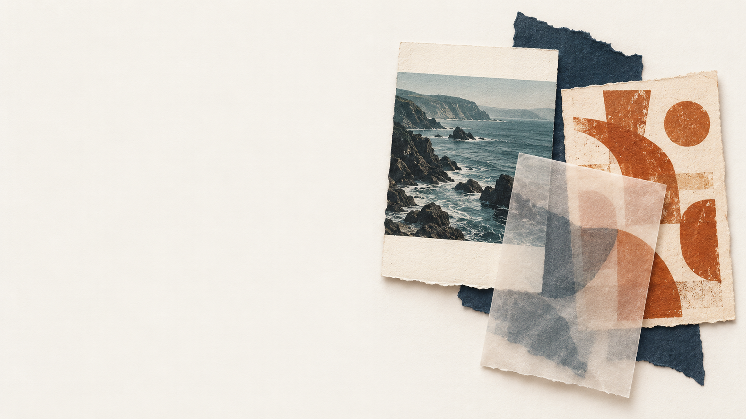
Detecting hate
in memes
What can AI learn from
pictures or words alone?
Bogdan Fanea, Lena Bryll, Natalie Stadler
https://github.com/BogdanFanea/SpecialTopicSocialMining
Notes:
PRESENTER CONTEXT
Slides 1–10 form an approximately 8–10 minute talk. Slides 11–13 are backup material for questions. Replace the three author placeholders before presenting. The next slide contains a discriminatory dataset example, discussed critically.
TALK TRACK (about 20 seconds)
This project asks a limited question: how well can existing AI models recognise hateful memes when they receive only the picture or only the written caption? We compared four models under the same conditions. The main finding is that the stronger image and text models finish close together, while individual examples show how much context each approach can miss.
SOURCES
Source: /Users/davidklingbeil2/Downloads/Special_Topics/report.tex, /Users/davidklingbeil2/Downloads/Special_Topics/artifacts/results.json, and /Users/davidklingbeil2/Downloads/Special_Topics/artifacts/analysis.json.
Cover illustration: generated with the built-in image generation tool, not experimental data. Saved asset: /Users/davidklingbeil2/Downloads/Special_Topics/.presentation-build/cover.png. Prompt: Wide editorial paper collage on warm off-white, with right-side meme-like cards, a teal coastline fragment, unreadable rust-orange marks and translucent paper. Leave the left half empty for an editable title. No readable text, people, symbols, logos, charts or hateful content.

Slide 2
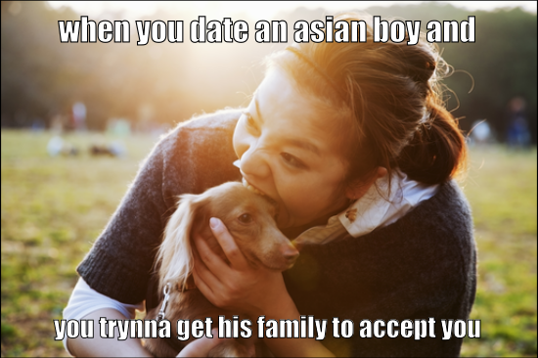
Why the picture and caption matter together
Picture alone
A woman with a dog.
Words alone
Trying to win a boyfriend’s family over.
Together
The dog-eating stereotype makes the meme hateful.
Dataset example 48296
Image is a compilation of assets, including ©Getty Image.
2
Notes:
TALK TRACK (about 60 seconds)
A meme combines a picture and a written message. The picture here shows a woman with a dog. The caption, considered alone, describes wanting a boyfriend's family to accept someone. Together, the dog and the reference to an Asian boyfriend invoke a racist dog-eating stereotype. That is why this example has a hateful label in the course dataset. Explain the mechanism critically rather than repeating the stereotype as a factual claim.
Our study separates the inputs on purpose. It tests how much each model can recover from only one source of information. This example also reminds us that a caption can look fairly ordinary until the picture supplies its missing meaning.
If asked: the example ID is 48296. The report's image model gives it 0.156 and text model 0.771 in the selected seed, with a hateful label of 1. A correct text prediction may reflect a shortcut rather than an understanding of the image.
IMAGE SOURCE
/Users/davidklingbeil2/Downloads/Special_Topics/data/img/48296.png, Hateful Memes dataset. Image is a compilation of assets, including ©Getty Image.
SOURCES (do not read aloud)
Source: /Users/davidklingbeil2/Downloads/Special_Topics/report.tex, /Users/davidklingbeil2/Downloads/Special_Topics/artifacts/results.json, and /Users/davidklingbeil2/Downloads/Special_Topics/artifacts/analysis.json.

Slide 3
Four models, one input type at a time
Input | Model | Pretraining
Pictures | ResNet-50 | Visual patterns for recognising objects
Pictures | CLIP | Visual patterns learned with help from captions
Words | MiniLM | Sentence meaning with a compact model
Words | MPNet | Sentence meaning with a larger model
Each encoder uses one input type and its own linear classifier.
3
Notes:
TALK TRACK (about 50 seconds)
We used two picture readers and two text readers. A reader is a pretrained encoder: a model that turns an input into a list of numerical features. You do not need to know the numbers to follow the comparison. ResNet-50 originally learned to recognise objects. CLIP learned picture patterns using image-caption pairs during pretraining. MiniLM and MPNet learned representations of sentence meaning, with MPNet being the larger model.
During this experiment, each image model received only meme pixels, and each text model received only the supplied caption. We never combined the feature lists. CLIP's text tower did not run. Its prior language-based training is still relevant when we interpret the results.
MODEL SOURCES
https://docs.pytorch.org/vision/0.19/models/generated/torchvision.models.resnet50.html
https://huggingface.co/openai/clip-vit-base-patch32
https://huggingface.co/sentence-transformers/all-MiniLM-L6-v2
https://huggingface.co/sentence-transformers/all-mpnet-base-v2
SOURCES (do not read aloud)
Source: /Users/davidklingbeil2/Downloads/Special_Topics/report.tex, /Users/davidklingbeil2/Downloads/Special_Topics/artifacts/results.json, and /Users/davidklingbeil2/Downloads/Special_Topics/artifacts/analysis.json.

Slide 4
How we kept the comparison fair
8,500
500
1,000
Training
Validation
Test
Learn patterns
Choose settings
Check final performance
We trained the same type of linear classifier for each encoder.
The encoders stayed frozen. We ran each setting with three seeds.
4
Notes:
TALK TRACK (about 60 seconds)
We used the course's original data split. Think of training as learning from worked examples, validation as a practice exam for choosing settings, and test as the final exam after those choices are locked. There are 8,500 training examples, 500 validation examples and 1,000 test examples. The validation set contains equal numbers of hateful and non-hateful memes.
Every reader stayed fixed. On top of its numerical features, we trained the same small linear decision rule. We tried six settings for each reader and repeated each setting three times with different random starting points. That makes 72 classifier fits. We chose settings and saved checkpoints using validation performance only, then evaluated the final checkpoints on test. We did not train a combined picture-and-text model.
The test labels came from a public mirror. Slide 9 explains that limitation. The original training and validation labels stayed unchanged.
SOURCES (do not read aloud)
Source: /Users/davidklingbeil2/Downloads/Special_Topics/report.tex, /Users/davidklingbeil2/Downloads/Special_Topics/artifacts/results.json, and /Users/davidklingbeil2/Downloads/Special_Topics/artifacts/analysis.json.

Slide 5
The score measures how well models rank memes
0.50
0.66
1.00
Chance ordering
Our stronger
results
Perfect ordering
A score near 0.66 means the hateful example ranks higher
in about 66 of 100 random hateful/non-hateful pairs.
AUROC is a ranking score. The percentage refers to pairs of examples.
5
Notes:
TALK TRACK (about 60 seconds)
Our main score is called AUROC. It measures ordering. Imagine drawing one hateful and one non-hateful example at random. We ask whether the model gives the hateful example the higher hateful-class score. An AUROC of 0.50 corresponds to chance ordering. A score of 1.00 corresponds to perfect ordering. A score near 0.66 means the hateful example ranks higher in roughly 66 out of 100 such pairs. Ties receive half credit in the formal definition.
This is not a claim that 66 percent of individual memes were classified correctly. Classification accuracy depends on a decision threshold. AUROC uses all the continuous scores and does not require that threshold. Our 0.5 threshold appears only in the example analysis. Higher AUROC is better.
The 0.66 illustration approximates the stronger measured test results, which range from about 0.655 to 0.660.
METRIC SOURCE
https://scikit-learn.org/1.5/modules/generated/sklearn.metrics.roc_auc_score.html
SOURCES (do not read aloud)
Source: /Users/davidklingbeil2/Downloads/Special_Topics/report.tex, /Users/davidklingbeil2/Downloads/Special_Topics/artifacts/results.json, and /Users/davidklingbeil2/Downloads/Special_Topics/artifacts/analysis.json.

Slide 6
Three models finish close together on test
The highest observed score is only about 0.005 above CLIP.
Test AUROC uses public-mirror labels. We could not confirm they are official.
6
Notes:
TALK TRACK (about 70 seconds)
These bars show the average test AUROC over the three selected runs. ResNet-50 scores 0.539. CLIP scores 0.655. MiniLM scores 0.660. MPNet scores 0.657. The full axis runs from zero to one, so the chart does not exaggerate the small differences among the three stronger models. The colours identify picture models in teal and text models in rust.
CLIP substantially improves on the other picture reader, ResNet-50. MiniLM has the highest observed test mean, but it leads CLIP by only about 0.005. That is too small to present as a reliable overall winner from this experiment. The complete means and run-to-run standard deviations are in backup slide 11. These test scores use public-mirror labels whose official provenance we could not confirm.
Do not describe the bars as percentages of correct classifications. The chart shows AUROC, explained on the previous slide.
SOURCES (do not read aloud)
Source: /Users/davidklingbeil2/Downloads/Special_Topics/report.tex, /Users/davidklingbeil2/Downloads/Special_Topics/artifacts/results.json, and /Users/davidklingbeil2/Downloads/Special_Topics/artifacts/analysis.json.

Slide 7
The two text models change places
Text model | Validation AUROC | Test AUROC
MiniLM | 0.631 | 0.660
MPNet | 0.639 | 0.657
Model choices came from validation only.
The small differences do not establish a reliable winner.
Test AUROC uses public-mirror labels. We could not confirm they are official.
7
Notes:
TALK TRACK (about 50 seconds)
The text-model ordering changes between the validation set and the final test set. MPNet leads on validation, with 0.639 compared with MiniLM's 0.631. MiniLM leads on test, with 0.660 compared with MPNet's 0.657. This matters because our model choices came from validation only. We therefore chose MPNet as the text representative for the detailed example comparison, even though MiniLM later had the higher test mean.
For the validation-selected pair, CLIP and MPNet have test means of 0.6552 and 0.6566, a gap of 0.0014. The results support a cautious conclusion that the stronger image and text approaches perform similarly here. Three random seeds measure training variability, not uncertainty from the sample of memes or the labels. No statistical significance test established a winner.
SOURCES (do not read aloud)
Source: /Users/davidklingbeil2/Downloads/Special_Topics/report.tex, /Users/davidklingbeil2/Downloads/Special_Topics/artifacts/results.json, and /Users/davidklingbeil2/Downloads/Special_Topics/artifacts/analysis.json.

Slide 8
The models often disagree about the same meme
167 / 500
An anti-racist caption
MPNet flags it as hateful.
The supplied label says non-hateful.
validation examples produced
opposite decisions
A harmful stereotype
CLIP misses the link between
the portrait and the caption.
Decision rule: a hateful-class score
of 0.5 or higher counts as hateful.
8
Notes:
TALK TRACK (about 65 seconds)
Using the best image and text readers selected on validation, CLIP and MPNet, the seed-42 models give opposite decisions for 167 of the 500 validation memes. The rule is fixed: scores of 0.5 or higher count as hateful. This disagreement count is for one selected seed, not an average over all three runs. It does not tell us which model is right.
Two examples explain why. In example 01967, a caption describes stopping racism by burning its symbol. The image identifies that symbol as a swastika. The supplied label is non-hateful, but the text model flags it as hateful. It may be reacting to hostile-sounding words while missing the anti-racist stance. CLIP scores 0.118 and MPNet 0.765.
In example 19536, an altered-nose portrait and a caption about a Jewish friend finding coins invoke antisemitic stereotypes. The supplied label is hateful. CLIP misses it with 0.052, while MPNet scores 0.664. The image reader misses the combination, and the text reader may succeed using explicit lexical cues. These are interpretation hypotheses, not feature-attribution results.
ADDITIONAL REPORT CASES
38047: label 0, image 0.160, text 0.853. A gendered insult over a political photo raises label ambiguity.
82509: label 0, image 0.145, text 0.818. A vulgar caption over a runway photo may trigger lexical overreaction.
48296: label 1, image 0.156, text 0.771. The picture and caption invoke an anti-Asian dog-eating stereotype.
The report selected the five largest score-gap disagreements. They illustrate failure types rather than representative error frequencies.
SOURCES (do not read aloud)
Source: /Users/davidklingbeil2/Downloads/Special_Topics/report.tex, /Users/davidklingbeil2/Downloads/Special_Topics/artifacts/results.json, and /Users/davidklingbeil2/Downloads/Special_Topics/artifacts/analysis.json.

Slide 9
The test labels need careful interpretation
The course’s test examples had no labels.
A public copy supplied matching labels
for all 1,000 examples.
We could not confirm these
are the official test labels.
We kept the supplied training and validation labels.
9
Notes:
TALK TRACK (about 45 seconds)
Labels tell us whether each meme is hateful. The course's test examples did not include labels. We recovered annotations from a public mirror. We checked that all 1,000 example IDs, captions and image paths exactly matched the supplied test examples. The file is also byte-identical to a Kaggle copy documented by a research implementation. Those are useful consistency checks, but they do not authenticate it as the original competition ground truth.
Public copies also differ in some labels. The mirror disagrees with the course files on 823 training labels and three validation labels. We retained the course's original training and validation labels, and used the external labels only for final test evaluation. The test labels comprise 510 non-hateful and 490 hateful examples. We disclose the limitation rather than presenting these as official leaderboard scores.
ANNOTATION SOURCES
https://huggingface.co/datasets/neuralcatcher/hateful_memes/blob/d201c488dc7024623d1ecbcc987b3f132c4c2e12/test_seen.jsonl
https://github.com/YiLunLee/missing_aware_prompts/blob/9aa538159f4623de1936d25daee880ec47c062be/DATA.md
/Users/davidklingbeil2/Downloads/Special_Topics/data/external/provenance.json
SOURCES (do not read aloud)
Source: /Users/davidklingbeil2/Downloads/Special_Topics/report.tex, /Users/davidklingbeil2/Downloads/Special_Topics/artifacts/results.json, and /Users/davidklingbeil2/Downloads/Special_Topics/artifacts/analysis.json.

Slide 10
What the results show
CLIP is the strongest picture model.
The stronger image and text models
reach similar test AUROC scores.
Pictures or words alone
can miss the context that makes a meme hateful.
10
Notes:
TALK TRACK (about 45 seconds)
The strongest picture reader in this comparison is CLIP. The stronger picture and text readers achieve similar test ranking scores. The model size alone does not determine the result: the larger MPNet leads text on validation, while the smaller MiniLM has the higher test mean.
The examples show how much interpretation depends on the relationship between a picture and its caption. A model can miss a stereotype, overreact to provocative words, or arrive at a correct answer for the wrong reason. Image input can still contain written text, so we cannot interpret image-only performance as purely visual reasoning.
Our assignment establishes starting-point comparisons, often called baselines. We did not train or evaluate a model that combines picture and text. Testing such a model would be a separate next study, and this experiment cannot promise how much it would improve. The public-mirror test labels also limit the conclusion.
Stop the main talk here and invite questions. The next three slides are backup material.
SOURCES (do not read aloud)
Source: /Users/davidklingbeil2/Downloads/Special_Topics/report.tex, /Users/davidklingbeil2/Downloads/Special_Topics/artifacts/results.json, and /Users/davidklingbeil2/Downloads/Special_Topics/artifacts/analysis.json.

Slide 11
Backup: complete results
Model | Input | Validation AUROC | Test AUROC
ResNet-50 | Pictures | 0.5429 ± 0.0218 | 0.5390 ± 0.0091
CLIP | Pictures | 0.6445 ± 0.0049 | 0.6552 ± 0.0033
MiniLM | Words | 0.6310 ± 0.0019 | 0.6603 ± 0.0016
MPNet | Words | 0.6390 ± 0.0031 | 0.6566 ± 0.0069
Average ± sample standard deviation across three runs.
The spread measures training variability, not sampling confidence.
Test AUROC uses public-mirror labels. We could not confirm they are official.
11
Notes:
REFERENCE NOTES
These are the exact report values, rounded to four decimal places. Each entry is mean plus or minus sample standard deviation of AUROC across seeds 42, 43 and 44. The three selected checkpoints are independent models, not an ensemble. Test results use public-mirror labels.
ResNet-50: validation 0.542920 ± 0.0218459, test 0.539044 ± 0.0091363.
CLIP: validation 0.644475 ± 0.0049166, test 0.655193 ± 0.0033094.
MiniLM: validation 0.631035 ± 0.0019216, test 0.660271 ± 0.0016394.
MPNet: validation 0.639024 ± 0.0031404, test 0.656608 ± 0.0069251.
A small standard deviation here means similar results from different classifier initialisations. It does not establish confidence about a different sample of memes, a different label release, or real-world deployment.
SOURCES (do not read aloud)
Source: /Users/davidklingbeil2/Downloads/Special_Topics/report.tex, /Users/davidklingbeil2/Downloads/Special_Topics/artifacts/results.json, and /Users/davidklingbeil2/Downloads/Special_Topics/artifacts/analysis.json.

Slide 12
Backup: method and common questions
Question | Answer
What did we train? | One linear classifier per encoder
What stayed fixed? | All pretrained encoders
How did we choose settings? | Validation AUROC only
How many runs? | 6 settings × 3 seeds × 4 encoders = 72 fits
What could a next study test? | A model that combines pictures and words
12
Notes:
REFERENCE NOTES
An encoder is the pretrained reader that maps an image or text into a numerical feature vector, also called an embedding. Frozen means that none of its weights change during this experiment. A linear classifier is a single learned weighted sum of those features plus a bias. A sigmoid converts the output to a score between zero and one. Binary cross-entropy trains the score against the known 0/1 label.
Feature dimensions are 2,048 for ResNet-50, 512 for CLIP, 384 for MiniLM and 768 for MPNet. Training-only standardisation sets a comparable per-feature scale without using validation or test statistics. Image inputs use the checkpoint's prescribed resizing and normalisation. Text inputs use the matching tokenizer and masked mean pooling, followed by L2 normalisation. Maximum lengths are 256 and 384 tokens. No examples were truncated.
AdamW trains each classifier for 50 epochs with batch size 256. Learning rates are 0.0001, 0.001 and 0.01, and weight decay is 0 or 0.01. The seeds are 42, 43 and 44. We retain each fit's best validation epoch, then choose the configuration with the highest mean validation AUROC. There is no class weighting, encoder fine-tuning, feature fusion or threshold tuning.
EXACT CHECKPOINTS
ResNet50_Weights.IMAGENET1K_V2
openai/clip-vit-base-patch32
sentence-transformers/all-MiniLM-L6-v2
sentence-transformers/all-mpnet-base-v2
Immutable revisions, sources and selected epochs are in config.json and the report.
SOURCES (do not read aloud)
Source: /Users/davidklingbeil2/Downloads/Special_Topics/report.tex, /Users/davidklingbeil2/Downloads/Special_Topics/artifacts/results.json, and /Users/davidklingbeil2/Downloads/Special_Topics/artifacts/analysis.json.

Slide 13
Backup: sources
Report and experiment outputs
report.tex, results.json and the inspected validation examples
Kiela et al. (2020), The Hateful Memes Challenge
Pretrained models: TorchVision, OpenAI CLIP
and Sentence Transformers
Test annotations: neuralcatcher/hateful_memes
Full source links and label-provenance details appear in the speaker notes.
13
Notes:
SOURCES
Report: /Users/davidklingbeil2/Downloads/Special_Topics/report.tex
Results: /Users/davidklingbeil2/Downloads/Special_Topics/artifacts/results.json
Examples and analysis: /Users/davidklingbeil2/Downloads/Special_Topics/artifacts/analysis.json and artifacts/error_analysis.json
Dataset paper: https://arxiv.org/abs/2005.04790
TorchVision ResNet-50: https://docs.pytorch.org/vision/0.19/models/generated/torchvision.models.resnet50.html
CLIP paper: https://arxiv.org/abs/2103.00020
CLIP checkpoint: https://huggingface.co/openai/clip-vit-base-patch32
MiniLM: https://huggingface.co/sentence-transformers/all-MiniLM-L6-v2
MPNet: https://huggingface.co/sentence-transformers/all-mpnet-base-v2
Test labels: https://huggingface.co/datasets/neuralcatcher/hateful_memes/blob/d201c488dc7024623d1ecbcc987b3f132c4c2e12/test_seen.jsonl
Research implementation documenting the Kaggle test-label copy: https://github.com/YiLunLee/missing_aware_prompts/blob/9aa538159f4623de1936d25daee880ec47c062be/DATA.md
ACKNOWLEDGMENTS
The original image on slide 2 carries the attribution requested by the dataset: Image is a compilation of assets, including ©Getty Image. The cover is a generated conceptual illustration, not dataset evidence.
SOURCES (do not read aloud)
Source: /Users/davidklingbeil2/Downloads/Special_Topics/report.tex, /Users/davidklingbeil2/Downloads/Special_Topics/artifacts/results.json, and /Users/davidklingbeil2/Downloads/Special_Topics/artifacts/analysis.json.

