Slide 2
Introduction to the R.A.D.U Project
NTT Data Corporation
HERCIU Bogdan
Version 1.7 / 04.10.12

Slide 3

Welcome to NTT Data

Slide 4

Index
Project Scope
Agenda
Daily Sync
Schedule

Slide 5

Project Scope
R.A.D.U. - Requirements And Design Utility
1. Store Requirements
Xml file
Requirements and Document Settings
2. Track Project Requirements
Perform Code Coverage
3. Monitor Requirements
Track Requirements Change
5. Statictics
4. Compare Between Baselines
Check the changes between Baselines
Code Coverage Percentage
Version Mismatch Requirements

Slide 6
Today’s Agenda
Install Environment (GitHub and Visual Studio Community)
GitHub YouTube Tutorial.
Get familiar with the project.
Try to understant the code that is already developed.

Slide 7

Daily Sync
Location:
- To be Decided. (in the office).
Participants:
- One NTT Data employee and YOU!
Duration:
- No more than 20 minutes
Purpose:
Answering the following three questions:
What did I do yesterday that helped the
development team meet my daily goal?
What will I do today?
Do I see any impediment in the near future?

Slide 8


Team work vs. individual work
vs.

Slide 9

Schedule
Preferable:
- All three to have the same time slot.

Slide 10


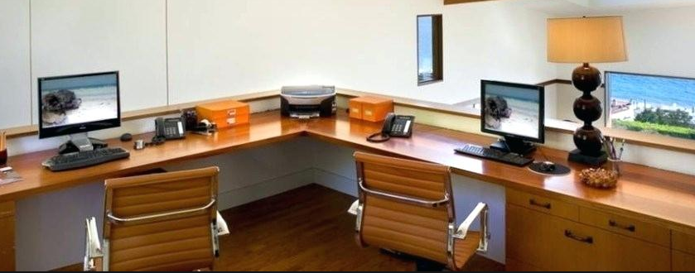
Remainder
Lunch Break
Relaxation Area
4th Floor
Office
1st Floor
11th Floor

Slide 11
Thank you for your attention!
NTT Data Corporation
Introduction to the R.A.D.U Project
Version 1.7 / 04.10.12

