Slide 1
How to design for color blind people?
Aleksandra Gacek
Piotr Luboń

Slide 2
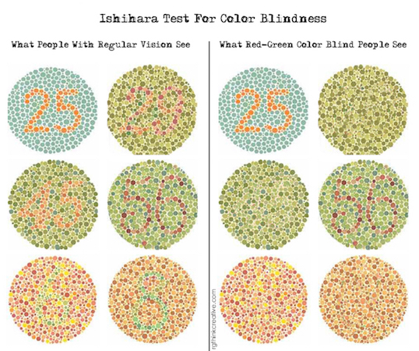
Notes:
https://usabilla.com/blog/wp-content/uploads/2015/11/red-green-color-blind-isihara-test-rgthinkcreative-1.jpg

Slide 3
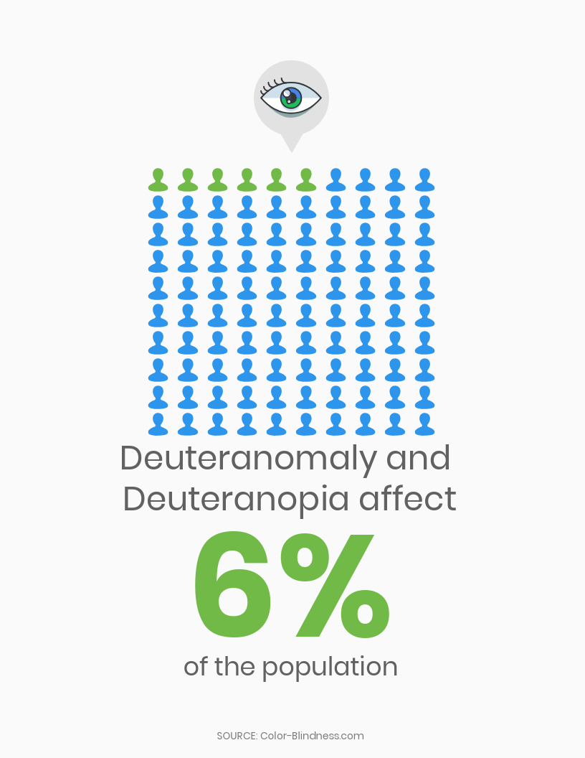

Slide 4
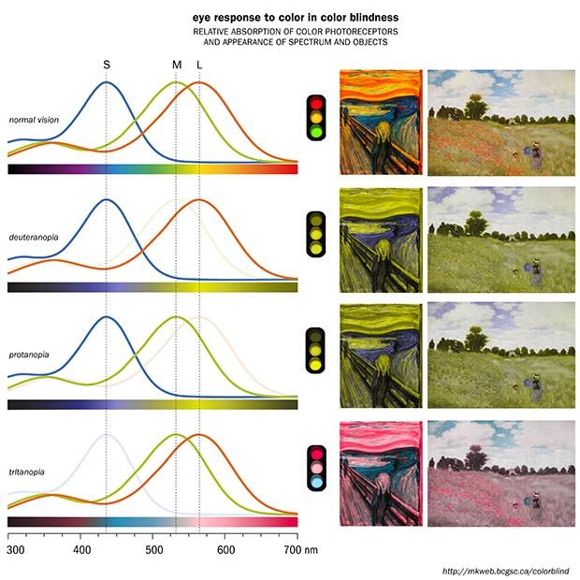

Slide 5
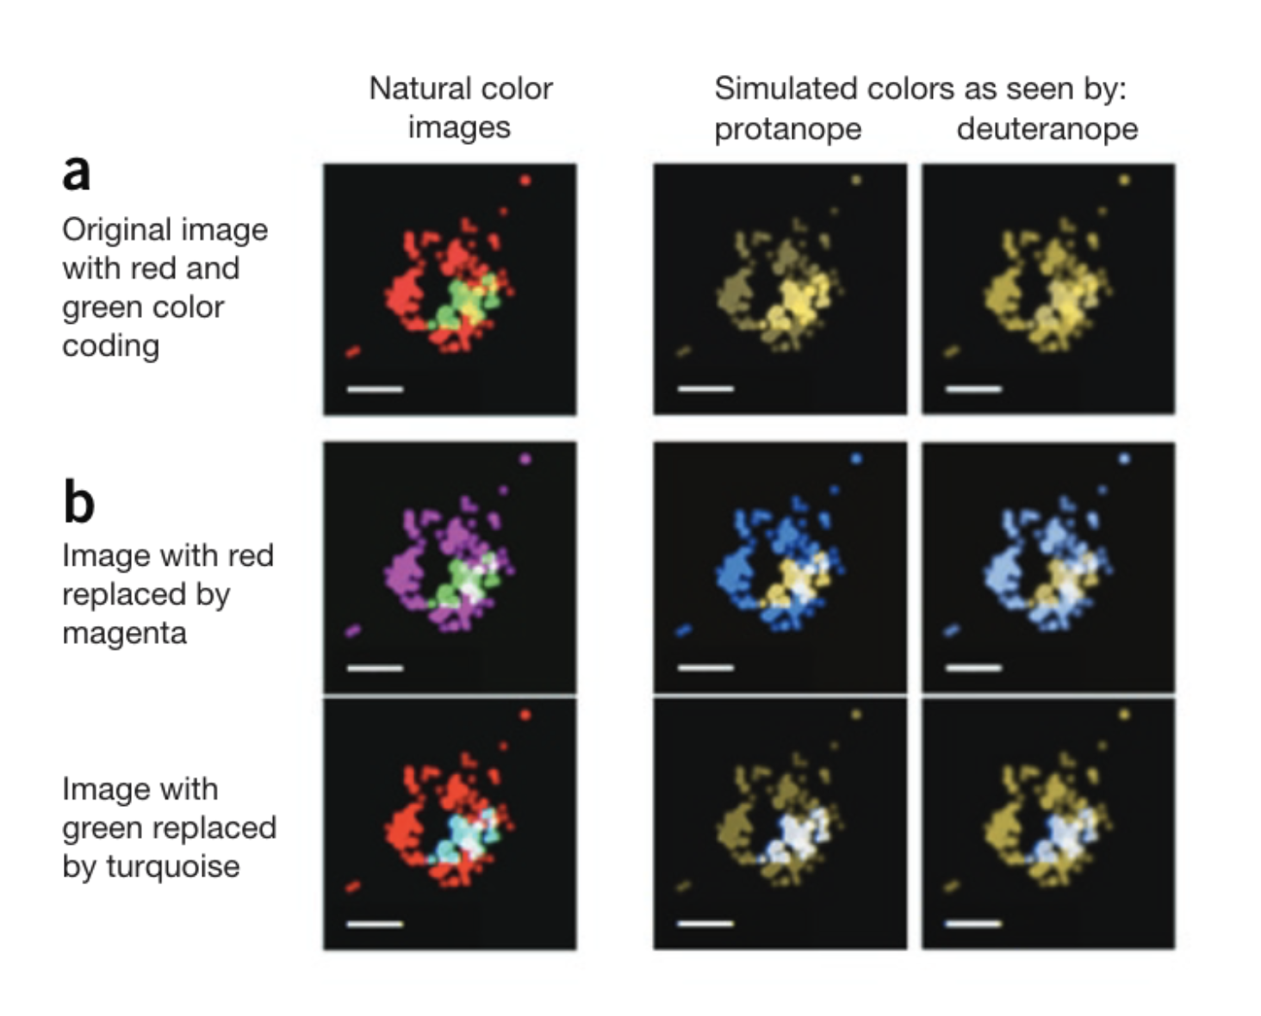
Replace red with magenta or green with turquoise

Slide 6
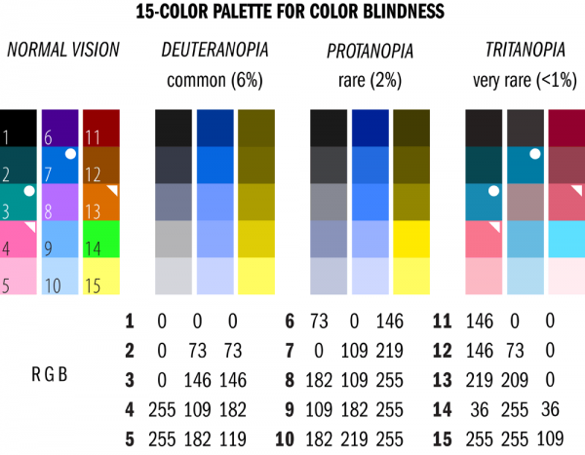
Use
the right palette
Notes:
przykład z artykułu fig 2

Slide 7
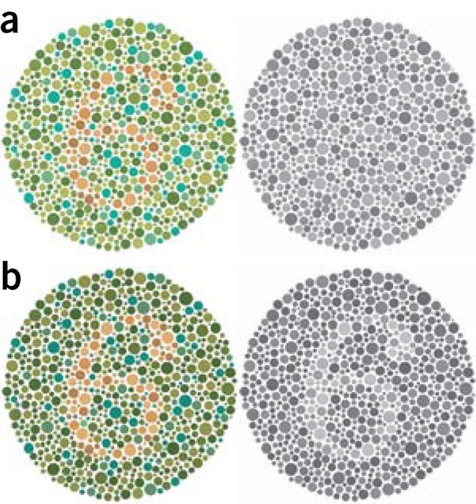
Use higher contrast

Slide 8
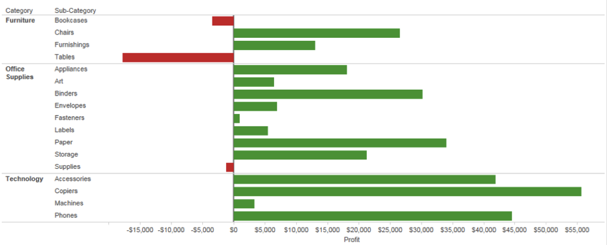
Use not only colours to differentiate between data

Slide 9
Thank you!
Useful links:
See how your website looks for colourblind person: https://www.toptal.com/designers/colorfilter/
How to create color blind friendly designs:
https://venngage.com/blog/color-blind-friendly-palette/
Based on:
http://www.readcube.com/articles/10.1038/nmeth.1618

