Slide 1
Scientific visualizations
Michał Maciąg, Rafał Kobiela

Slide 2
What is a scientific visualization ?
It is primarily concerned with the visualization of three-dimensional phenomena (architectural, meteorological, medical, biological, etc.), where the emphasis is on realistic renderings of volumes, surfaces, illumination sources, and so forth, perhaps with a dynamic (time) component.

Slide 3
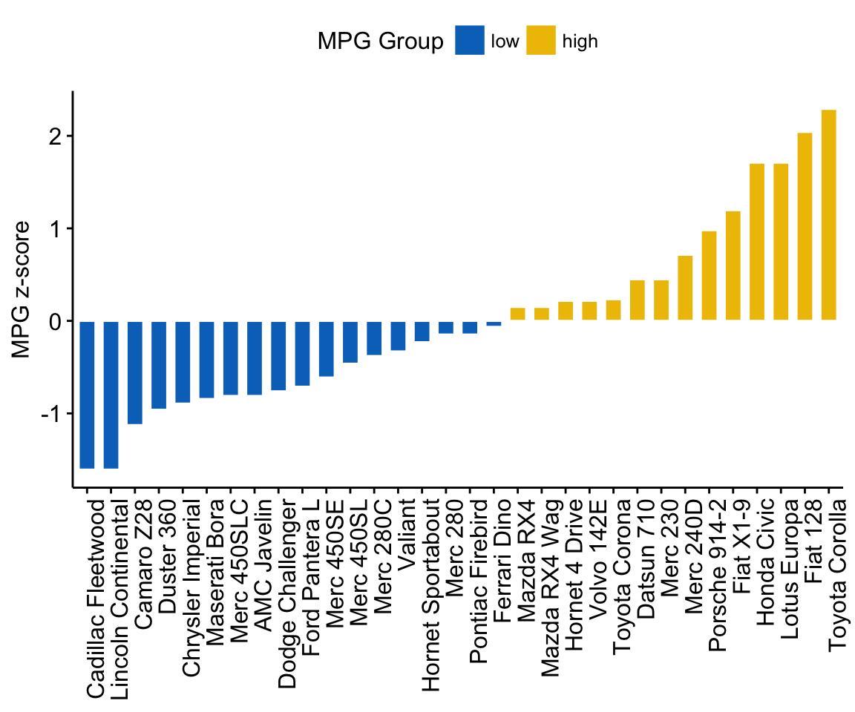
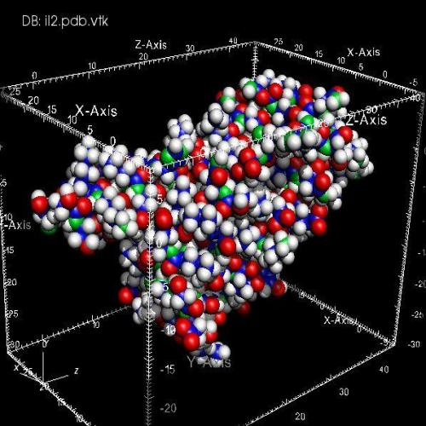
Scientific visualization vs information visualization:

Slide 4
Why good scientific visualization is hard to make ?
it must contains plenty of information
01
it presents expert knowledge
02
very often 3D visualization
03
sometimes dynamic visualization
04

Slide 5
Research exploring the memorability scientific visualizations:
research conducted by Rui Li and Jian Chen
scientists form Ohio State University
study exploring the memorability of spatial scientific visualizations
understand which the visual features contribute to memorability

Slide 6
Visual features contribute to memorability:
entropy
feature congestion
the number of edges
clutter
the number of distinct colors
familiarity
realism
interestingness
happiness

Slide 7
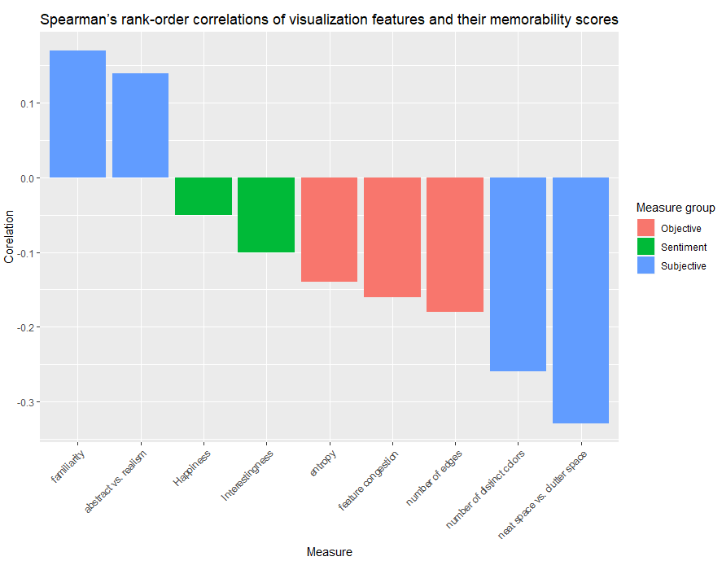
Results:

Slide 8
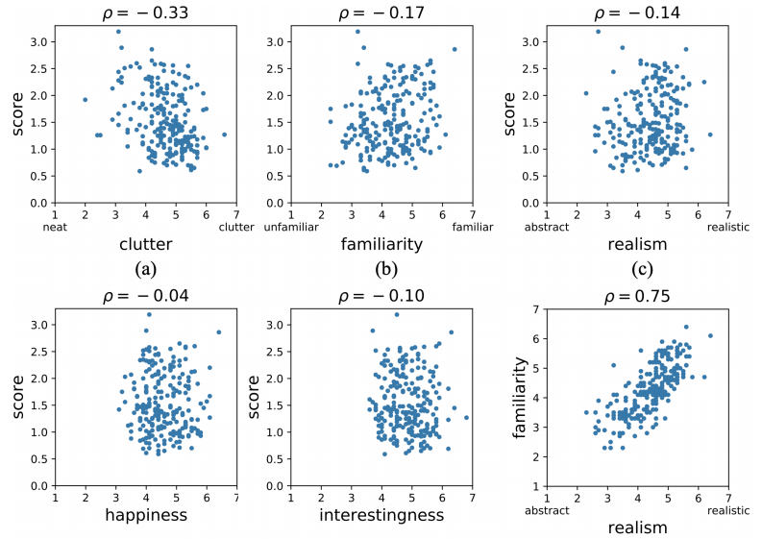
Subjective metrics vs memorability scores:

Slide 9
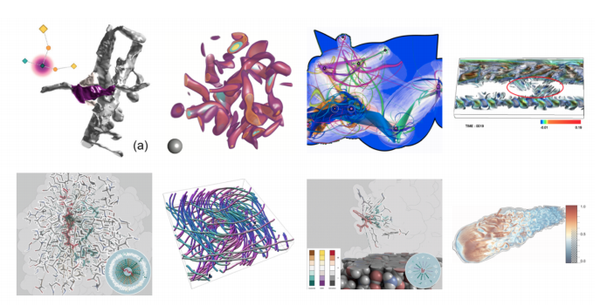
Least memorable scientific visualizations:

Slide 10
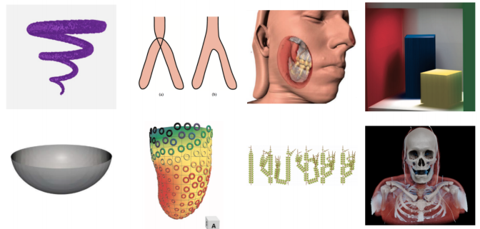
Most memorable scientific visualizations:

Slide 11
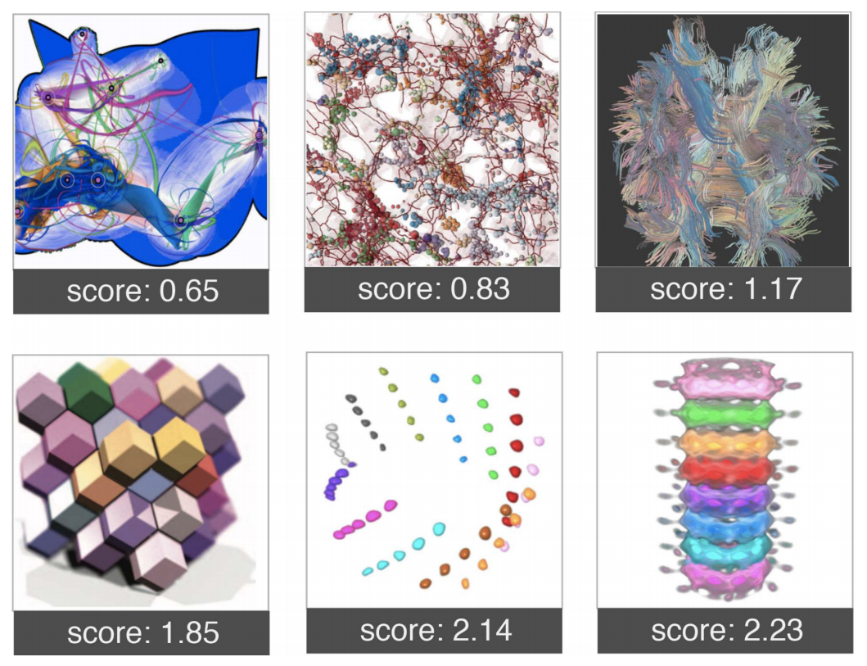
Colorful visualizations and clutter vs memorability scores:

Slide 12
Less is more:

Slide 13
The end
Thank You for listening

