Slide 1

Optimizing Predictions for House Prices using Particle Swarm Optimization
Semester 1, 2024-2025
Milosi Elias
Protopopescu Bogdan

Slide 2
Context and Motivation
Context:
Kaggle competition: House Prices - Advanced Regression Techniques.
Data includes features like size, location, and condition of houses.
Motivation:
Ensemble methods are effective for complex regression tasks.
PSO can optimize the combination of models for better performance.

Slide 3
Methodology - Workflow
Data Preprocessing:
Handling missing values and categorical features.
Standardizing numerical features.
Models Used:
Random Forest
SVR (Support Vector Regression)
KNeighbors Regressor
Optimization:
Generating ensemble predictions.
Applying PSO to optimize model weights.

Slide 4
Implementation
Libraries Used:
Pandas, NumPy, Scikit-learn, Pyswarm.
Data:
Training and test datasets provided by Kaggle.
Key Steps:
Generating individual model predictions.
Creating unoptimized ensemble predictions (mean of individual predictions).
Optimizing weights using PSO.

Slide 5
Limitations
Model Diversity:
Random Forest dominated the ensemble.
Hyperparameter Sensitivity:
PSO performance was sensitive to parameters like swarm size and iteration count.

Slide 6
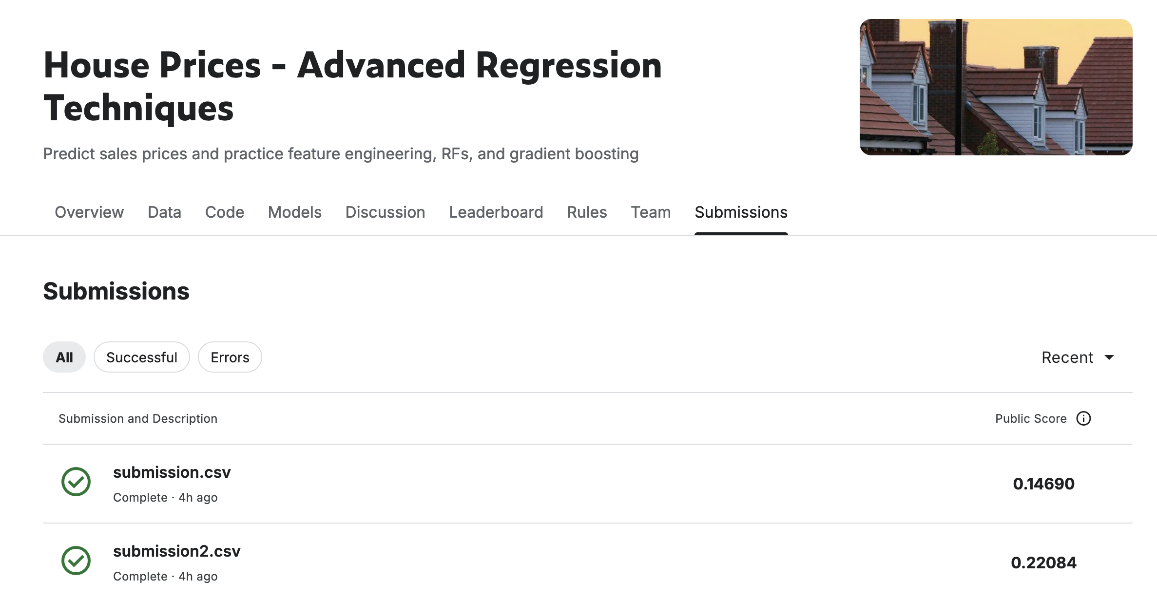
Results
Performance Without PSO:
Kaggle score: 0.22084
Performance With PSO:
Kaggle score: 0.14690
Conclusion:
PSO significantly reduced the error, demonstrating its efficiency in optimizing ensemble models.

Slide 7
Conclusions and Future Work
Conclusions:
PSO is an effective method for optimizing ensembles in regression tasks.
Future Work:
Testing other optimization methods (e.g., genetic algorithms).
Increasing model diversity by incorporating additional algorithms.

