Slide 1


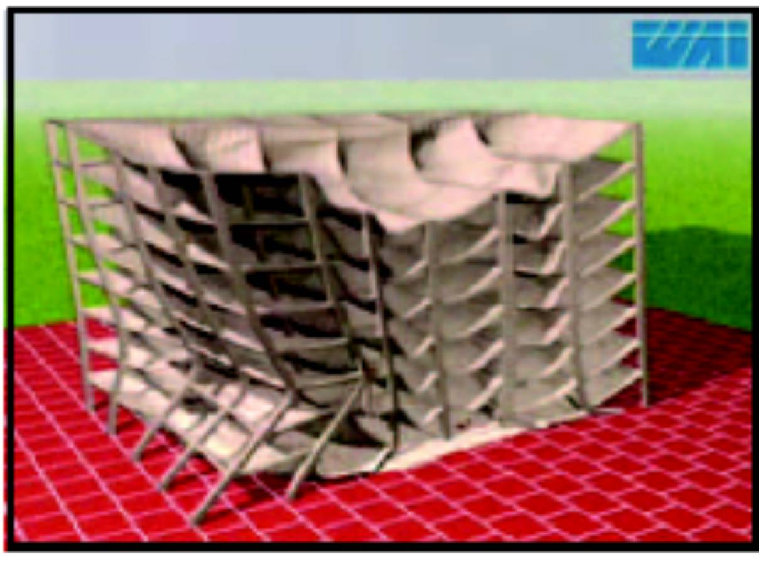
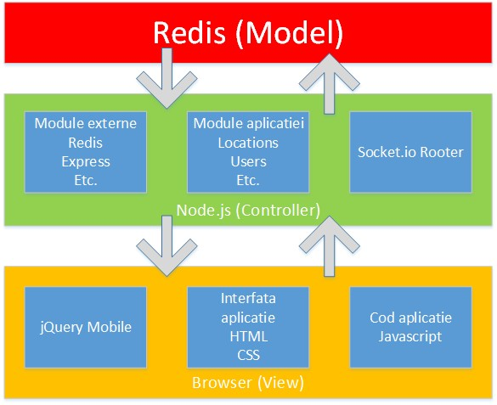
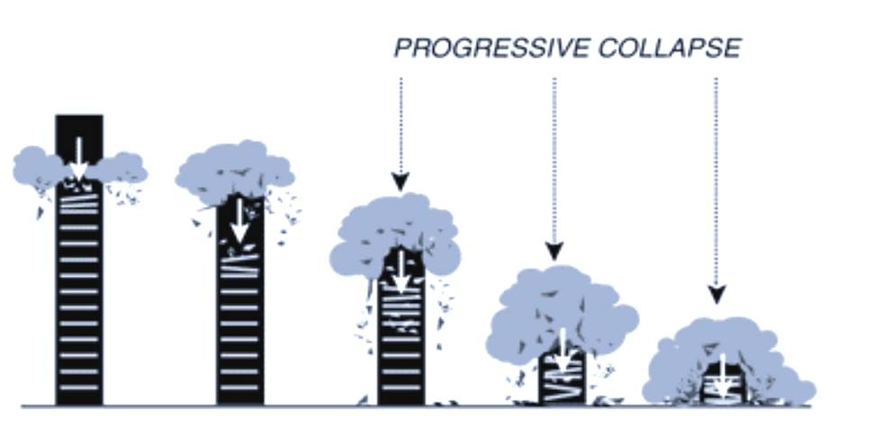
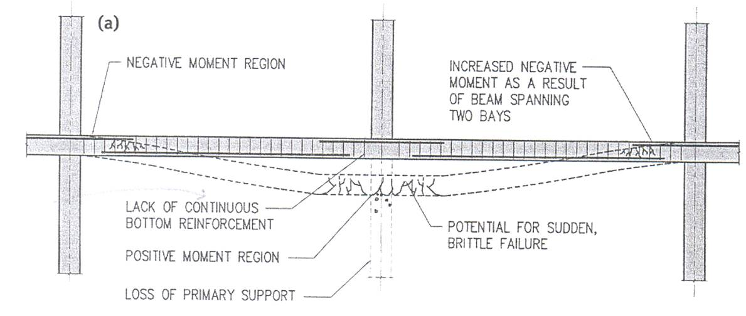
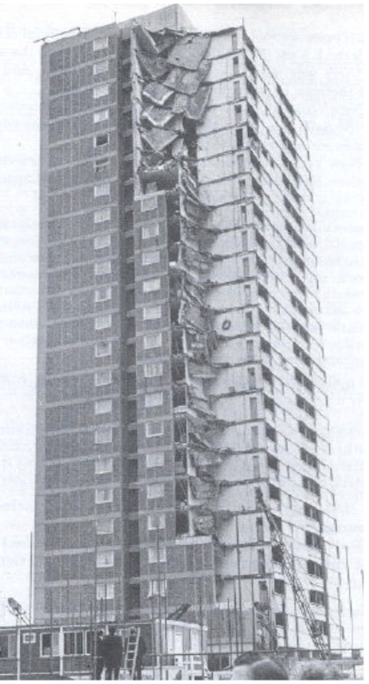
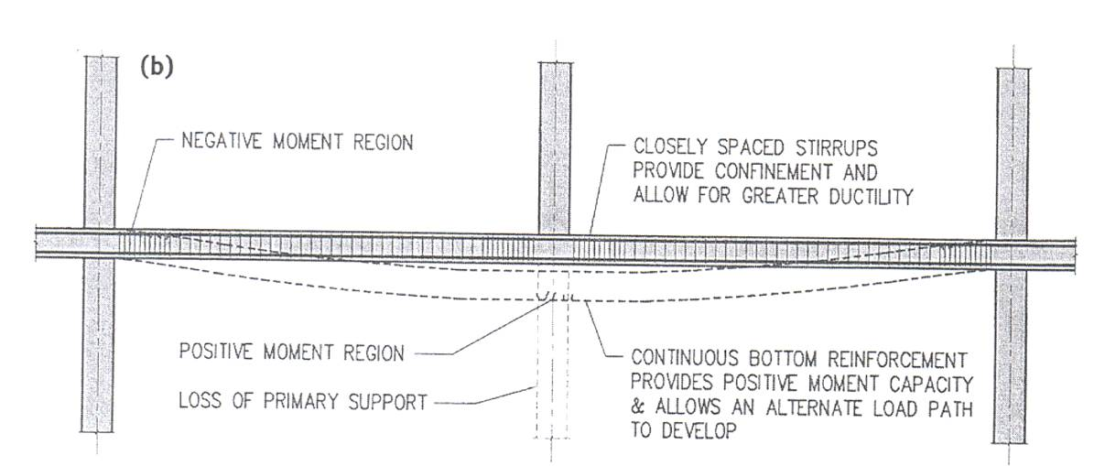
Titlul proiectului descris in continuare
Universitatea Petrol-Gaze din Ploiesti
Departamentul Tehnologia Informaţiei, Matematică, Fizică
Ion Popescu Dumitrescu
Master TAPI Informatică 2013 – proiect M201300
Rezumat
Arhitectura, Proiectare
The progressive collapse of the World Trade Center towers has generated a worldwide concern of the risks of progressive collapse in multi-story buildings. The prevention of progressive collapse lies primary in the proper and effective analysis of the structures having high potential to progressivity. Different analysis methods are presented herein such.
Linear Elastic Static Analysis
Analysis is done based on the static removal structural
This method is approximate, and hence, design loads are conservative.
The main advantages of this method lie in its simplicity.
Linear Elastic Static Analysis
Analysis is done based on the static removal major structural element.
This method is approximate, and hence, design loads conservative.
The main advantages of this method lie in its simplicity.
Progressive Failure of Multi-story Building
Structura
Descriere aplicaţie
Concluzii
Progressive collapse occurs when local failure of primary structural element leads to a chain reaction of structural element failures, and resulting in the collapse of all or disproportionately large part of the structure.
The total prevention of progressive collapse may not be feasible as it is uneconomic. Yet, proper designing and detailing can significantly reduce its possibility.
The alternate load path method focuses on providing a redundant load path following the loss of an individual structural member, so that a disproportionate collapse will not take place.
Integrity, continuity, and energy-dissipating capacity in the structural members are essential to transfer the loads from the locally damaged region to adjacent regions without collapse.
The analysis of multi-story buildings subjected to progressive collapse can be preliminary started using a simple method such as the linear elastic static method. If further analysis is necessary, more advanced analysis approaches can be used such as the non-linear elastic static and the non-linear dynamic analyses (Marjanishvili, 2004).
The size, shape, and importance of the building are the major factors used to determine the most suitable analysis approach for each building
To prevent progressive collapse, the structural system of the building should be able to tolerate the removal of one or more structural members and redistribute their load on the surrounding members, so that disproportionate collapse would not take place
The alternate load path method focuses on providing a redundant load path following the loss of an individual structural member, so that a disproportionate collapse will not take place
Integrity, continuity, and energy-dissipating capacity in the structural members are essential to transfer the loads from the locally damaged region to adjacent regions capable of sustaining these additional loads without collapse.
The alternate load path method focuses on providing a redundant load path following the loss of an individual structural member, so that a disproportionate collapse will not take place
The weight and impact of the collapsed upper floors caused a series of progressive failures of the corner bay of the building, which collapsed from top to bottom all the way to the ground.
timf.upg-ploiesti.ro/prj/M201300

