Slide 1
Galaxy Impact
Bogdan Teodorov

Slide 2
Introduction
"Galaxy Impact" is a thrilling 2D space shooter game designed for PC, immersing players in a visually stunning intergalactic adventure.
Set against the backdrop of a vast and mesmerizing galaxy, players pilot customizable spaceships through challenging levels, engaging in intense battles against waves of enemy spacecraft and colossal boss encounters. The gameplay is inspired by classic arcade to recreate a nostalgic yet innovative experience and vibe.
Players embark on a quest to uncover the mysteries of the galaxy, facing numerous obstacles, upgrading their ships with powerful weapons, and confronting intelligent adversaries. The narrative unfolds gradually, providing a sense of purpose and depth to the fast-paced action.

Slide 3
Main Character
The main character is a skilled space pilot, who is eager to discover various mysteries hidden within the galaxy. Piloting a spacecraft, player navigates through the galaxy, facing adversaries and upgrading its ship as he/she progresses.
The main character's abilities evolve with gameplay, unlocking new weapons, defensive capabilities, and special maneuvers.

Slide 4
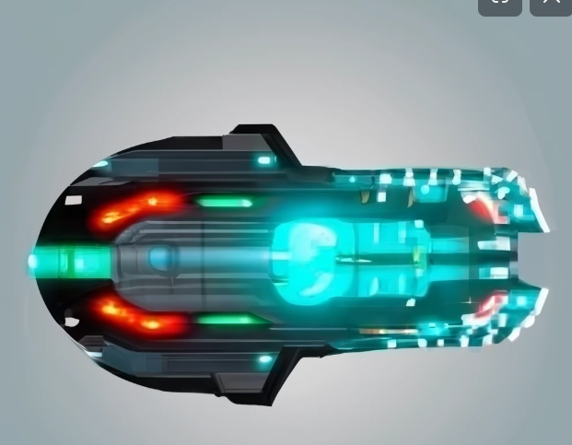
Sketch of Main Character
Armed to the teeth, the spaceship is equipped with an array of energy weapons, missiles, and defensive systems.
Each weapon has its unique visual signature, from laser beams slicing through the void to explosive missiles creating vibrant bursts of color.
As player progresses, he/she can unlock and upgrade these weapons to be able to surpass any challenges standing on the way to discover secrets of galaxy.

Slide 5
Opponents
Opponents in "Galaxy Impact" vary in intelligence and tactics.
Enemy spacecraft exhibit diverse attack patterns, utilizing evasive maneuvers, formations, and strategic retreats.
Boss encounters present formidable challenges, requiring players to adapt their strategies

Slide 6
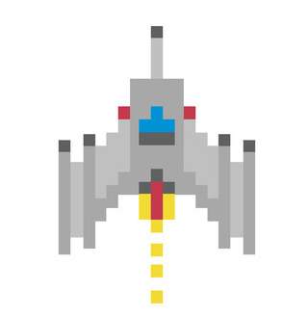
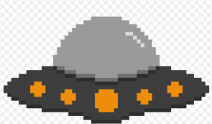
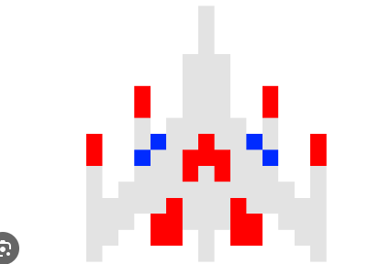
Sketch of Opponents
Regular enemies will be small, nimble spaceships with a sleek design armored with laser guns or heavy weaponry depending on the type of enemy.
Some of them will have non laniary pattern to make them challenging targets.

Slide 7
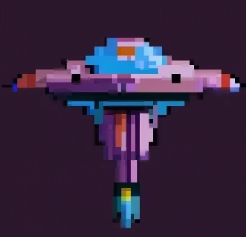
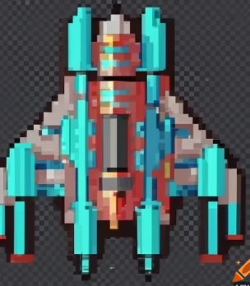

Sketch of Opponents pt.2
Bosses will look like large and heavily armored battleships with imposing presence.
Multiple weapon emplacements, including heavy lasers and missile launchers.
Some of them will be able to summon support ships to make battle more fascinating.

Slide 8
Environment
The game is set in a visually captivating galactic environment, featuring vibrant nebulae, asteroid fields, and cosmic phenomena.
Each level offers a unique backdrop, from outer space battles to futuristic urban landscapes.
The dynamic environment enhances the overall gaming experience, providing a sense of scale and diversity.

Slide 9
Controls
The game interface includes intuitive controls, allowing players to navigate their ships with precision.
Controls include directional movement using standard keys for moving, mouse button for shooting, and extra keys for the activation of special abilities.
The interface is designed for simplicity, providing a smooth and responsive gaming experience.

Slide 10
Summary
"Galaxy Impact" is an immersive 2D space shooter designed for PC gaming enthusiasts, offering a nostalgic nod to classic arcade titles while introducing a fresh and visually captivating experience.
Players take command and navigate through a beautifully rendered galactic landscape filled with intense, retro-inspired space battles. T
he game seamlessly combines classic 8-bit graphics with the beloved gameplay mechanics of classic 2D shooters, creating a thrilling and accessible gaming experience.

