Slide 1
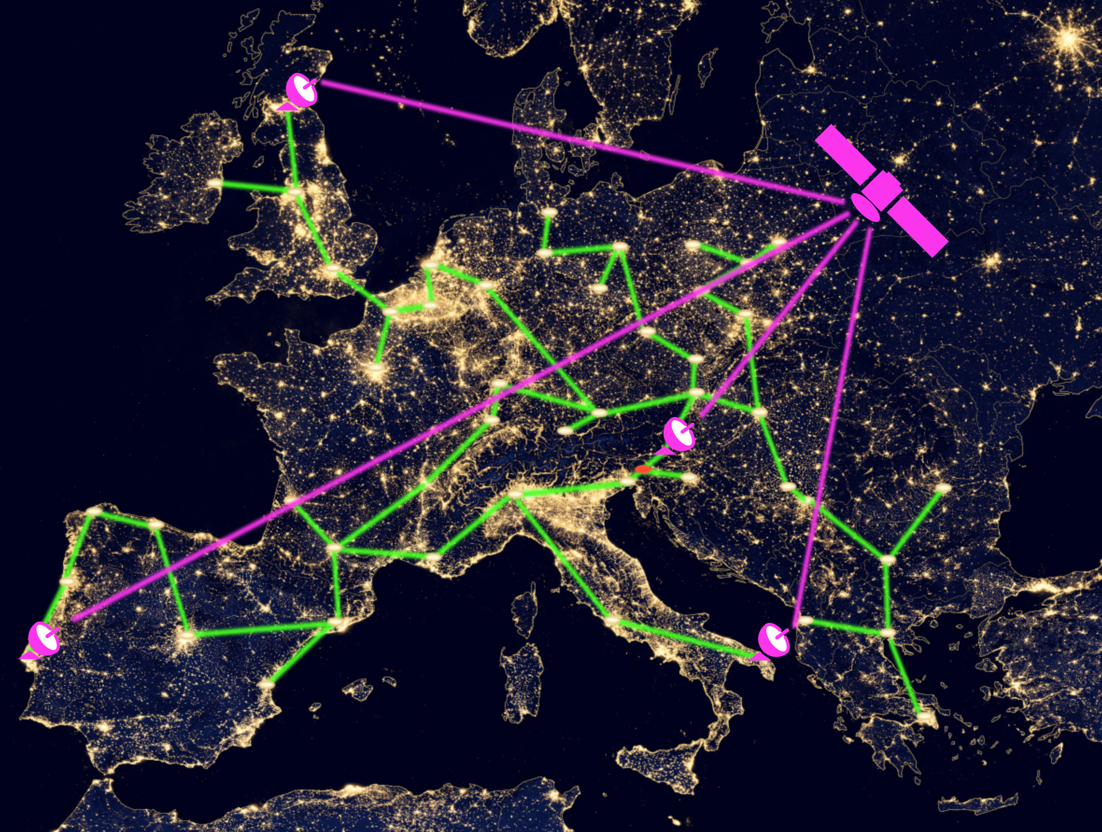
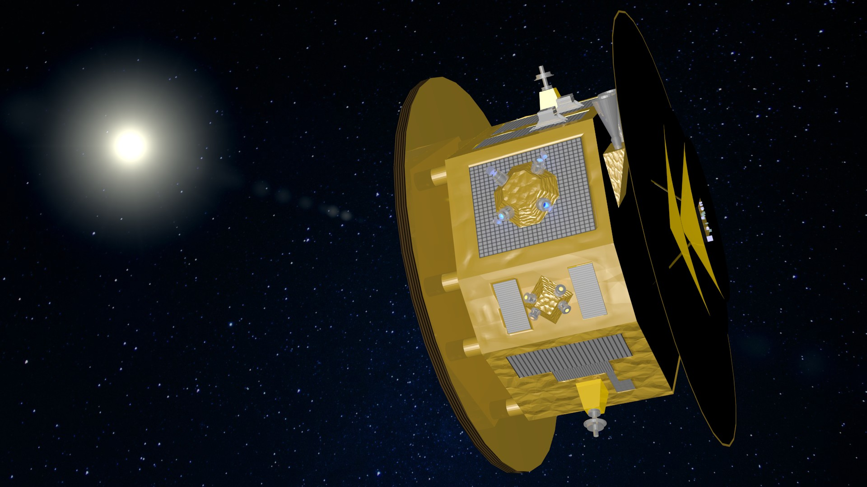
Quantum applications & Quantum foundations
Background-Credit:
NASA
Rainer Kaltenbaek
“artistic” impression,
MAQRO spacecraft

Slide 2
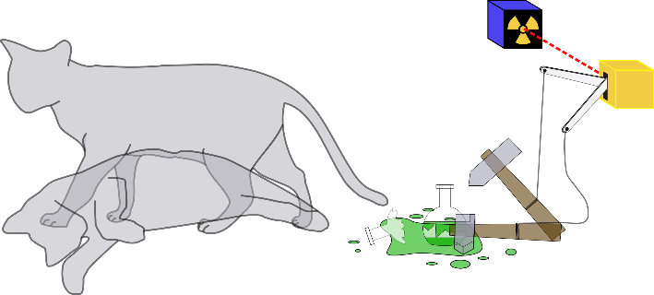
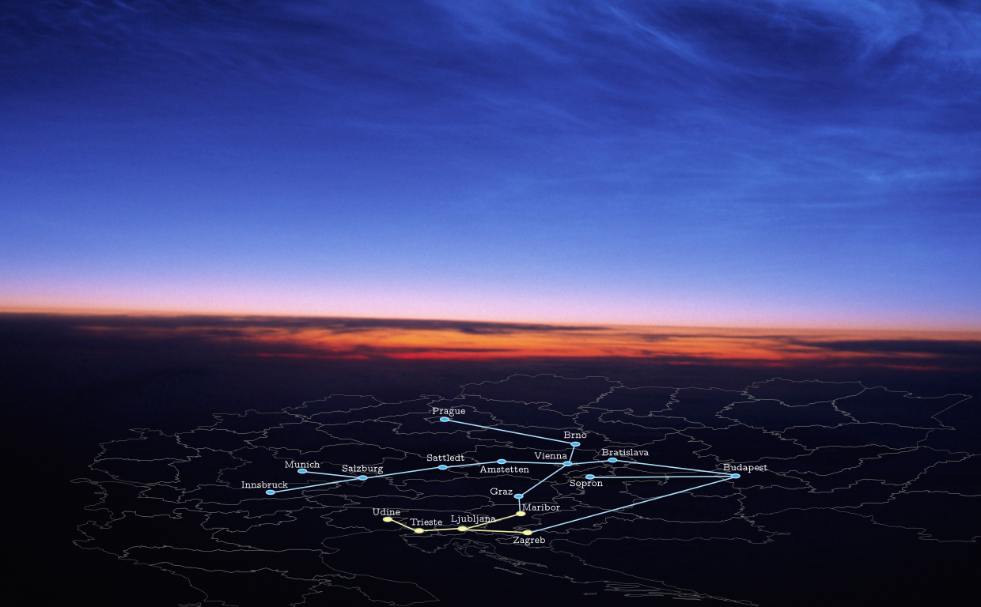
Overview
PART I/II
Harnessing space for quantum experiments
Isolate quantum systems
Deviations from quantum physics?
Quantum sensing?
Increase TRL of quantum technologies
PART II/II
Quantum technologies & quantum networks
Entanglement as a resource
Sensing, computing, communication, ...
Quantum internet

Slide 3
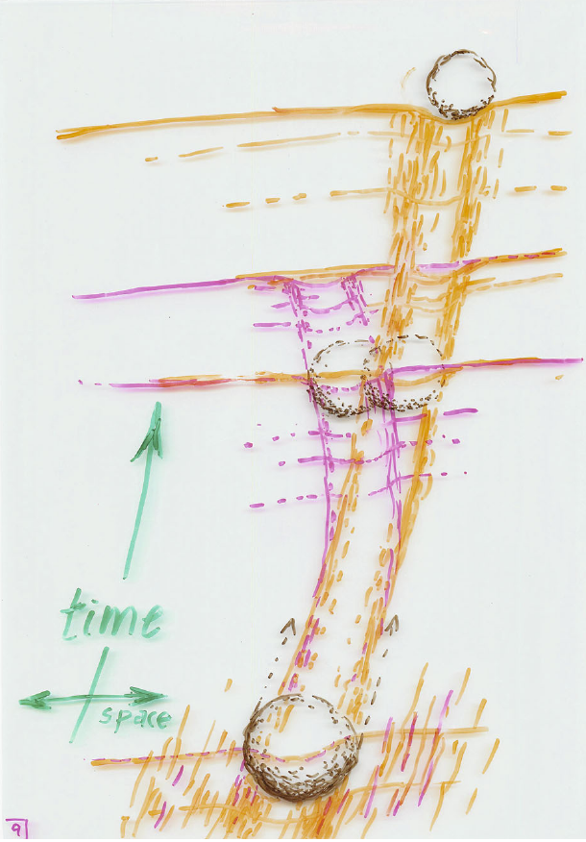
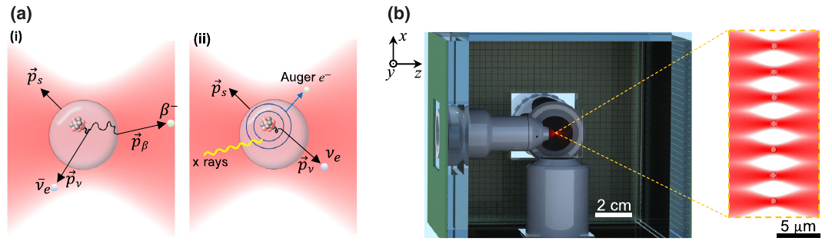
Macroscopic tests of quantum physics
Platform for macroscopic quantum experiments
Testing quantum physics
Quantum-Classical transition?
Gravity effects?
New Physics?
High-precision quantum sensor
High-precision sensing (e.g. Barker et al arXiv 2303.09922)
Exotic matter?
Dark matter? (e.g.: PRD 96, 023007 (2016))
…
Penrose, Found. Phys. 44 (2014)
e.g. neutrinos
Carney et al, PRX Qu. 4,
010315 (2023)

Slide 4
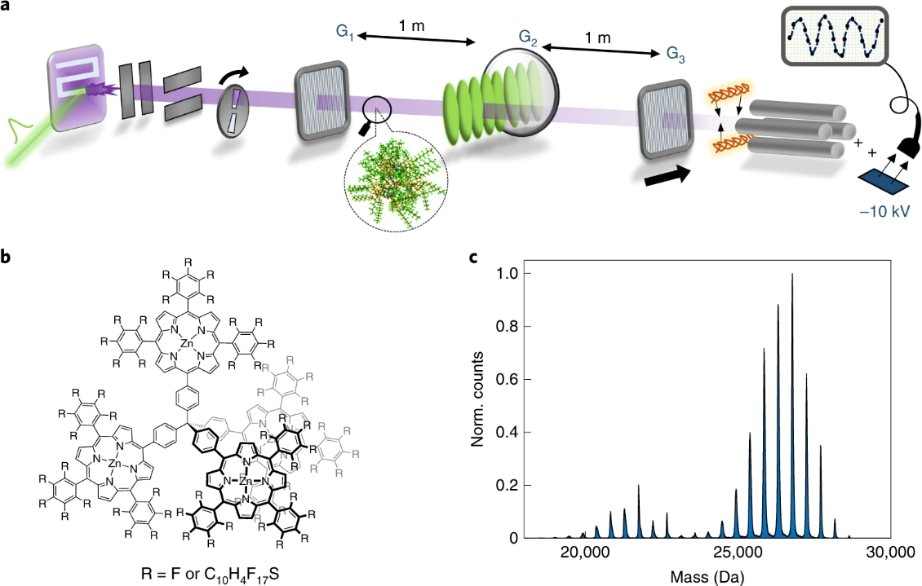
Ground-based experiments – current record
Record: 2.5 x 10⁴ amu
Fein et al., Nat. Phys. 15, 1242 (2019)

Slide 5
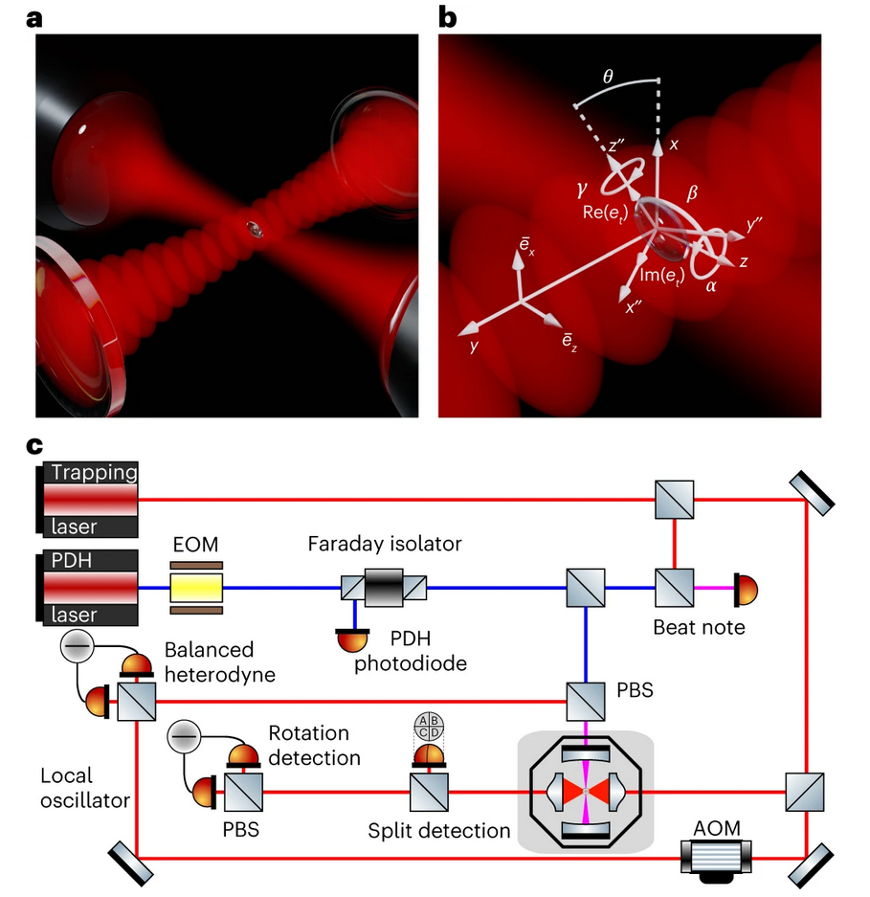
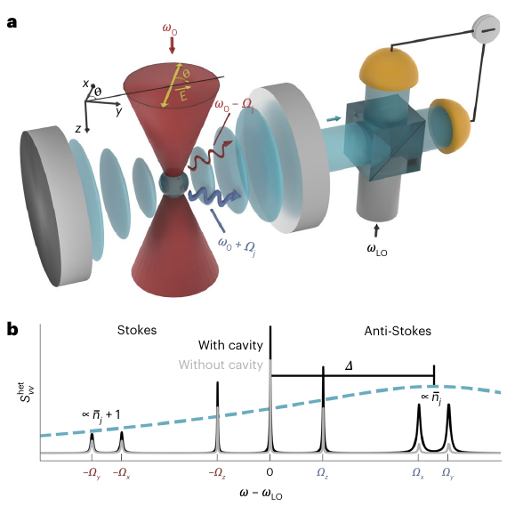
Quantum control of macroscopic objects
2D ground-state cooling
“6D” cooling
Piotrowski et al. Nat. Phys. 19 (2023)
Pontin et al. Nat. Phys. 19 (2023)

Slide 6
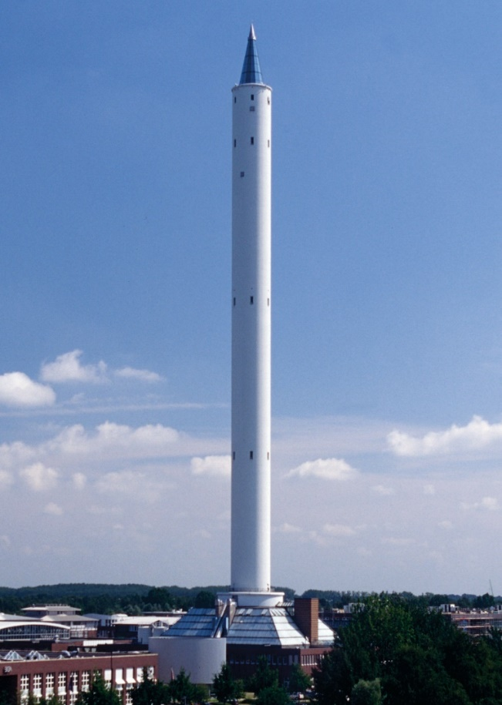
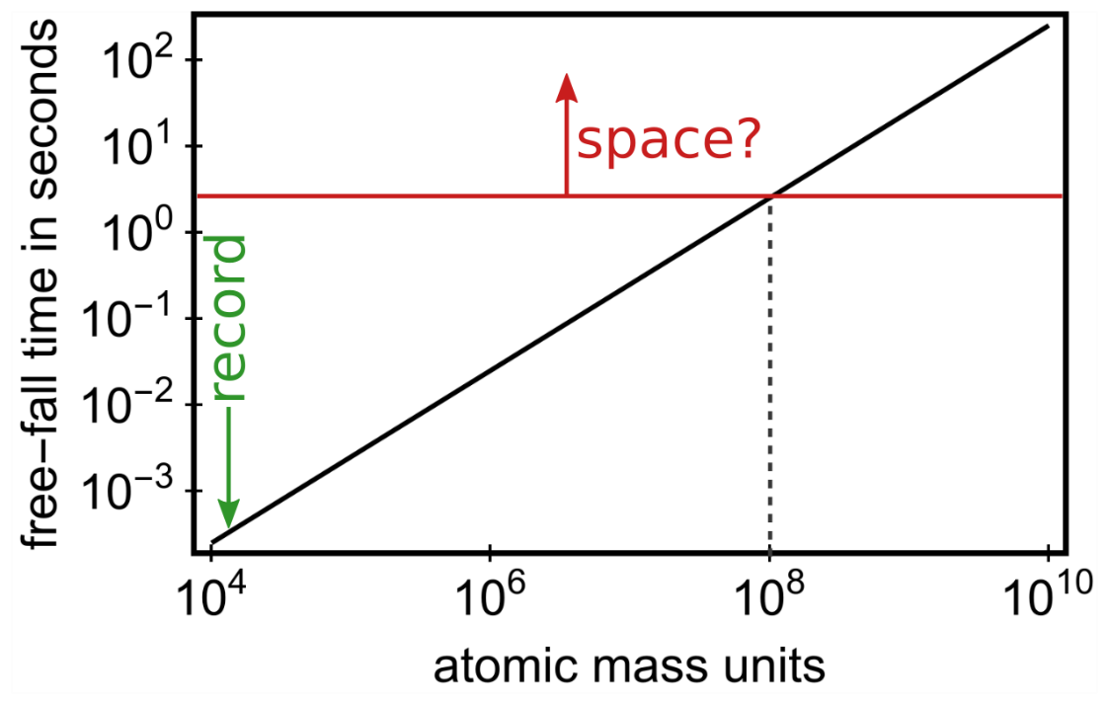
Limitations for Earth-bound experiments?
The more mass,
the longer the fall
nano-g vibration isolation
10³-10⁴ data points per test

Slide 7
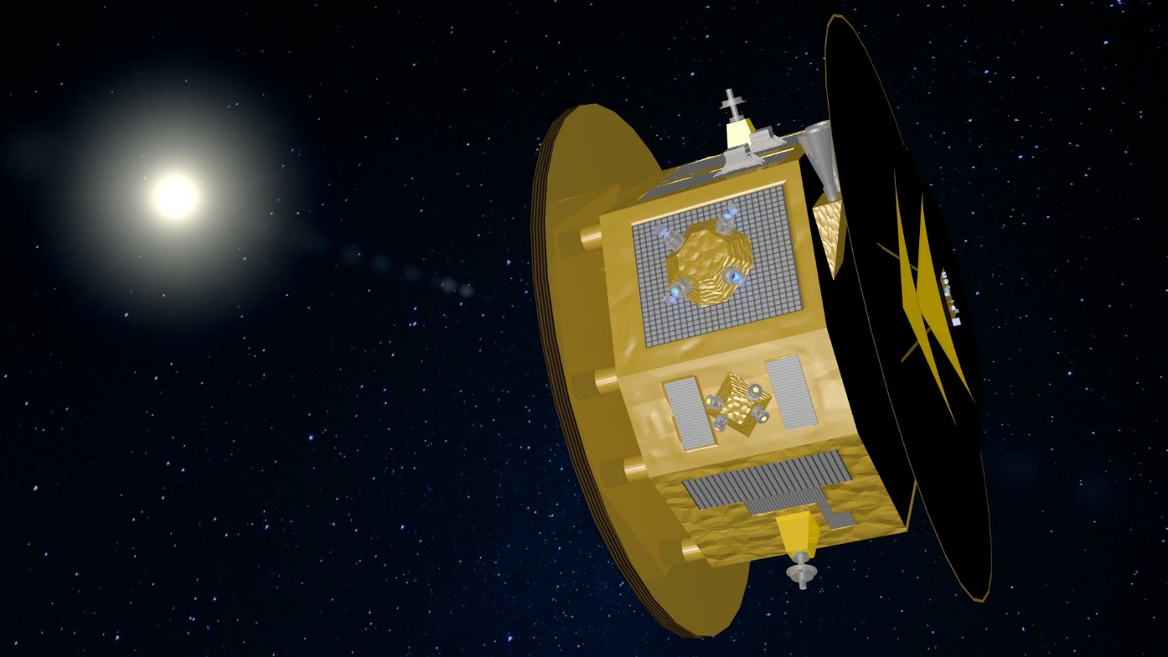
Can we do tests in space? → MAQRO mission
Evolving since 2010

Slide 8
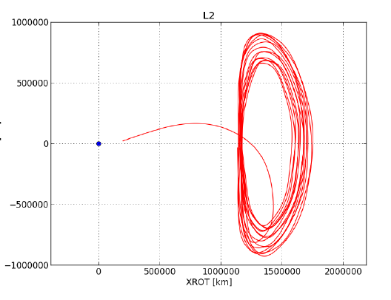
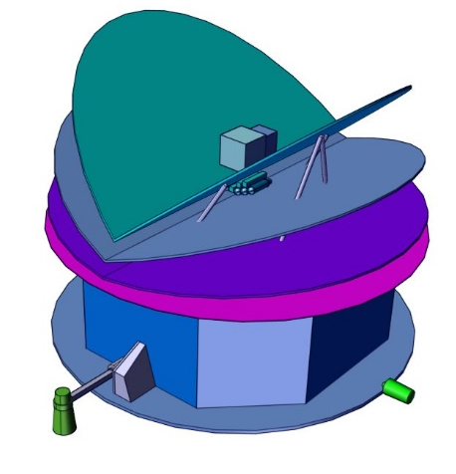
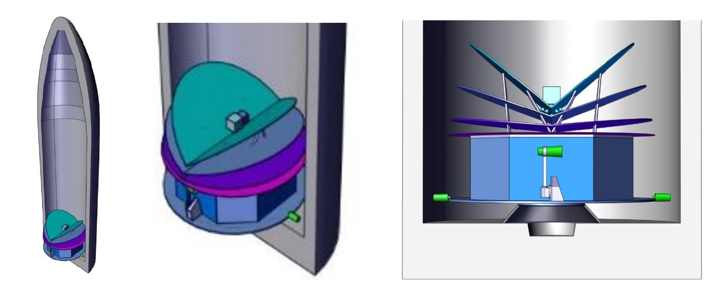
Feasibility study at ESA – 2018
T. Voirin et al, QPPF study report (2019)

Slide 9

MAQRO – suggested experiments
Free quantum evolution
Kaltenbaek et al., MQES report (2012)

Slide 10
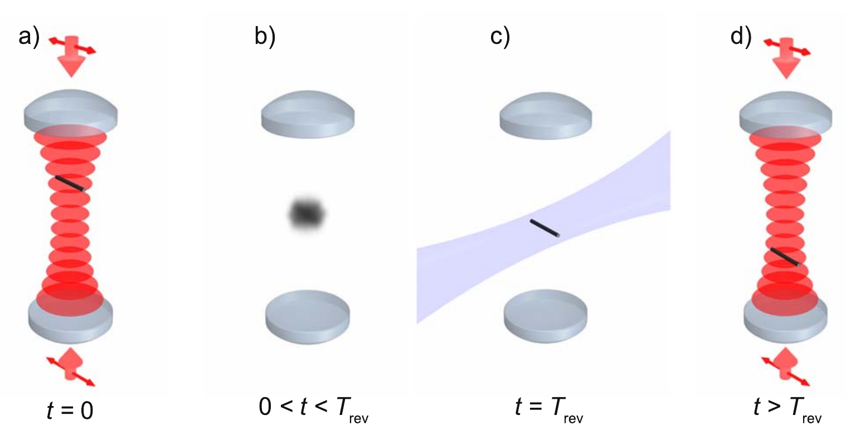
MAQRO – suggested experiments
Free quantum evolution
Kaltenbaek et al., MQES report (2012)
Orientational revivals
Stickler et al., NJP (2018)

Slide 11
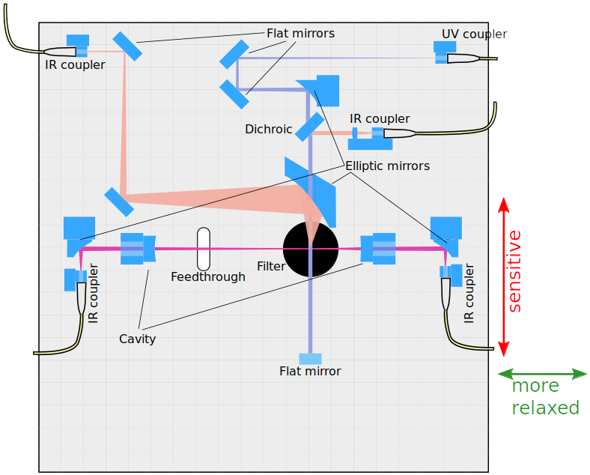
MAQRO – suggested experiments
Free quantum evolution
Matter-wave interferometry
Bateman et al., Nat. Comm. (2014)
Kaltenbaek et al., EPJ-QT (2016)
Kaltenbaek et al., Qu. Sci. Techn. (2023)
Kaltenbaek et al., MQES report (2012)
Orientational revivals
Stickler et al., NJP (2018)

Slide 12
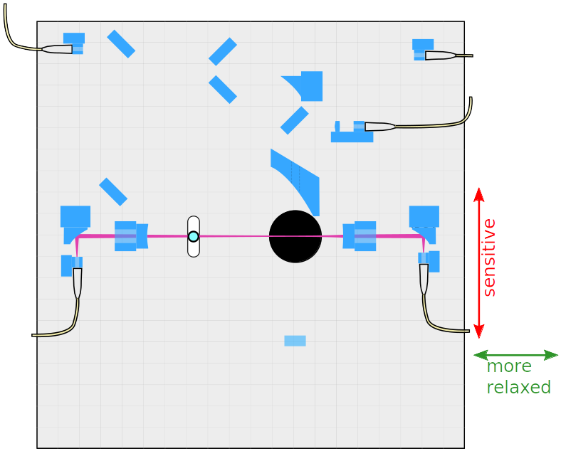
MAQRO – Matter-wave interferometry
Loading a particle

Slide 13
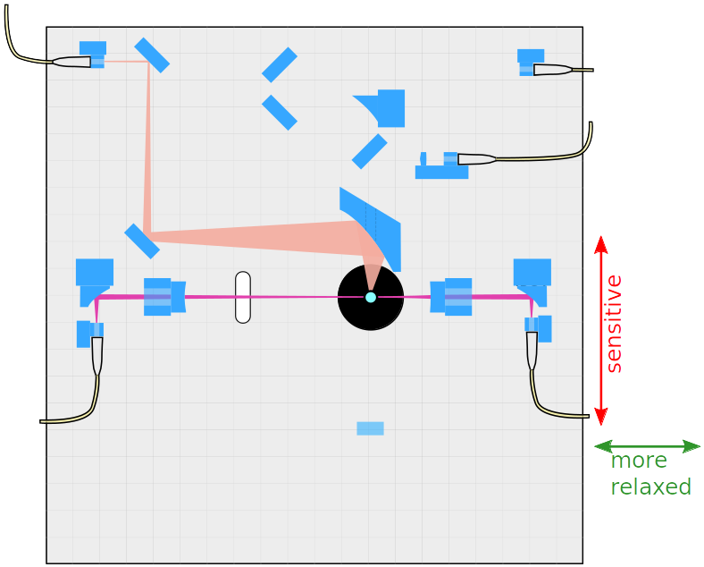
MAQRO – Matter-wave interferometry
Trapping and preparing

Slide 14
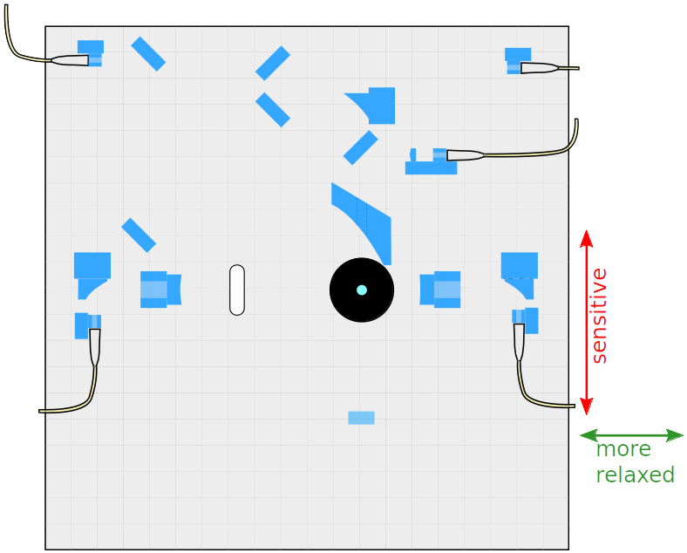
MAQRO – Matter-wave interferometry
Releasing the particle

Slide 15

MAQRO – Matter-wave interferometry
Free evolution

Slide 16

MAQRO – Matter-wave interferometry
Optical phase grating

Slide 17

MAQRO – Matter-wave interferometry
More free evolution

Slide 18

MAQRO – Matter-wave interferometry
Position measurement

Slide 19


Study at Concurrent Design Facility
Voirin et al, QPPF study report (2019)
MAQRO-type mission “New Science Idea“ (2017)
→ QPPF study (2018)
→ Ideal orbit around Sun-Earth L2
→ 3 critical issues
Voirin et al, QPPF study report (2019)

Slide 20
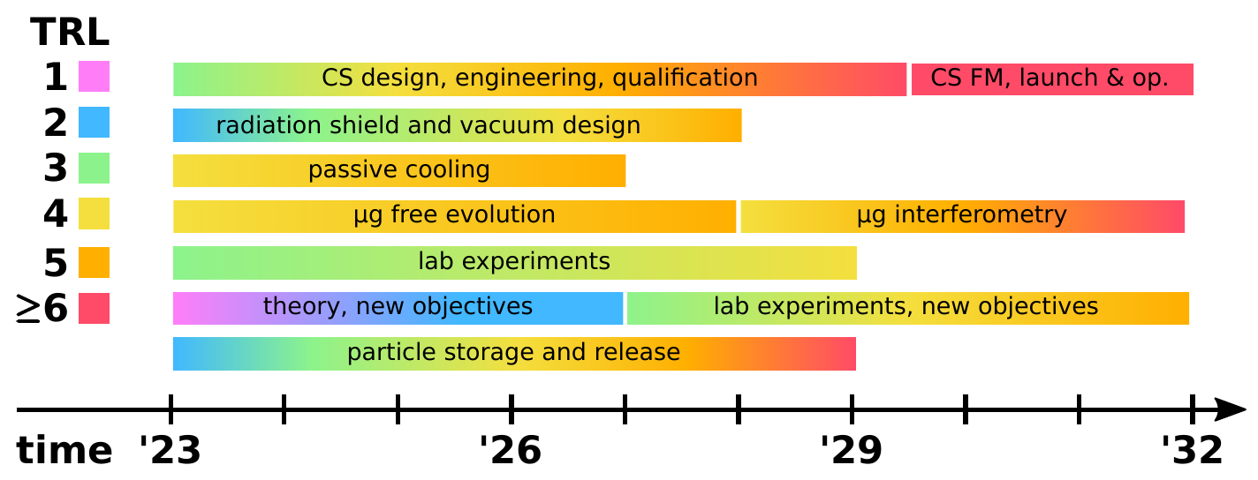
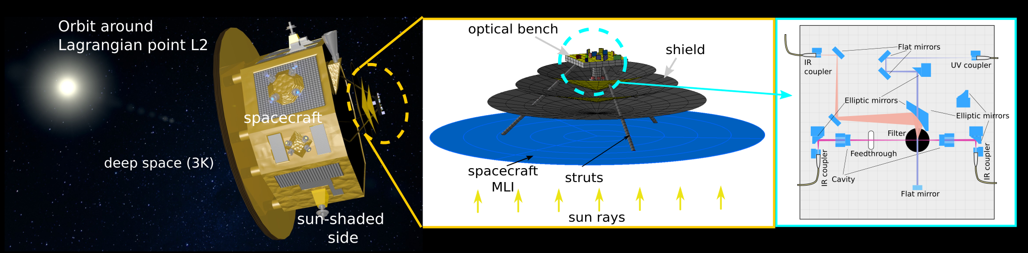
Proposal for NASA Research Campaign
NASA research campaign proposed 12/2021
→ Technology development
→ Aiming for launch ~2040
→ cubesat and µg demonstrators
→ additional science objectives?
Based on: Pilan Zanoni et al.,
Appl. Th. Eng. (2016)
Kaltenbaek et al, Quantum Sci. Techn. 8, 014006 (2023)

Slide 21
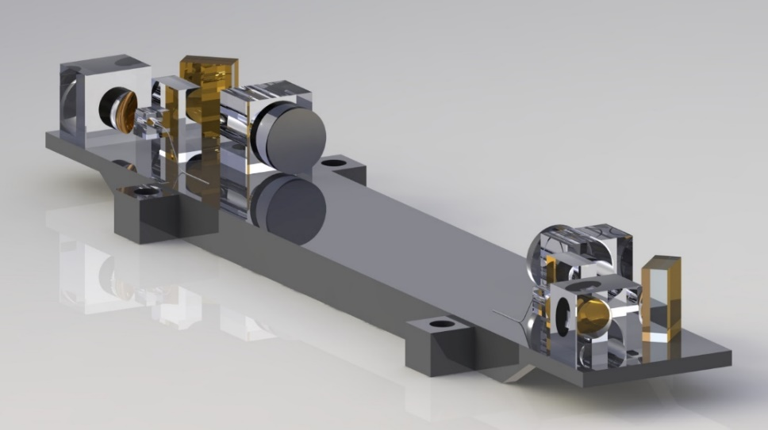
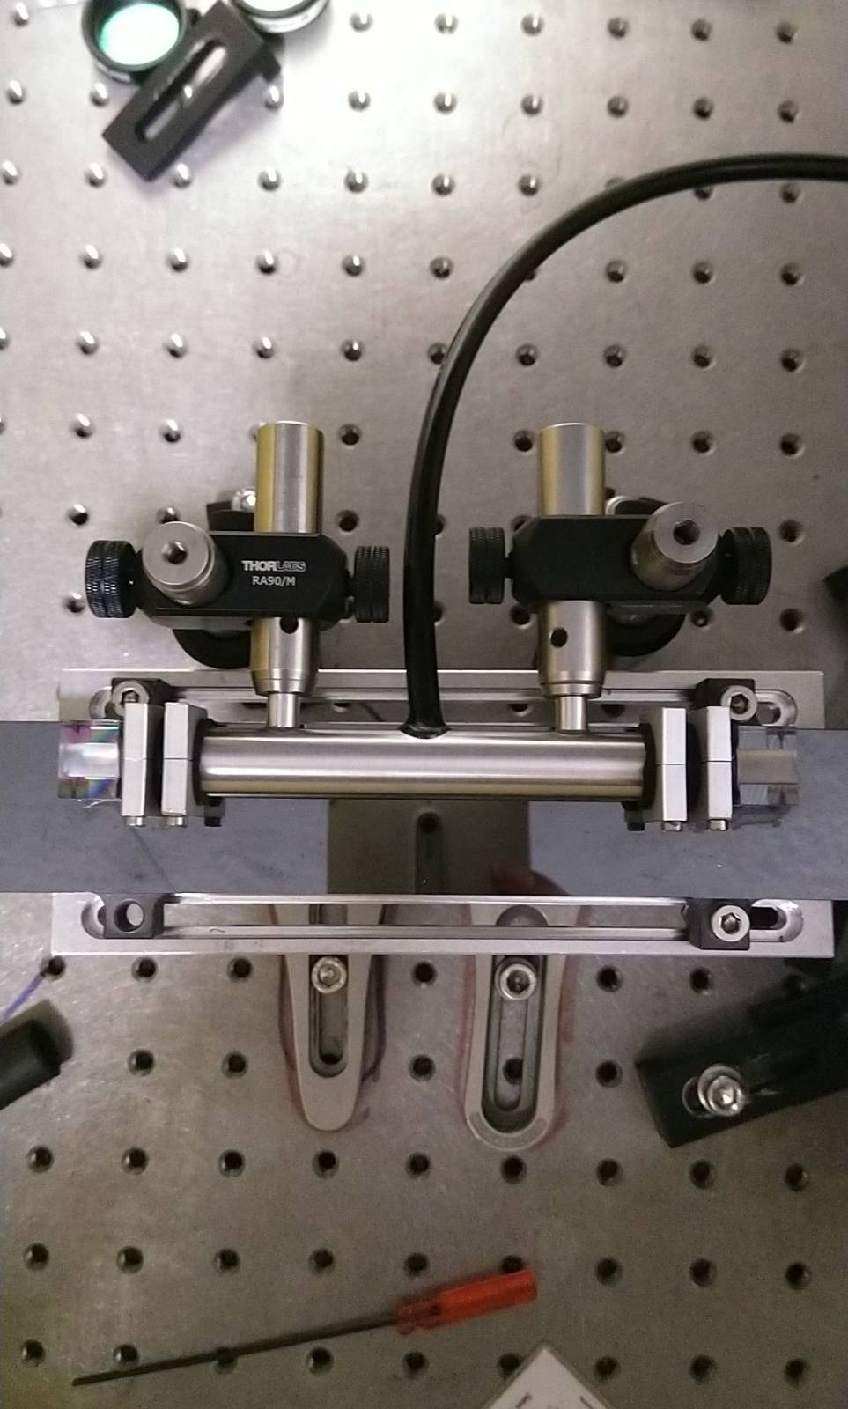

Cavity prototype for MAQRO
3D rendering of the cavity design
High-finesse cavity flooded in nitrogen
Alignment at 300K, operation at 20K
Adhesively bonded, fused-silica design
SiC baseplate
Flooded with nitrogen to
prevent line-width broadening

Slide 22
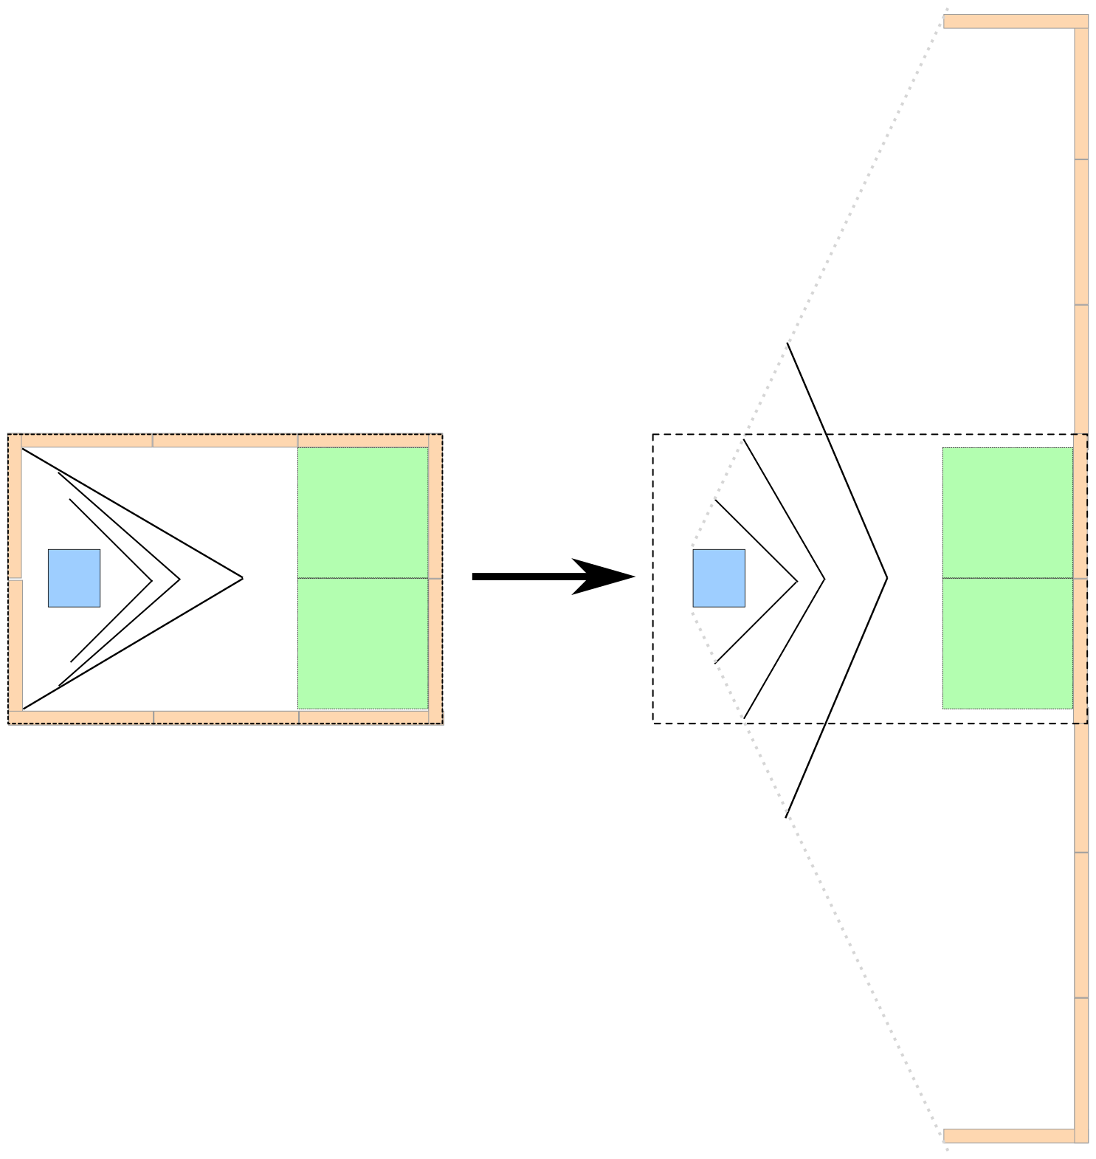
Demos in microgravity & space
Demonstations in microgravity
  Catch & release in drop tower
  Free quantum evolution
  Interferometry in microgravity
2U x 2U control unit
Launch nanosatellites
  Measure space environment
  Demonstrate key technologies
  Free quantum evolution in space
12U cubesat
Cold volume
maqro-mission.org & quantum.fmf.uni-lj.si

Slide 23
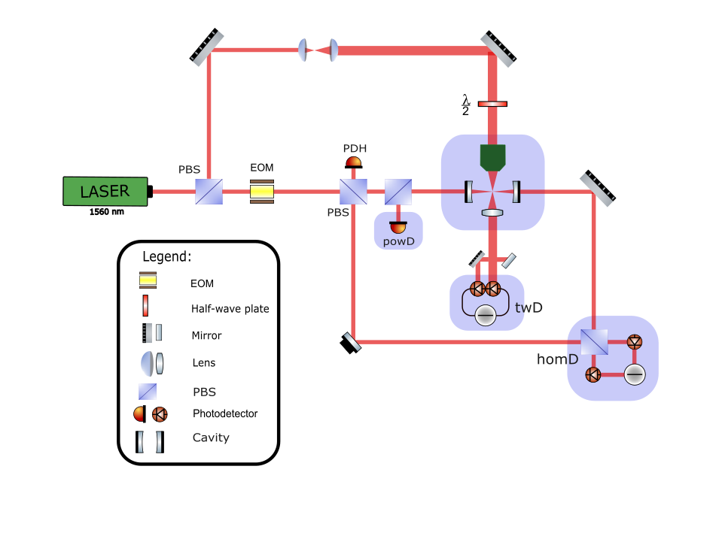
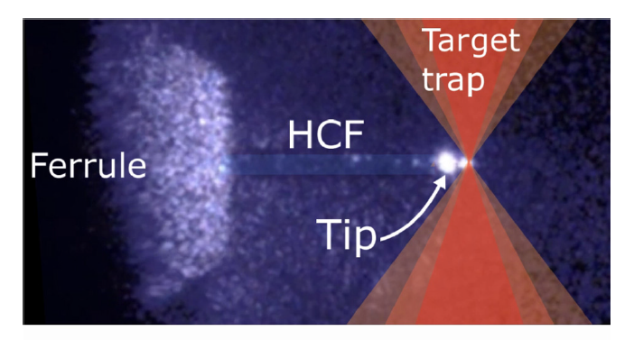
Optomechanics in the lab
Lindner et al, Appl. Phys. Lett. (2024)
Hadis Torbatiyan,
based on: Dare et al., arXiv:2305.16226

Slide 24
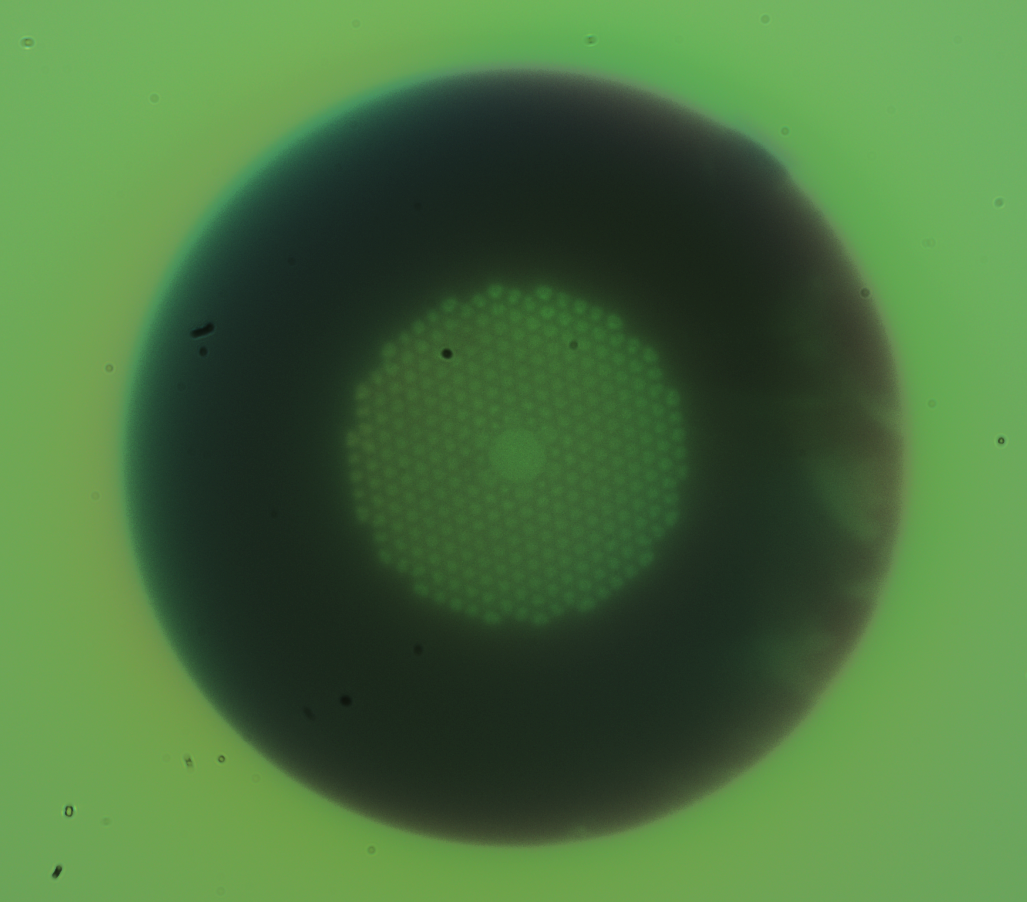
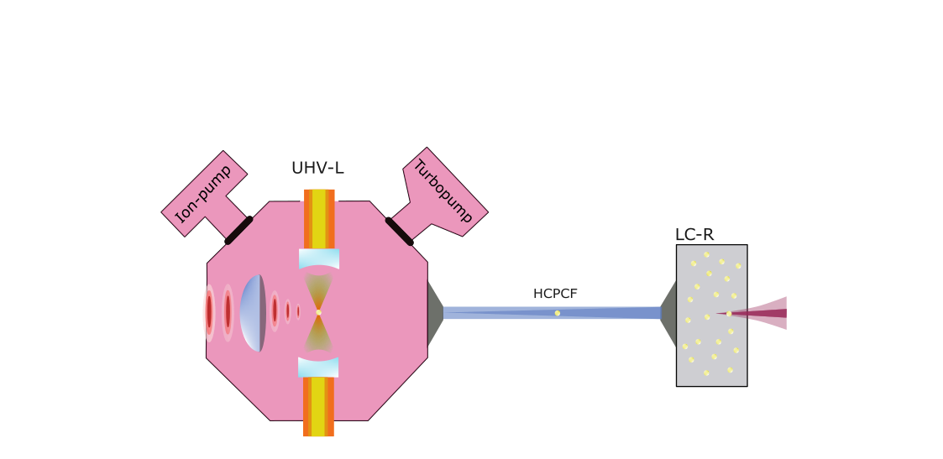
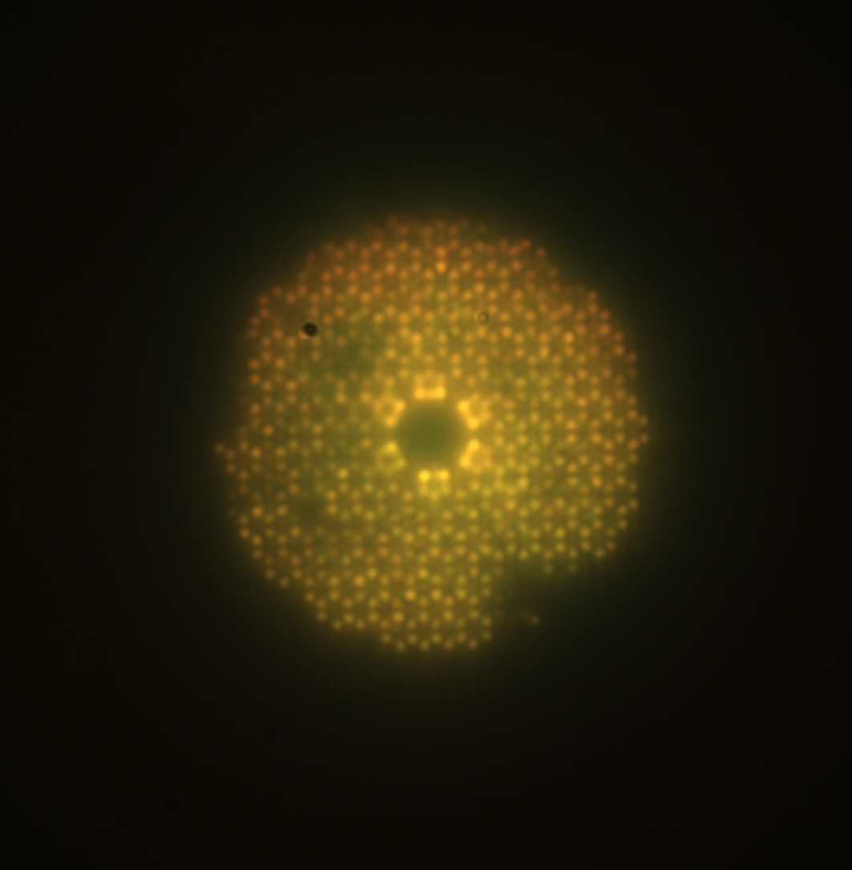
Getting particles into ultra-high vacuum (UHV)
→ Trap in low vacuum
→ Guide them through HCPCF
→ Trap in UHV
Hollow-core photonic-crystal fiber (HCPCF)
Hadis Torbatiyan
Hadis Torbatiyan & Guri Buza

Slide 25
Simple demonstration setup
Hadis Torbatiyan & Guri Buza

Slide 26
Overview
PART I/II
Harnessing space for quantum experiments
Isolate quantum systems
Deviations from quantum physics?
Quantum sensing?
Increase TRL of quantum technologies
PART II/II
Quantum technologies & quantum networks
Entanglement as a resource
Sensing, computing, communication, ...
Quantum internet

Slide 27
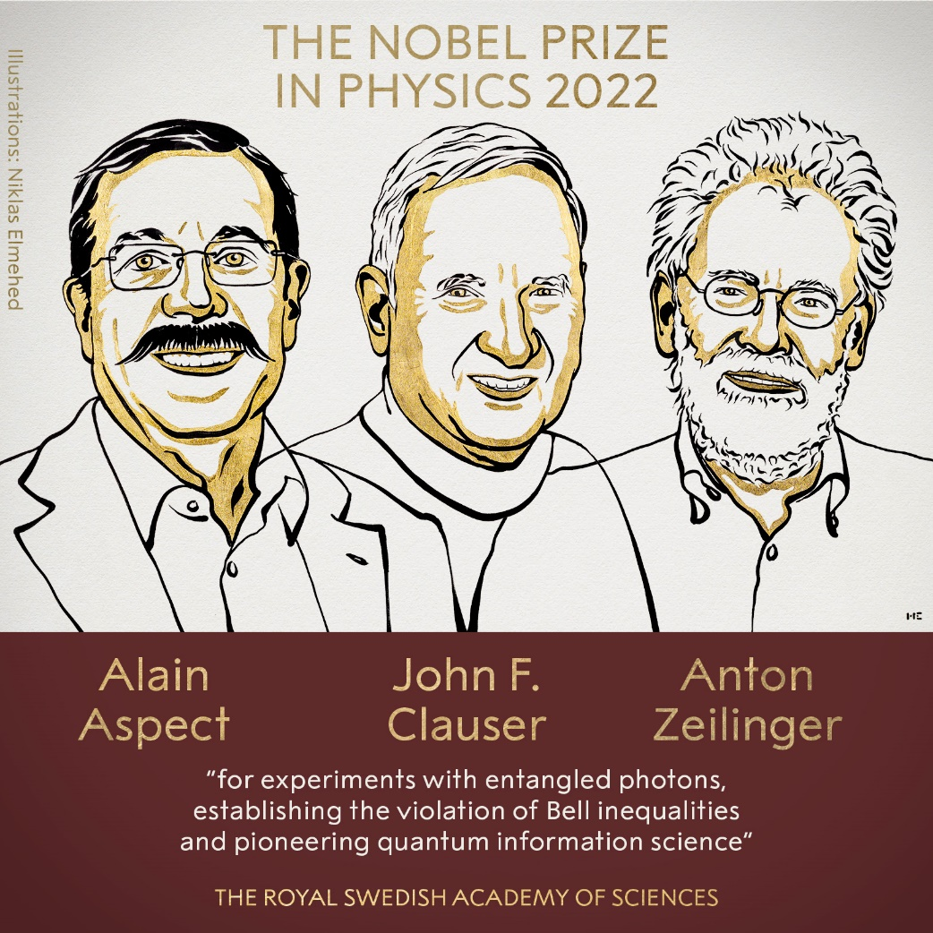
2nd Quantum Revolution?
From foundations to applications
Entanglement
→ physical reality vs non-locality
Miniaturization & Moore’s law
→ quantum computers?
Quantum communication & Quantum information processing
→ quantum networks?

Slide 28
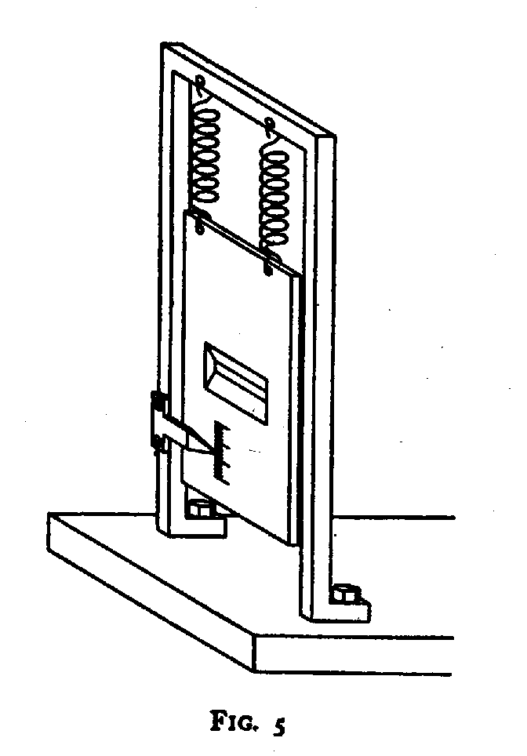
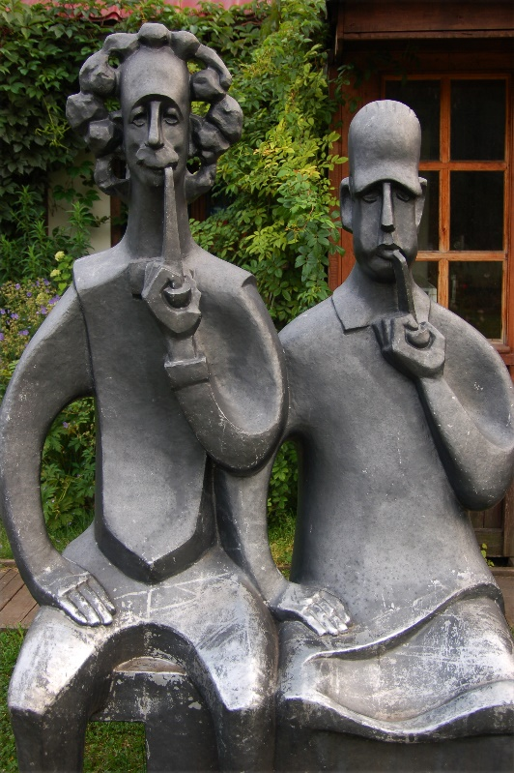
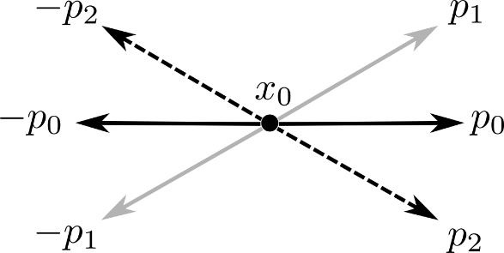

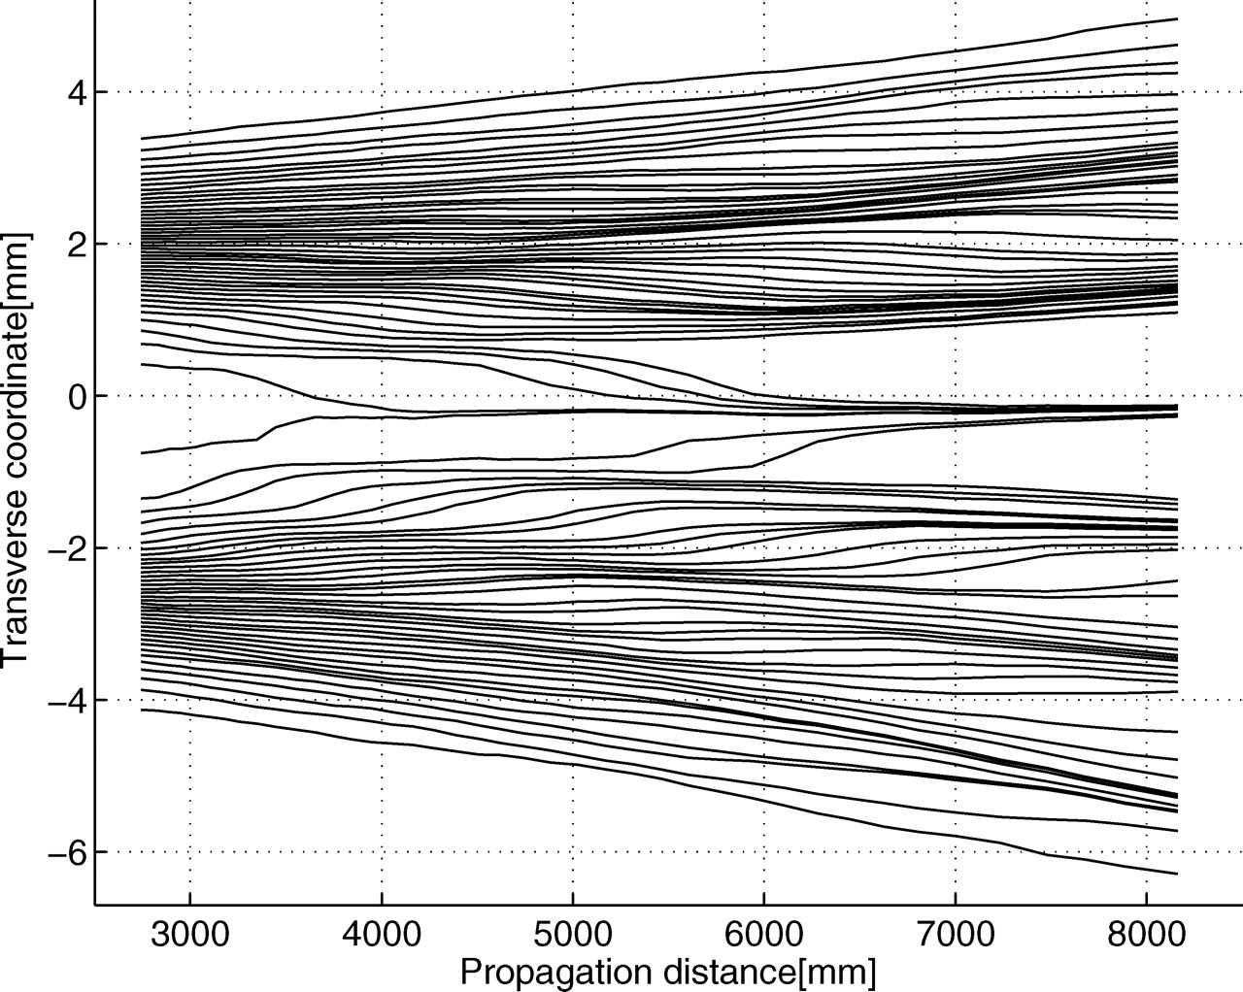
Hidden variables?
Hidden variables?
Quantum physics ”complete”?
CC BY-NC-SA 2.0, Marcella
CC 4.0, R. Kaltenbaek
Classical correlations?
→ no, more than that

Slide 29
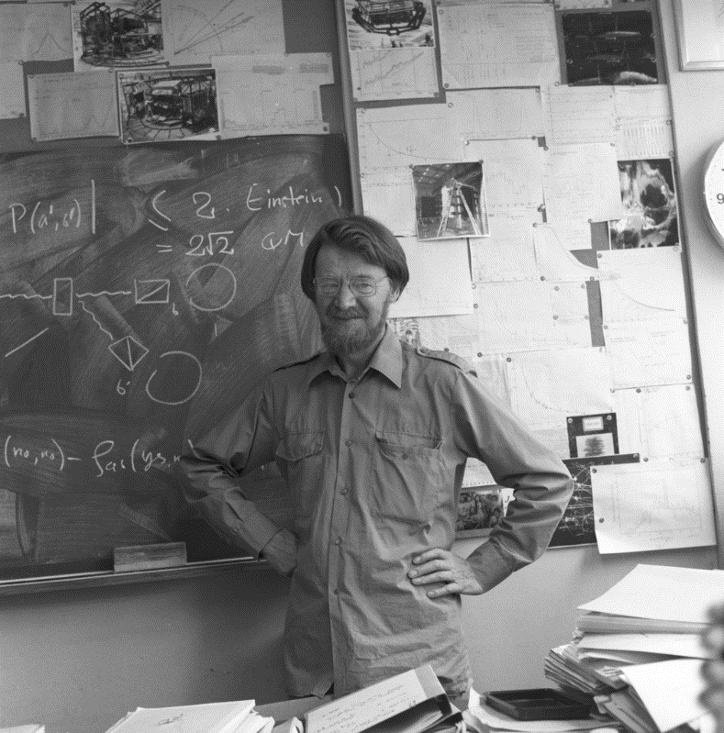
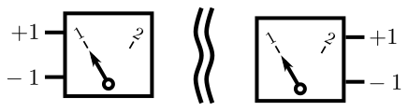
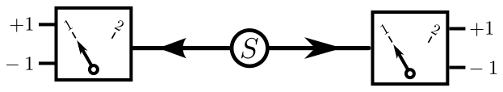
Bell: Quantum Physics vs Local Realism
John Bell 1960s:
→ can we test that?
→ Spatially separated measurements
→ dichotomic outcomes
→ random choice of measurement
Entangled states violate Bell inequality!
CC 4.0, CERN
“Local Realism”
→ no signaling
→ measurement outcomes
predetermined
BUT: original Bell inequality not testable

Slide 30
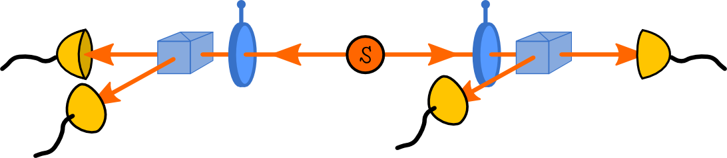
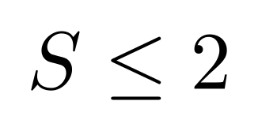
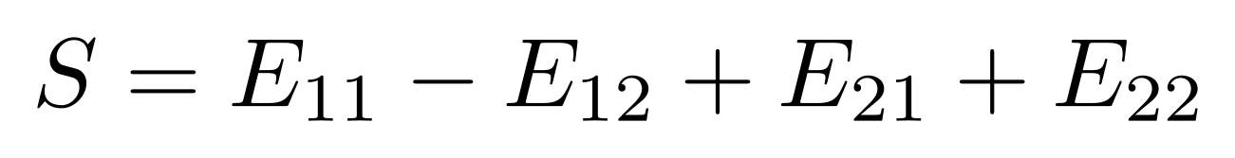
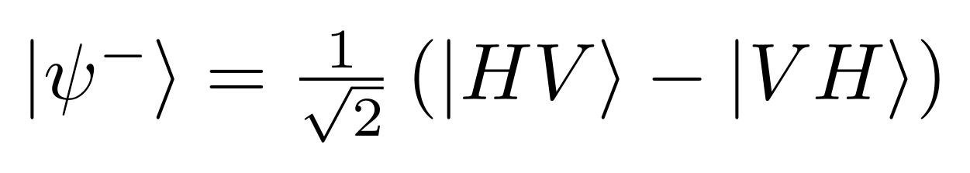
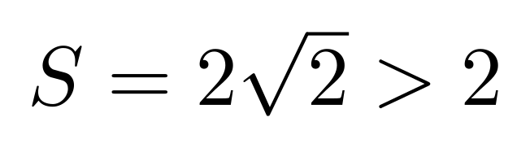
Experimental Bell tests
John F. Clauser et al., late 1950s, early 1970s:
→ modified Bell-type inequalities
→ CHSH inequality
where
Clauser et al violated CHSH (early 1970s)
BUT, CHSH tests had loopholes:
1) fair sampling (imperfect detection)
2) freedom of choice (random settings)
3) locality
→ violates CHSH inequality:

Slide 31
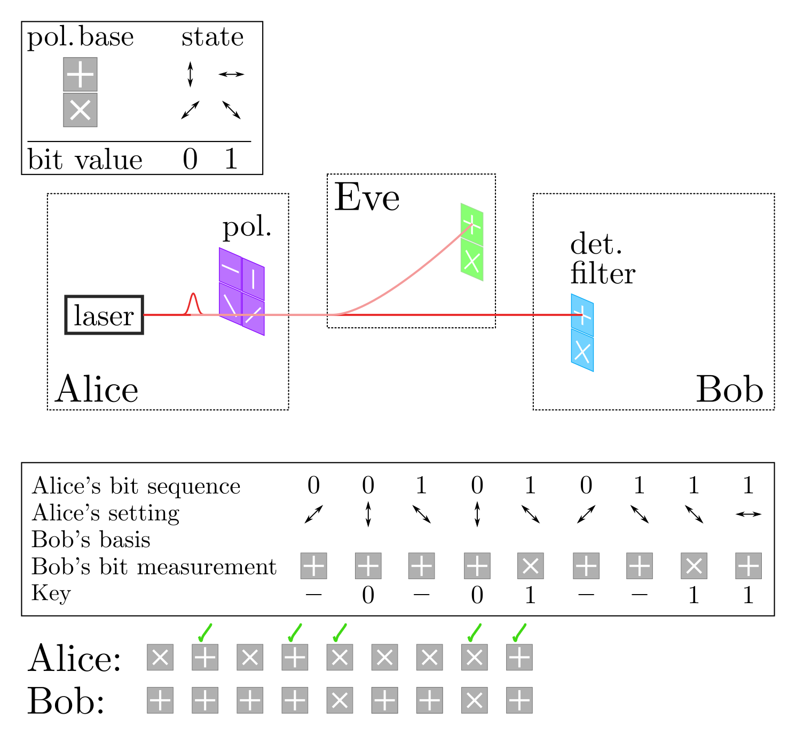
First applications – quantum key distribution
Bennett & Brassard – Proc. IEEE (1984)
→ quantum key distribution (QKD)
→ the BB84 protocol
→ safe generation of secret key
→ physics ensures safety

Slide 32
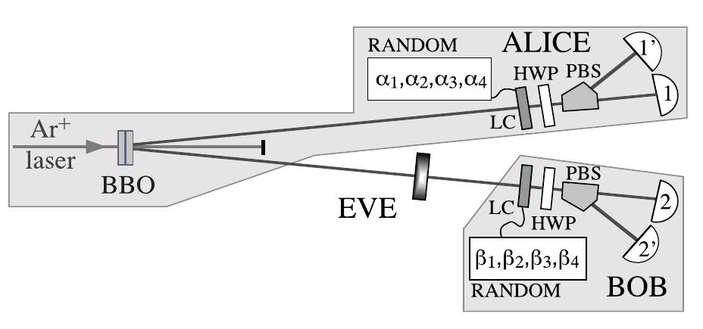
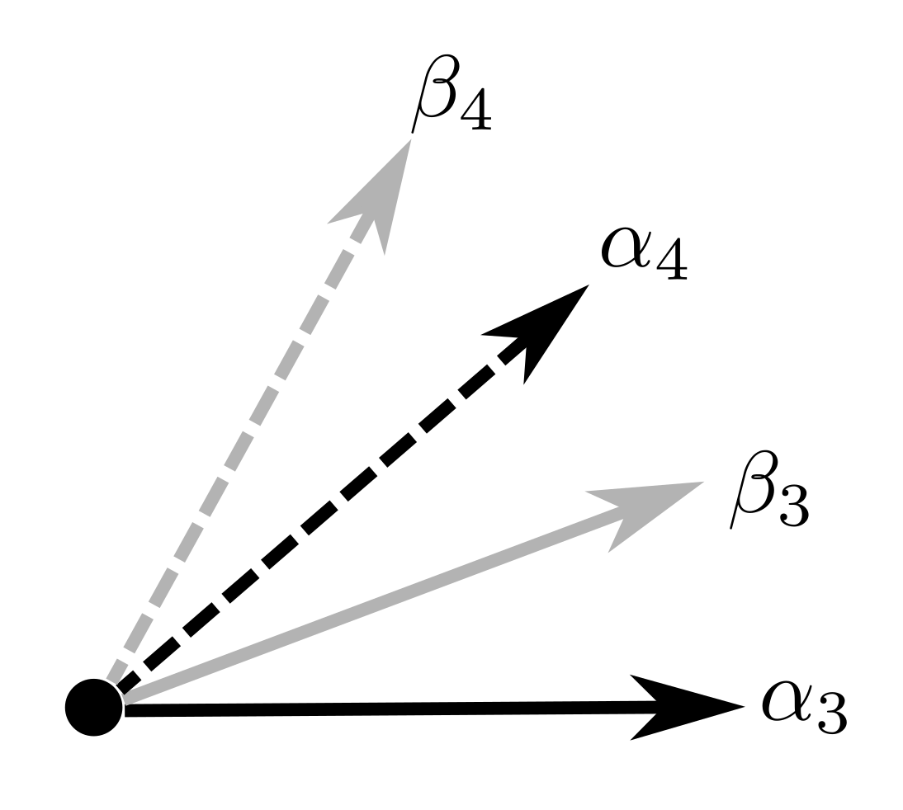
Entanglement-based QKD
Ekert, PRL 67 (1991)
→ test CHSH inequality on random subset
→ the E91 protocol
→ basis for device-independent QKD
Half the angles optimal for BB84
Other half optimal for CHSH

Slide 33
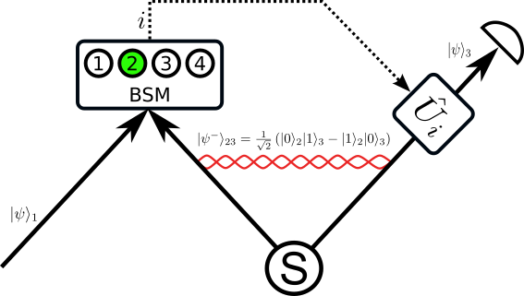
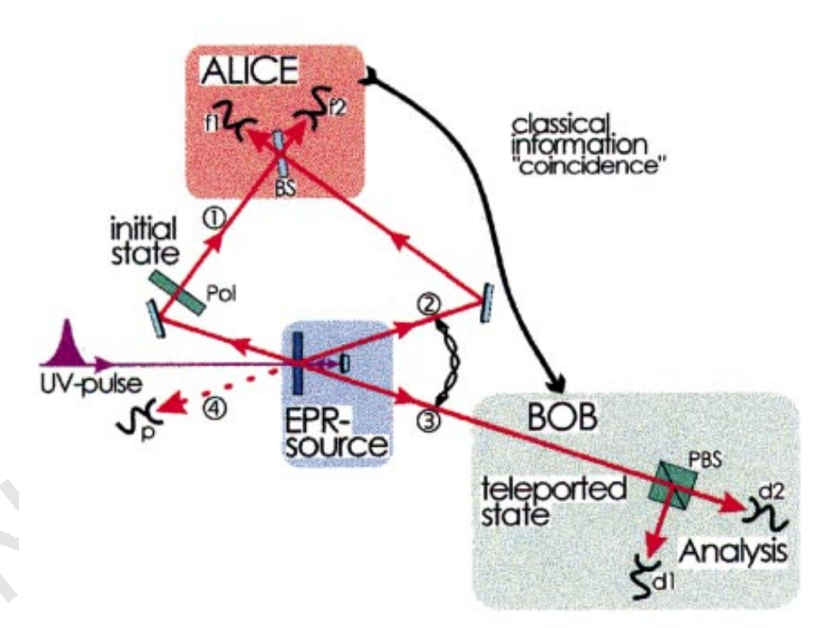
Quantum state teleportation
Bennett et al. - PRL 70 (1993)
Bouwmeester et al. (Zeilinger group) – Nature 390 (1997)
→ first discrete-variable QST
Bouwmeester et al. Nature (1997)

Slide 34
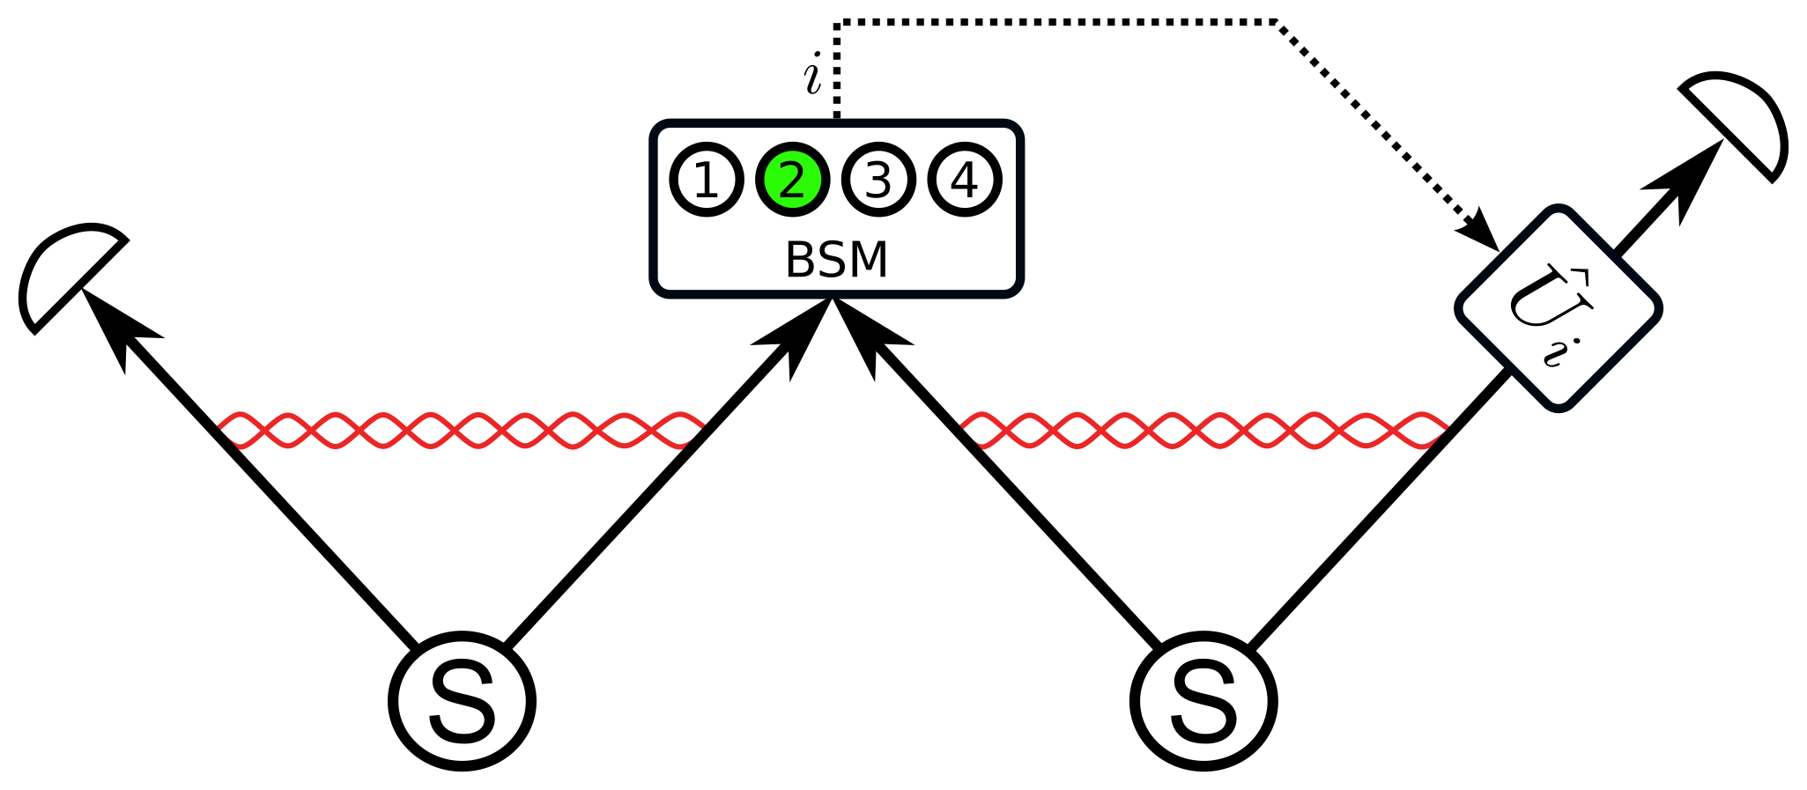
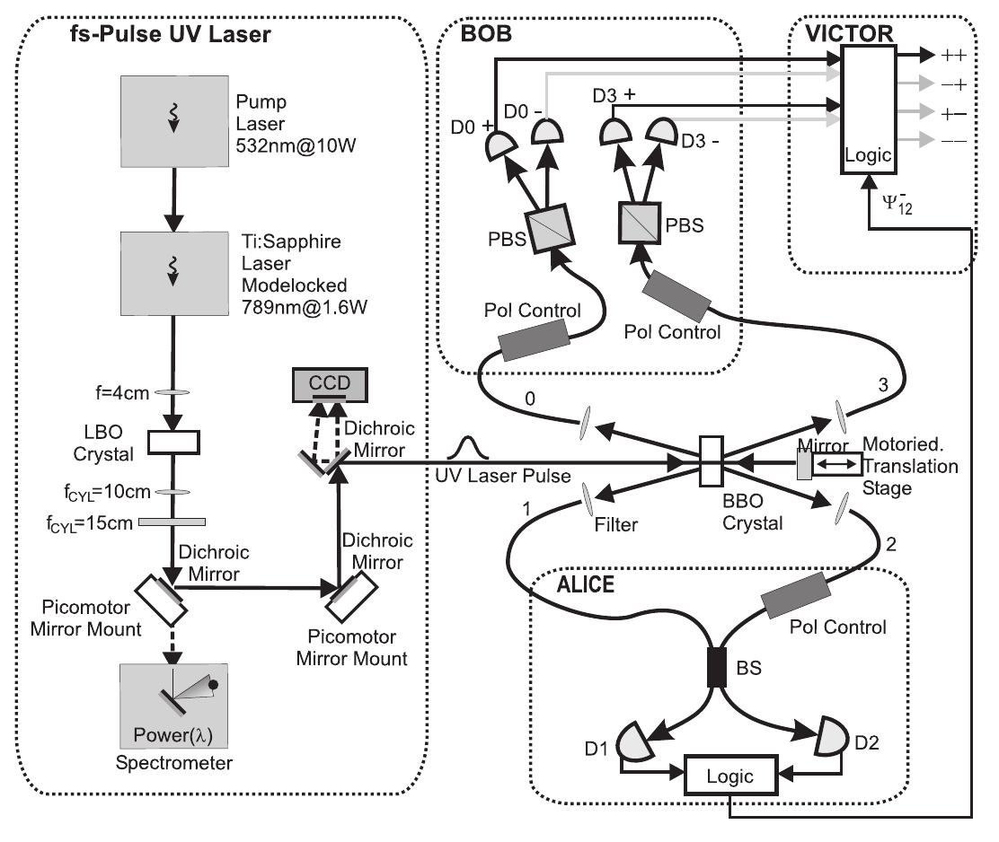
Teleportation of entanglement
Żukowski et al. - PRL 71 (1993)
Pan et al. – PRL 80 (1998)
Jennewein et al. – PRL 88 (2002)
Jennewein, PhD thesis (2002)

Slide 35

Quantum networks
Connect:
quantum computers, sensors, simulators
quantum communication,
e.g.: quantum cryptography, super-dense coding, teleportation
Central elements:
End nodes
Switches
Quantum repeater

Slide 36


Quantum Repeater
Overcome exponential losses:
– Briegel et al. PRL 81 (1998)
– Duerr et al. PRA 59 (1999)
Requires:
→ entanglement swapping
→ quantum memories
Kaltenbaek, PhD thesis (2008)

Slide 37


Entanglement Distillation
Bennett et al – PRL 76 (1996)
→ “purification” of mixed-state entanglement
Kaltenbaek, PhD thesis (2008)
Kaltenbaek, PhD thesis (2008)

Slide 38


Narrow-band 1310 nm entanglement
Cavity-enhanced SPDC
Lock cavities to laser
Lock laser to gas cell
Switch lock-mode / source-mode
1310nm photons
Bandwidth ~1MHz

Slide 39

Narrow-band 1550 nm entanglement
Cavity-enhanced SPDC
Lock cavities to laser
Lock laser to gas cell
Switch lock-mode / source-mode
New Source design
1550nm entanglement
New Source design
780 + 1560nm entanglement

Slide 40

Quantum Communication
Credit: ESA, Ursin
Euro-QCI initiative
Slovene national infrastructure
Interfacing with neighbors
Prepare for satellite link

Slide 41


Slovene national quantum network (SiQUID)
Build national quantum communication infrastructure
Six nodes connected with quantum key distribution (QKD)
Entanglement-based QKD to be future safe
Entanglement shared as a resource

Slide 42

Bright source of entanglement
Sagnac source:
Relatively narrowband (<100 GHz)
Periodically poled lithium niobate (PPLN) crystal in Sagnac interferometer
Super-conducting nanowire single-photon detectors (SNSPDs)
S. Neumann et al (Ursin group), Quantum 6, 822 (2022)

Slide 43

Coupling SPDC and optomechanics
Couple extremely narrow-band SPDC to optomechanical cavity
Coherently displace input photons
Integer excitations of oscillator
Akram et al, NJP 12 (2010)

Slide 44


Prepare optomechanical Fock states
Extremely narrow-band SPDC
Drive number-state transitions in trapped particle
Release and observe evolution
Towards optomechanical Mach-Zehnder
n=2
10 s evolution
n=5
10 s evolution

Slide 45
Conclusions
Narrow-band entanglement
New concepts for preparing states
Technology development towards MAQRO
Demonstrations in µg?
Cubesat pathinders?
maqro-mission.org & quantum.fmf.uni-lj.si

