Slide 1
Logistics Optimization for Delivery Routes – Flipkart
SQL & Power BI Project
Presented by: Bogireddy Nithin Kumar Reddy

Slide 2
Project Overview
Analyze logistics performance
Identify delays
Optimize routes and warehouses

Slide 3
Objectives
Improve
Improve delivery efficiency
Reduce
Reduce delays
Analyze
Analyze agent and warehouse performance

Slide 4
Dataset Overview
Orders
Routes
Warehouses
Delivery Agents
Shipment Tracking

Slide 5
Data Cleaning
Removed duplicates
Handled NULL values
Standardized data

Slide 6
Delay Analysis
Identified delayed routes
Analyzed delay reasons
Ranked delays

Slide 7
Route Optimization
Calculated efficiency ratio
Identified worst routes
Improved routing

Slide 8
Warehouse Performance
Analyzed processing time
Compared delays
Identified bottlenecks

Slide 9
Agent Performance
Compared efficiency
Identified low performers

Slide 10
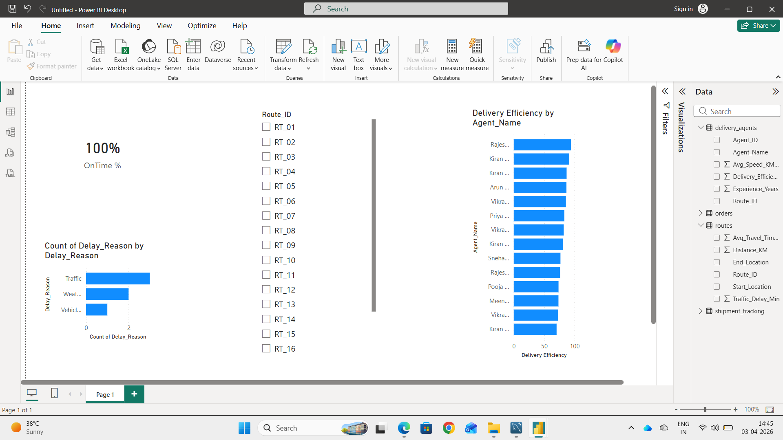
KPI Dashboard

Slide 11
Key Insights
On-Time %
Delay Reasons
Efficiency Metrics

Slide 12
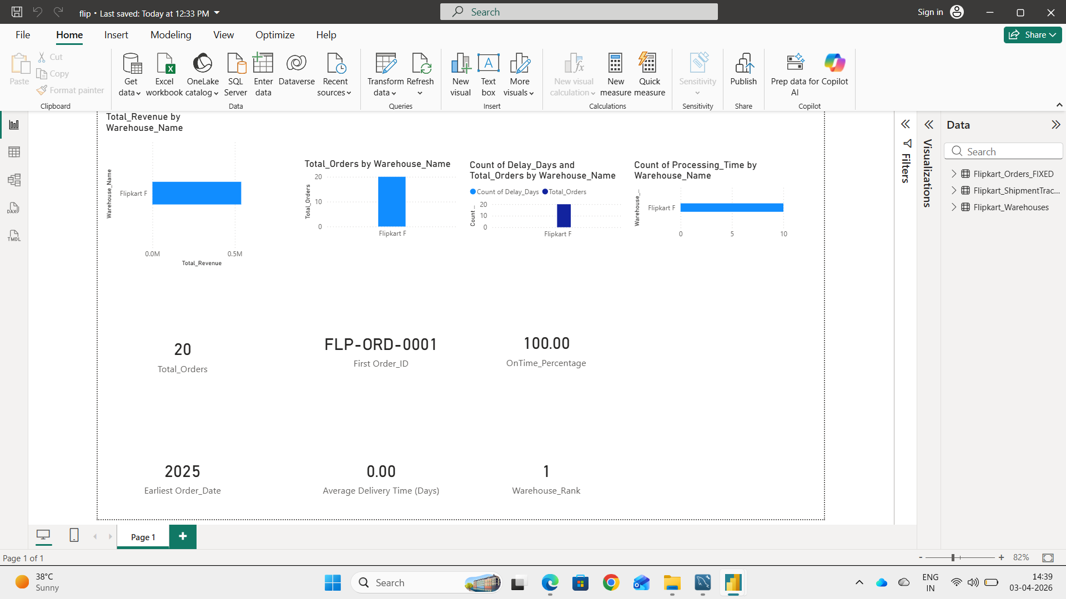
Power BI Dashboard

Slide 13
Key Insights
Traffic is main delay cause
Some routes inefficient
Warehouse performance varies

Slide 14
Conclusion
Data-driven logistics improves efficiency
Optimization needed

