Slide 1
Recommender system based on Matrix factorization and bpr
From Python to Rust

Slide 2
Hybrid Workflow: Development in both languages.
Python (Training): Used for data analysis, rapid prototyping, and model training using PyTorch.
ONNX (The Bridge): Open Neural Network Exchange format for interoperability.
Rust (inference) and concurrent scenario: High-performance, concurrent web server for real-time recommendations.
The architecture

Slide 3
Model development in python
Algorithm: Matrix Factorization (MF) with Bayesian Personalized Ranking (BPR).
Goal: Optimize latent factors to rank observed items (positives) higher than unobserved ones (negatives).
Framework: PyTorch.
Dataset: MovieLens (tested on Small and 1M versions).
Output: Learned user/item embeddings exported for production.

Slide 4
Model development in rust
The same model was developped in Rust using Candle, with the same parameters and the way to handle the data before the training.
Three main vectors:
Users
Items
Interactions

Slide 5
Model Export & Interoperability
ONNX
Hardware acceleration support.
Language agnostic (train in Python, run in C++, C#, Rust).
The Process
Tracing the PyTorch model execution.
Defining dynamic axes (to support batch processing).
Exporting the computational graph to a .onnx binary.
Result
A portable artifact containing weights and architecture, decoupled from the Python interpreter.

Slide 6
Data Consistency & Sanity Checks
The "Index Alignment" Risk: Python and Rust must map User ID 100 to the exact same internal matrix index.
Verification Strategy:
Using test in Rust.
Dual Implementation: Replicated the CSV parsing logic in Rust.
Automated Tests:
Dataset Dimensions: Asserting user/item counts match.
ID Mapping: Checking specific random IDs in both systems.
History Check: Verifying user history length matches exactly.
Outcome: 100% alignment between Python training data and Rust serving data.

Slide 7
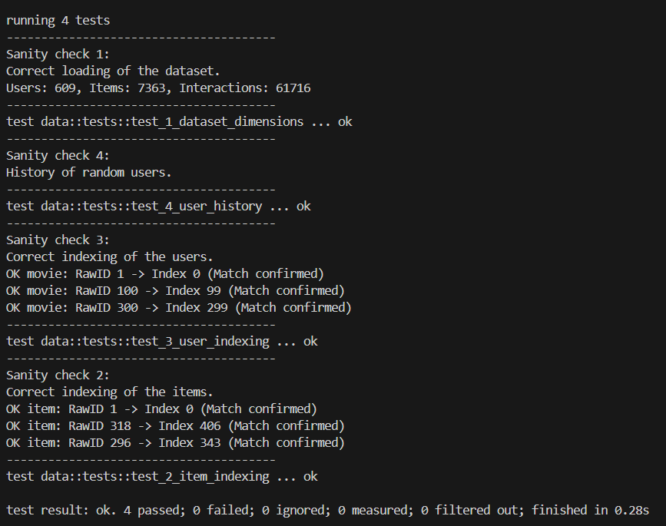
Data Consistency & Sanity Checks

Slide 8
TRAINING TIME AND HIT RATIO (ml-latest-small dataset)

Slide 9
Latency reporting (latest-small dataset)

Slide 10
training time AND HIT RATIO (ml-1m-csv dataset)

Slide 11
Latency reporting (ml-1m-csv dataset)

Slide 12
Production Server in Rust
Crates used
Axum: Asynchronous web framework.
Tokio: Async runtime for concurrency.
ORT (ONNX Runtime): Rust bindings for executing the model.
Performance features
Zero-Copy: Efficient memory management.
Type Safety: Compilation-time guarantees against common bugs.
Low Latency: Inference times < 1ms per request.

Slide 13
The Challenge: How to handle a concurrent scenario.
The Solution: Implemented an Object Pool Pattern using async-channel.
How it works:
Created N worker sessions (matching CPU cores, in this case 8).
Requests "borrow" a session from the pool and return it after inference.
Result: True parallelism without race conditions or locks.
Handling Concurrency
Requests queue
Workers
…
Request
Request
Request
Request

Slide 14
Stress Testing & Benchmarks
Methodology
Custom Async Rust Client spawning 50+ concurrent requests (using the model trained on latest-small dataset).
Metrics
Server Processing Time: ~0.6ms (Pure inference logic).
End-to-End Latency: Stable under load.
Scalability: Linear handling of requests thanks to the Tokio runtime.
Conclusion
The Rust architecture successfully handles high-throughput scenarios with minimal resource footprint.

Slide 15
stress testing results
Total throughput: 50 requests in 0.33s
Average server processing: 0.65 ms
Despite the initial network overhead (cold TCP connections), the Rust inference engine handles the load in perfect parallelism, keeping computation times under a millisecond.

Slide 16
Stress test limits
Baseline Validation
Initial tests confirmed stability at 50 concurrent requests.
Now the system will be evaluated on growing number of requests per second.
Ramp-Up Approach
Goal: Identify the system's Maximum Throughput.
Method: Incrementally increasing Target RPS (Requests Per Second) steps.
From 100 RPS to 15,000 RPS.
Failure Criteria (SLA Breach)
The system is considered "broken" if either condition is met:
Latency Timeout: P99 > 2000 (Client stops waiting).
Service Collapse: Error Rate > 5% (Connection Refused / Dropped packets).

Slide 17
Break stress test

Slide 18
The Breaking Point: 10,000 RPS
Stable Zone: Up to 7500 RPS, the system maintained low latency (P99 < 100ms) and 0% errors.
Saturation Zone: At 10000 RPS, Real RPS diverged from Target RPS (3508/10000).
Root Cause: Queue Saturation
Arrival Rate > Processing Rate: The CPU could not compute recommendations fast enough to clear the incoming queue.
Resource Exhaustion: The OS eventually stopped accepting new TCP connections (Port Exhaustion/Backlog limit), triggering the >5% error rate.
Conclusion
Rust + Candle/ORT achieved extreme efficiency on a single node.
The bottleneck was computational throughput, not language overhead.
Breaking point analysis

Slide 19
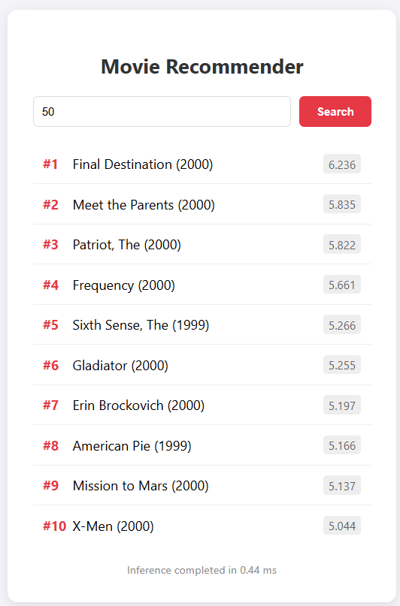
Real-Time Testing Dashboard (HTML Client)
Purpose:
Example of user experience.
Implementation:
A lightweight index.html single-page application.
Uses vanilla JavaScript fetch API to query the Rust server asynchronously.
Workflow:
Input: The user enters a target User ID.
Process: The browser sends a GET request to localhost:3000.
Visualization: Renders the Top-10 Movie Recommendations and Server Inference Time in a clean, readable list.
Technical Note: Requires enabling CORS (Cross-Origin Resource Sharing) on the Axum server to allow browser-based requests.

Slide 20
Next Steps: Optimization & Real-World Validation
Hyperparameter Fine-Tuning
Implement to find the optimal number of Latent Factors, Learning Rate, and Regularization.
Concurrency Architecture Exploration
Explore Spawn Blocking.

