Slide 1
Neural Networks
Multi Layer Perceptron – Multiclass Classifier

Slide 2
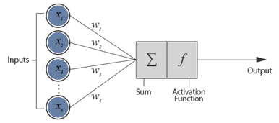
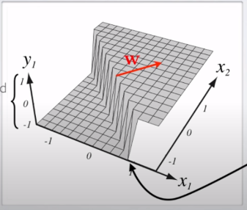
Perceptron Review
We have seen how a perceptron works
How it can be used for linearly separable classification

Slide 3
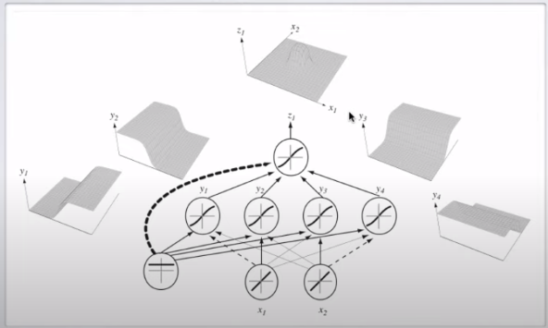
Multi Layer Perceptron (MLP)
In order to more complex classes (non linearly separable) we will stack multiple layers of perceptrons

Slide 4
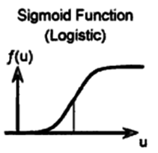
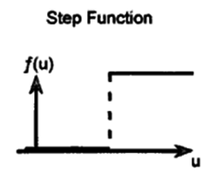
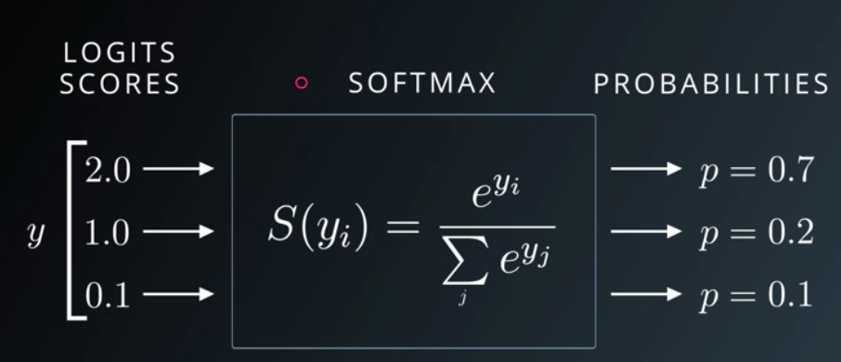


Activation functions
Step Activation function
$y=\left\{\begin{aligned}1, if X≥0 \\ 0, if X<0\end{aligned}\right.$
Sigmoid Logistic function
Used in order to capture finer detail
$y=\frac{1}{1+e^{−X}}$
Softmax Activation function
Used because we have multiple classes, outputs a probability
$y_{i}=\frac{e^{y_{i}}}{\sum_{j}{e^{y_{j}}}}$

Slide 5
Training
What are derivatives?
According to Wikipedia: “The derivative of a function of a real variable measures the sensitivity to change of the function value with respect to a change in its argument”
This means that a derivative measures how much a function f(x) changes when we increase or decrease x.
Why we need it?
Because we have advanced from the step function to sigmoid we now need to compute the derivative of the function in order to know how much and in what direction to update the weights

Slide 6

Training

Slide 7
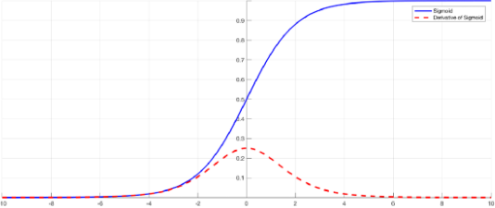

Activation Function Derivatives
Derivative of Step Activation
No derivative, a function needs to be continuous (no sharp edges) in order to be derivable
Derivative of the Sigmoid Logistic
$σ^{′}\left(x\right)=σ(x)(1−σ(x))$
Full derivation at: https://towardsdatascience.com/derivative-of-the-sigmoid-function-536880cf918e
Derivative of the Softmax Activation
$−(e\left(y\right)−f(x))$
Full derivation at: https://www.youtube.com/watch?v=1N837i4s1T8&list=PL6Xpj9I5qXYEcOhn7TqghAJ6NAPrNmUBH&index=9

Slide 8

Updating the weights
For the output layer we just compute the error and by using the derivative of the activation function see in which way the weights have to be updated
For the hidden layers we need to use derivative the derivative chain rule
$F^{′}\left(x\right)=f^{′}\left(g\left(x\right)\right)g′(x)$
This means that for the hidden layers we don’t have to compute the derivative in respect to the output, we can just calculate it in respect to the next layer
A more in depth explication of the chain rule:
https://www.youtube.com/watch?v=0T0QrHO56qg
Updating the weights example:
https://www.youtube.com/watch?v=1N837i4s1T8&list=PL6Xpj9I5qXYEcOhn7TqghAJ6NAPrNmUBH&index=9

Slide 9
Python Example
https://github.com/Bogst/NeuralNetworks/tree/master/MLP_Multiclass_Clasifier

