Slide 1
Neural Networks
Perceptron

Slide 2
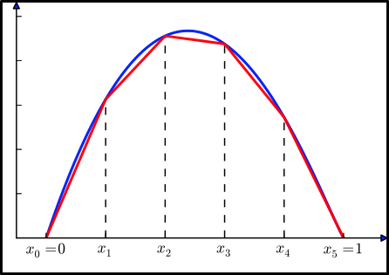
What is a neural network?
A neural network is an universal function approximator

Slide 3
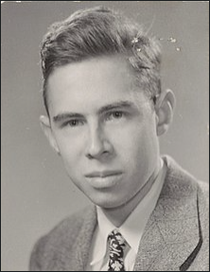
Perceptron
Fundamental unit of the neural network
Developed by Frank Rosenblatt in 1950s

Slide 4
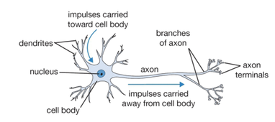
Perceptron
Inspired by what at the time was believed to be the working mechanism of a neuron

Slide 5
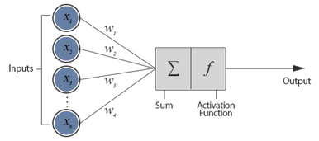
Components of a perceptron
Activation function
Step function – it triggers once a threshold value is surpassed
Weights
The amount each feature contributes to the classification
what we are trying to learn
Bias
An extra term that allows flexibility to the model
It allows for the decision boundary to not include the origin
Also learned

Slide 6
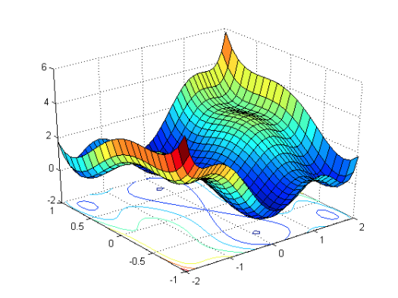
Functions used in training the perceptron
Loss function
Function that determines what it means to be wrong and also establishes by how much
1 if the classification is wrong, 0 otherwise
Learning rate
How much we update the weights with each example
0.5

Slide 7
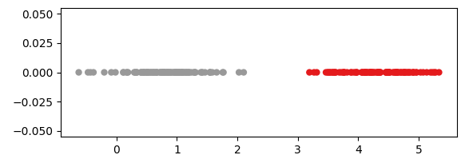
How it works
It “learns” a series of weights corresponding to input features
It finds out which features contribute to each class and by how much
The number of features dictates the dimensionality of the space in which we are working
Notes:
in a 1d example, if we want to classify objects into big or small, we give the perceptron different data points together with their label and it will learn that if the input is under a certain value it is considered small, otherwise it will be considered big. We will look at a dimensional case because it is easy to understand, but it works the same for higher dimensions, with the number of dimensions being equal to the number of input features

Slide 8
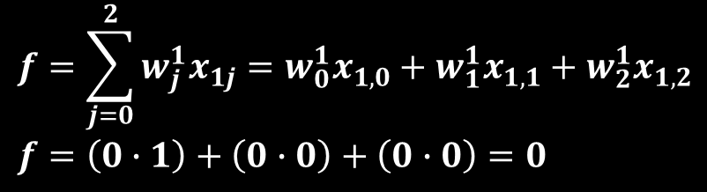
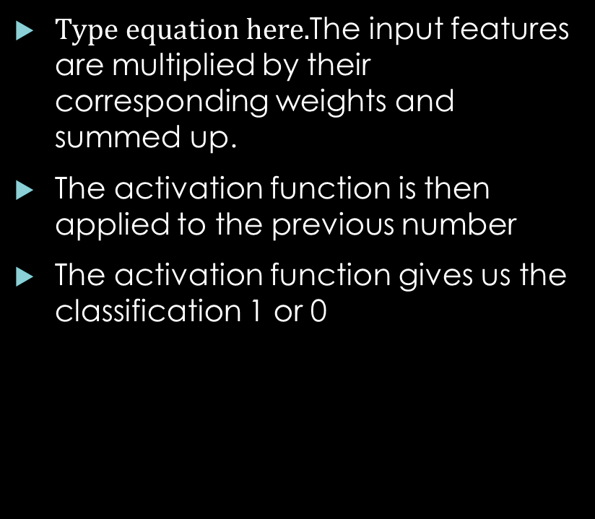
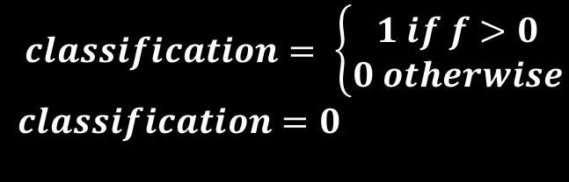
How does it really work - classification
The input features are multiplied by their corresponding weights and summed up.
The activation function is then applied to the previous number
The activation function gives us the classification 1 or 0
$$f=\sum_{j=0}^{2}{w_{j}^{1}x_{1j}}=w_{0}^{1}x_{1,0}+w_{1}^{1}x_{1,1}+w_{2}^{1}x_{1,2}$$
$$f=\left(0∙1\right)+\left(0∙0\right)+\left(0∙0\right)=0$$
$$classification= \left\{\begin{aligned}1 if f>0 \\ 0 otherwise\end{aligned}\right.$$
$$classification=0$$

Slide 9

How does it really work? - Training
In order to learn the weights we perform a classification
We determine how wrong the classification was based on the loss function
We update the each of the weights based on how wrong de classification was, how much it contributed to the end result and what the learning rate dictates
$error=y−classification$ = 1-0=1
$$w_{0}^{2}= w_{0}^{1}+learning rate∙error∙x_{1,0}$$
$$w_{0}^{2}=0+0.5∙1∙1=0.5$$
$$w_{1}^{2}= w_{1}^{1}+learning rate∙error∙x_{1, 1}$$
$$w_{1}^{2}=0+0.5∙1∙0=0$$
$$w_{i}^{2}=\left[\begin{matrix}0.5 \\ 0\end{matrix}\right]$$

Slide 10
Python example

