Slide 1
Speech Emotion Recognition
Visium Use case
Bohan Wang

Slide 2
Objective
The objective is to make a deep learning model which can classify speech into various categories of emotions.
The application of the speech emotion recognition system :
psychiatric diagnosis
intelligent toys
Lie detection

Slide 3
1.Common Technique
Pipeline of speech emotion recognition

Slide 4
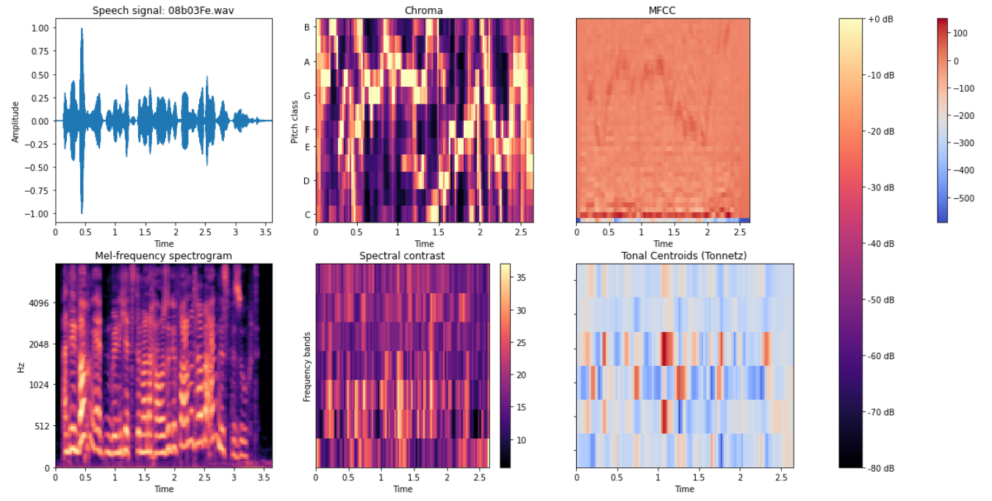

Pipeline
MFCC (mfcc)
Chroma (chroma)
Mel Sepectrogram Frequency (mel)
Contrast (contrast)
Tonnetz (tonnetz)
Audio files in .wav, .mp3 format
CNN
The different emotion to which the audio files belong.
Input
Feature Extraction
Classification
Output

Slide 5
535 Utterances
7 emotions
16 kHz sampling rate
Speech Corpus: EmoDB
The EMODB database is the freely available German emotional database. The database is created by the Institute of Communication Science, Technical University, Berlin, Germany. Ten professional speakers (five males and five females) participated in data recording. The database contains a total of 535 utterances.
The EMODB database comprises of seven emotions: 1) anger; 2) boredom; 3) anxiety; 4) happiness; 5) sadness; 6) disgust; and 7) neutral.
The data was recorded at a 48-kHz sampling rate and then down-sampled to 16-kHz.

Slide 6
Data Augmentation
Random
Iibrosa function
1
Time-stretch an audio series by a random rate.
Uniformly distributed over [0.3, 2.0)
librosa.effects.time_stretch
2
Shift the pitch of a waveform by random steps
Uniformly distributed over
[-2, 2.)
librosa.effects.pitch_shift

Slide 7
Feature Extraction
Features: Based on speech signal processing library (librosa)
MFCC (mfcc)
Chroma (chroma)
Mel Sepectrogram Frequency (mel)
Contrast (contrast)
Tonnetz (tonnetz)

Slide 8
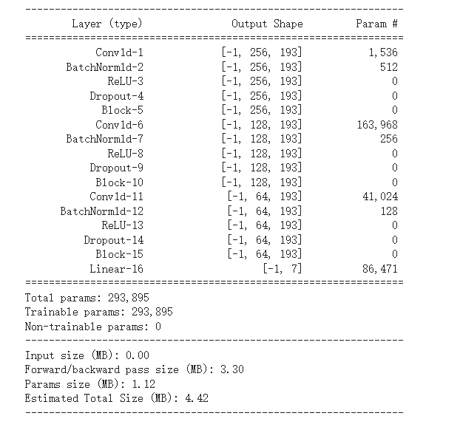
CNN
1 x 5 x 256
1 x 5 x128
1 x 5 x 64
FC: 7

Slide 9
5 Fold cross validation
Best Hyperparameters
Value
1
Learning rate
0.001
2
Weight decay
0.005
3
gamma for exponential learning rate schedule
0.95

Slide 10
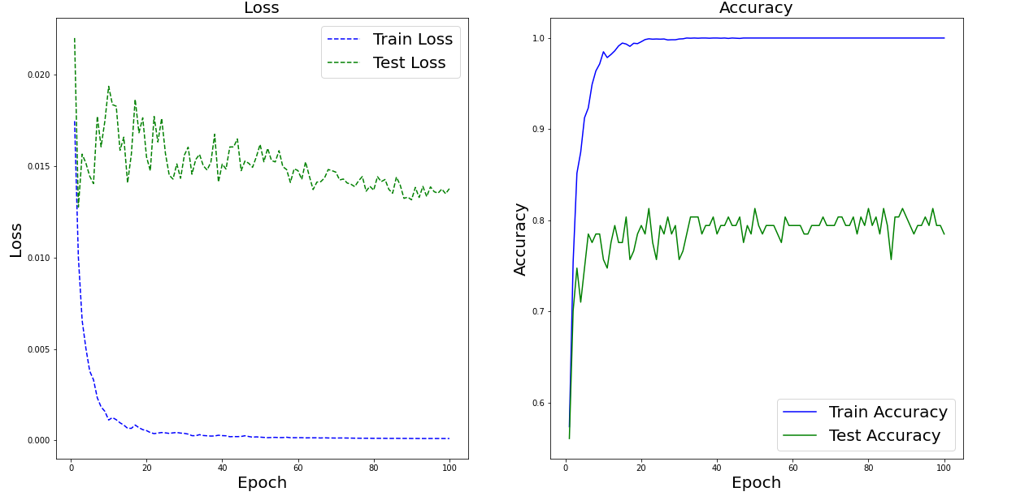
Training and Results
Training setup:
Epoch: 100
Batch size: 64
Optimizer: Adam
Learning rate: 0.001
Weight decay: 0.005
Gamma for exponential learning rate schedule: 0.95
Train accuracy: 100%
Best test accuracy: 81.3%

Slide 11
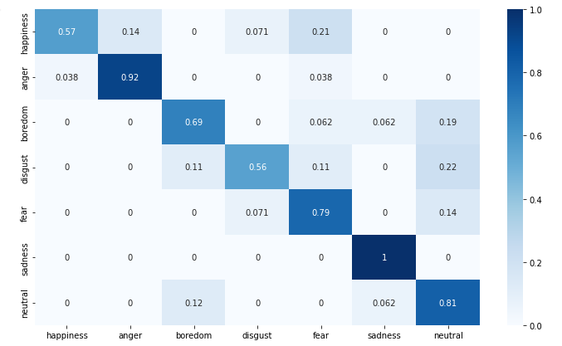
Confusion Matrix
Comment:
Sad speech is the easiest to be predicted.
Happy speech is easy to be classified into anger and fear speech.

Slide 12

THANKS!
Future ideas:
LSTM to get the temporal correlation of the features + CNN classifier
Regularization techniques: Label smoothing and DropBlock to prevent overfitting
I am so sorry not to finish the Docker file and Flask API. I am not familiar with the two tools. If I have the chance to do an internship at Visium, I will learn the two tools as soon as possible. I am sorry, again.

