Slide 1

Music of The Future
Group: Team 4 - CS Duals
Names: Rachel Liu, Bohan Jiang, Dapo Folami, Justin Li

Slide 2
Music is the universal language of mankind. It can help with stress, mood, memory, depression, and many more.

Slide 3
Data Consideration
1
The data that you are considering in the project

Slide 4



We are using the Spotify Dataset from 1921 to 2020 that consists of over 160,000 different tracks. These data points are sourced through Spotify’s public API.
Numerical
Binary
Categorical
Danceability (0 to 1)
Popularity (0 to 1)
Loudness (-60 to 0)
Mode (Major or Minor)
Explicit (Yes or No)
Key (C, C#, etc)
Artists
Track Name

Slide 5
Value & Impact
2
What is the value of analyzing this data and the impact that it can make in a particular business

Slide 6
Objective: Predict the next hit song and understand what features drives popularity over time
Provide a data-driven approach to the music industry
Help record labels and producers create hit songs
Analyze changing trends in music popularity over time

Slide 7
Unanswered Questions
3
What questions we hoped to answer

Slide 8
Variable Relations
There are over 19 unique variables in this dataset and we wish to build a better understanding of their relations with each other
1
Trending Music
Unpack different trends from 1921 to 2020 and understand what trends are forming in the future
2
Feature Impact and Significance
Analyze each feature and understand its significance with popularity
3

Slide 9
Techniques and Methodologies
4
What techniques you will be using or have already used

Slide 10
Predicting Features Trends
Predicting Popularity
End Objective
Utilizing dataset features to predict popularity.
Techniques Used: K-means Clustering, Random Forests, Neural Networks
Predict the next hit song and understand what features drives popularity over time
Identifying how features are trending to create future popular songs

Slide 11
Anticipated Results and Improvements
5
What results have you achieved so far and how do you plan on improving those results in the remaining time

Slide 12
Step 1
Step 2
Step 3
Step 4
Data Exploration
Initial Analysis
Model Building
Verify Results
Explore and clean the dataset
Analyze dataset via data visualizations and descriptive statistics
Build different predictive models with findings from our initial analysis
Run models on different test sets to get error metrics and measure accuracy

Slide 13
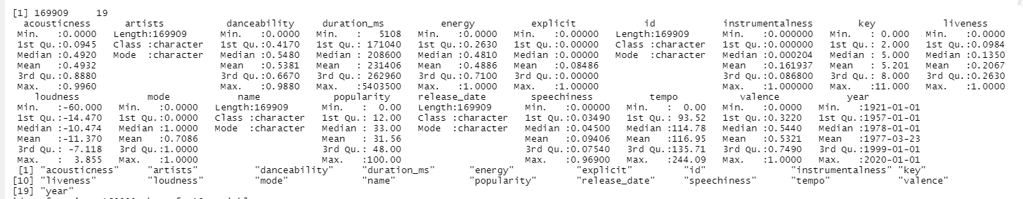
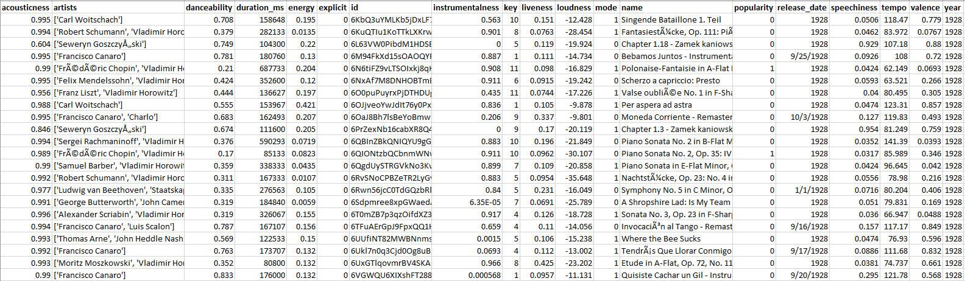
Data Exploration

Slide 14
Data Exploration: Song Examples
Acousticness: Sonata No. 3, Op. 23 in F-Sharp Minor: IV. Presto con fuoco; Meno mosso
Danceability: Funky Cold Medina
Valence: Electric Zoo

Slide 15
Step 1
Step 2
Step 3
Step 4
Identify Problem
Initial Analysis
Model Building
Verify Results
Explore and clean the dataset
Analyze dataset via data visualizations and descriptive statistics
Build different predictive models with findings from our initial analysis
Run models on different test sets to get error metrics and measure accuracy

Slide 16
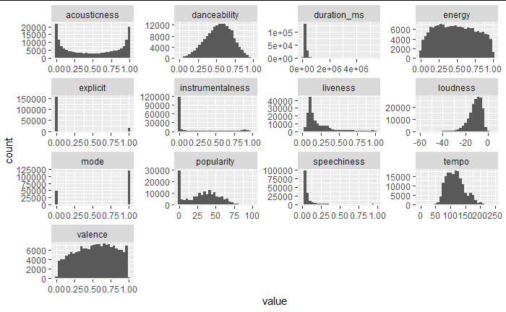
Data Analysis: Feature Distribution Histograms

Slide 17
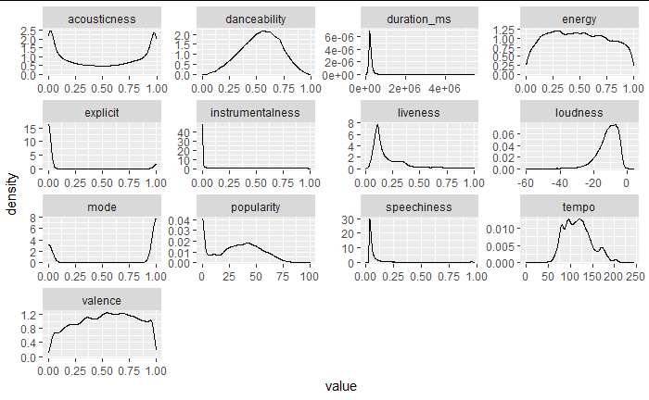
Data Analysis: Feature Distribution Density Plots

Slide 18
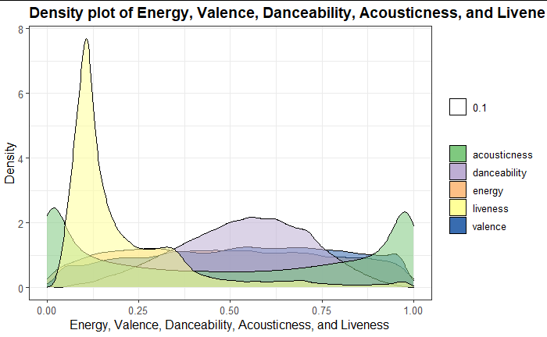
Data Analysis: Density of Key Characteristics

Slide 19
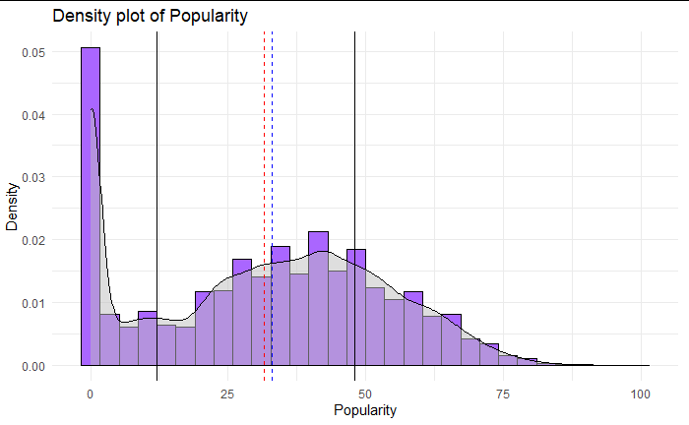
Data Analysis: Density of Popularity

Slide 20
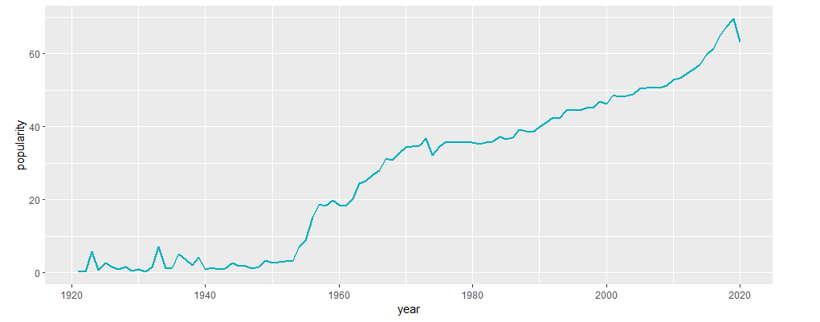
Data Analysis: Popularity over Time

Slide 21
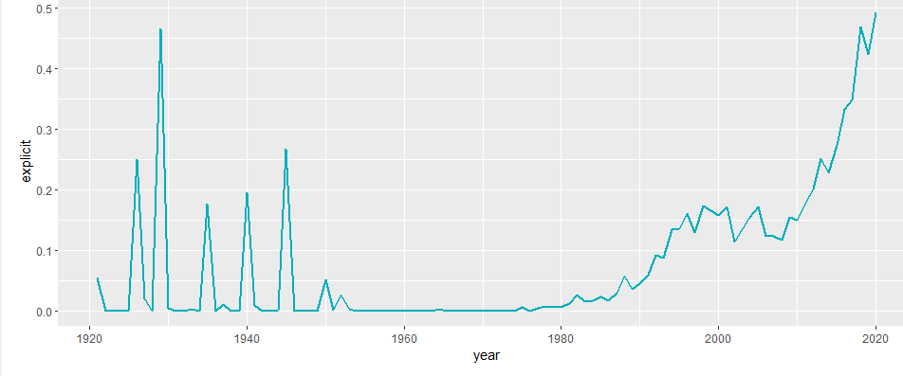
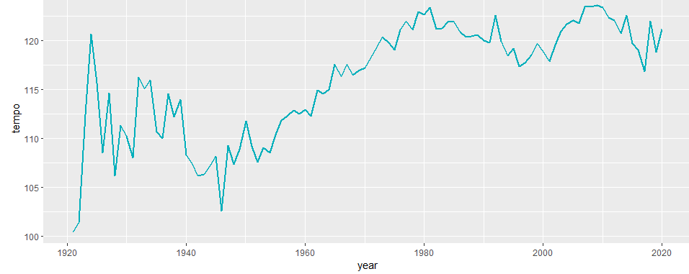
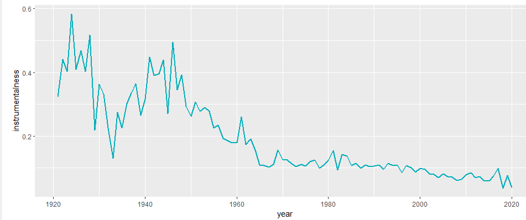
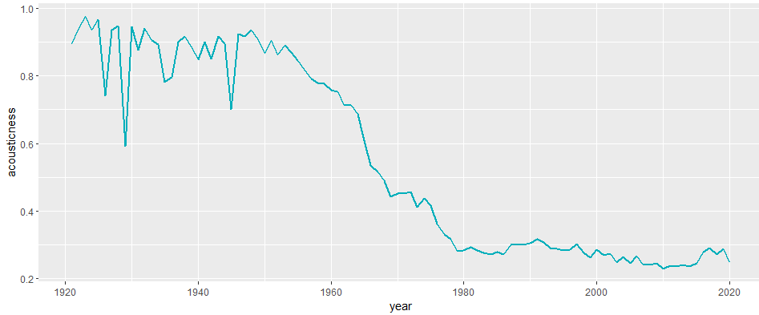
Data Analysis: Key Trends over Time

Slide 22
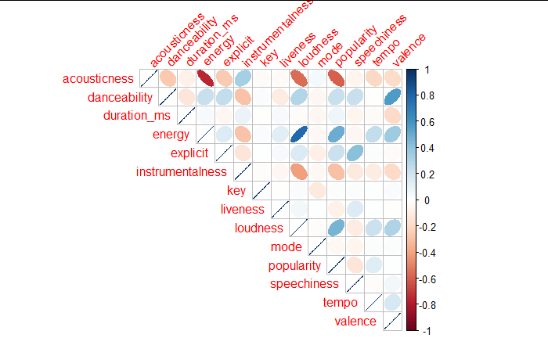
Data Analysis: Feature Correlations

Slide 23
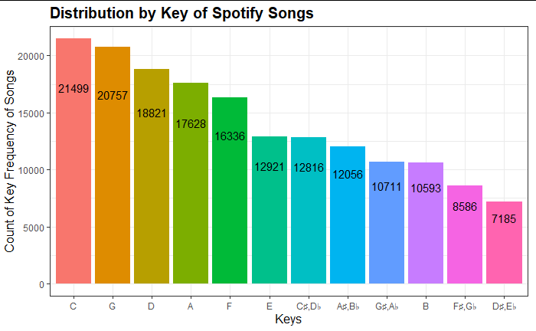
Data Analysis: Distribution by Key

Slide 24
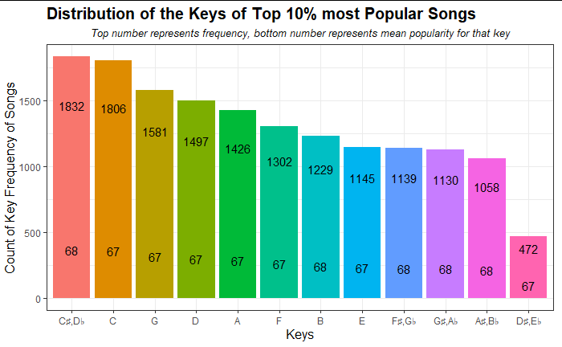
Data Analysis: Distribution by Key, Most Popular Songs

Slide 25
Step 1
Step 2
Step 3
Step 4
Identify Problem
Initial Analysis
Model Building
Verify Results
Explore and clean the dataset
Analyze dataset via data visualizations and descriptive statistics
Build different predictive models with findings from our initial analysis
Run models on different test sets to get error metrics and measure accuracy

Slide 26
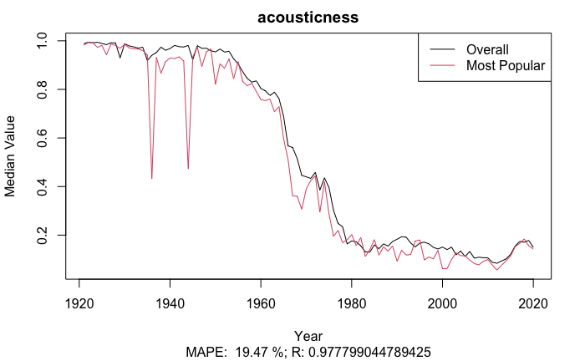
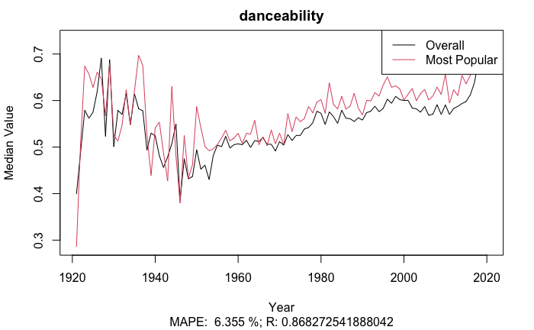
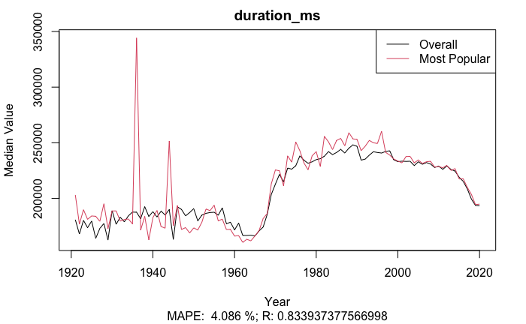
Feature Analysis: Popular Trait Differences

Slide 27
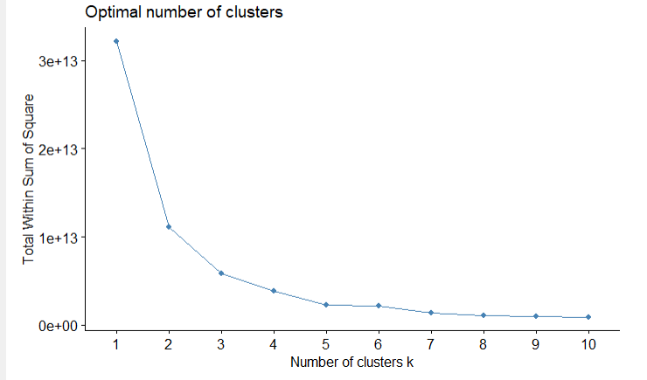
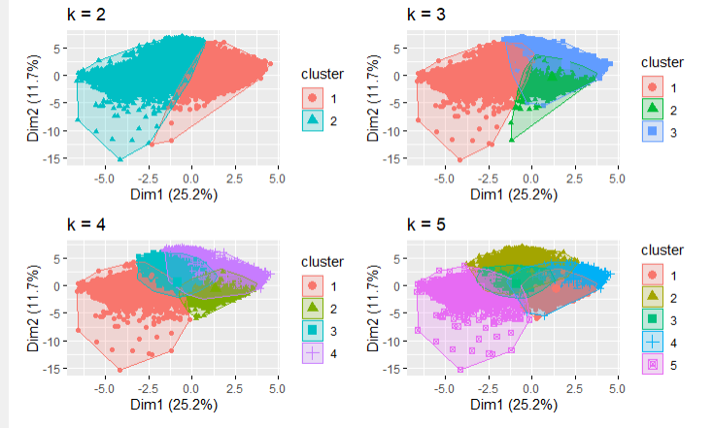
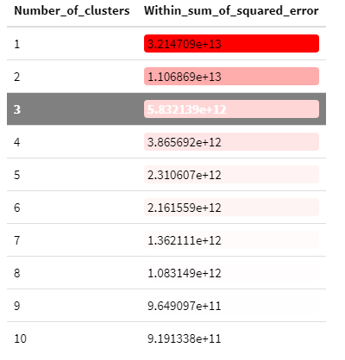
Categorizing Songs: K-means Clustering

Slide 28
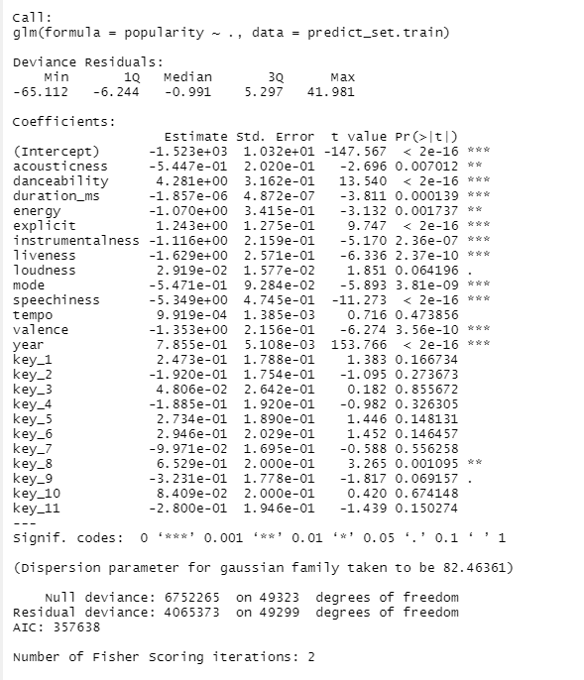

Predicting Popularity: Multiple Linear Regression
Error Metrics

Slide 29
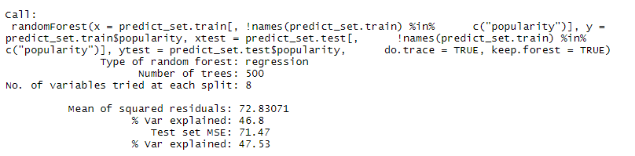
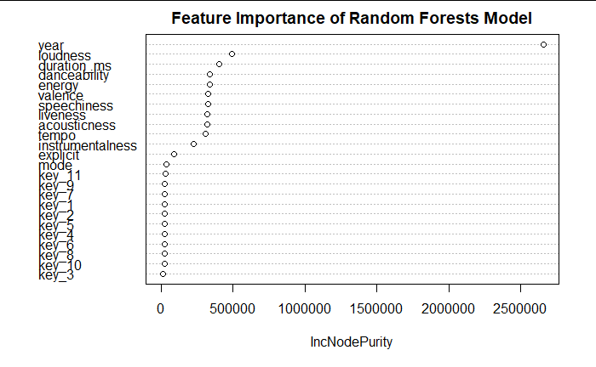

Predicting Popularity: Random Forests
Error Metrics

Slide 30
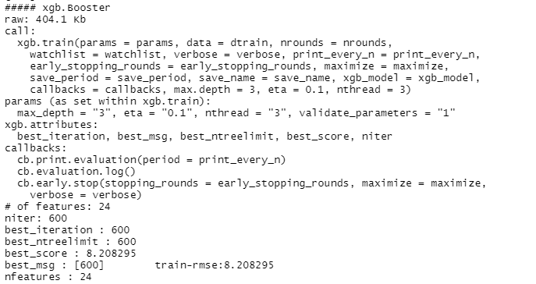
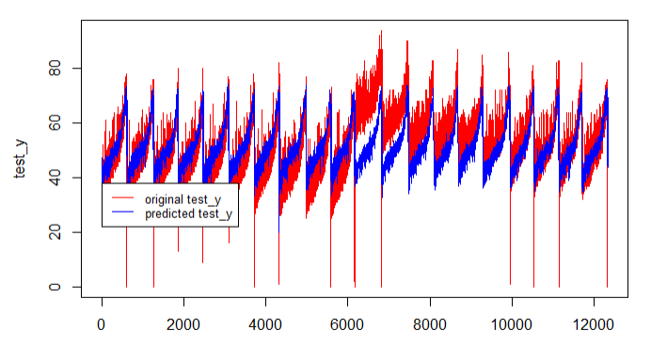
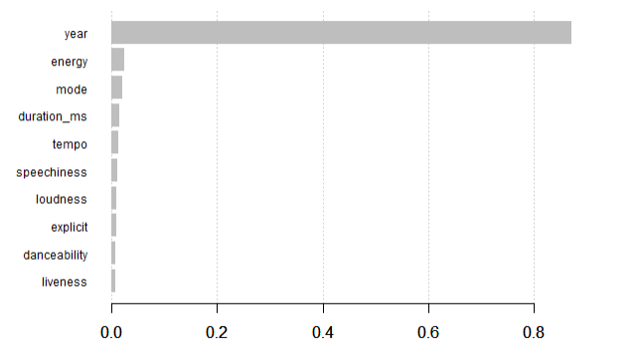

Predicting Popularity: Gradient Boosting
Error Metrics

Slide 31
Step 1
Step 2
Step 3
Step 4
Identify Problem
Initial Analysis
Model Building
Verify Results
Explore and clean the dataset
Analyze dataset via data visualizations and descriptive statistics
Build different predictive models with findings from our initial analysis
Run models on different test sets to get error metrics and measure accuracy

Slide 32
Predicting Popularity: Model Comparisons
 | Multiple Linear Regression | Random Forests | Gradient Boosting
RMSE | 8.9850 | 8.45407 | 8.5456
MAE | 6.9819 | 6.5832 | 6.6096
MASE | 1.3706 | 1.2923 | 1.2975

Slide 33
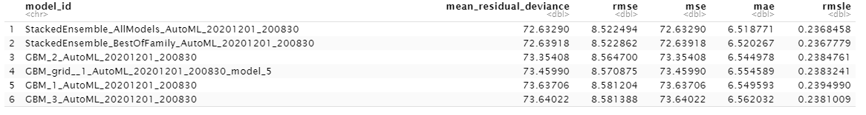
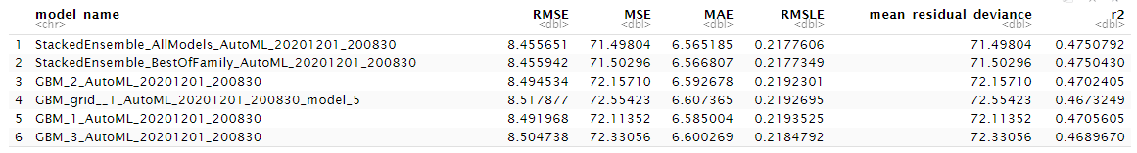
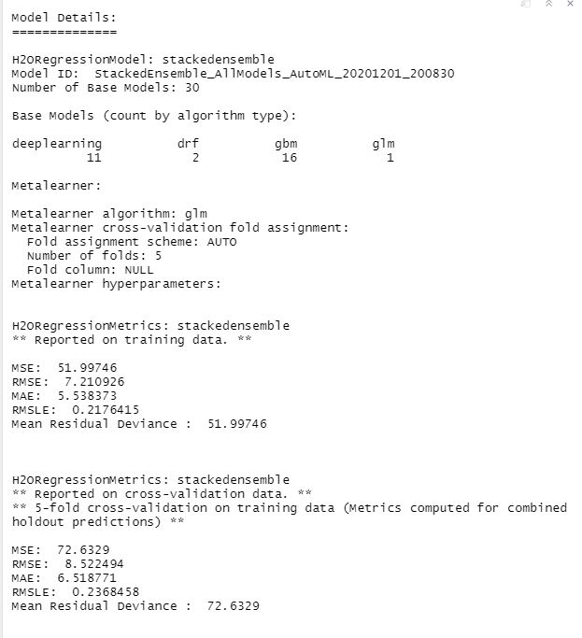
Predicting Popularity: AutoML Model Search
Training Set Metrics
Testing Set Metrics

Slide 34
Predicting Popularity: AutoML Model Search

Slide 35
Thank You!
Q&A

