Slide 1

Music of The Future
Group: Team 4 - CS Duals
Names: Rachel Liu, Bohan Jiang, Dapo Folami, Justin Li

Slide 2
Music is the universal language of mankind. It can help with stress, mood, memory, depression, and many more.

Slide 3
Data Consideration
1
The data that you are considering in the project
Notes:
Once we decided on that direction, we wanted to find the right data set

Slide 4



We are using the Spotify Dataset from 1921 to 2020 that consists of over 160,000 different tracks. These data points are sourced through Spotify’s public API.
Numerical
Binary
Categorical
Danceability (0 to 1)
Popularity (0 to 1)
Loudness (-60 to 0)
Mode (Major or Minor)
Explicit (Yes or No)
Key (C, C#, etc)
Artists
Track Name
Notes:
-one that stood out was the Spotify Public API (Define Spotify – one of the biggest music streaming platform)
-We found this dataset that has over 160k different songs over the span of 99 years
-Great thing about this is that the Spotify API provides a range of variables that we can play around with
-Categorized into 3 different buckets : numerical + binary + categorical
-By having these 3 types data points, we had a very strong foundation to do our analysis on
1. Data Set Description
For this project, our team decided to take a data-driven approach to evaluate music. We are using the Spotify Dataset from 1921 to 2020 that consists of over 160,000 different tracks. In order to stay consistent in the evaluation, all data was sourced from the Spotify Web API. The following set of data is combination of Primary, Numerical, Dummy(binary), and Categorical data. This allows us to explore different types of models and draw different insights. Here are all the variables that is included in the data set:
Primary
- id: this an unique key comprised of numbers and characters that is assigned to each track generated by Spotify
Numerical
- acousticness: range from 0(LOW) to 1(HIGH)
- danceability: range from 0(LOW) to 1(HIGH)
- energy: range from 0(LOW) to 1(HIGH)
- duration_ms: majority range from 200,000 to 300,000
- instrumentalness: range from 0(LOW) to 1(HIGH)
- valence: range from 0(LOW) to 1(HIGH)
- popularity: range from 0(LOW) to 100(HIGH)*
- tempo: majority range from 50(LOW) to 150(high)
- liveness: range from 0(LOW) to 1(HIGH)
- loudness majority range from -60 to 0
- speechiness: range from 0(LOW) to 1(HIGH)
- year: range from 1921 to 2020
Dummy
- mode: 0 represents minor and 1 represents major
- explicit: 0 represents no explicit content and 1 represents explicit content
Categorical
- key: this consists of all different music keys on onctave encoded from 0 to 11 (i.e. C = 0, C# = 1, etc...)
- artists: the artist of the track
- release_date: the date of release in yyyy-mm-dd format
- name: the name of the track
*With our approach on evaluating different tracks, we decided to use popularity as our main dependant variable.

Slide 5
Value & Impact
2
What is the value of analyzing this data and the impact that it can make in a particular business
Notes:
Before jumping into the meat of the project, we had to discuss what is our ultimate goal and why is this valuable

Slide 6
Objective: Predict the next hit song and understand what features drives popularity over time
Provide a data-driven approach to the music industry
Help record labels and producers create hit songs
Analyze changing trends in music popularity over time
Notes:
-Overarching objective: Predict the next hit song and understand what features drives popularity over time
-I think there’s A lot of benefit and impact to answering this question
-Music industry is around $21.5B and there’s a lot of stakeholder in there.
-We want to help anyone in the industry (whether you’re a music producer or a singer) to give them a data-driven approach to music, and to help them identify different trends in this industry.
-And to hopefully give people like us some better tiktok music in the future ;)

Slide 7
Unanswered Questions
3
What questions we hoped to answer

Slide 8
Variable Relations
There are over 19 unique variables in this dataset and we wish to build a better understanding of their relations with each other
1
Trending Music
Unpack different trends from 1921 to 2020 and understand what trends are forming in the future
2
Feature Impact and Significance
Analyze each feature and understand its significance with popularity
3
Notes:
What do people want to listen to in music???????????
Where is it trending???

Slide 9
Techniques and Methodologies
4
What techniques you will be using or have already used

Slide 10
Predicting Features Trends
Predicting Popularity
End Objective
Utilizing dataset features to predict popularity.
Techniques Used: K-means Clustering, Random Forests, Neural Networks
Predict the next hit song and understand what features drives popularity over time
Identifying how features are trending to create future popular songs
Notes:
Model 1 - Rachel & Dapo
Rolling correlation plots for each feature VS. popularity over time.
Use HW
Model 2 - Bohan
Panel Regression
Not standardized since OLS is invariant
Unbalanced panel since different number of data points per year
KNN
Decision Tree
etc..

Slide 11
Anticipated Results and Improvements
5
What results have you achieved so far and how do you plan on improving those results in the remaining time

Slide 12
Step 1
Step 2
Step 3
Step 4
Data Exploration
Initial Analysis
Model Building
Verify Results
Explore and clean the dataset
Analyze dataset via data visualizations and descriptive statistics
Build different predictive models with findings from our initial analysis
Run models on different test sets to get error metrics and measure accuracy
Notes:
Add green bar transition after each slide

Slide 13
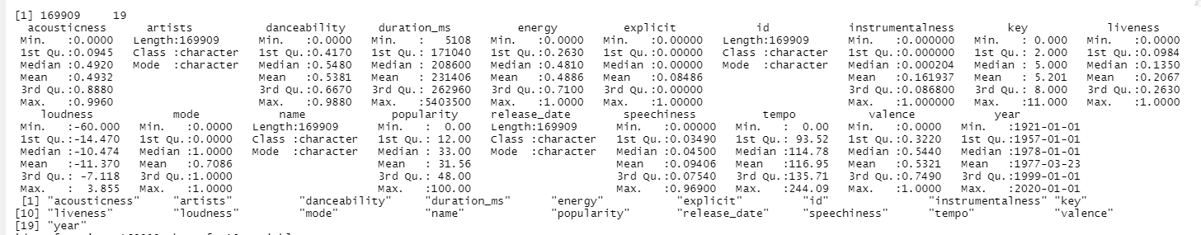
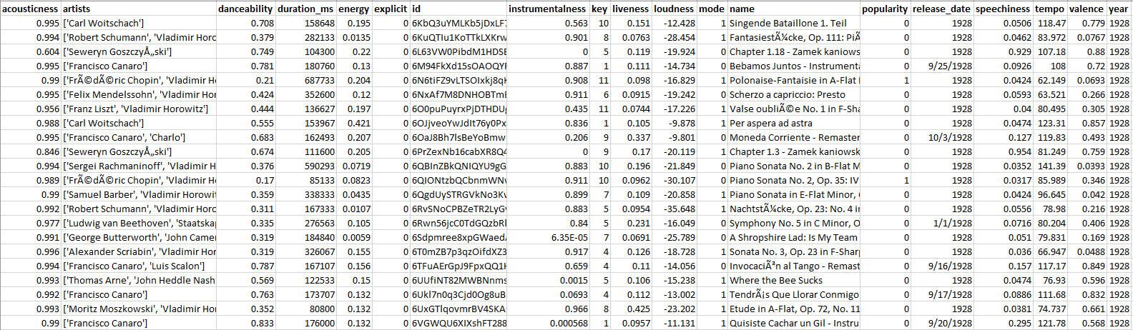
Data Exploration
Notes:
Unbalanced Panel Dataset - but with different observed entities at every cross section.

Slide 14
Data Exploration: Song Examples
Acousticness: Sonata No. 3, Op. 23 in F-Sharp Minor: IV. Presto con fuoco; Meno mosso
Danceability: Funky Cold Medina
Valence: Electric Zoo
Notes:
Step 1 - Data exploration screenshots

Slide 15
Step 1
Step 2
Step 3
Step 4
Identify Problem
Initial Analysis
Model Building
Verify Results
Explore and clean the dataset
Analyze dataset via data visualizations and descriptive statistics
Build different predictive models with findings from our initial analysis
Run models on different test sets to get error metrics and measure accuracy

Slide 16
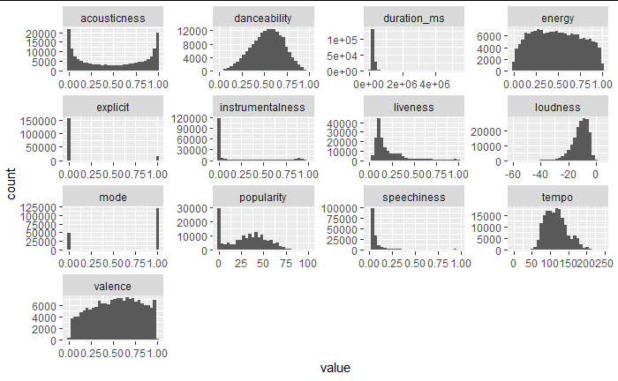
Data Analysis: Feature Distribution Histograms
Notes:
Step 2 - Correlation & Regression screenshots

Slide 17
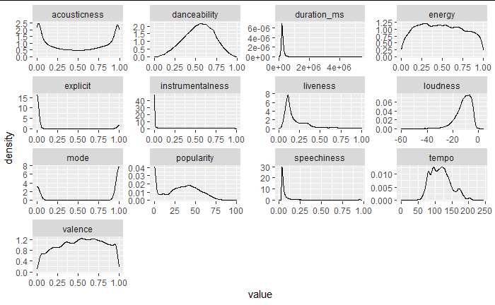
Data Analysis: Feature Distribution Density Plots
Notes:
Step 2 - Correlation & Regression screenshots

Slide 18
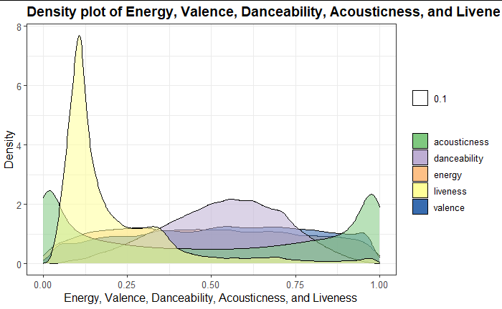
Data Analysis: Density of Key Characteristics
Notes:
Step 2 - Correlation & Regression screenshots

Slide 19
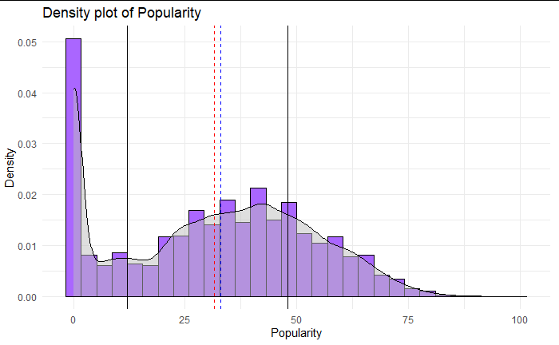
Data Analysis: Density of Popularity
Notes:
Step 2 - Correlation & Regression screenshots

Slide 20
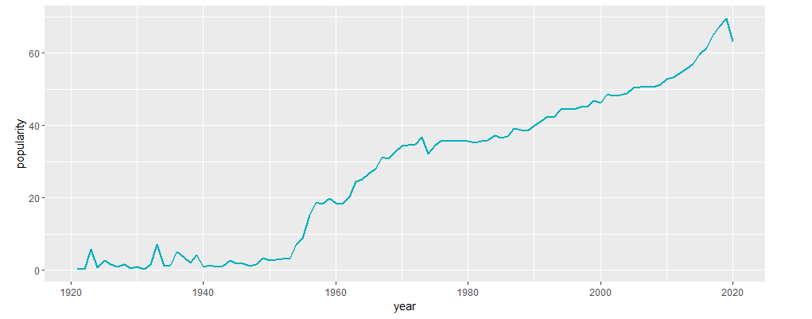
Data Analysis: Popularity over Time
Notes:
Step 2 - Correlation & Regression screenshots

Slide 21
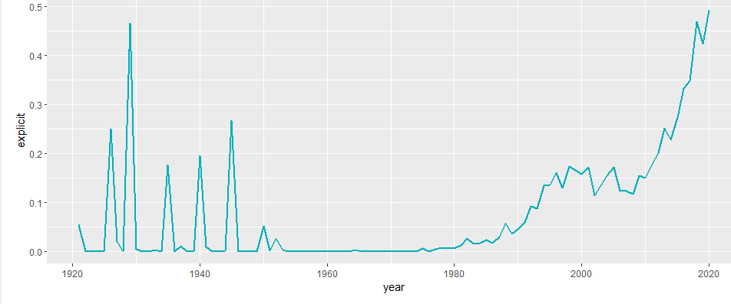
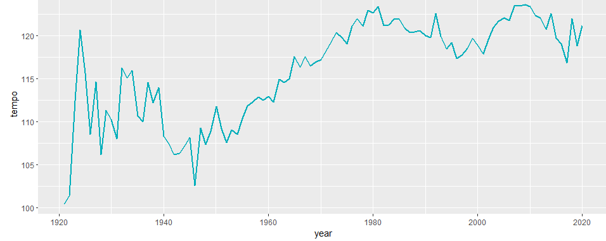
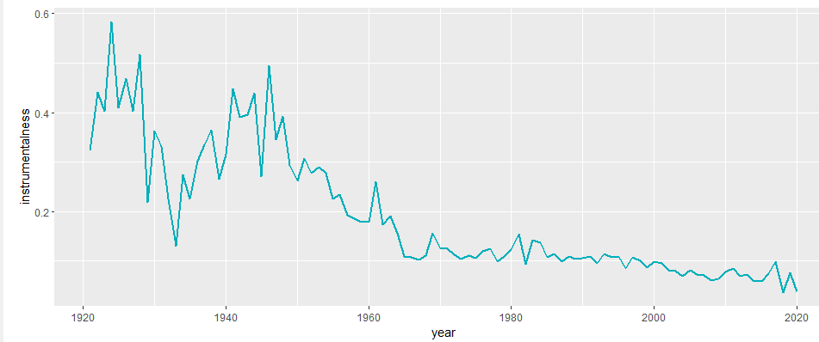
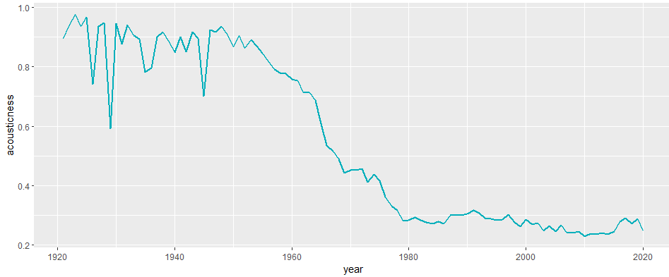
Data Analysis: Key Trends over Time
Notes:
Step 2 - Correlation & Regression screenshots

Slide 22
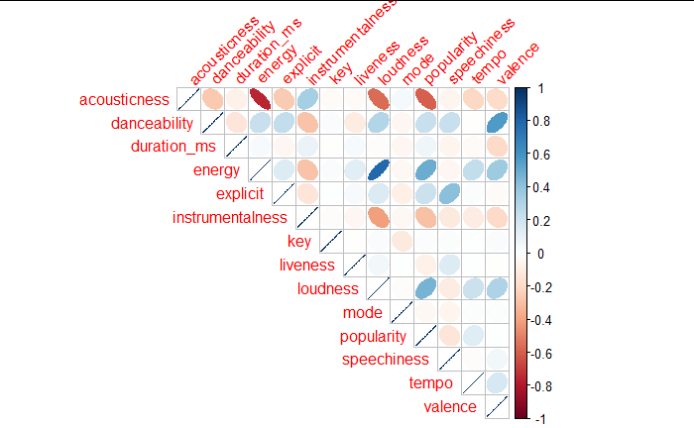
Data Analysis: Feature Correlations
Notes:
Step 2 - Correlation & Regression screenshots

Slide 23
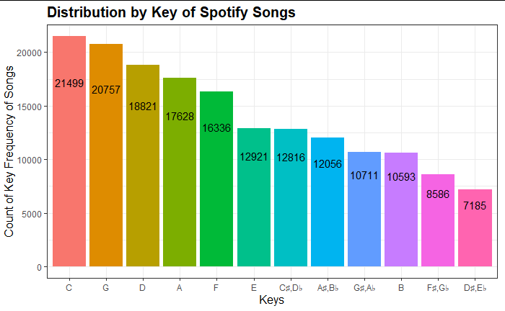
Data Analysis: Distribution by Key
Notes:
Step 2 - Correlation & Regression screenshots

Slide 24
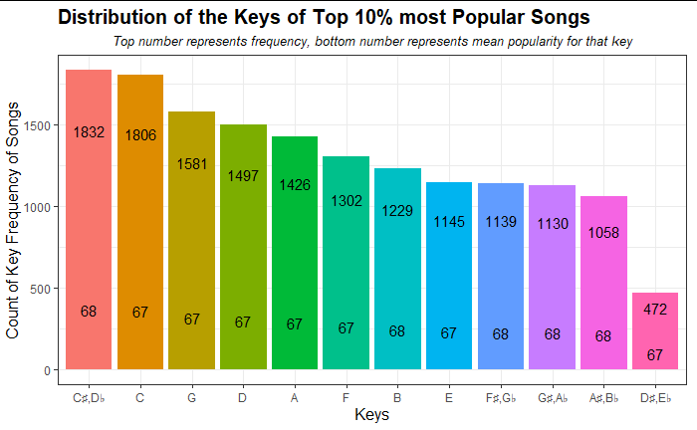
Data Analysis: Distribution by Key, Most Popular Songs
Notes:
Step 2 - Correlation & Regression screenshots

Slide 25
Step 1
Step 2
Step 3
Step 4
Identify Problem
Initial Analysis
Model Building
Verify Results
Explore and clean the dataset
Analyze dataset via data visualizations and descriptive statistics
Build different predictive models with findings from our initial analysis
Run models on different test sets to get error metrics and measure accuracy
Notes:
80/20 Training/Testing Split

Slide 26
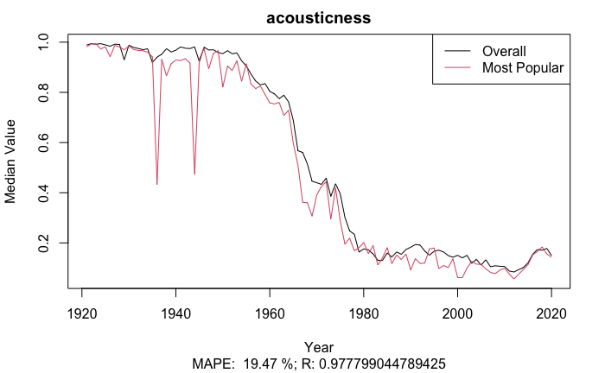
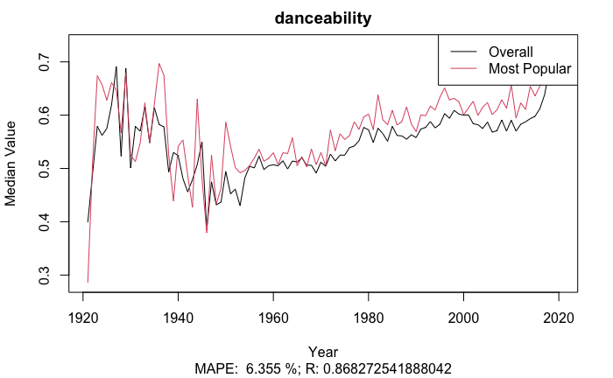
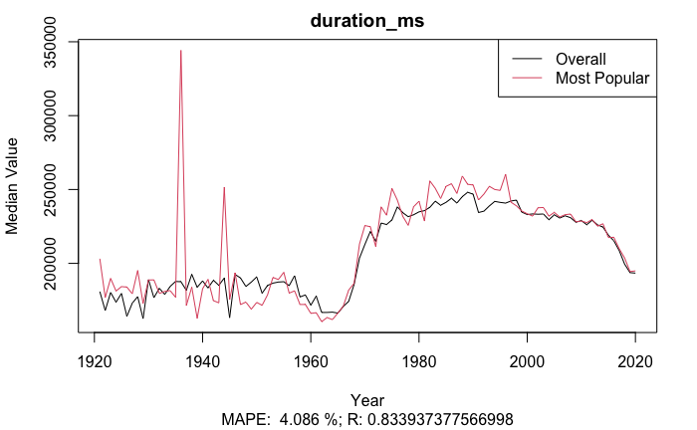
Feature Analysis: Popular Trait Differences

Slide 27
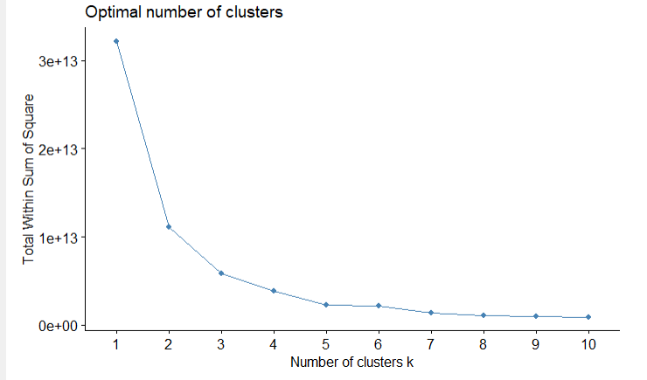
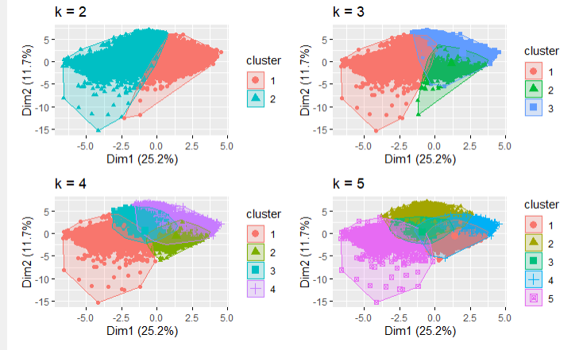
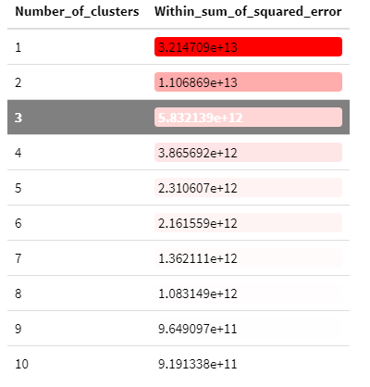
Categorizing Songs: K-means Clustering
Notes:
K-means clustering to determine how many “categories” of songs there are (Unsupervised learning technique)
Dimensionality Reduction Technique to group songs together - can perform PCA and then do K-means to visualize
Elbow method used where within-cluster sum-of-squares is minimized
3 clusters chosen since the 4th cluster only minimally improves WSS

Slide 28
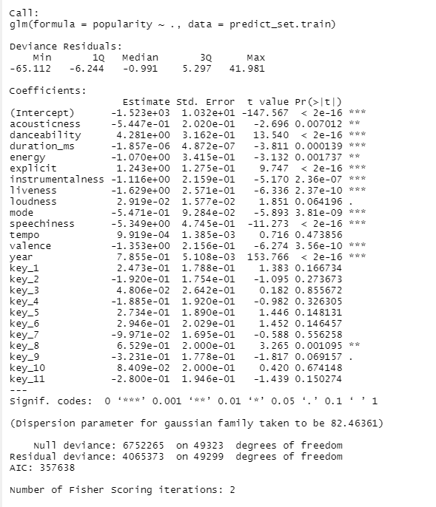

Predicting Popularity: Multiple Linear Regression
Error Metrics
Notes:
Step 1 - Data exploration screenshots

Slide 29
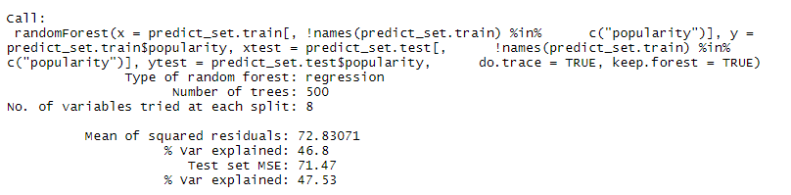
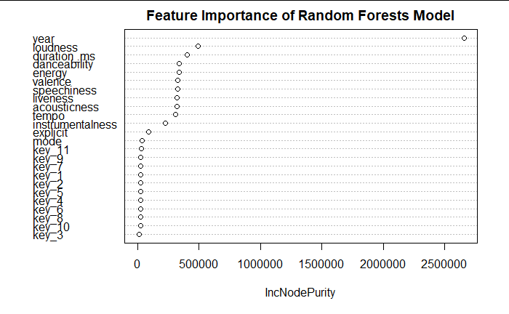

Predicting Popularity: Random Forests
Error Metrics
Notes:
Step 1 - Data exploration screenshots

Slide 30
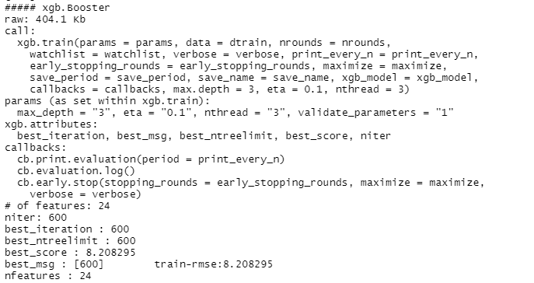
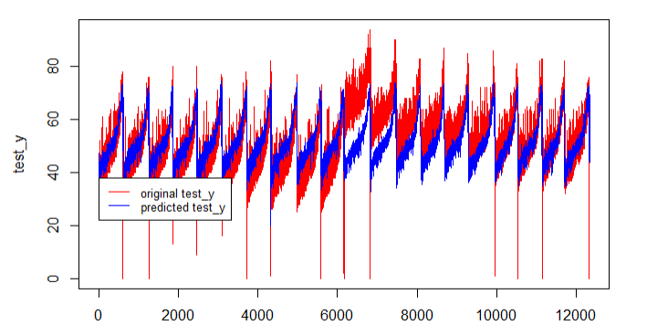
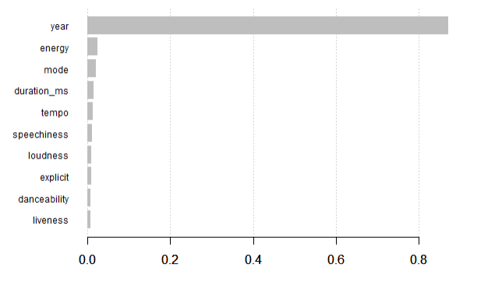

Predicting Popularity: Gradient Boosting
Error Metrics
Notes:
Step 1 - Data exploration screenshots

Slide 31
Step 1
Step 2
Step 3
Step 4
Identify Problem
Initial Analysis
Model Building
Verify Results
Explore and clean the dataset
Analyze dataset via data visualizations and descriptive statistics
Build different predictive models with findings from our initial analysis
Run models on different test sets to get error metrics and measure accuracy

Slide 32
Predicting Popularity: Model Comparisons
 | Multiple Linear Regression | Random Forests | Gradient Boosting
RMSE | 8.9850 | 8.45407 | 8.5456
MAE | 6.9819 | 6.5832 | 6.6096
MASE | 1.3706 | 1.2923 | 1.2975
Notes:
Able to predict popularity up to a 9% confidence interval, but a lot left to be desired since year is the most significant predictor and var explained is low
Suggests that features in dataset are not really a strong predictor of popularity, and maybe alternative data like frequency of the song on twitter/insta would be better
Maybe popularity is just unusually hard to predict, is similar to the stock market

Slide 33
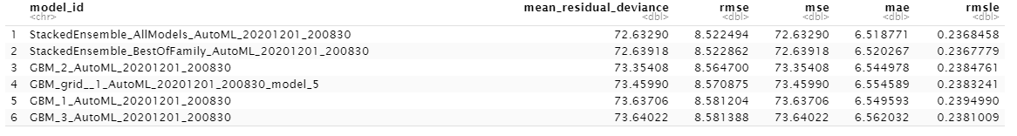
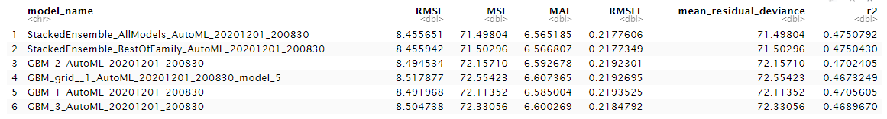
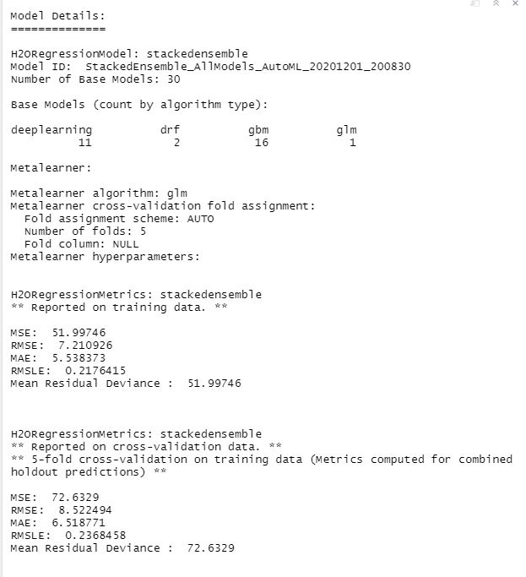
Predicting Popularity: AutoML Model Search
Training Set Metrics
Testing Set Metrics
Notes:
Step 1 - Data exploration screenshots

Slide 34
Predicting Popularity: AutoML Model Search
Notes:
Step 1 - Data exploration screenshots

Slide 35
Thank You!
Q&A

