Slide 1
EC544 Challenge 2
Group Members: Boheng Zhao, Huichong Fu,
Nirmit Shah,Yi Zhu

Slide 2
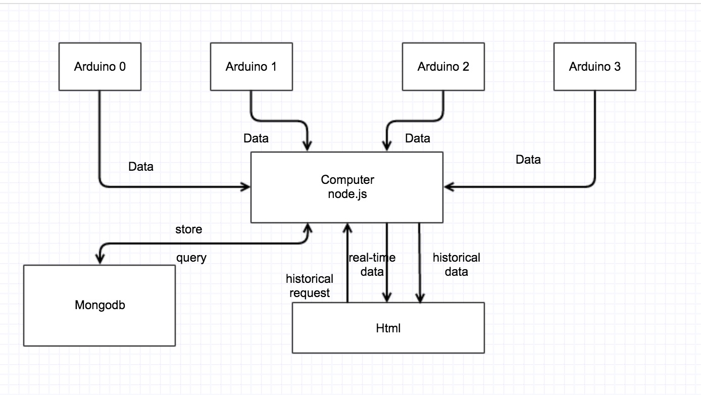
Graphic design

Slide 3
Architecture & data flow
Data received from 4 Arduino will be stored in the mongo database, real-time data is sending every 10 seconds.
Data transmission between client and server is implemented by io.emit and distinguished by different marked header.
Historical request will be sent from client to server and after a query of mongodb, historical data will be pushed to client.

Slide 4
Summary & Challenges
Handling Call back function issue concerning using cursor in Javascript.
Importing another .js file from local path to xbeechat.js.
Data transmission between client and server.

Slide 5
Demonstration

Slide 6
Thank You !

