Slide 1
Boika Lab: Collect Step Heights for Electrochemical Collision Experiment by Python
04/2023
Baosen Zhang
Advisor: Dr. Aliaksei Boika
Department of chemistry
The University of Akron, Akron, OH 44325

Slide 2
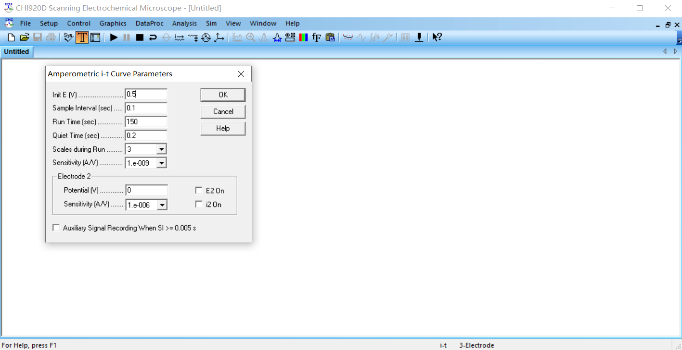
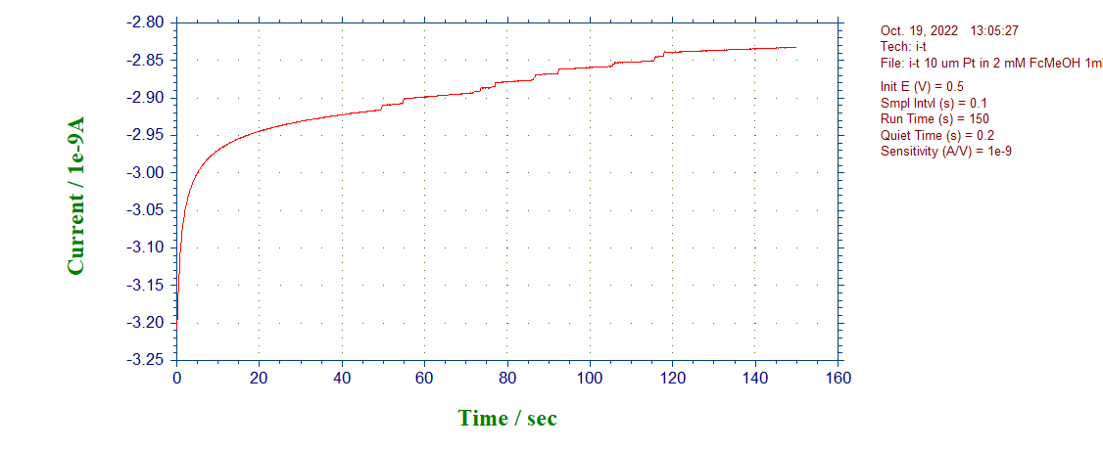
Problem
Solution is 2mM FcMeOH, 1M KNO₃, 10fM PS beads (d=0.99μM) in water. WE is Pt (d=10μm). CE is Pt. RE is Ag/AgCl.
Problem:
Read the step height and its time from current-time curve using Python?

Slide 3
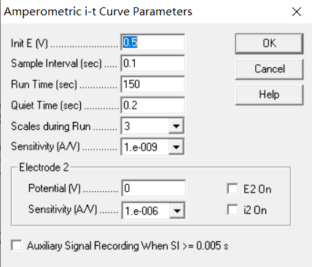
Code Explanation
Code explanation: example 1
Solution is 2mM FcMeOH, 1M KNO3, 10fM PS beads (d=0.99uM) in water. WE is Pt (d=10um). CE is Pt. RE is Ag/AgCl. Potential is 0.5 V.

Slide 4
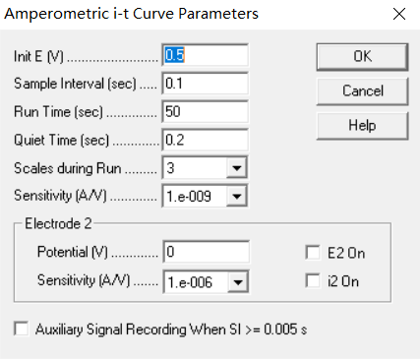
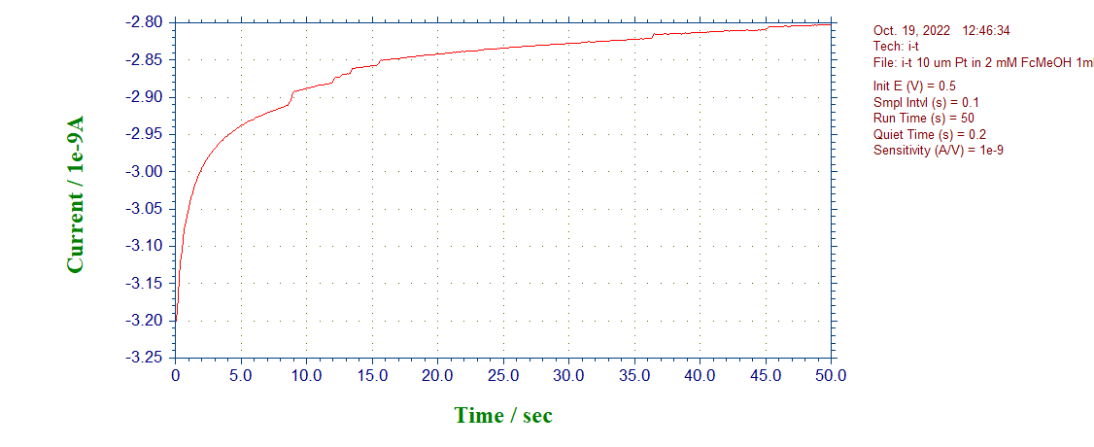
Code Explanation
Code explanation: example 2
Solution is 2mM FcMeOH, 1M KNO3, 10fM PS beads (d=0.99uM) in water. WE is Pt (d=10um). CE is Pt. RE is Ag/AgCl. Potential is 0.5 V.

Slide 5
Welcome you to improve our code!

