Slide 1

RaceDayAPI
A Secure .NET Web API for Race Event Management
BOIKANYO MALEKA
ST10472664

Slide 2

Project Overview
What is RaceDay API?
  A backend RESTful API designed to manage race events.
  Connects Organisers, Participants, and Race Data.
Core Features:
  User Registration & Secure Login.
  Event & Category Management.
  Participant Enrollments.
  Race Result Tracking.

Slide 3

Technology Stack
Framework: ASP.NET Core 8 (C#)
Database: SQLite (managed via Entity Framework Core)
Security: JWT (JSON Web Tokens) & BCrypt Password Hashing
API Documentation: Swagger UI
Architecture: RESTful API with Controller-based routing

Slide 4

Database Design (Models)
User: Base entity for authentication (Email, PasswordHash, Role).
Organiser: Manages events and records results.
Participant: Enrolls in races and receives results.
RaceEvent & Category: Defines the race details and distances (e.g., 10km, 21km).
Enrollment & RaceResult: Links participants to categories and stores finish times.

Slide 5

Security & Authentication
JWT Authentication:
Users receive a secure token upon login.
Tokens expire after 60 minutes for security.
Role-Based Authorization:
[Authorize(Roles = "Organiser")]: Protects event creation and result recording.
[Authorize(Roles = "Participant")]: Protects enrollments.
Password Security: Passwords are never stored in plain text; they are hashed using BCrypt.

Slide 6
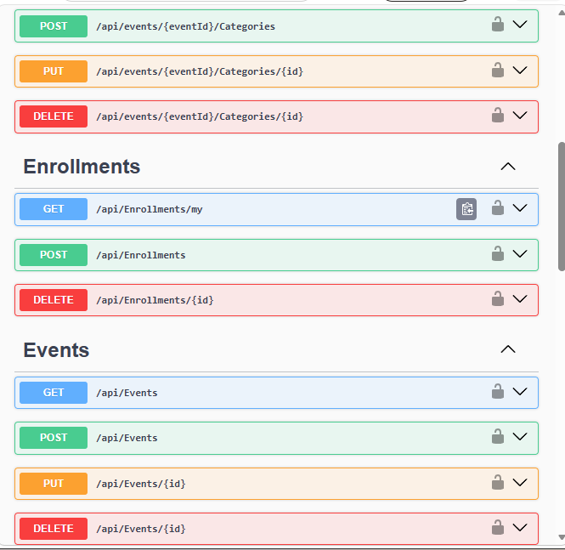
API Endpoints Overview
Auth: POST /register, POST /login
Events: GET, POST, PUT, DELETE /api/Events
Categories: GET, POST, PUT, DELETE /api/Categories
Enrollments: POST /api/Enrollments (Links Participant to Category)
Results: POST /api/Results (Records finish time and position)

Slide 7

Challenges & Solutions
Challenge 1: Circular References in JSON
  Issue: Event -> Category -> Event caused an infinite loop crash (500 Error).
  Solution: Configured ReferenceHandler.IgnoreCycles in Program.cs.
Challenge 2: Foreign Key Constraints
  Issue: SQLite rejected data if parent records (like Organisers) didn't exist first.
  Solution: Adjusted the Registration logic to automatically create Organiser/Participant profiles immediately after User creation.
Challenge 3: Role Conflicts
  Issue: 403 Forbidden errors when testing endpoints.
  Solution: Strictly separated workflows: Organisers manage data, Participants consume data.

Slide 8
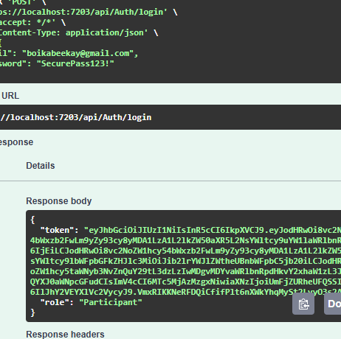

Demonstration
Successful Login returning a JWT Token.

Slide 9
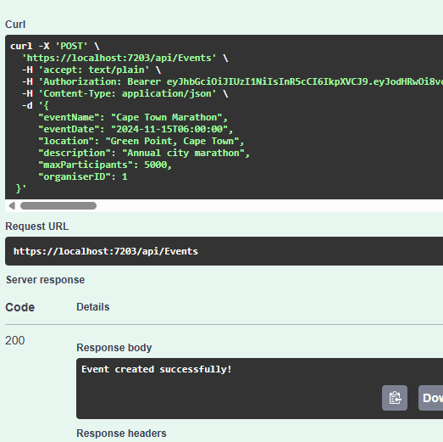

Continuation
Creating a Race Event (200 Created).

Slide 10
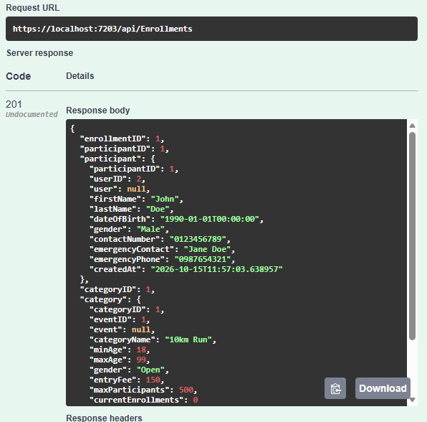

Continued
A Participant enrolling in a Category.

Slide 11
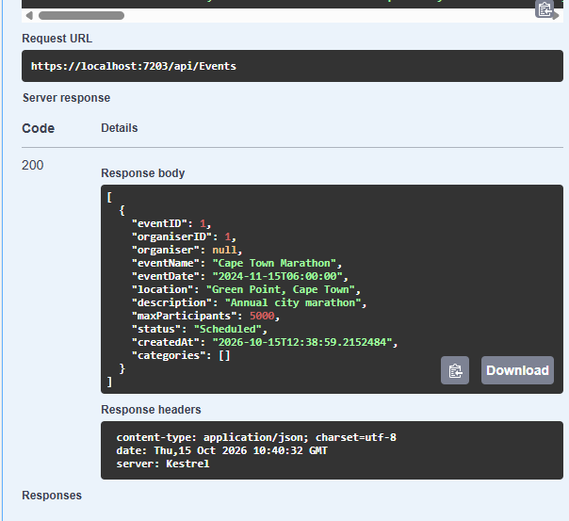

Demonstration done
The GET /api/Events response showing nested Categories.

Slide 12


Conclusion
Summary: Successfully built a secure, relational API with role-based access control.
Future Improvements:
  Integrate a Payment Gateway (e.g., PayFast) for enrollment fees.
  Add Email Notifications for race confirmations.
  Implement file uploads for race banners and participant profiles.

