Slide 1
Boilerquant onboarding By: Sandilya Kambhampati

Slide 2
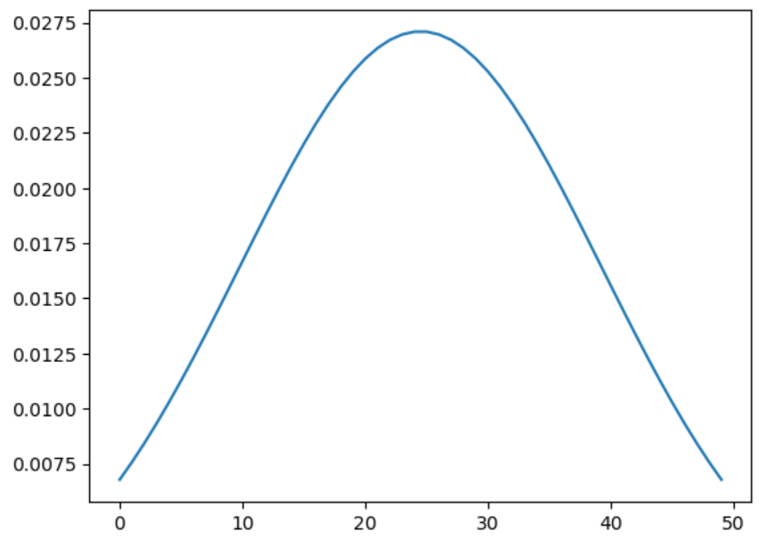
Idea
Create a Weighted Moving Average using variable length windows and a normal distribution centered around the window size.
Window Sizes: 2, 3, 5, 10, 25, 50 days
Looking at Gold Futures
First Strategy
Buy: When the closing price is less than the Weighted Moving Average
Sell: When the closing price is greater than the Weighted Moving Average

Slide 3
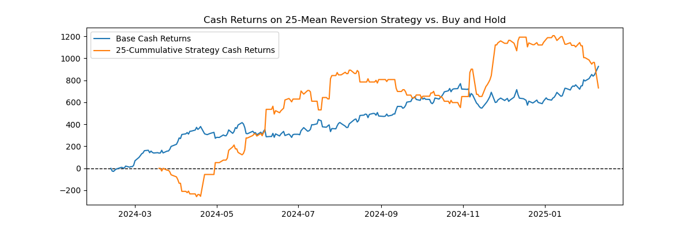
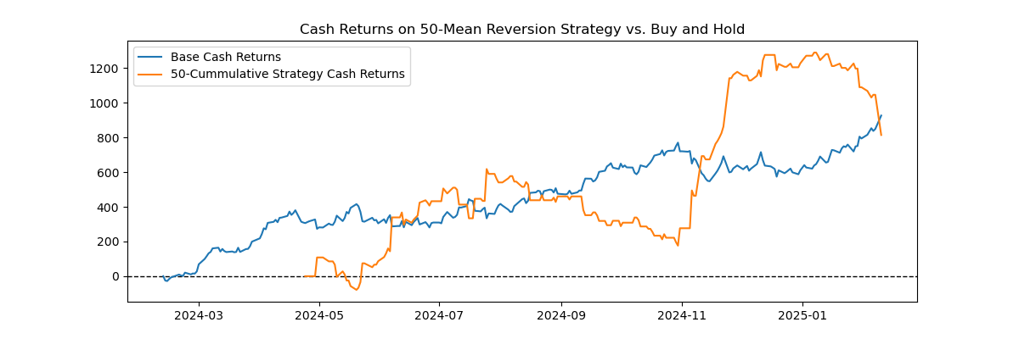
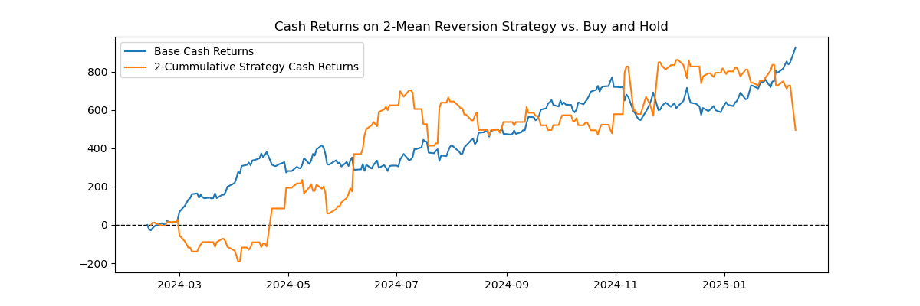
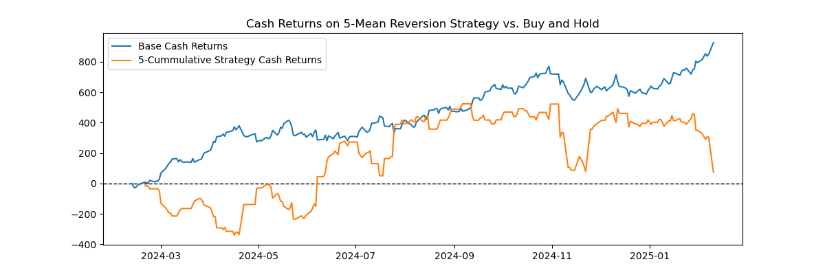
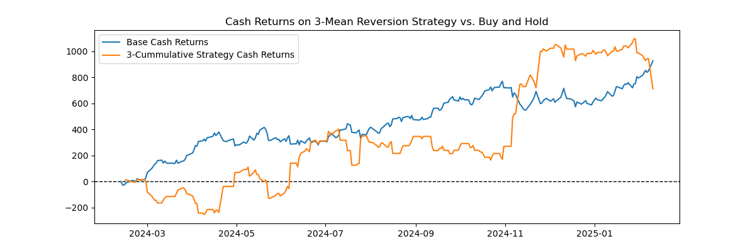
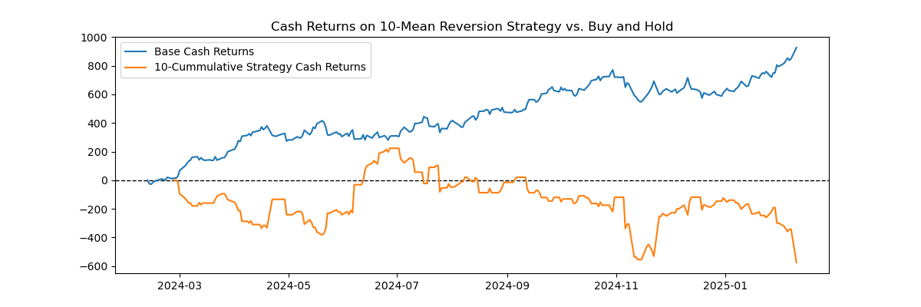
Improved Strategy
Buy: When the closing price is less than the Weighted Moving Average
Sell: When the closing price is greater than the Weighted Moving Average
Quantity dependent on percent change from previous day
Converted cumulative return to cash return
Sharpe Ratio-2: -4.57
Sharpe Ratio-3: -4.56
Sharpe Ratio-5: -4.57
Sharpe Ratio-10: -4.61
Sharpe Ratio-25: -4.47
Sharpe Ratio-50: -4.47

Slide 4
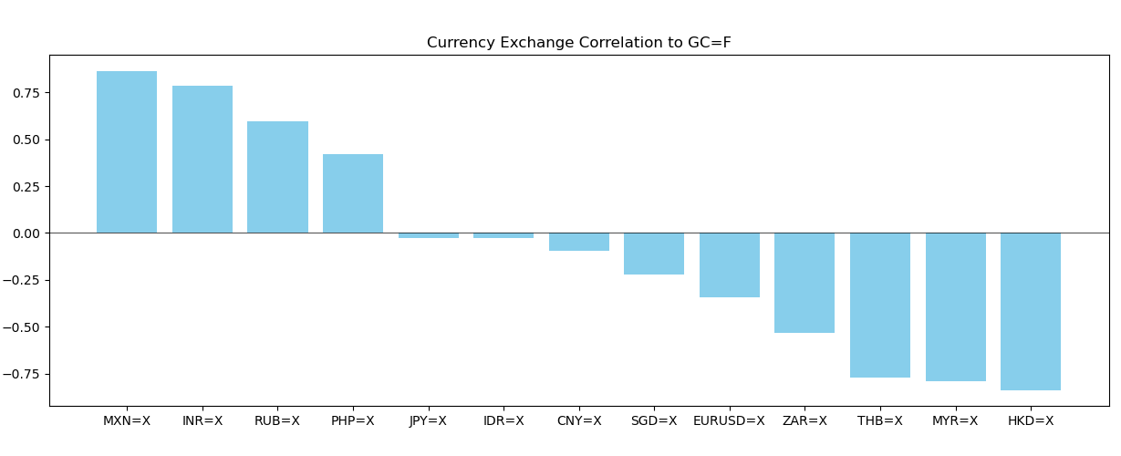
Future Steps
Look at the impact of currency markets on gold futures
Compare how signals can be impacted by multiple variables
Multiple Currency Closing Prices
Volume, Open, Low, High Prices

