Slide 1
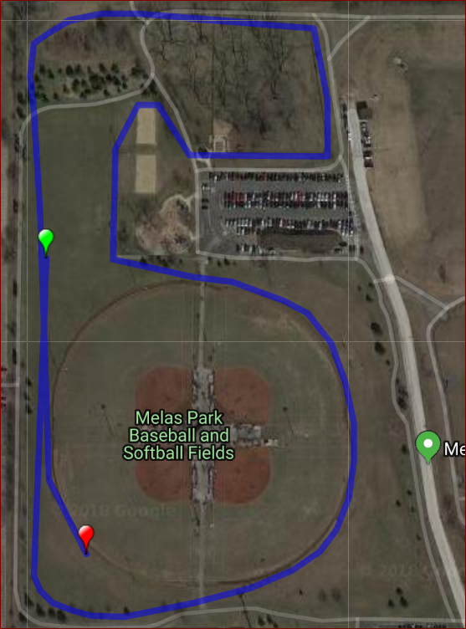
Fred D. Martin, XC Invitational, 2018
Melas Park, Mt. Prospect, IL
1.0 Mile Course (1.02)
Start
Finish

Slide 2
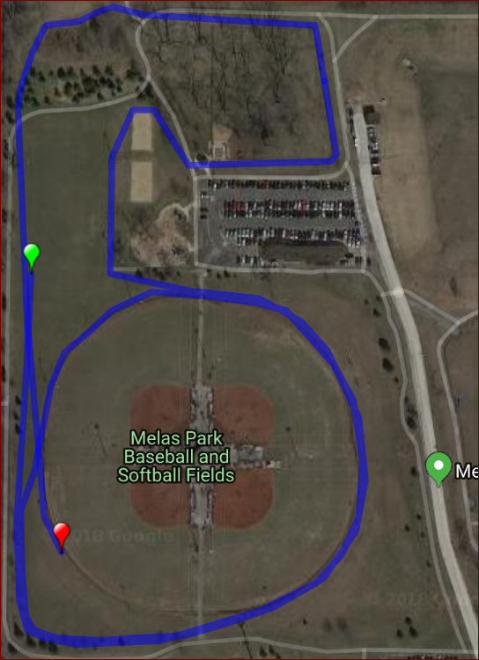
Fred D. Martin, XC Invitational, 2018
Melas Park, Mt. Prospect, IL
1.5 Mile Course (1.48)
Route for 2nd loop.
Loop 1 and 2 route split
Start
Route for 1st loop.
Finish

Slide 3
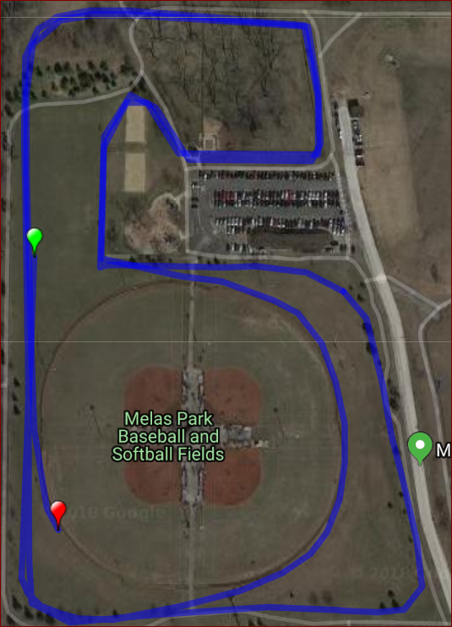
Fred D. Martin, XC Invitational. 2018
Melas Park, Mt. Prospect, IL
2.0 Mile Course (2.01)
Start
Finish
Route for 1st loop.
Loop 1 and 2 route split
Route for 2nd loop.

