Slide 1
CS253L01
Jim Conrad, PhD
Boise State University

Slide 2
One-Minute Course in C Programming
For Java Programmers…

Slide 3
Why Study C?
Many major projects are written mostly in C
Linux kernel
MS/Windows kernel
FreeBSD (OS X kernel)
iOS kernel
Android kernel
Oracle database
MySQL database
Apache web server
Embedded Systems (Internet of Things)

Slide 4
If C is so Great and Important, Why Isn’t Everything Written in C?
“Where there is great power there is great responsibility.”
-- Winston Churchill, 1906
-- Marvel, 1962

Slide 5
C and Java: The Fundamental Differences
C
Java
ANSI Standardized Language
Source files named, *.c and *.h
Object files named, *.o
Compiles to machine language
Can be hosted on “bare metal”
Procedural (no objects)
Language defined by Oracle
Source files named, *.java
Object files named, *.class
Compiles to bytecode
Always hosted by the JRE
Mostly object-oriented

Slide 6
C and Java: Similarities
Code blocks: {…}
Statements terminated by semicolons (;)
Decision structures: if, else, else if, switch, case
Looping structures: while, for, do
Some primitive types: short, int, long, float, double, char
Many operators: = += -= + - * / ++ -- == <= >= != && || ? etc

Slide 7
helloworld.c
#include <stdio.h>
main() {
printf(“Hello world!\n”);
}
#include imports definitions from akin to java’s import
No classes in C. Functions are akin to java static methods
C doesn’t require the details for main() if your code doesn’t depend upon them.
Stdio.h defines printf that, in this example, works akin to System.out.print

Slide 8
Programming Language Terminology
Scope: Refers to the visibility of an identifier (e.g. a variable name) --- where it can be accessed. E.g. in java, the scope of a local variable is that of the code block defining it.
Storage class: Refers to where and when a programming language allocates memory for something (e.g. a variable). For example, in java, storage for a parameter is allocated on the stack when a method is invoked

Slide 9
Introduction to C Variables
int sum(int x, int y) {
int z;
z = x + y;
return z;
}
Defines a function named sum returning an int value
sum behaves akin to a static method in java – there exists one instance of sum in the entire program
x and y are int parameters
z is an automatic (local) variable

Slide 10
Automatic Variables
int sum(int x, int y) {
int z;
z = x + y;
return z;
}
z is an automatic (local) variable
Its scope is the compound statement (i.e. code block) in which it’s defined, here… everything between { and }
Storage for automatic variables is allocated when the function is invoked, and freed when the function returns

Slide 11
External Variables
int x=0;
void incX() {
x++;
}
void decX() {
x--;
}
x is defined external to all the functions in the file that defines it
Its scope extends throughout that file and can be accessed globally from other files
Storage is allocated when the program starts (before main)
While it is akin to a public static variable in java…
The static keyword means something different in C

Slide 12
External Static Variables in C
static int x=0;
void incX() {
x++;
}
void decX() {
x--;
}
x is a static external variable
It’s external because it’s defined externally to any function in this file
Its scope extends throughout the file defining it
Static variables are invisible outside the file that defines them
Storage is allocated when the program starts (before main)
It is akin to a private static variable in java
Static has to do with visibility, not storage

Slide 13
Poll: Variables
What is the scope of an automatic variable in C?
What is the scope of an external static variable in C?

Slide 14
Omissions to be Addressed Later
Arrays
Character Strings
Pointers vs. References
Static methods
Variable and parameter details
structs
Header files (i.e. *.h)
The macro pre-processor
Bit operations
Etc

Slide 15
Building a C Program: Onyx Command Line
Edit
*.c
eclipse
gcc
Execute
vim
emacs
kwrite
Compile
*.o
Link
a.out
gcc

Slide 16
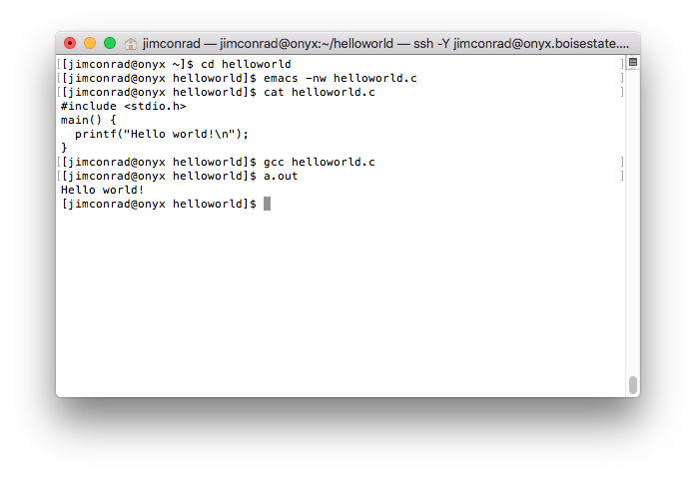
Building a C Program on Onyx

Slide 17
Exercise: helloworld.c
Login to onyx
Setup a directory folder for your helloworld files
Choose your text editor (hint: use kwrite if you know not vim nor emacs) and create helloworld.c
Compile and link: gcc –o helloworld helloworld.c
Execute: ./helloworld
Analysis: ls -lF

