Slide 1
Privacy and Big Data
Dr. Hoda Mehrpouyan
Computer Science Department
Fall 2019
Notes:
<number>

Slide 2
Best Practices
Decentralized versus centralized data analytics
selectiveness (for effectiveness) the new era of analytics
Support and automation of policy enforcement
co-controllership and information sharing should be controlled by automated policy definition and enforcement
Transparency and control
consent needs to be reinforced with new models and automated enforcement mechanisms

Slide 3
Privacy
From “big data versus privacy” to “big data with privacy”
The scale is in terms of volume, variety, velocity and veracity, all the Vs of the big data definition brings existing privacy risks into a whole new level
Lack of control and transparency
how to effectively and timely inform users and on who is in charge of this task, especially when the processing requires the interaction of many players.
Example: data captured from sensors and cameras, from screening posts in social networks or from analysis of web searches
Notes:
<number>

Slide 4
Privacy Challenges
Data reusability
mobile apps providers collect personal data in order to provide users with information about their fitness or health status (e.g. heart condition, dietary habits, etc.). These data can be valuable to insurance companies and/or other providers (e.g. sports centers, dietary consultants, etc.) who may target specific users.

Slide 5
Privacy Challenges II
Data inference and re-identification
combine data sets from many different sources to derive more (and new) information.
privacy risks, especially if linking different sources may allow the emergence of patterns related to single individuals
combination of anonymized data sets and advanced analytics can lead to re-identification of a person by extracting and combining different pieces of information

Slide 6
Privacy Challenges III
Profiling and automated decision making
profiling example: online advertising, which is also closely related to price differentiation (perceived by the willingness of people to pay) .
Another example is that of profiling in predictive police algorithms, which can lead to discrimination of people, even based on the area where they live

Slide 7
Privacy Challenges IV
Enforcing, and/or monitoring the data protection controls
the involvement and interaction of many diverse stakeholders, which makes it even more difficult (for regulators, data controllers and users) to identify privacy flaws and impose relevant measures

Slide 8
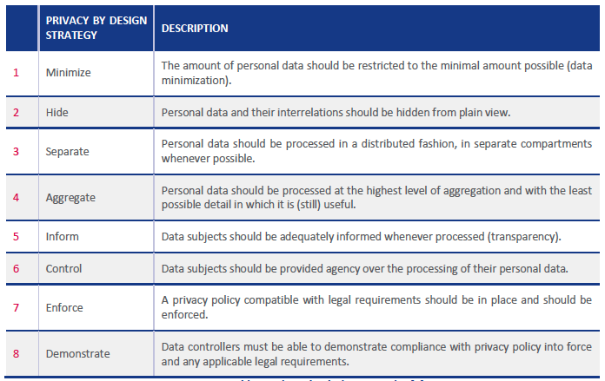
Privacy Measures
Notes:
<number>

Slide 9
Privacy enhancing technologies (PETs)
authentication
communications anonymity
privacy in databases, statistical disclosure control
privacy preserving data mining, private information retrieval
storage privacy, privacy preserving computations

Slide 10
Data Acquisition/Collection
Minimize
Define what data are needed before collection, select before collect
Aggregate
Anonymization
Hide
anti-tracking , encryption, identity masking, secure file sharing
Inform
appropriate notice to users, transparency mechanism
Give users control
consent, opt-out, privacy preferences, enforce policies

Slide 11
Data Analysis & Data Curation
Aggregation
Anonymization (K-anonymity family, differential privacy)
Hide
searchable encryption, privacy preserving computing

Slide 12
Anonymization
Anonymization refers to the process of modifying personal data in such a way that individuals cannot be re-identified and no information about them can be learned

Slide 13
Data Privacy: The Problem
Given a dataset with sensitive information, such as:
Census data
Health records
Social network activity
Telecommunications data
How can we:
enable “desirable uses” of the data
while protecting the “privacy” of the data subjects?
Academic research
Informing policy
Identifying subjects for drug trial
Searching for terrorists
Market analysis
…
????

Slide 14
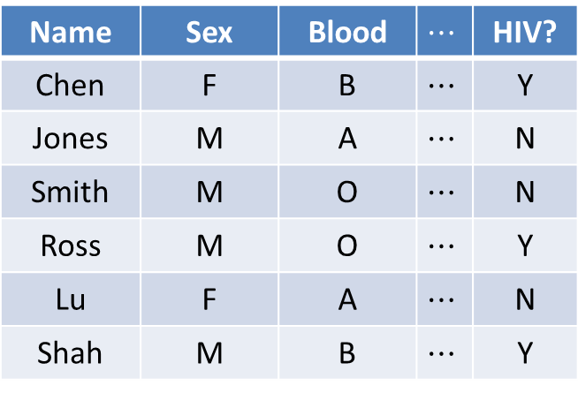
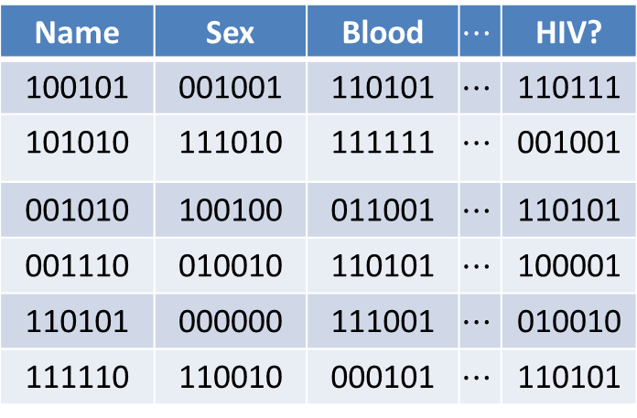
Approach 1: Encrypt the Data
Name | Sex | Blood |  | HIV?
100101 | 001001 | 110101 |  | 110111
101010 | 111010 | 111111 |  | 001001
001010 | 100100 | 011001 |  | 110101
001110 | 010010 | 110101 |  | 100001
110101 | 000000 | 111001 |  | 010010
111110 | 110010 | 000101 |  | 110101
Name | Sex | Blood |  | HIV?
Chen | F | B |  | Y
Jones | M | A |  | N
Smith | M | O |  | N
Ross | M | O |  | Y
Lu | F | A |  | N
Shah | M | B |  | Y
Name | Sex | Blood |  | HIV?
100101 | 001001 | 110101 |  | 110111
101010 | 111010 | 111111 |  | 001001
001010 | 100100 | 011001 |  | 110101
001110 | 010010 | 110101 |  | 100001
110101 | 000000 | 111001 |  | 010010
111110 | 110010 | 000101 |  | 110101
Name | Sex | Blood |  | HIV?
Chen | F | B |  | Y
Jones | M | A |  | N
Smith | M | O |  | N
Ross | M | O |  | Y
Lu | F | A |  | N
Shah | M | B |  | Y
Notes:
<number>

Slide 15
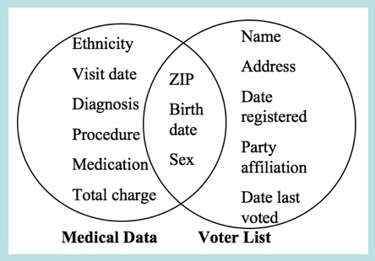
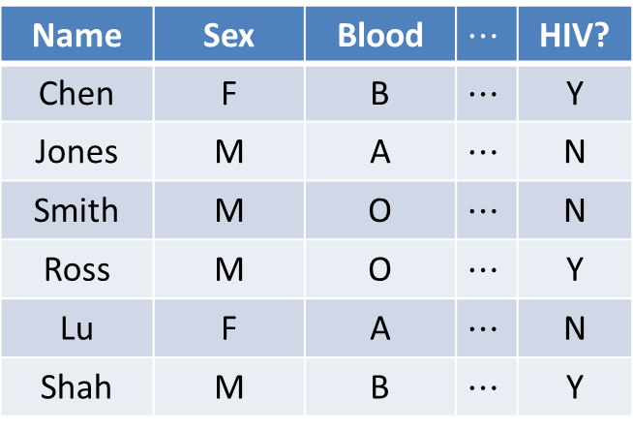
Approach 2: Anonymize the Data
Name | Sex | Blood |  | HIV?
Chen | F | B |  | Y
Jones | M | A |  | N
Smith | M | O |  | N
Ross | M | O |  | Y
Lu | F | A |  | N
Shah | M | B |  | Y
Name | Sex | Blood |  | HIV?
Chen | F | B |  | Y
Jones | M | A |  | N
Smith | M | O |  | N
Ross | M | O |  | Y
Lu | F | A |  | N
Shah | M | B |  | Y
[Sweeney `97]
“re-identification” often easy
Notes:
<number>

Slide 16
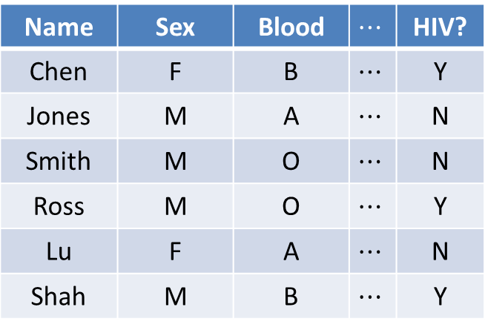
Approach 3: Mediate Access
C
Name | Sex | Blood |  | HIV?
Chen | F | B |  | Y
Jones | M | A |  | N
Smith | M | O |  | N
Ross | M | O |  | Y
Lu | F | A |  | N
Shah | M | B |  | Y
Name | Sex | Blood |  | HIV?
Chen | F | B |  | Y
Jones | M | A |  | N
Smith | M | O |  | N
Ross | M | O |  | Y
Lu | F | A |  | N
Shah | M | B |  | Y
q₁
a₁
C
q₂
a₂
q₃
a₃
trusted
“curator”
data analysts
Problems?
Even simple “aggregate” statistics can reveal individual info. [Dinur-Nissim `03, Homer et al. `08, Mukatran et al. `11, Dwork et al. `15]

Slide 17

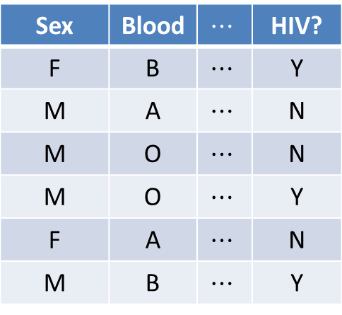
Differential privacy
[Dinur-Nissim ’03+Dwork, Dwork-Nissim ’04, Blum-Dwork-McSherry-Nissim ’05, Dwork-McSherry-Nissim-Smith ’06]
C
Sex | Blood |  | HIV?
F | B |  | Y
M | A |  | N
M | O |  | N
M | O |  | Y
F | A |  | N
M | B |  | Y
Sex | Blood |  | HIV?
F | B |  | Y
M | A |  | N
M | O |  | N
M | O |  | Y
F | A |  | N
M | B |  | Y
q₁
a₁
C
q₂
a₂
q₃
a₃
curator
data analysts
Requirement: effect of each individual should be “hidden”

Slide 18
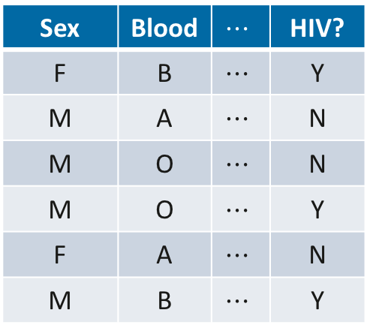
Differential privacy
[Dinur-Nissim ’03+Dwork, Dwork-Nissim ’04, Blum-Dwork-McSherry-Nissim ’05, Dwork-McSherry-Nissim-Smith ’06]
C
Sex | Blood |  | HIV?
F | B |  | Y
M | A |  | N
M | O |  | N
M | O |  | Y
F | A |  | N
M | B |  | Y
Sex | Blood |  | HIV?
F | B |  | Y
M | A |  | N
M | O |  | N
M | O |  | Y
F | A |  | N
M | B |  | Y
q₁
a₁
C
q₂
a₂
q₃
a₃
curator
adversary

Slide 19
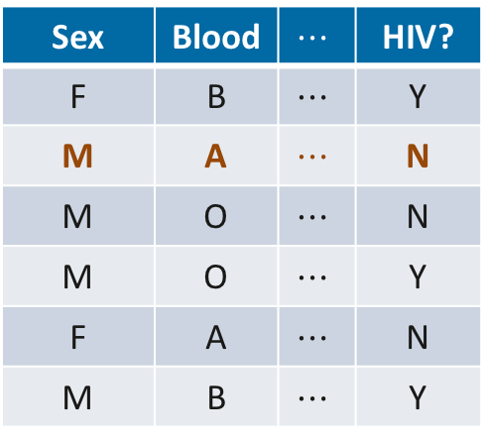
Differential privacy
[Dinur-Nissim ’03+Dwork, Dwork-Nissim ’04, Blum-Dwork-McSherry-Nissim ’05, Dwork-McSherry-Nissim-Smith ’06]
C
Sex | Blood |  | HIV?
F | B |  | Y
M | A |  | N
M | O |  | N
M | O |  | Y
F | A |  | N
M | B |  | Y
Sex | Blood |  | HIV?
F | B |  | Y
M | A |  | N
M | O |  | N
M | O |  | Y
F | A |  | N
M | B |  | Y
q₁
a₁
C
q₂
a₂
q₃
a₃
curator
adversary
Requirement: an adversary shouldn’t be able to tell if any one person’s data were changed arbitrarily

Slide 20
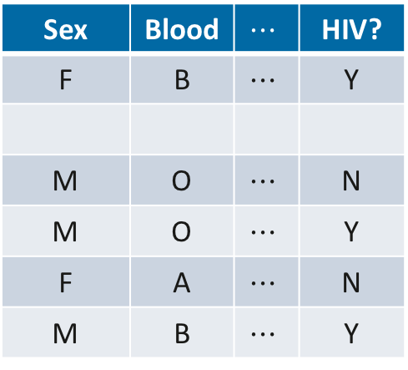
Differential privacy
[Dinur-Nissim ’03+Dwork, Dwork-Nissim ’04, Blum-Dwork-McSherry-Nissim ’05, Dwork-McSherry-Nissim-Smith ’06]
C
Sex | Blood |  | HIV?
F | B |  | Y
M | O |  | N
M | O |  | Y
F | A |  | N
M | B |  | Y
Sex | Blood |  | HIV?
F | B |  | Y
M | O |  | N
M | O |  | Y
F | A |  | N
M | B |  | Y
q₁
a₁
C
q₂
a₂
q₃
a₃
curator
adversary
Requirement: an adversary shouldn’t be able to tell if any one person’s data were changed arbitrarily

Slide 21
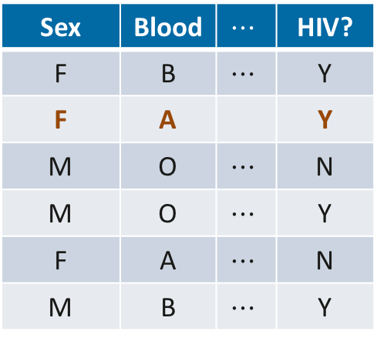
Differential privacy
[Dinur-Nissim ’03+Dwork, Dwork-Nissim ’04, Blum-Dwork-McSherry-Nissim ’05, Dwork-McSherry-Nissim-Smith ’06]
C
Sex | Blood |  | HIV?
F | B |  | Y
F | A |  | Y
M | O |  | N
M | O |  | Y
F | A |  | N
M | B |  | Y
Sex | Blood |  | HIV?
F | B |  | Y
F | A |  | Y
M | O |  | N
M | O |  | Y
F | A |  | N
M | B |  | Y
q₁
a₁
C
q₂
a₂
q₃
a₃
curator
adversary
Requirement: an adversary shouldn’t be able to tell if any one person’s data were changed arbitrarily

Slide 22
DP Theory & Practice
Theory: differential privacy research has
many intriguing theoretical challenges
rich connections w/other parts of CS theory & mathematics
e.g. cryptography, learning theory, game theory & mechanism design, convex geometry, pseudorandomness, optimization, approximability, communication complexity, statistics, …
Practice: interest from many communities in seeing whether DP can be brought to practice
e.g. statistics, databases, medical informatics, privacy law, social science, computer security, programming languages, …

