Slide 1
5 Real-World
Student Accommodation Finder
Websites & Apps
A competitive scan informing Student Finder Accommodation

Slide 2

01
ONSA (One National Student Accommodation)
WHAT THEY DO WELL
Verified landlords, easy registration, secure payments, nationwide coverage.
WHAT THEY DO LESS WELL
Application fee may discourage some students; limited extra student services.
URL: onsa.co.za
Author: ONSA | Accessed: 12 July 2026

Slide 3
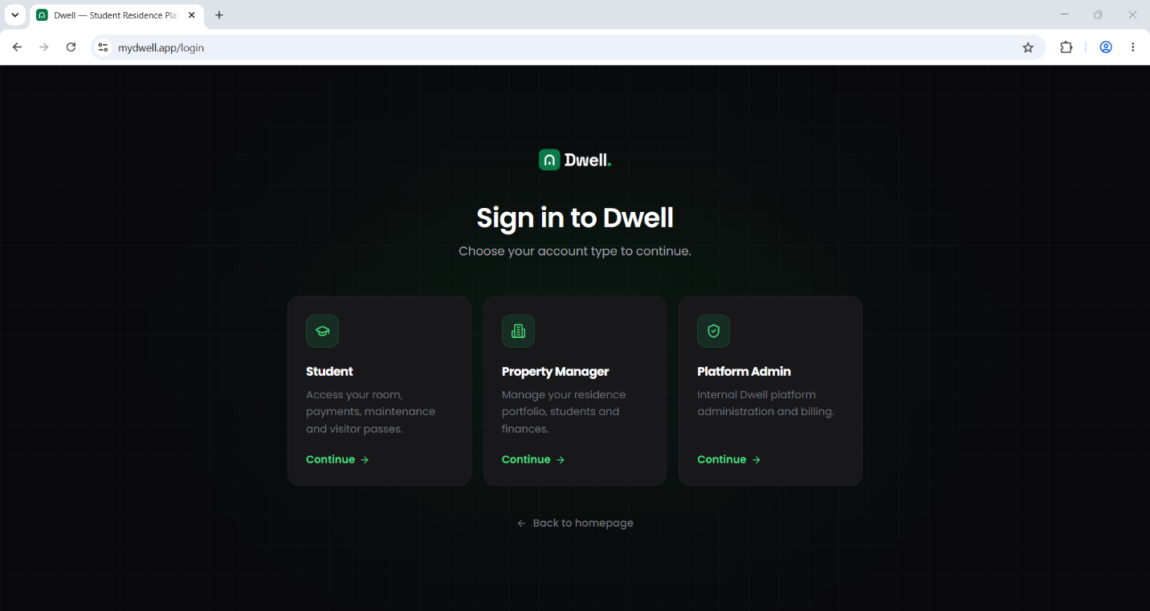
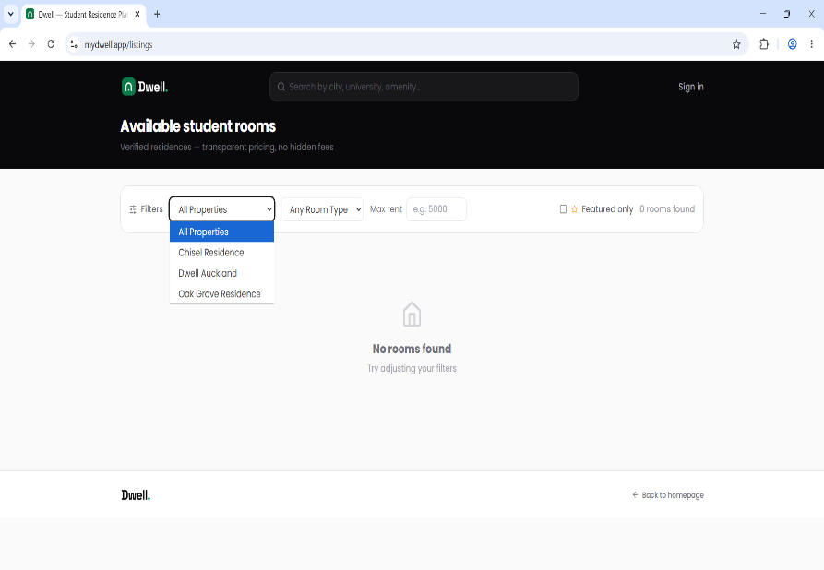
02
Dwell
WHAT THEY DO WELL
Modern interface, verified residences, maintenance and payment management, student portal.
WHAT THEY DO LESS WELL
Focuses mainly on managed residences rather than offering many accommodation choices.
URL: mydwell.app
Author: Dwell | Accessed: 12 July 2026

Slide 4
03
ResiFind
Screenshot
not available
WHAT THEY DO WELL
Verified listings, SOS safety feature, free student access, simple application process.
WHAT THEY DO LESS WELL
Availability may vary depending on university or city.
URL: www.resifind.co.za
Author: ResiFind | Accessed: 12 July 2026

Slide 5
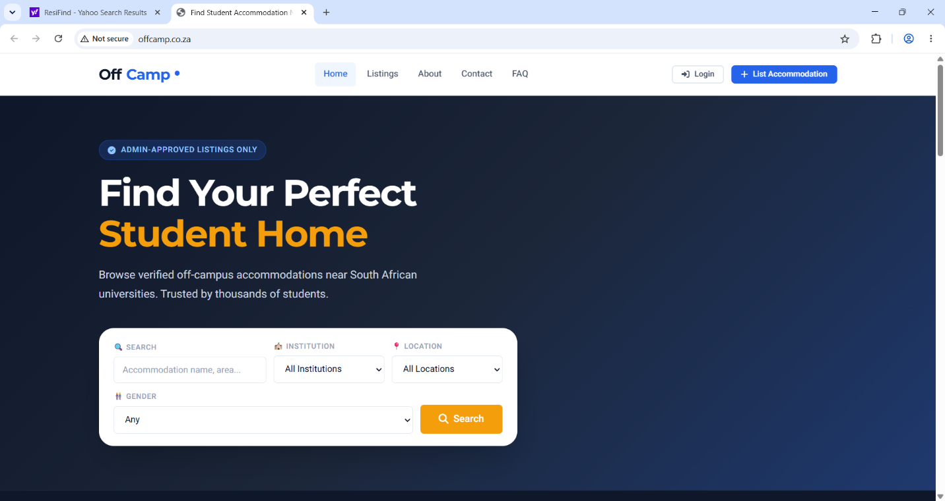
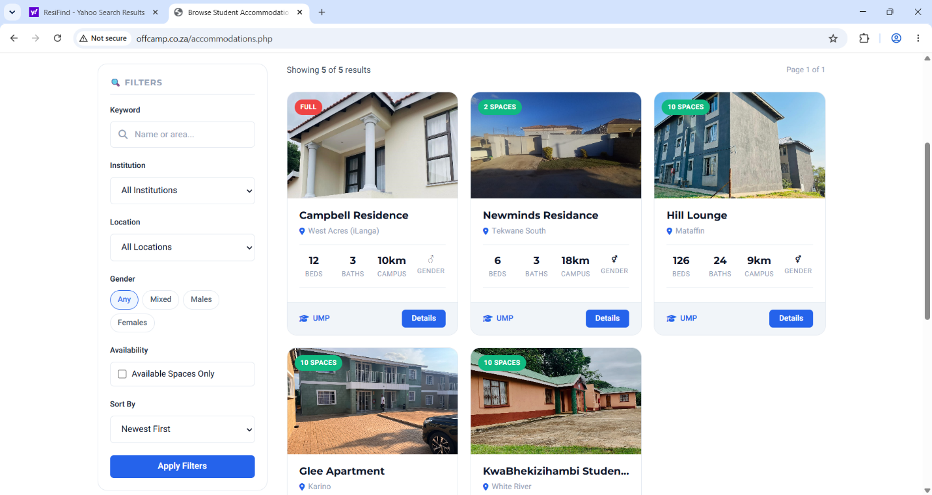
04
OffCamp
WHAT THEY DO WELL
Direct landlord contact, smart filters, verified listings.
WHAT THEY DO LESS WELL
Covers fewer universities than larger competitors.
URL: www.offcamp.co.za
Author: OffCamp | Accessed: 12 July 2026

Slide 6
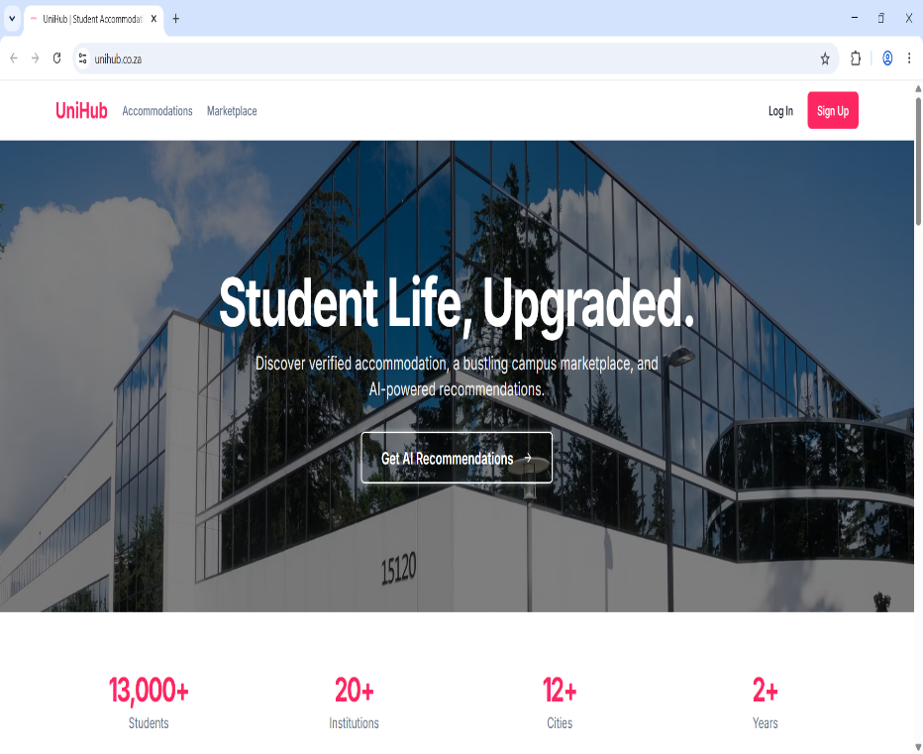
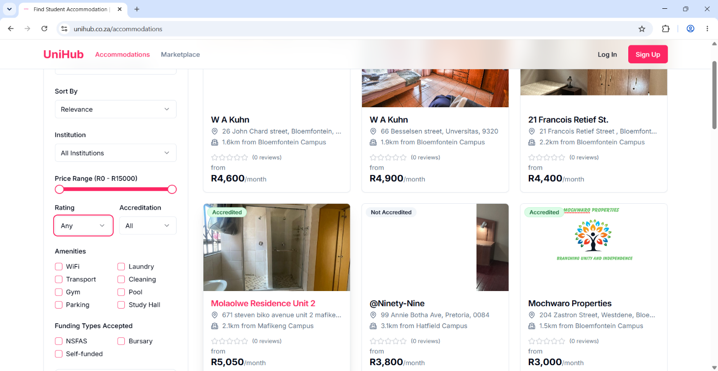
05
UniHub
WHAT THEY DO WELL
Combines accommodation with a student marketplace, AI recommendations, verified listings.
WHAT THEY DO LESS WELL
Newer platform with fewer accommodation listings in some areas.
URL: unihub.co.za
Author: UniHub | Accessed: 12 July 2026

Slide 7
Key Takeaway for Student Finder Accommodation
All five competitors already emphasize verification, confirming it is a baseline market expectation.
None combine NSFAS-specific accreditation filtering with verified listings — this remains Student Finder Accommodation's clearest gap in the market.
Coverage gaps (fewer universities, limited cities) at several competitors present an opportunity for broader, more inclusive reach.
AI-driven features (like UniHub's recommendations) are emerging as a differentiator worth building on early.

