Slide 1


Web scraper using Python
Bojan Faletic

Slide 2
Goal of project
Create web agent to search on Ebay in order to find undervalued items

Slide 3
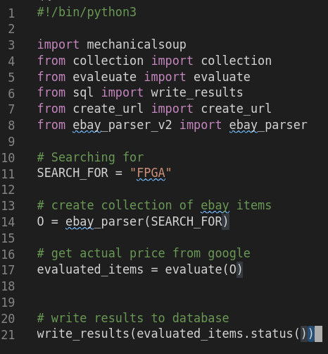
Overview of program

Slide 4
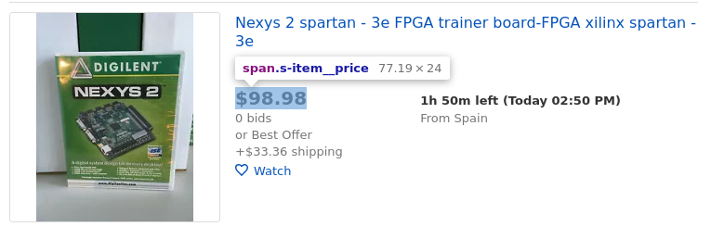


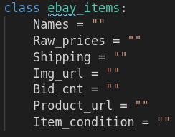
Ebay parser

Slide 5
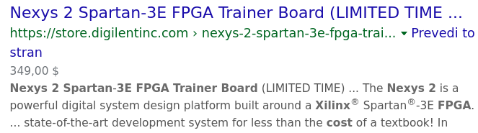
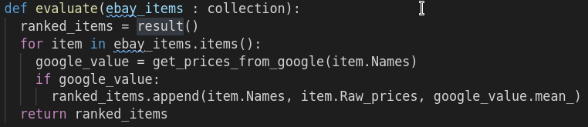
Get price from google

Slide 6
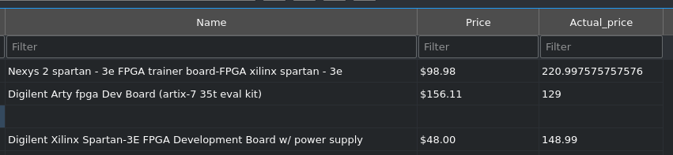
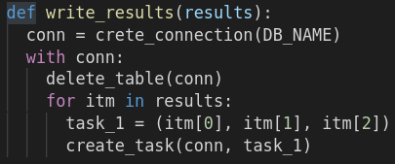
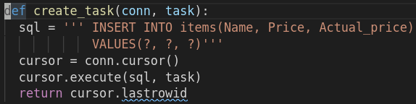
Write to database

Slide 7
Future work
Create front end application
Add support for multiple search items
(better than just array)
Automatically enter bidding

