Slide 1
C omputer
S cience
I diots

Slide 2
C

Slide 3


Slide 4
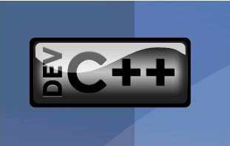

Slide 5


Slide 6
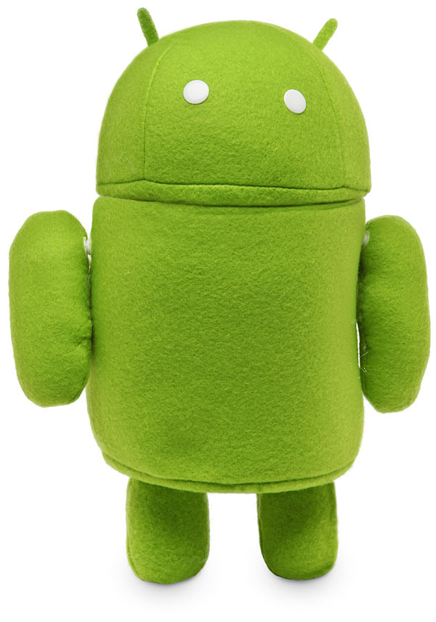
ANDROID

Slide 7


Slide 8


Slide 9


Slide 10





