Slide 1


K.U.R.U
Bluetooth controlled car

Slide 2
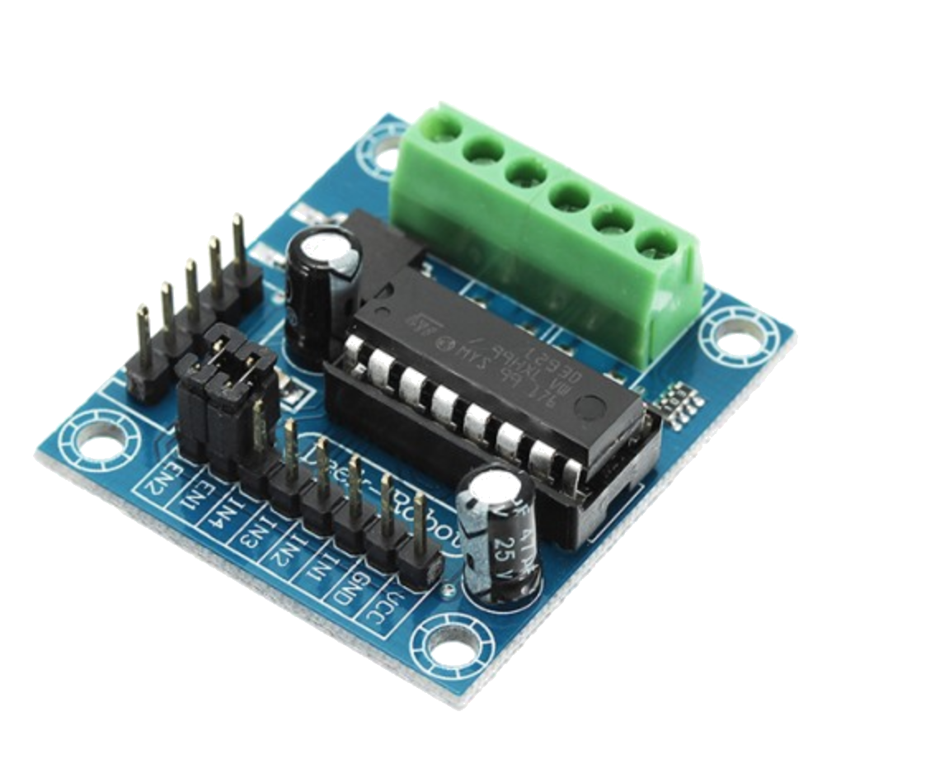
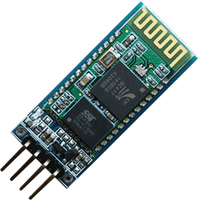
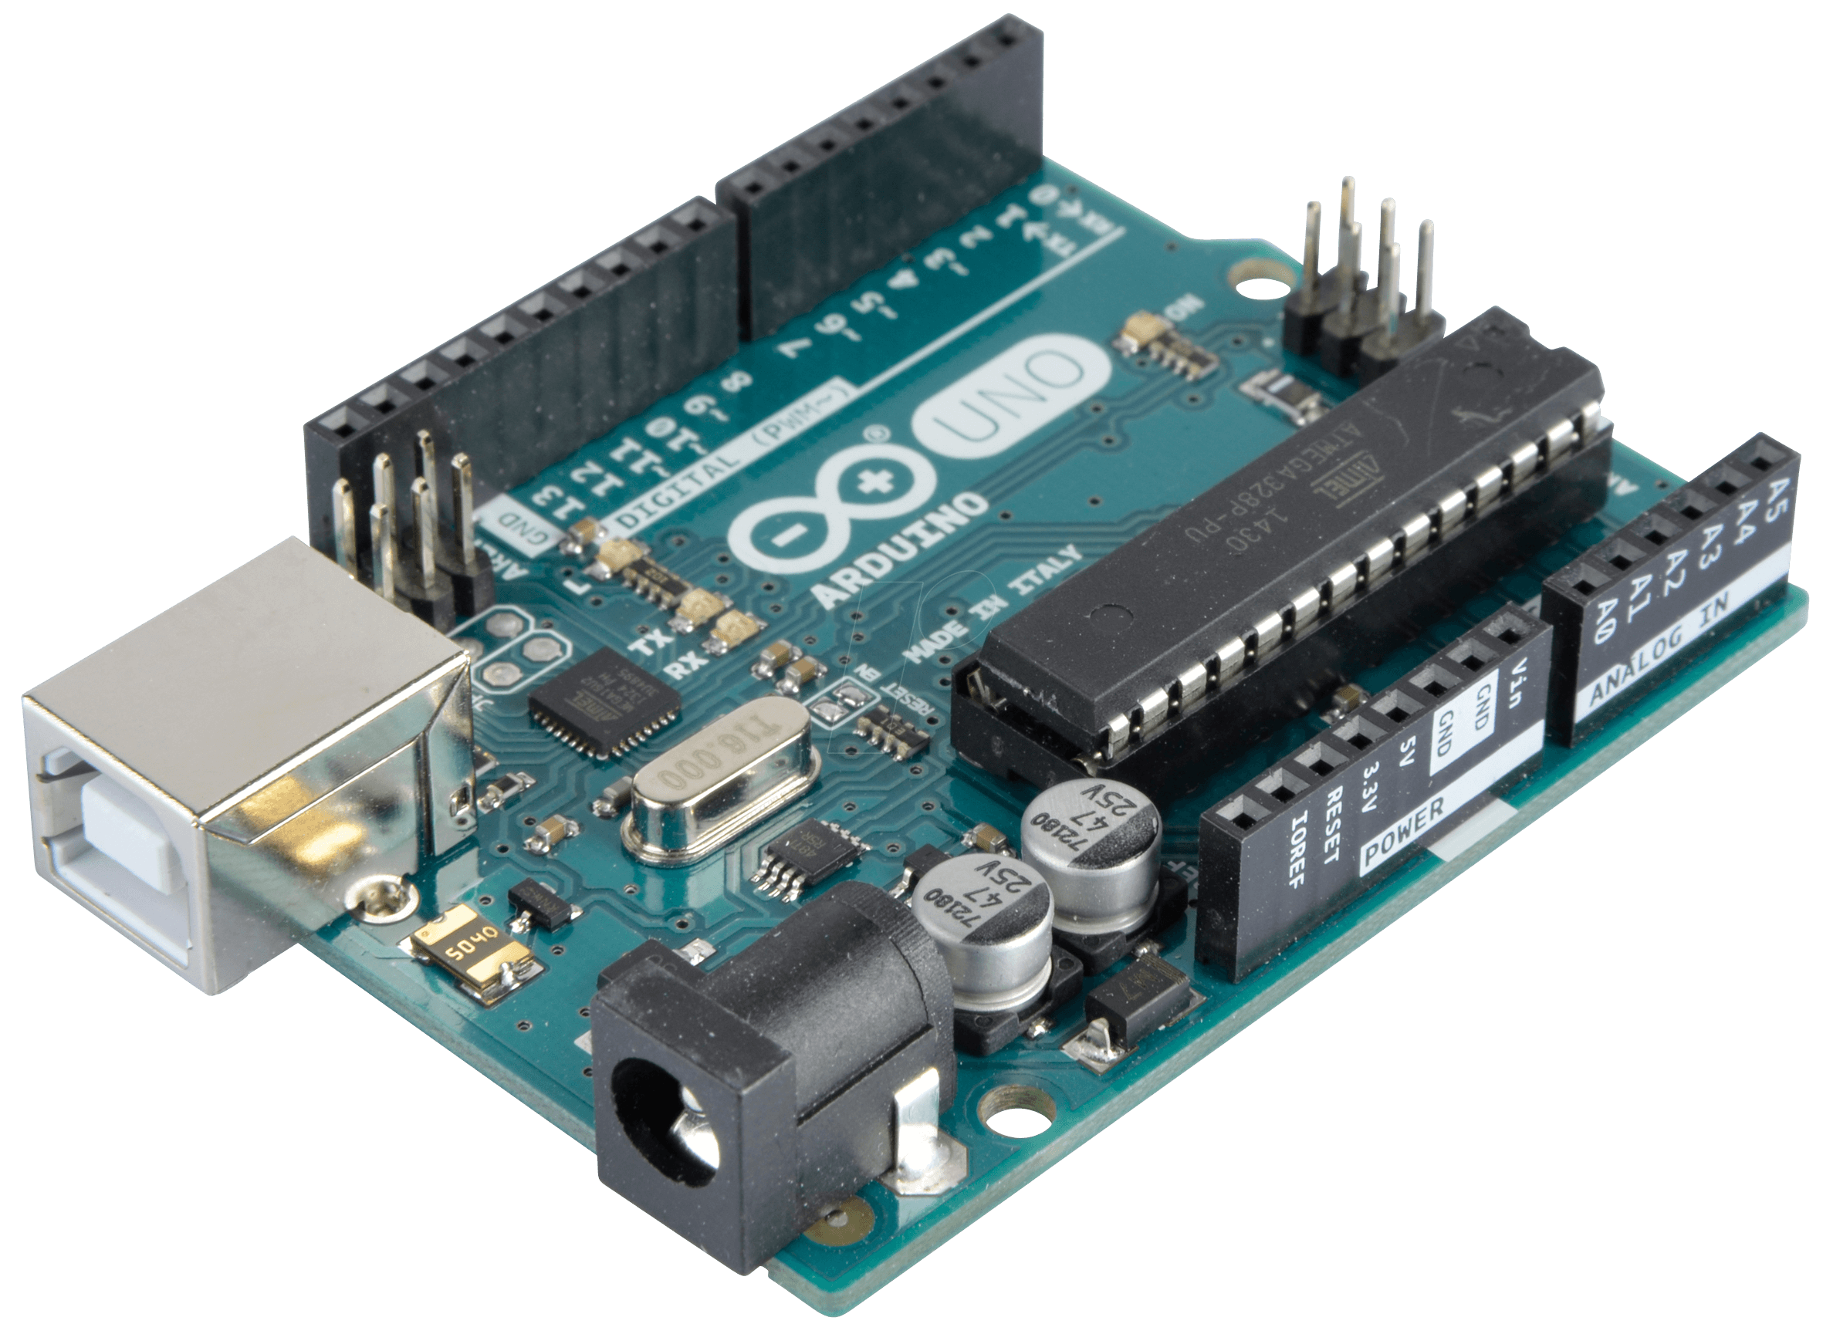

Slide 3
Functionality
K.U.R.U is a car which is controlled trough smartphone app via "Bluetooth". It is driven by two 9V DC motors with L293D module. The main functionality is controlled by the main board which is Arduino Uno.

Slide 4
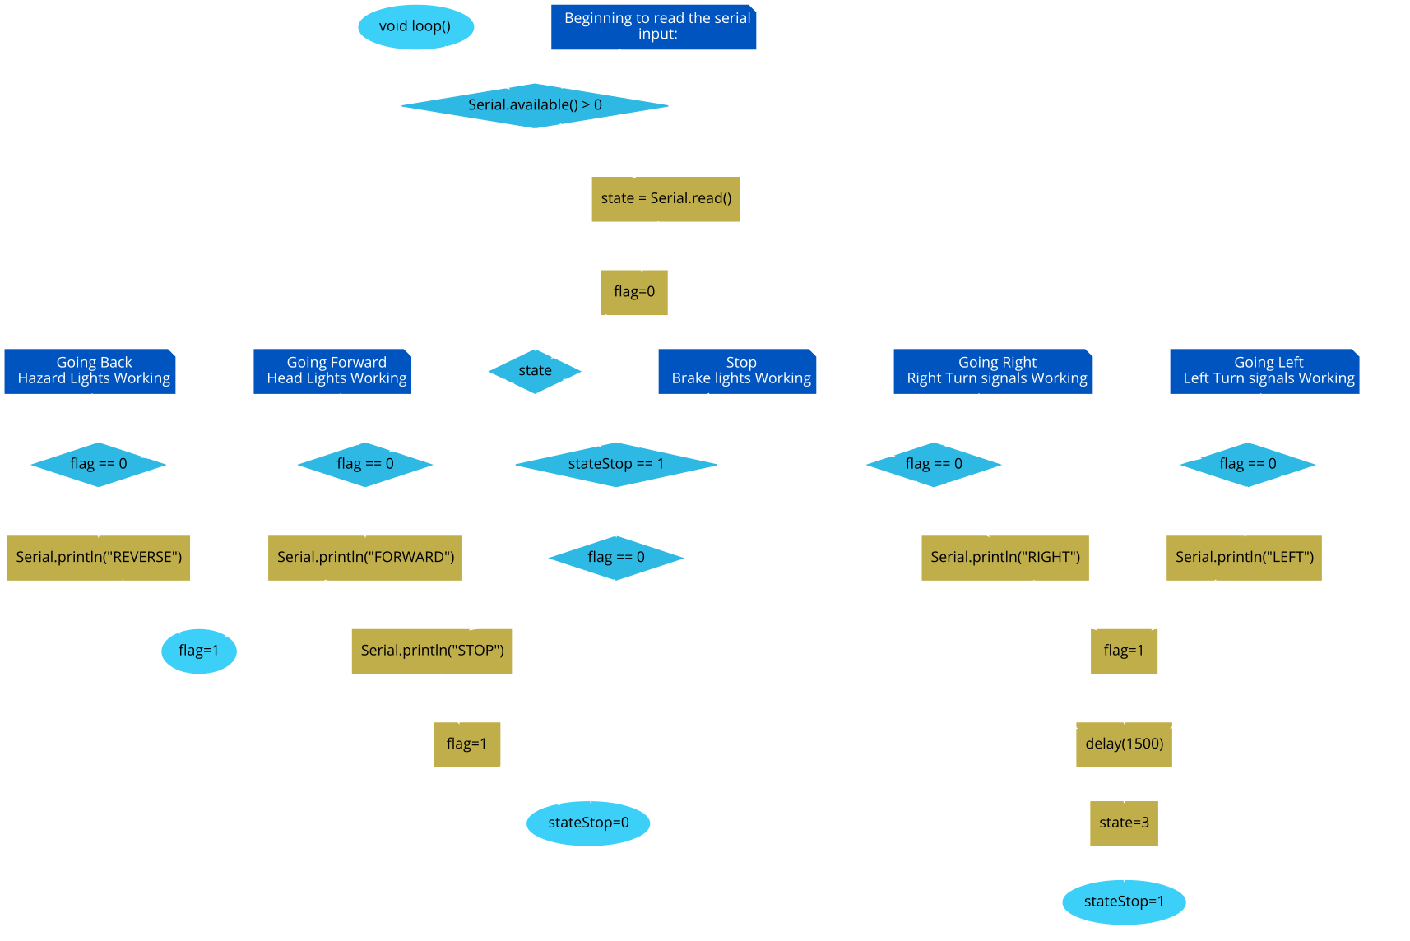

Slide 5
Authors
Hristo Dimitrov – Car Chassis, Presentation, Documentation
Bojidar Markov – Source code, Wiring , Mobile App

Slide 6
Thanks for the attention
7.VII.2019 - city Sliven

