Slide 1
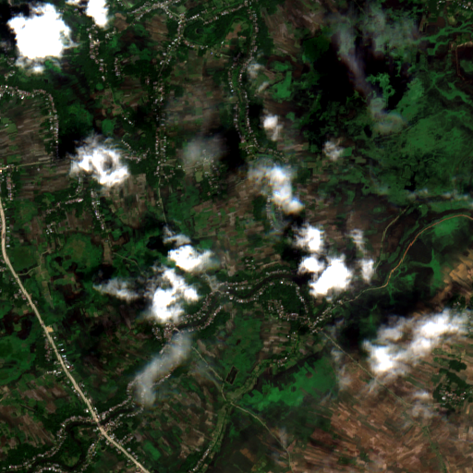
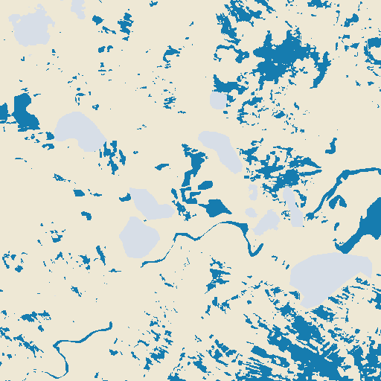
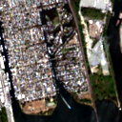
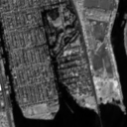


a Benchmark experiment
Sen1Floods11
RGB / RGB+NIR U-Net
Test-set evaluation
Input
Image-mean
water IoU
F1
RGB
0.2028
0.5399
64
64
128
128
RGB+NIR
0.5150
0.8404
256
256
Sentinel-2
Labels
512
b NYC application
Selected weights
Sentinel-2 L1C
Water predictions
FloodNet point comparison
Detected / observed wet site–date pairs
RGB
1 / 13
RGB+NIR
9 / 13
RGB
NIR (B8)
RGB
RGB+NIR
Notes:
Layout inspired by WorldFloods (2021), https://doi.org/10.1038/s41598-021-86650-z, and Portalés-Julià et al. (2023), Fig.5, https://doi.org/10.1038/s41598-023-47595-7. Original redrawing with actual project data. Sen1Floods11 contains 446 pairs with train/validation/test/Bolivia splits 252/89/90/15. RGB: B4/B3/B2; RGB+NIR adds B8. TRAIN-derived channel standardization. Separate models, identical architecture and protocol. Minimum validation Dice loss selects epoch 18 for both. Image-mean water IoU averages water IoU across images. Metrics transcribed from actual notebook08 results. NYC example: Davenport, 21 September 2024. Point counts cover 13 wet site-date pairs on 21 September and 18 October 2024 and are not pixel accuracy. Water masks include permanent water.

Slide 2
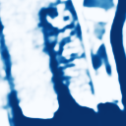
Training pair
Labels
Solid: inference
Loss
0.5 weighted CE + 0.5 Dice
Dashed: training or skip links
Logits / gradients
Training input
Sentinel-2 input
U-Net
Water probability
Water mask
64
64
128
128
256
256
RGB
NIR (B8)
512
3 or 4 standardized bands
Encoder / decoder + skip links
Softmax: P(water)
Argmax
Notes:
Original project-method diagram inspired by Portalés-Julià et al. (2023), Fig.5, https://doi.org/10.1038/s41598-023-47595-7. Training example: India_285297 (Sen1Floods11). Lower inference example: Davenport, 21 September 2024. RGB+NIR probability and mask are actual returned outputs. U-Net encoder widths 64/128/256/512; three max-pooling stages, bilinear upsampling, no cloud head. Softmax over water and non-water, then argmax. Weighted CE and Dice use valid labeled pixels. TRAIN-derived normalization and independently trained RGB/RGB+NIR weights. Arrows terminate at separate model input and supervision anchors for clarity.

