Slide 1


DATA COMMUNICATION
CSE 225/233
WEEK-12, LESSON-2
MULTIPLE ACCESS

Slide 2
Frame Exchange (Data and Control)
1. Before sending a frame, the source station senses the medium by checking the energy level at the carrier frequency.
The channel uses a persistence strategy with backoff until the channel is idle.
After the station is found to be idle, the station waits for a period of time called the DCF interframe space (DIFS); then the station sends a control frame called the request to send (RTS).

Slide 3
Frame Exchange (Data and Control)
After receiving the RTS and waiting a period of time called the
short interframe space (SIFS), the destination station sends a
control frame, called the clear to send (CTS), to the source station.
This control frame indicates that the destination station is ready to receive data.
The source station sends data after waiting an amount of time equal to SIFS.
The destination station, after waiting an amount of time equal to
SIFS, sends an acknowledgment to show that the frame has been
received. Acknowledgment is needed in this protocol because the
station does not have any means to check for the successful arrival
of its data at the destination. On the other hand, the lack of
collision in CSMA/CD is a kind of indication to the source that data have arrived.

Slide 4
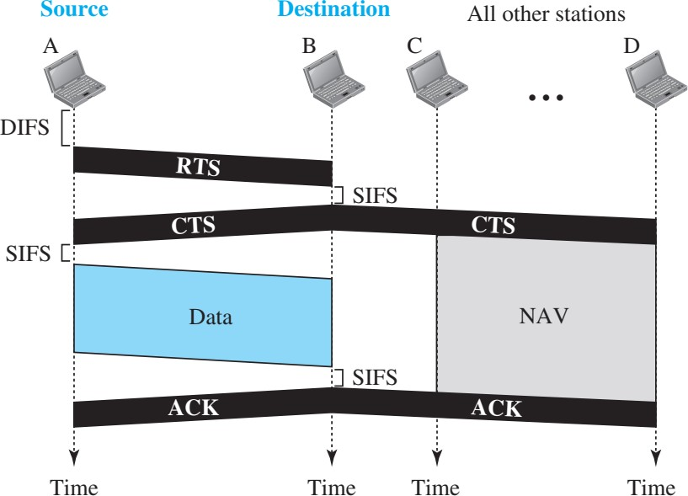
CSMA/CA and NAV

Slide 5
Network Allocation Vector (NAV)
How do other stations defer sending their data if one station acquires access?
In other words, how is the collision avoidance aspect of this protocol accomplished?
The key is a feature called NAV. When a station sends an RTS frame, it includes the duration of time that it needs to occupy the channel. The stations that are affected by this transmission create a timer called a network allocation vector (NAV) that shows how much time must pass before these stations are allowed to check the channel for idleness.
Each time a station accesses the system and sends an RTS frame, other stations start their NAV. In other words, each station, before sensing the physical medium to see if it is idle, first checks its NAV to see if it has expired.

Slide 6

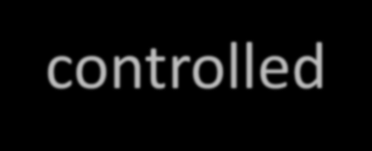
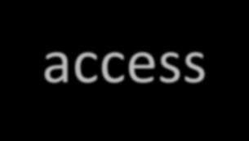


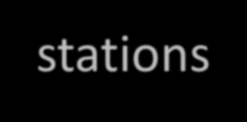
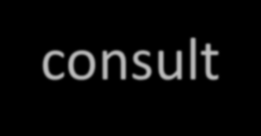
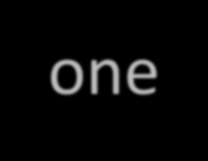
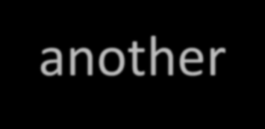

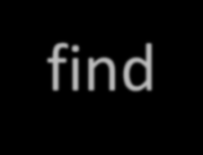
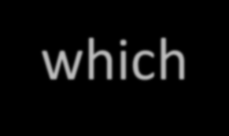
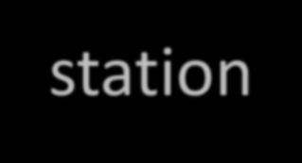

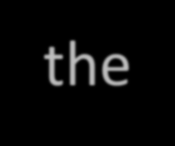
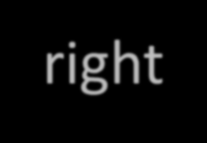
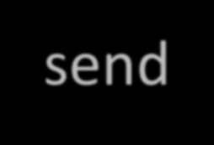
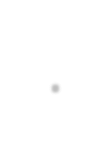



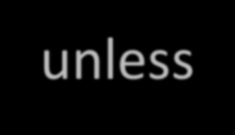
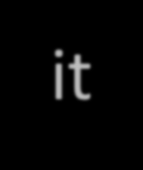

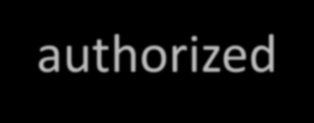

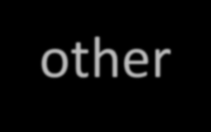


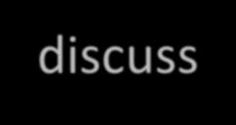
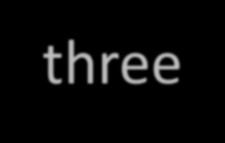

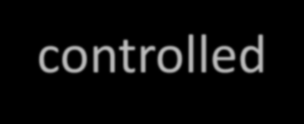

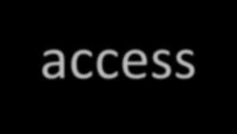
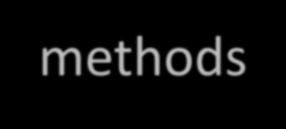

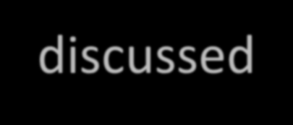

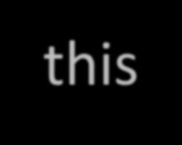
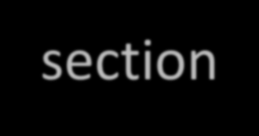
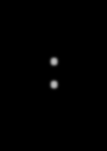
CONTROLLED ACCESS
In controlled access, the stations consult one another to find which station has the right to send. A station cannot send unless it has been authorized by other stations. We discuss three popular controlled-access methods.
Topics discussed in this section:
Reservation Polling
Token Passing

Slide 7
Reservation
In the reservation method, a station needs to make a reservation before sending data. Time is divided into intervals. In each interval, a reservation frame precedes the data frames sent in that interval. If there are N stations in the system, there are exactly N reservation mini slots in the reservation frame. Each mini slot belongs to a station. When a station needs to send a data frame, it makes a reservation in its own mini slot. The stations that have made reservations can send their data frames after the reservation frame. Figure in the next slide will explain the concept.

Slide 8
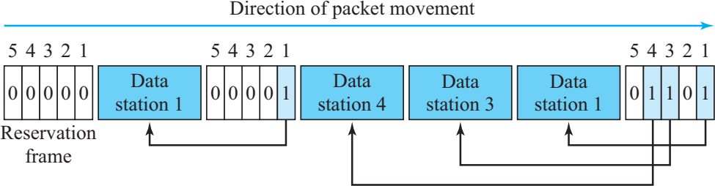
Reservation Access Method

Slide 9
Polling
Polling works with topologies in which one device is designated as a primary station and the other devices are secondary stations. All data exchanges must be made through the primary device even when the ultimate destination is a secondary device. The primary device controls the link; the secondary devices follow its instructions. It is up to the primary device to determine which device is allowed to use the channel at a given time.
The primary device, therefore, is always the initiator of a session. This method uses poll and select functions to prevent collisions. However, the drawback is if the primary station fails, the system goes down.

Slide 10
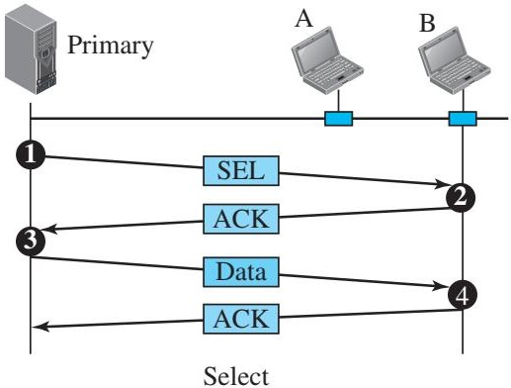
Select Function
The select function is used whenever the primary device has something to send. Primary device always controls the link. If the primary is neither sending nor receiving data, it knows the link is available. If it has something to send, the primary device sends it. What it does not know, however, is whether the target device is prepared to receive. So the primary must alert the secondary to the upcoming transmission and wait for an acknowledgment of the secondary’s ready status. Before sending data, the primary creates and transmits a select (SEL) frame, one field of which includes the address of the intended secondary.
12.10

Slide 11
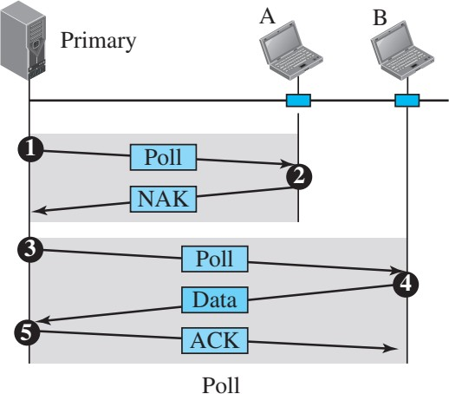
Poll Function
The poll function is used by the primary device to solicit transmissions from the secondary devices. When the primary is ready to receive data, it must ask (poll) each device in turn if it has anything to send. When the first secondary is approached, it responds either with a NAK frame if it has nothing to send or with data (in the form of a data frame) if it does. If the response is negative (a NAK frame), then the primary polls the next secondary in the same manner until it finds one with data to send. When the response is positive (a data frame), the primary reads the frame and returns an acknowledgment (ACK frame), verifying its receipt.
12.10

Slide 12
Token Passing
In the token-passing method, the stations in a network are organized in a logical ring. In other words, for each station, there is a predecessor and a successor. The predecessor is the station which is logically before the station in the ring; the successor is the station which is after the station in the ring. The current station is the one that is accessing the channel now. The right to this access has been passed from the predecessor to the current station. The right will be passed to the successor when the current station has no more data to send.
12.10

Slide 13
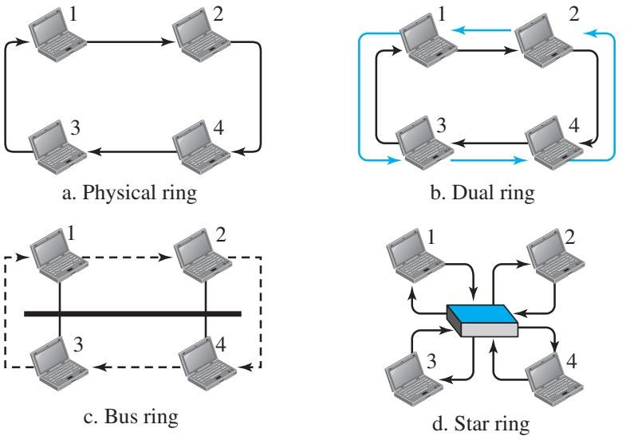
Logical ring and physical topology in token-passing access method
12.10

Slide 14
Data Communication Lecture Series, NRC, MAY2020

