Slide 1


DATA COMMUNICATION
CSE 225/233
WEEK-12, LESSON-1
MULTIPLE ACCESS

Slide 2
Background
When nodes or stations are connected and use a common link, called a multipoint or broadcast link, we need a multiple-access protocol to coordinate access to the link.
The problem of controlling the access to the medium is similar to the rules of speaking in an assembly. The procedures guarantee that the right to speak is upheld and ensure that two people do not speak at the same time, do not interrupt each other, do not monopolize the discussion, and so on.
Many protocols have been devised to handle access to a shared link. All of these protocols belong to a sublayer in the data-link layer called media access control (MAC)
12.2

Slide 3
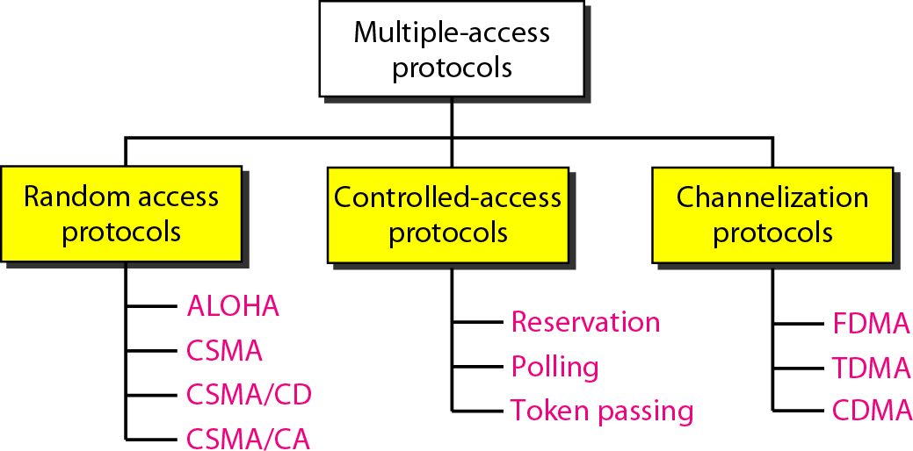
Taxonomy of Multiple Access Protocol
12.2

Slide 4

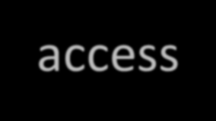

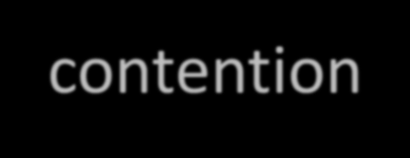


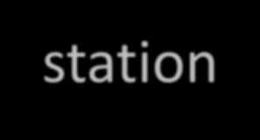




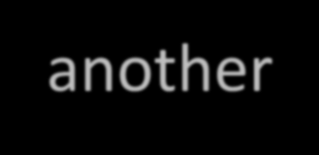

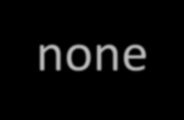



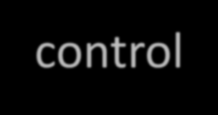

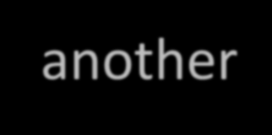
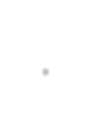

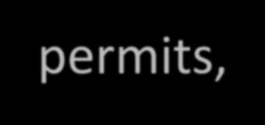


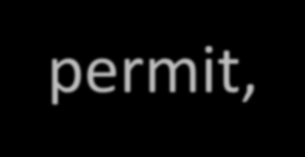


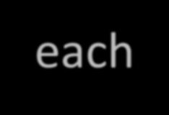
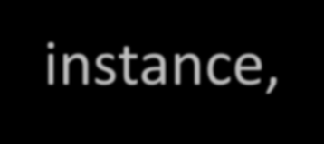



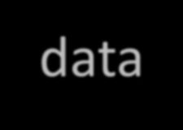

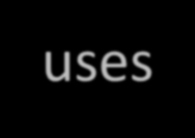
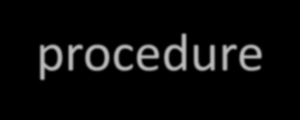
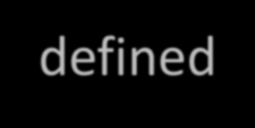

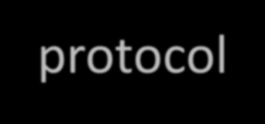


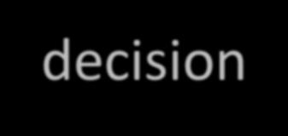

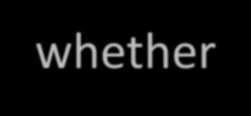




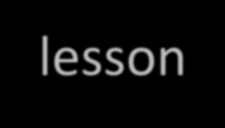
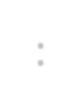

Random Access
In random access or contention methods, no station is superior to another station and none is assigned the control over another. No station permits, or does not permit, another station to send. At each instance, a station that has data to send uses a procedure defined by the protocol to make a decision on whether or not to send.
Topics discussed in this lesson:
ALOHA
Carrier Sense Multiple Access
Carrier Sense Multiple Access with Collision Detection Carrier Sense Multiple Access with Collision Avoidance
12.2

Slide 5
Background (Random Access)
In a random-access method, each station has the right to the medium without being controlled by any other station. However, if more than one station tries to send, there is an access conflict—collision—and the frames will be either destroyed or modified. To avoid access conflict or to resolve it when it happens, each station follows a procedure that answers the following questions:
When can the station access the medium?
What can the station do if the medium is busy?
How can the station determine the success or failure of the
What can the station do if there is an access conflict?
transmission?
12.2

Slide 6
ALOHA
ALOHA, the earliest random-access method, was developed at the University of Hawaii in early 1970. It was designed for a radio (wireless) LAN, but it can be used on any shared medium. It is obvious that there are potential collisions in this arrangement. The medium is shared between the stations. When a station sends data, another station may attempt to do so at the same time. The data from the two stations collide and become garbled.
The original ALOHA protocol is called pure ALOHA. The idea is that each station sends a frame whenever it has a frame to send (multiple access). However, since there is only one channel to share, there is the possibility of collision between frames from different stations.
12.2

Slide 7
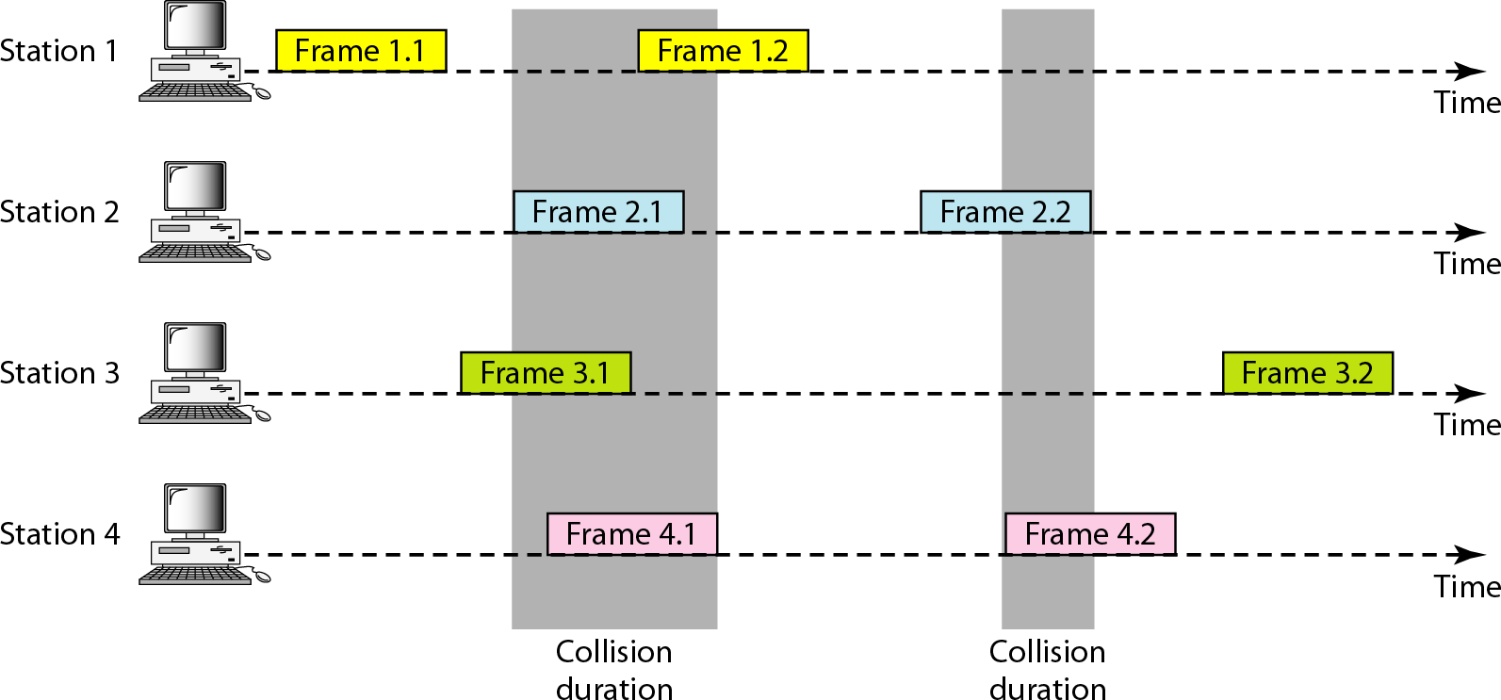
Frames in a pure ALOHA network
12.2

Slide 8
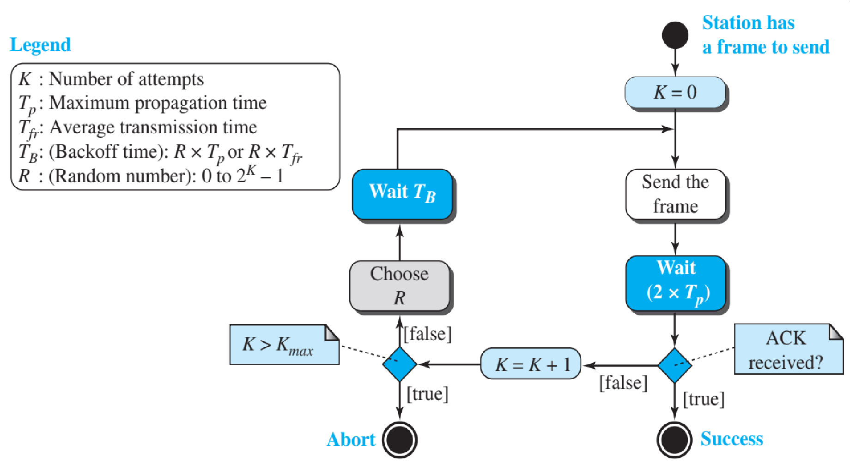
Procedure for pure ALOHA protocol
12.2

Slide 9
Example
The stations on a wireless ALOHA network are a maximum of 600 km apart. If we assume that signals propagate at 3 × 10⁸ m/s, we find
Tp = (600 × 10⁵ ) / (3 × 10⁸ ) = 2 ms.
Now we can find the value of TB for different values of K .
a. For K = 1, the range is {0, 1}. The station needs to| generate a random number with a value of 0 or 1. This means that TB is either 0 ms (0 × 2) or 2 ms (1 × 2), based on the outcome of the random variable.
12.2

Slide 10
Example (Contd.)
b. For K = 2, the range is {0, 1, 2, 3}. This means that TB can be 0, 2, 4, or 6 ms, based on the outcome of the random variable.
c. For K = 3, the range is {0, 1, 2, 3, 4, 5, 6, 7}. This means that TB can be 0, 2, 4, . . . , 14 ms, based on the outcome of the random variable.
d. We need to mention that if K > 10, it is normally set to 10.

Slide 11
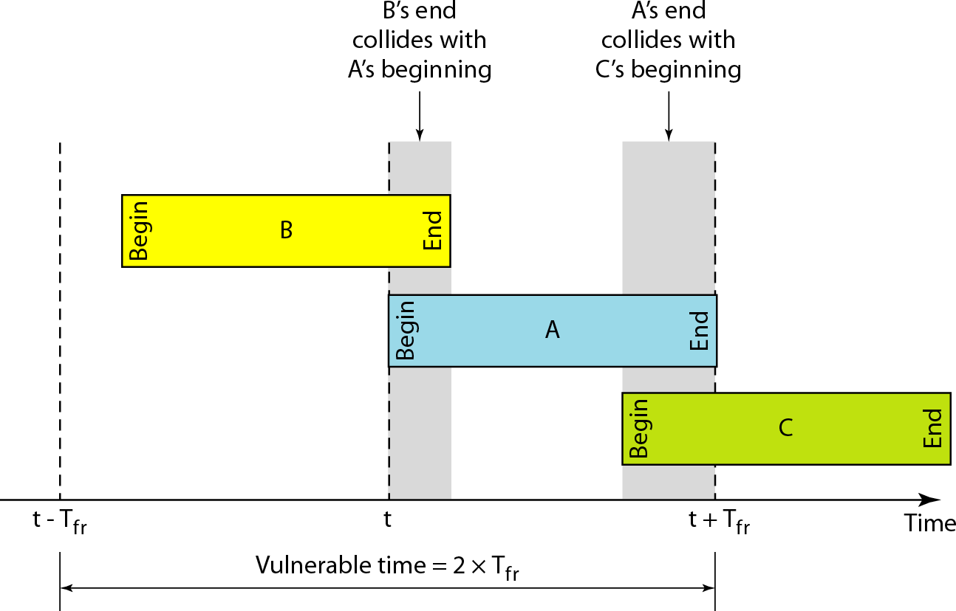
Vulnerable time for pure ALOHA protocol
Vulnerable time, the length of time in which there is a possibility of collision. We assume that the stations send fixed length frames with each frame taking Tfr seconds to send. Following figure shows the vulnerable time for station B.

Slide 12
Example
Problem:
A pure ALOHA network transmits 200-bit frames on a shared channel of 200 kbps. What is the requirement to make this frame collision-free?
Solution
Average frame transmission time Tfr is 200 bits/200 kbps or 1 ms. The vulnerable time is 2 × 1 ms = 2 ms. This means no station should send later than 1 ms before this station starts transmission and no station should start sending during the one 1-ms period that this station is sending.

Slide 13
Note
The throughput for pure ALOHA is
S = G × e ^{−2G}
The maximum throughput
S_{max} = 0.184 when G= (1/2).

Slide 14
Example
Problem:
A pure ALOHA network transmits 200-bit frames on a shared channel of 200 kbps. What is the throughput if the system (all stations together) produces
a. 1000 frames per second b. 500 frames per second
c. 250 frames per second.
Solution
The frame transmission time is 200/200 kbps or 1 ms.
a. If
the system creates 1000 frames per second,
this is 1
frame per millisecond.
The load is 1. In this case
S = G×
_{e}−2 G
or S = 0.135 (13.5 percent). This means
that the throughput is 1000 × 0.135 = 135 frames. Only
135 frames out of 1000 will probably survive.

Slide 15
Example
b. If the system
creates 500 frames per second,
this is
(1/2) frame per millisecond. The load is (1/2).
In this
case S = G × e
−2G
or S = 0.184 (18.4 percent). This
means that the throughput is 500 × 0.184 = 92 and that only 92 frames out of 500 will probably survive. Note that this is the maximum throughput case, percentagewise.
c. If the system creates 250 frames per second, this is (1/4) frame per millisecond. The load is (1/4). In this case S = G × e −^{2G} or S = 0.152 (15.2 percent). This means that the throughput is 250 × 0.152 = 38. Only 38 frames out of 250 will probably survive.

Slide 16
Slotted Aloha
In pure ALOHA there is no rule that defines when the station can send. A station may send soon after another station has started or just before another station has finished. Slotted ALOHA was invented to improve the efficiency of pure ALOHA.
In slotted ALOHA time is divided into slots of T_{fr} seconds and force the station to send only at the beginning of the time slot.

Slide 17
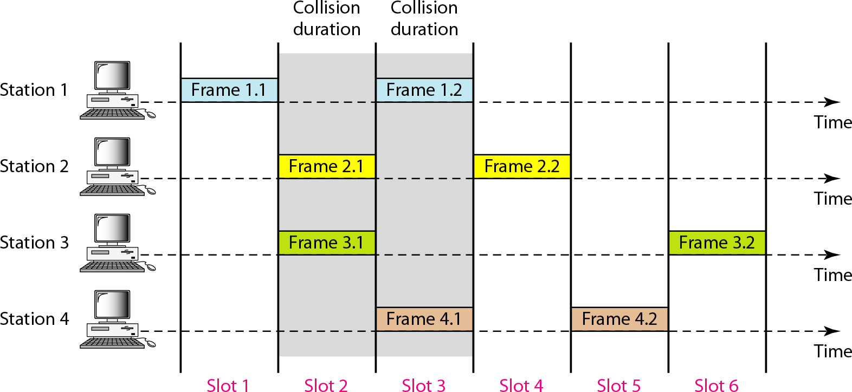
Frames in a slotted ALOHA network

Slide 18
Note
The throughput for pure ALOHA is
S = G × e ^{−G}
The maximum throughput
S_{max} = 0.368 when G= 1

Slide 19
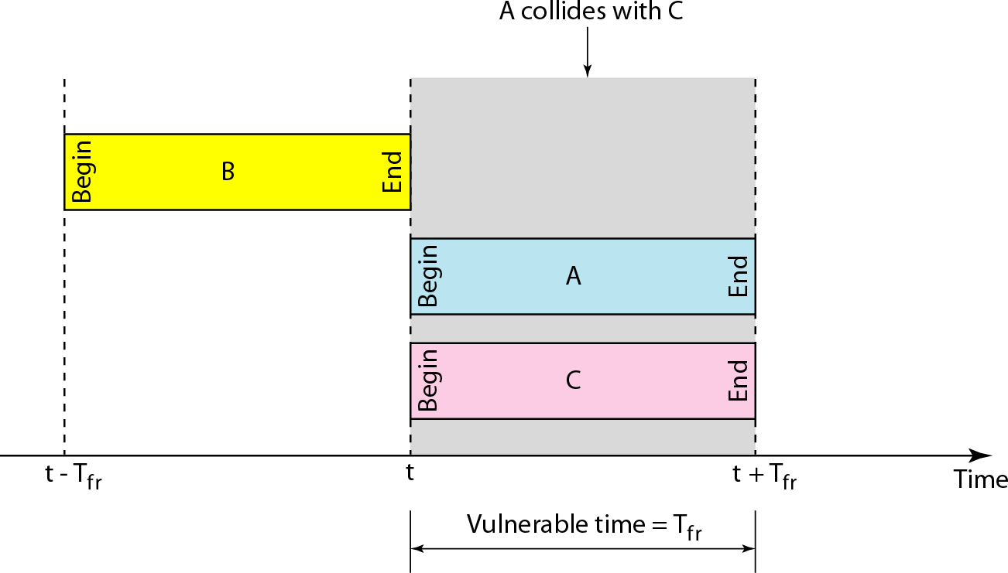
Vulnerable time for slotted ALOHA protocol

Slide 20
Example
Problem:
A slotted ALOHA network transmits 200-bit frames on a shared channel of 200 kbps. What is the throughput if the system (all stations together) produces
a. 1000 frames per second b. 500 frames per second
c. 250 frames per second.
Solution
The frame transmission time is 200/200 kbps or 1 ms.
a. If
the system creates 1000 frames
per second, this is 1
frame per millisecond.
The load is 1. In this case
S = G×
_{e}−G
or S = 0.368 (36.8 percent). This means
that the throughput is 1000 × 0.0368 = 368 frames.
Only 386 frames out of 1000 will probably survive.

Slide 21
Example (Contd.)
b. If the system creates 500 frames per second, this is (1/2) frame per millisecond. The load is (1/2). In this case S = G × e^{−G} or S = 0.303 (30.3 percent). This means that the throughput is 500 × 0.0303 = 151. Only 151 frames out of 500 will probably survive.
c. If the system creates 250 frames per second, this is (1/4) frame per millisecond. The load is (1/4). In this case
S = G × e or S = 0.195 (19.5 percent). This means
−G
that the throughput is 250 × 0.195 = 49. Only 49 frames out of 250 will probably survive.

Slide 22
CSMA
To minimize the chance of collision and, therefore, increase the performance, the CSMA method was developed. The chance of collision can be reduced if a station senses the medium before trying to use it. Carrier sense multiple access (CSMA) requires that each station first listen to the medium (or check the state of the medium) before sending. In other words, CSMA is based on the principle “sense before transmit” or “listen before talk.”
CSMA can reduce the possibility of collision, but it cannot eliminate it. Figure in the next slide will explain the reason.

Slide 23
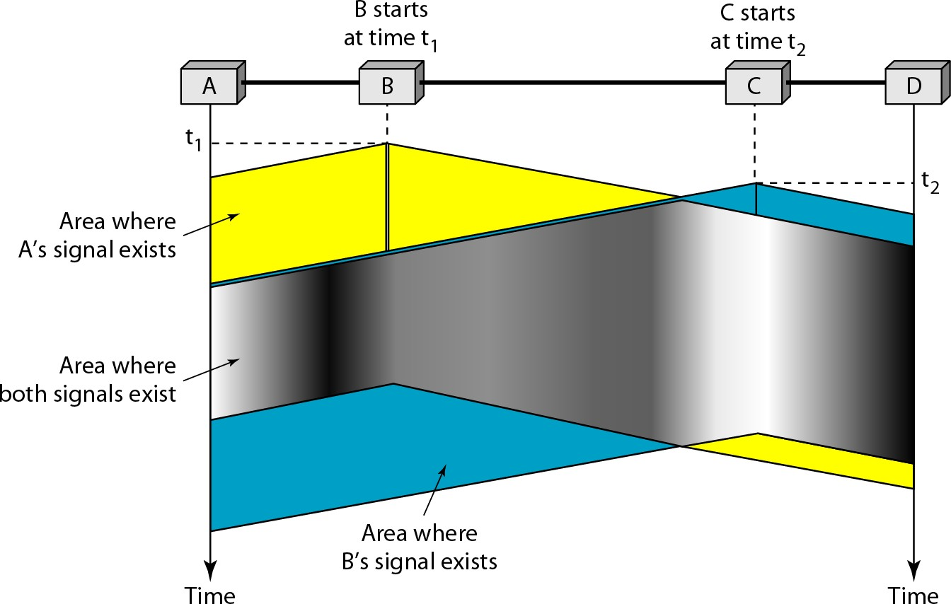
Space/time model of the collision in CSMA

Slide 24
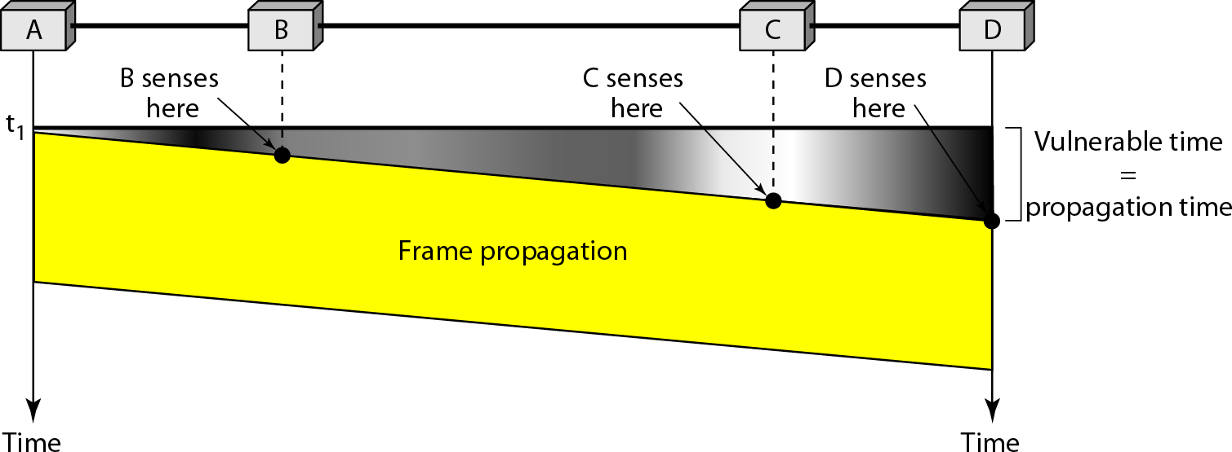
Vulnerable time in CSMA

Slide 25
Persistence Methods
What should a station do if the channel is busy?
What should a station do if the channel is idle?
To answer these questions three methods have been devised :
the 1 persistent method,
the nonpersistent method, and the p persistent method.

Slide 26
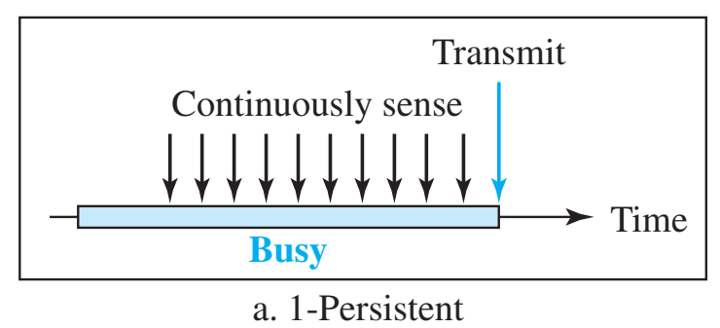
Behavior of Persistence Methods
1-Persistent
The 1-persistent method is simple and straightforward. In this method, after the station finds the line idle, it sends its frame immediately (with probability 1). This method has the highest chance of collision because two or more stations may find the line idle and send their frames immediately.

Slide 27
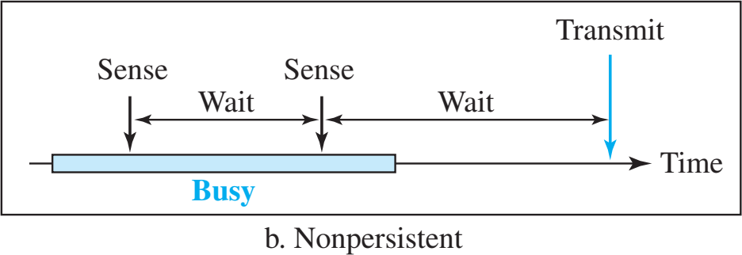
Behavior of Persistence Methods
Nonpersistent
In the nonpersistent method, a station that has a frame to send senses the line. If the line is idle, it sends immediately. If the line is not idle, it waits a random amount of time and then senses the line again. This method reduces the efficiency of the network because the medium remains idle when there may be stations with frames to send.

Slide 28
Behavior of Persistence Methods
p-Persistent
The p-persistent method is used if the channel has time slots with a slot duration equal to or greater than the maximum propagation time. The p-persistent approach combines the advantages of the other two strategies. It reduces the chance of collision and improves efficiency. In this method, after the station finds the line idle it follows these steps:
With probability p, the station sends its frame.
With probability q = 1 - p, the station waits for the beginning of the next time slot and checks the line again.
If the line is idle, it goes to step 1.
If the line is busy, it acts as though a collision has occurred and uses the backoff procedure.

Slide 29
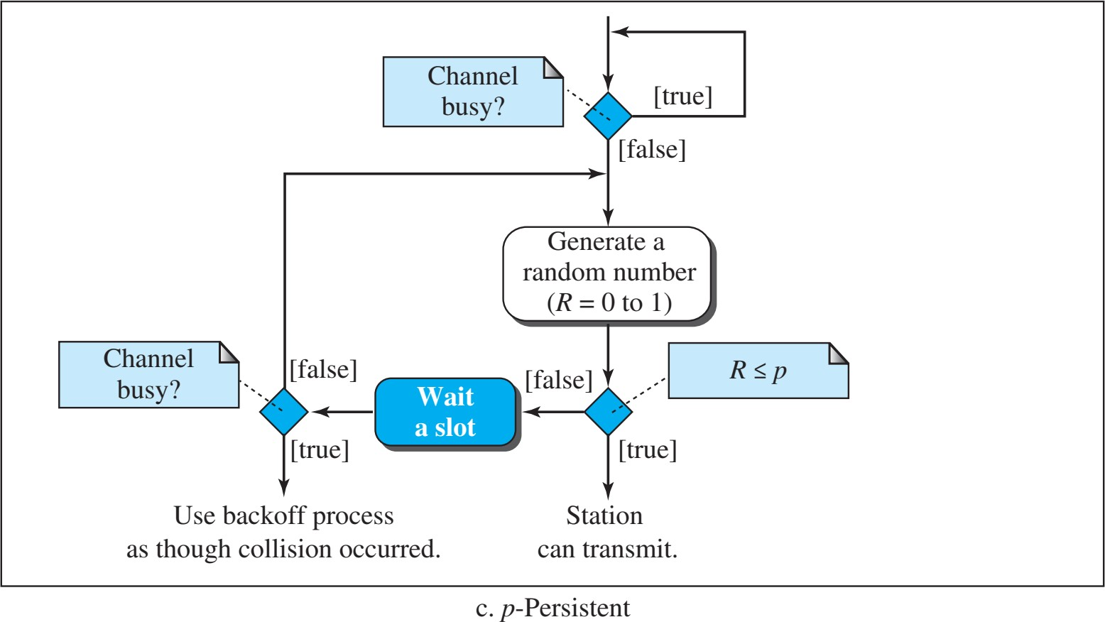
p-Persistent

Slide 30
CSMA/CD
The CSMA method does not specify the procedure following a collision. Carrier sense multiple access with collision detection (CSMA/CD) augments the algorithm to handle the collision. In this method, a station monitors the medium after it sends a frame to see if the transmission was successful. If so, the station is finished. If, however, there is a collision, the frame is sent again.
Procedure of CSMA/CD is explained in the next slide by a flowchart.

Slide 31
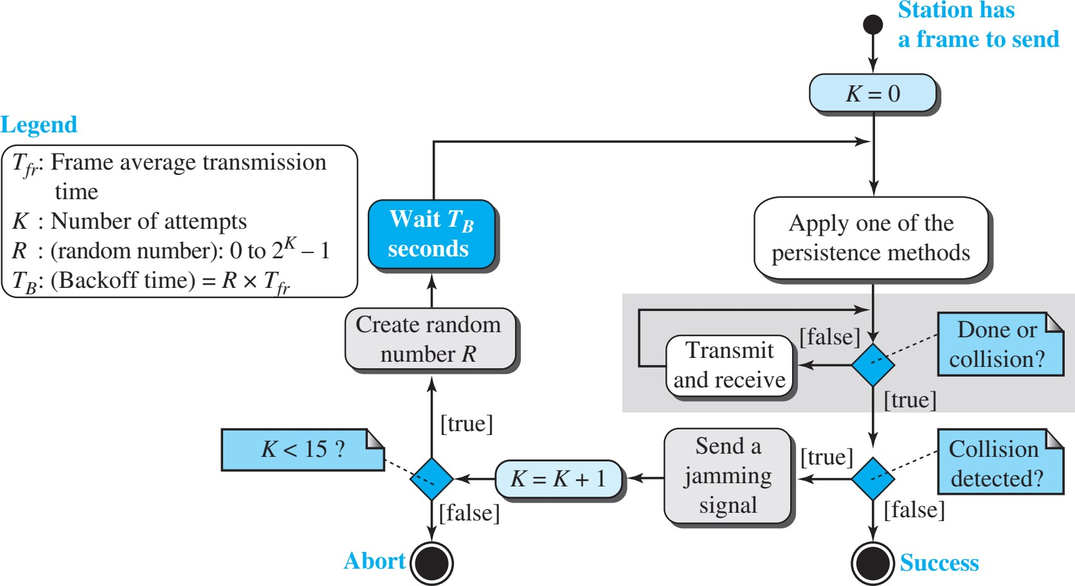
CSMA/CD (Procedure)

Slide 32
CSMA/CA
Carrier sense multiple access with collision avoidance (CSMA/CA) was invented for wireless networks. Collisions are avoided through the use of CSMA/CA’s three strategies: the interframe space, the contention window, and acknowledgments.
Procedure of CSMA/CA is explained in the next slide by a flowchart.

Slide 33
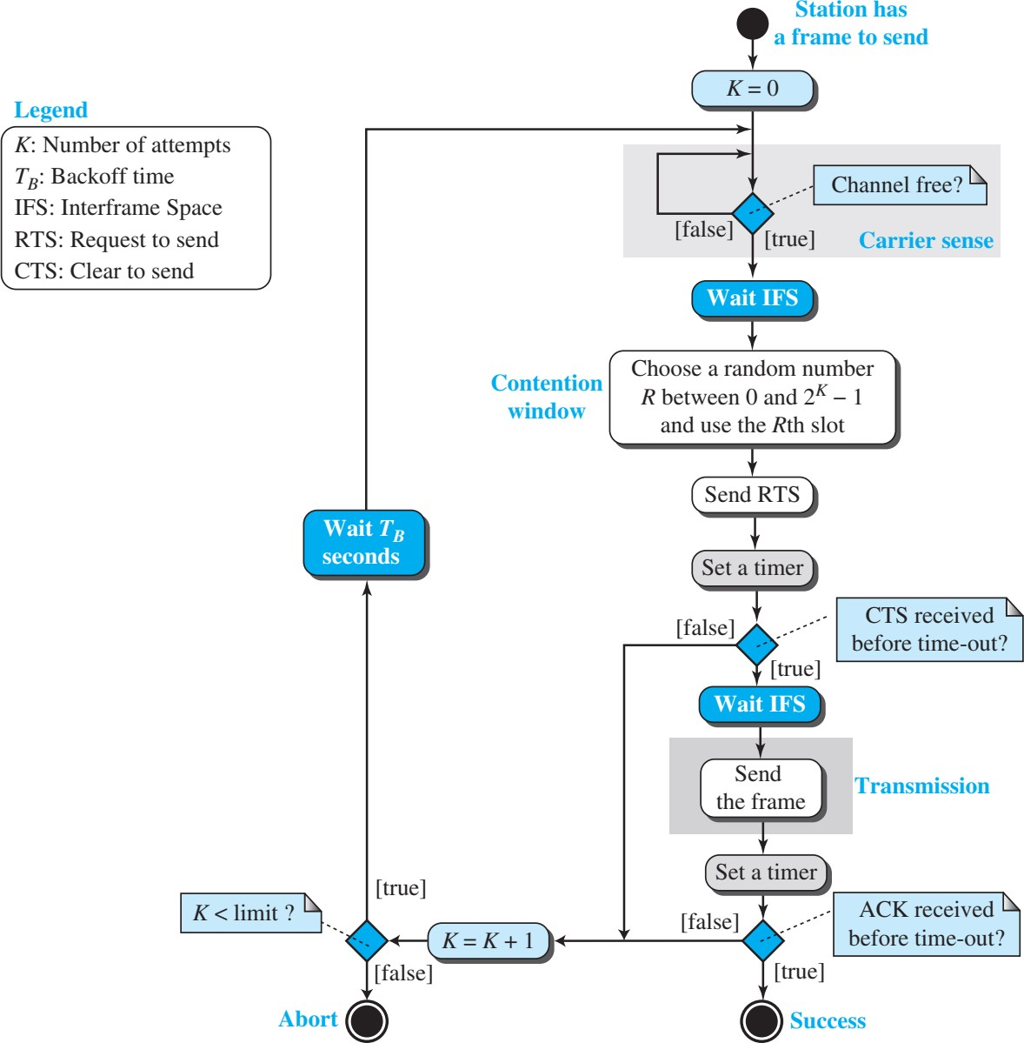
CSMA/CA (Procedure)

Slide 34

Data Communication Lecture Series, NRC, MAY2020
2.34

