Slide 1
CMCS Part 2 → Part 3 Updates
Overview of improvements based on lecturer feedback.

Slide 2
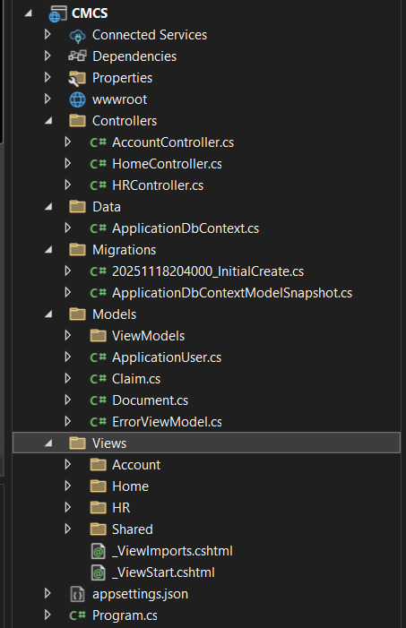
Architecture Changes
Refactored architecture to better separate Models, Views, and Controllers for easier maintenance.

Slide 3
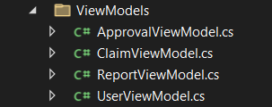

Architecture Changes
Introduced ViewModels to clean up views and improve data transfer between controllers and views.

Slide 4

Architecture Changes
Updated existing controllers and added new ones to better organize logic and support added system features.

Slide 5

Architecture Changes
Implemented user role restrictions to ensure only authorized users can access specific features.

Slide 6
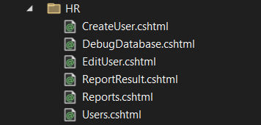
Key Features Added
Added functionality for HR to view and edit user details, including roles.

Slide 7
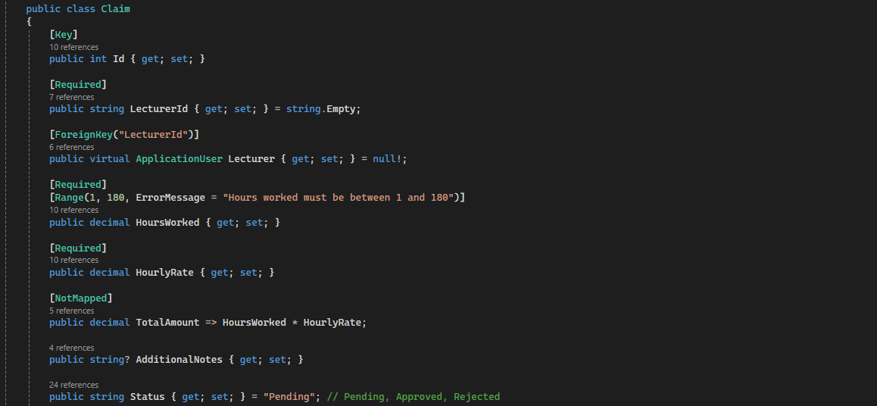
Key Features Added
Created a structured process for employees to submit claims with proper validation and tracking.

Slide 8
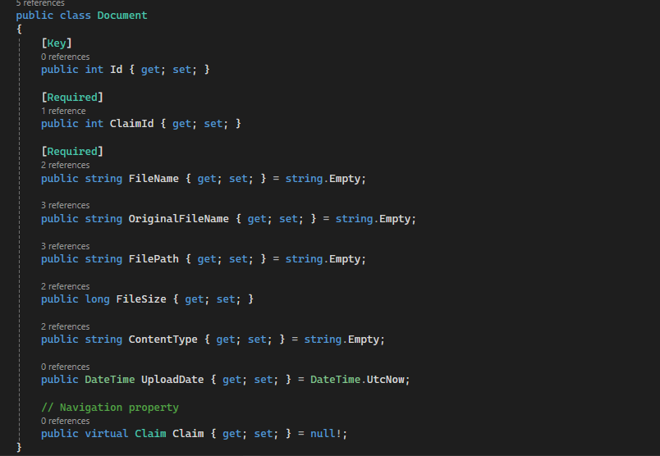
Key Features Added
Added ability for users to upload supporting documents such as receipts.

Slide 9
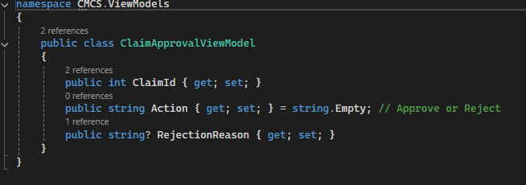
Key Features Added
- Implemented system for HR to review, approve, or reject claims.

Slide 10

HR Module
- HR can now view all users and manage their details within the system.

Slide 11
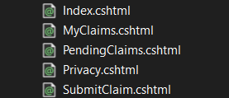
HR Module
HR can oversee claims submitted by employees and submit claims when needed.

Slide 12
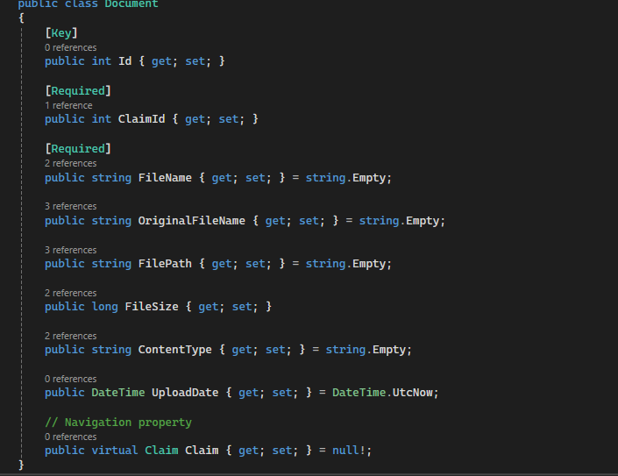
Claims Workflow
Document upload is integrated into the claims process to provide necessary evidence.

Slide 13
Security Updates
The system now uses ASP.NET Identity, which provides:
Secure login & registration
Password hashing
User role management
Authentication handling
This is a major improvement to security and scalability.

Slide 14
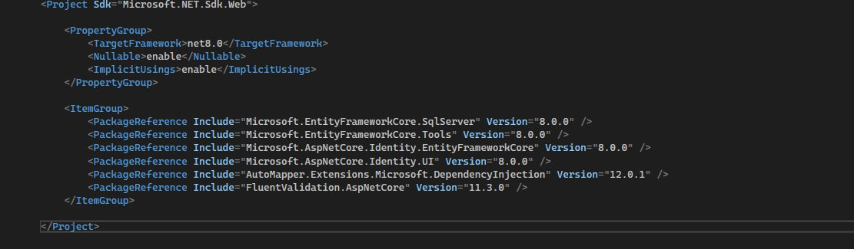

Slide 15

Security Updates
More fine-grained authorization ensures certain pages or actions are restricted to specific roles.
Examples:
Only HR can approve claims
Only Admin can change roles

